Slide 1
Beckhoff Slide Master
Templates

Slide 2
Graphics | Icons
Note: For text arrows, type “minus + minus + right-arrow” - - >
Auto correct will change it to →.

Slide 3
Graphics | Icons
Background gradient example
Text label
NEU
NEW
on demand
internal
highlight frame
intern

Slide 4


Graphics | Excamples for technical graphic components
Cloud
L
C

Slide 5

Graphics | Icons
Examples for complex items
XML
XML
<xml/>
Team
of
Engineers
<xml/>
Customer
Note: For typographic approval signs in tables, use ✔(Alt + 10004), for rejection use ✖ (Alt + 10006), for non-existent use – (Alt + 0150).

Slide 6
Graphics | Icons
Examples for the use of colors
Element 1
Element 2
Element 3
Element 4
Element 1-1
Element 2-1
Element 3-1
Element 4-1
!
Text
Text
Text

Slide 7
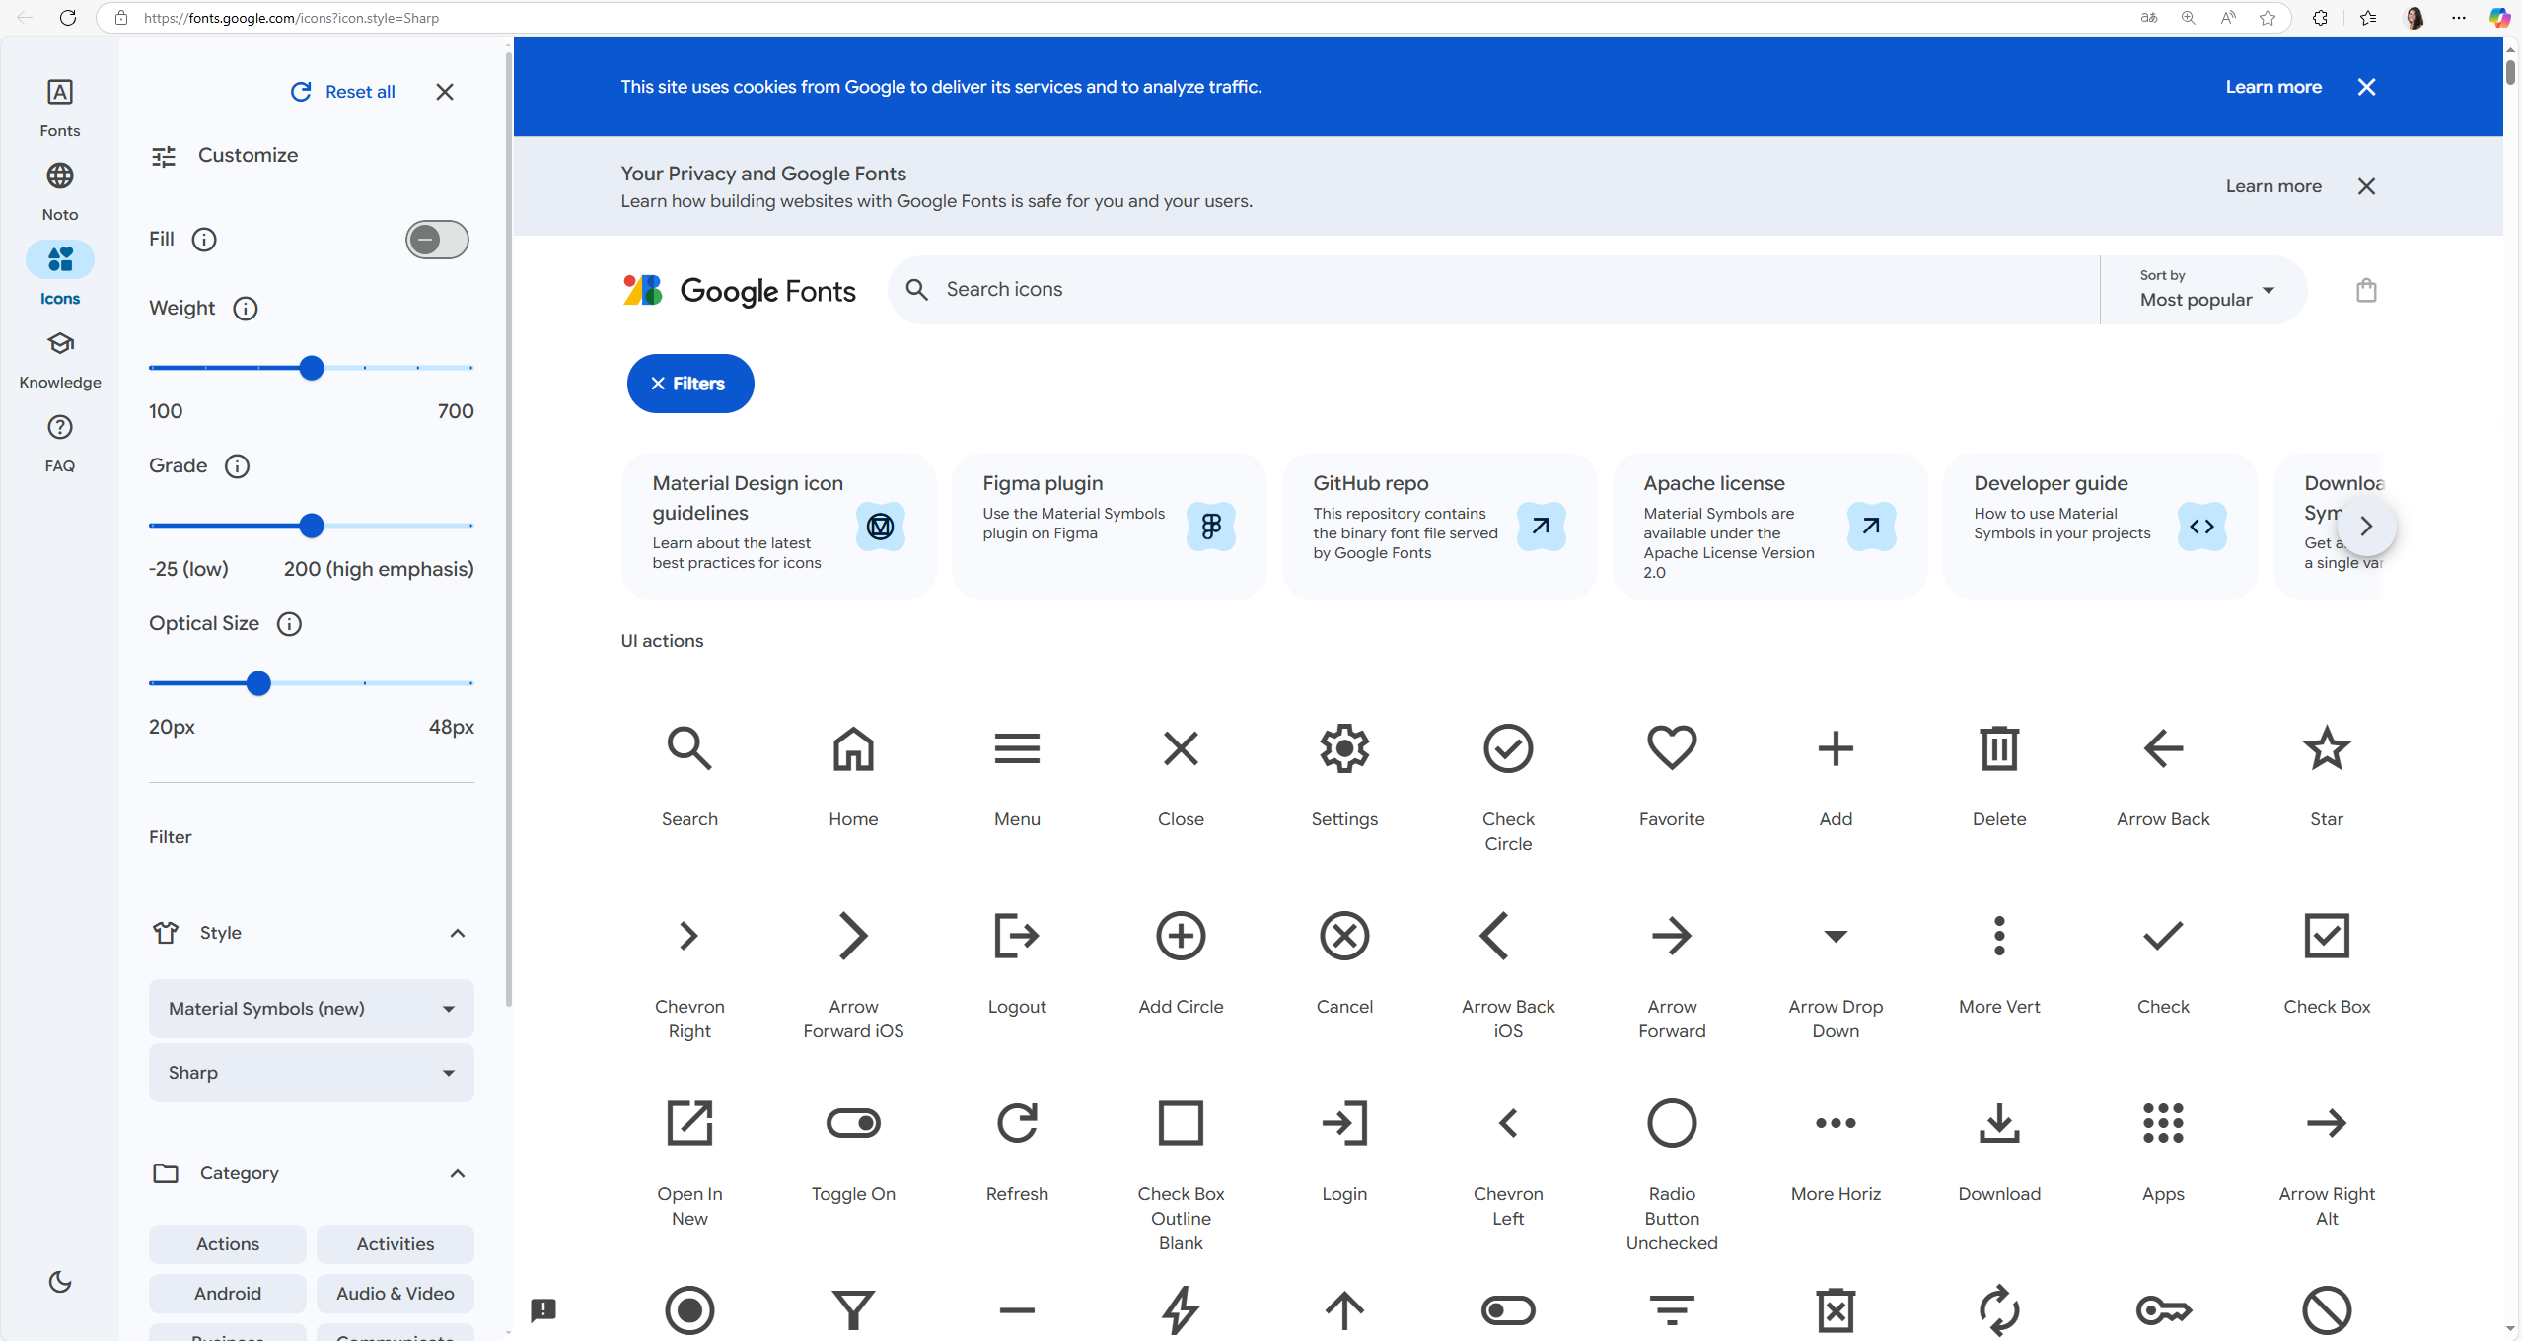
Google Icons
For more icons please use the
Google Icons.
Features:
simple
lines only
areas only for special cases
monochrome
angular
Material Symbols & Icons - Google Fonts
→ suitable line widths etc. are already preset under this link
Notes:
Material Symbols & Icons - Google Fonts
→ suitable line widths etc. are already preset under this link
Features:
simple
lines only
areas only for special cases
monochrome
angular
Specification
Style: Sharp
Weight: 400
Fill: Off
Grade: Normal (0)
Optical Size: 24dp

Slide 8
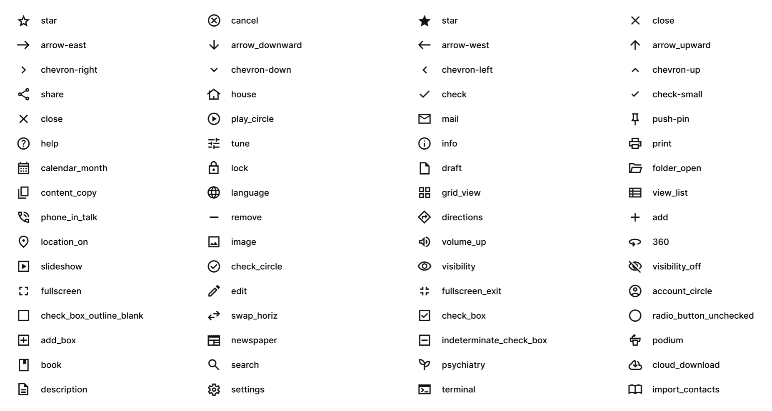
Google Icons | Examples

Slide 9
Graphics | Example 1
Text
Text
Text
Text
Text

Slide 10
Graphics | Example 2
Text
Text
Text
Text
Text

Slide 11
Graphics | Example 3
Text
Text
Text
Text
Text
Text
Text
Text

Slide 12
Graphics | Example 4
Text
Text
Text
  Text
    Text
Text
  Text
    Text

Slide 13
Graphics | Example 5
Text
Text
Text
Text
Text
Text
  Text
    Text
Text
  Text
    Text
Text
Text
Text
  Text
    Text
Text
  Text
    Text

Slide 14
Graphics | Example 6
Text
Text 1
Text 2
Text 3
Text
Text
Text
Text
Text

Slide 15
Graphics | Hierarchy
Text
Text
Text
Text
Text
Text

Slide 16
Graphics | Timeline 1
Project 1
Project 4
Project 2
2020
1
2
3
4
5
6
7
8
9
10
11
12
Project 3

Slide 17
Graphics | Timeline 2
1 | 2 | 3 | 4 | 5 | 6 | 7 | 8 | 9 | 10 | 11 | 12
Project 1
Project 2
Project 3
Project 4

Slide 18
Graphics | Timeline 3
1st quarter | 2nd quarter | 3rd quarter | 4th quarter
Project 1
Project 2
Project 3
Project 4

Slide 19
Graphics | Pie chart
Information 1
Information 2

Slide 20
Graphics | Ring chart

Slide 21
Graphics | Bar chart 1
In all chart types, colors of single elements or data series can be customized as needed.

Slide 22
Graphics | Bar chart 2 with data table and legend keys at the bottom

Slide 23
Graphics | Bar chart 2 with legend on the right

Slide 24
Graphics | Bar chart 2 with legend on the right

Slide 25
Graphics | Bar chart 3

Slide 26
Graphics | Line chart

Slide 27
Table layout | Banded rows
Headline | Headline | Headline | Headline | Headline | Headline
Text | Text | Text | Text | Text | Text
Text | Text | Text | Text | Text | Text
Text | Text | Text | Text | Text | Text
Text | Text | Text | Text | Text | Text
Text | Text | Text | Text | Text | Text
Text | Text | Text | Text | Text | Text
Text | Text | Text | Text | Text | Text
Text | Text | Text | Text | Text | Text
Text | Text | Text | Text | Text | Text
If possible, set the text margin in the first column to 1.25 cm.

Slide 28
Table layout | Banded columns
Headline | Headline | Headline | Headline | Headline | Headline
Text | Text | Text | Text | Text | Text
Text | Text | Text | Text | Text | Text
Text | Text | Text | Text | Text | Text
Text | Text | Text | Text | Text | Text
Text | Text | Text | Text | Text | Text
Text | Text | Text | Text | Text | Text
Text | Text | Text | Text | Text | Text
Text | Text | Text | Text | Text | Text
Text | Text | Text | Text | Text | Text
If possible, set the text margin in the first column to 1.25 cm.

Slide 29
Table layout | First column with color accent
Headline | Headline | Headline | Headline | Headline | Headline
Text | Text | Text | Text | Text | Text
Text | Text | Text | Text | Text | Text
Text | Text | Text | Text | Text | Text
Text | Text | Text | Text | Text | Text
Text | Text | Text | Text | Text | Text
Text | Text | Text | Text | Text | Text
Text | Text | Text | Text | Text | Text
Text | Text | Text | Text | Text | Text
Text | Text | Text | Text | Text | Text
If possible, set the text margin in the first column to 1.25 cm.

Slide 30
Table layout | First column and total row with color accent
Headline | Headline | Headline | Headline | Headline | Headline
Text | Text | Text | Text | Text | Text
Text | Text | Text | Text | Text | Text
Text | Text | Text | Text | Text | Text
Text | Text | Text | Text | Text | Text
Text | Text | Text | Text | Text | Text
Text | Text | Text | Text | Text | Text
Text | Text | Text | Text | Text | Text
Text | Text | Text | Text | Text | Text
Total | Result | Result | Result | Result | Result
If possible, set the text margin in the first column to 1.25 cm.

Slide 31

Team overview template | Up to 10 people
Insert your own photos:
Click on image
→ right click
→ “Change Picture”
→ “This Device…”
Max Mustermann
Max Mustermann
Max Mustermann
Max Mustermann
Max Mustermann
Max Mustermann
Max Mustermann
Max Mustermann
Max Mustermann
Max Mustermann

Slide 32
Team overview template | Up to 21 people
Insert your own photos:
Click on image
→ right click
→ “Change Picture”
→ “This Device…”
Max Mustermann
Max Mustermann
Max Mustermann
Max Mustermann
Max Mustermann
Max Mustermann
Max Mustermann
Max Mustermann
Max Mustermann
Max Mustermann
Max Mustermann
Max Mustermann
Max Mustermann
Max Mustermann
Max Mustermann
Max Mustermann
Max Mustermann
Max Mustermann
Max Mustermann
Max Mustermann
Max Mustermann

Slide 33
Team overview template with space for description | Up to 10 people
Insert your own photos:
Click on image
→ right click
→ “Change Picture”
→ “This Device…”
Max Mustermann
Position
Max Mustermann
Position
Max Mustermann
Position
Max Mustermann
Position
Max Mustermann
Position
Max Mustermann
Position
Max Mustermann
Position
Max Mustermann
Position
Max Mustermann
Position
Max Mustermann
Position

Slide 34
Note for internal information in footer

Slide 35
Hinweis auf interne Information im Footer

Slide 36
Thank you for your attention

Slide 37
Vielen Dank für Ihre Aufmerksamkeit

Slide 40
Beckhoff Automation [legal form]
[Address details 1]
[Address details 2]
[Address details 3]
[Address details 4]
Phone: +[country code] [number]
E-mail: [account]@beckhoff.[domain]
Web: www.beckhoff.[domain]

