Slide 1
Insurance analytics
Presented by Prajwal Ratnaparkhi Data Analytics | Bank Analytics Project

Slide 2
INTRODUCTION
This project focuses on building an end-to-end Insurance Analytics Dashboard to help business teams monitor performance and improve decision-making.
We analyzed insurance data related to revenue, opportunities, renewals, branch performance, and sales activities and converted it into interactive visual dashboards.
The solution provides a single centralized view of key business KPIs, enabling management to track targets, identify growth opportunities, and optimize sales and operational performance.
By transforming raw insurance data into actionable insights, this project supports data-driven business strategy and performance management.

Slide 3
Data Overview
For this project, we used structured insurance business datasets containing:
Policy Data – Policy type, premium amount, renewal information
Opportunity Data – Open opportunities, deal stages, pipeline values
Revenue Data – Brokerage, invoices, achieved revenue
Account Executive Data – Sales representatives performance
Branch Data – Location-wise business performance
Meeting Data – Sales activity tracking

Slide 4
DATA FLOW & CONNECTION
Data Flow Architecture
Raw insurance data imported from Excel files
Data cleaning and formatting performed
Relationships created between tables:
Account Executive → Opportunities
Branch → Revenue
Meeting Date → Sales Activity
Connected cleaned data

Slide 5
KPIs & BUSINESS IMPACT
1. Total Brokerage
Shows total brokerage amount generated by insurance sales
If Increasing:
1) Business profitability improves
2) Strong sales performance
If Decreasing:
1) Revenue risk
2) Need to improve sales strategy
Total Brokerage
34.57M

Slide 6
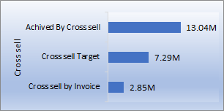
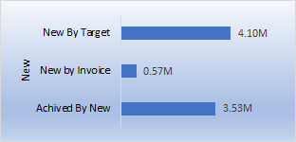
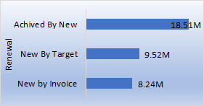
2)Cross Sell, New Business, Renewal – Business Impact
This KPI measures revenue contribution from different insurance business segments.
Higher Renewal → Stable revenue flow Ensures consistent income and improves customer retention.
Lower Renewal → Unstable revenue flow Indicates customer churn and increased revenue risk.
Higher Cross Sell → Increased customer value Improves revenue per customer and maximizes product utilization.
Lower Cross Sell → Reduced customer value Shows missed upselling opportunities and lower profitability.
Higher New Business → Faster company growth Expands market presence and increases customer base.
Lower New Business → Slower company growth Limits market expansion and reduces long-term revenue potential.

Slide 7
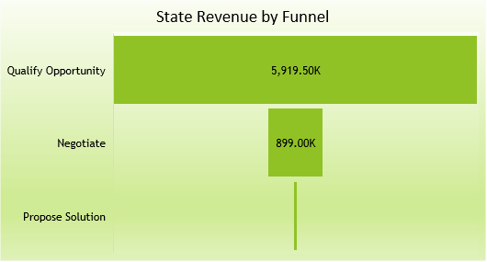
3. Total Open Opportunities
Shows future sales pipeline
Impact:
High Value → Strong future revenue potential
Low Value → Weak sales funnel
4. Stage Funnel Revenue
Tracks opportunity movement across stages
Impact:
More deals in "Qualified" stage → Growth opportunity
Less deals in "Negotiation" → Conversion problem
Open Opportunity
44

Slide 8
5. Target vs Achieved Revenue
Measures branch and team performance
Impact:
Achieved > Target → Business success
Achieved < Target → Performance gap

Slide 9
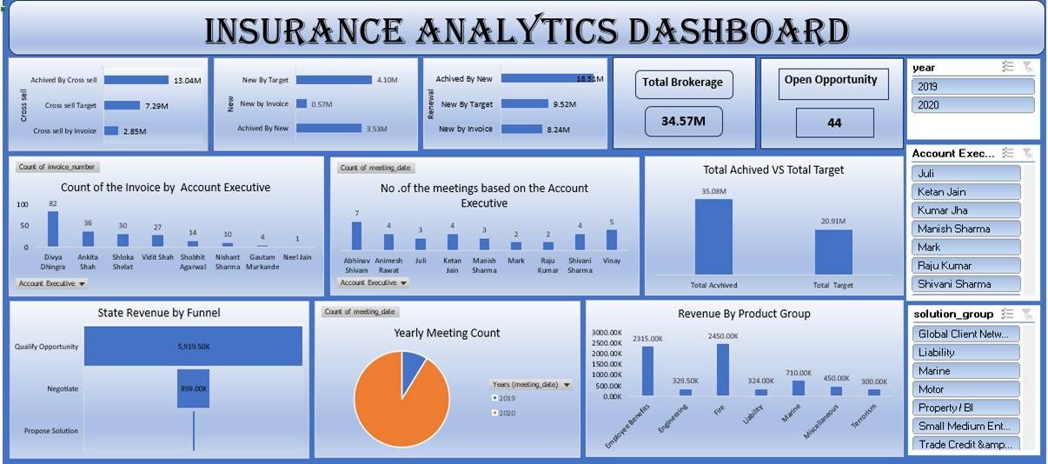
Excel Dashboard
Provides a high-level snapshot of total brokerage, open opportunities, achieved vs target, and executive-wise performance.

Slide 10
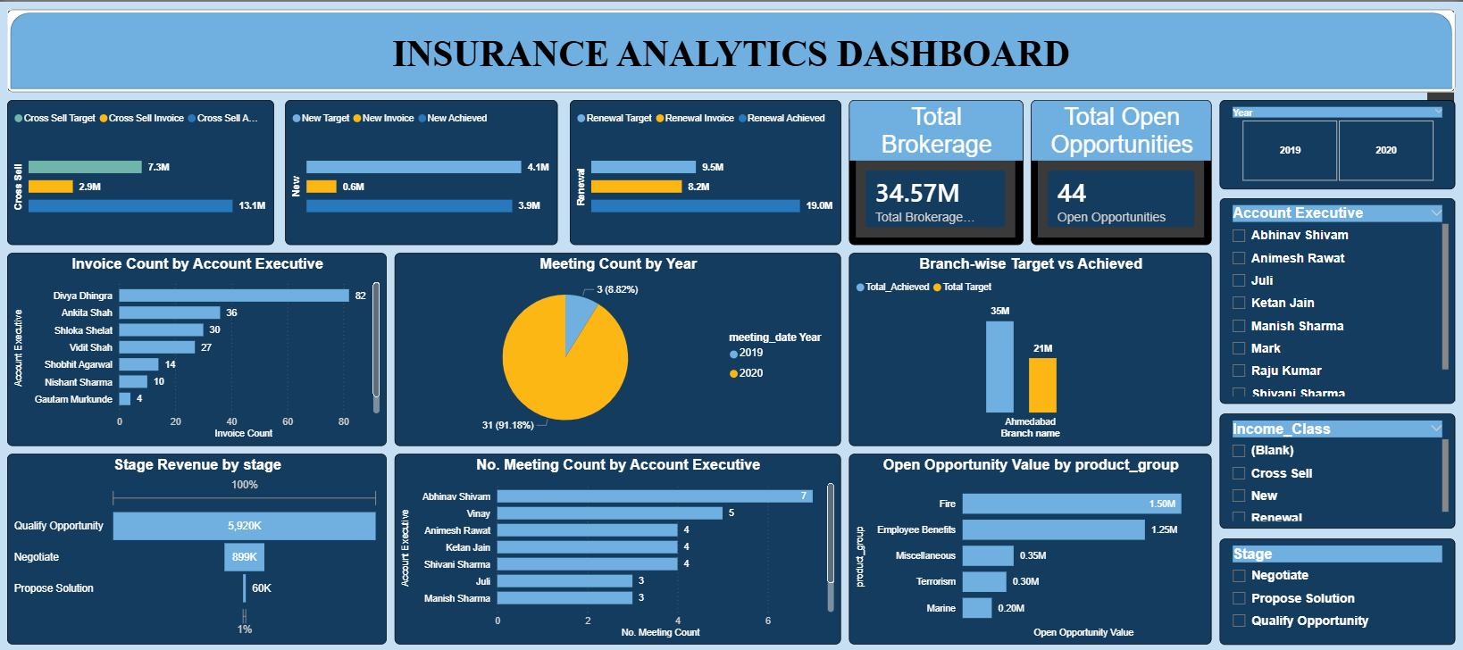
Power bi Dashboard
Highlights revenue distribution across New, Renewal, and Cross-sell with executive contribution analysis.

Slide 11
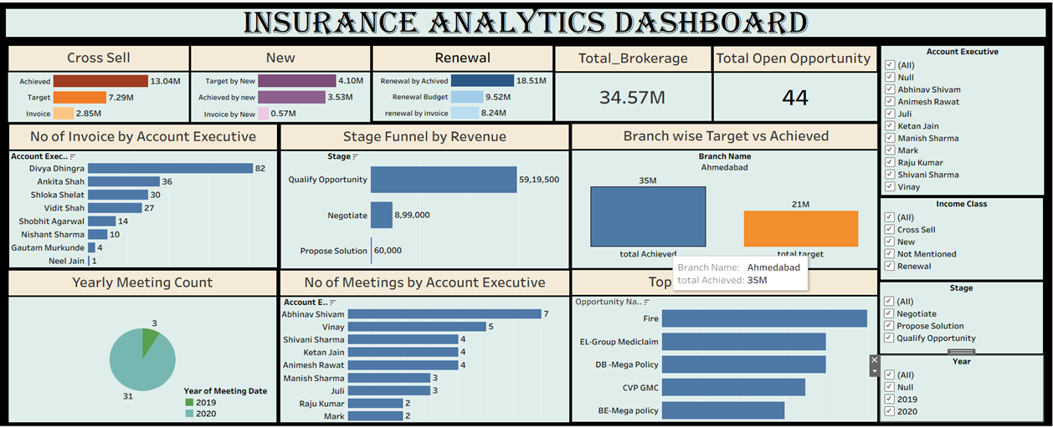
Tableau Dashboard
Stage-wise funnel shows major revenue drop at negotiation and proposal stages, indicating follow-up and pricing gaps.

Slide 12
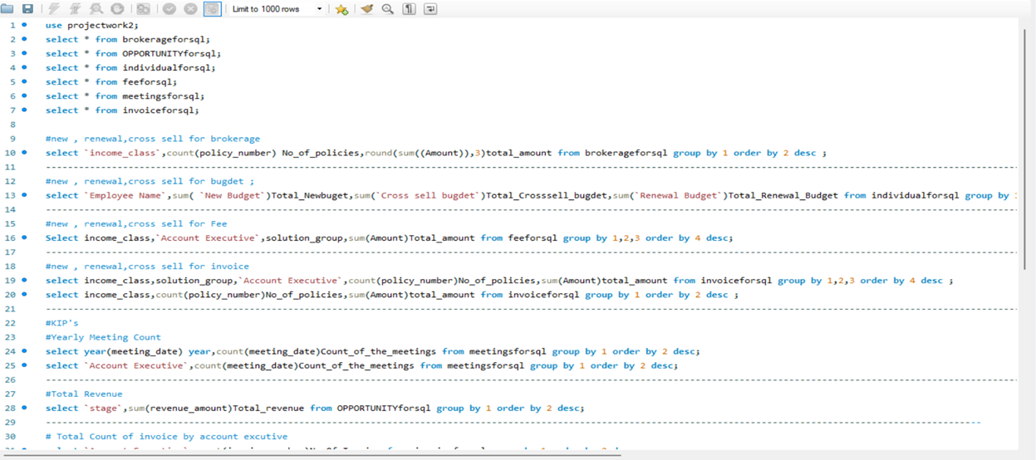
SQL Dashboard

Slide 13
CHALLENGES FACED
Technical & Data Challenges :-
Missing values
KPI formatting errors
Handling dynamic filters
Relationship mismatches

Slide 14
SUGGESTIONS FROM OUR END
Business Recommendations
Improve renewal strategy to ensure consistent revenue
Focus on high-value opportunity conversion
Increase digital adoption for policy renewals
Provide performance-based incentives to sales executives
Strengthen underperforming branch operations

Slide 15
BUSINESS IMPACT OF SUGGESTIONS
Expected Business Impact
Higher customer retention
Increased revenue growth
Better sales productivity
Improved pipeline conversion rate
Stronger business forecasting accuracy

Slide 16
CONCLUSION
The Insurance Analytics Dashboard successfully converts raw business data into meaningful insights.
It enables real-time performance tracking and strategic decision-making.
This project demonstrates the practical application of business intelligence, data analytics, and visualization skills.
The dashboard can be effectively used by management for continuous business improvement.
This project bridges the gap between raw data and business strategy by converting data into decision-ready insights.

Slide 17


