Slide 1
Problem Statement 3
IMPACT OF BREACH
Group No. 9
Team Members:
Akanksha Mahajan
Prajwal Adsul
Priyanka Kankal
Vaishnavi Patil

Slide 2
GOAL
Given a specific VM as vulnerable, to find a list of “at risk” VM(s) in descending order of risk.
Graphical interface that shows the vulnerability map
Protocol | Cost of Risk
TCP | 15
UDP | 35
ICMP | 50
ALL | 100
Higher cost of risk implies higher high risk

Slide 3
INPUTS
IP Table
192.0.2.4,192.0.2.59,TCP,22,ALLOW
192.0.2.4,192.0.2.41,UDP,22,ALLOW
192.0.2.4,192.0.2.41,ICMP,22,ALLOW
192.0.2.13,192.0.2.4,TCP,22,ALLOW
192.0.2.13,192.0.2.4,ICMP,22,ALLOW
192.0.2.13,192.0.2.41,UDP,22,ALLOW
192.0.2.15,192.0.2.13,TCP,22,ALLOW
192.0.2.15,192.0.2.24,ICMP,22,ALLOW
192.0.2.24,192.0.2.41,TCP,22,ALLOW
192.0.2.59,192.0.2.24,TCP,22,ALLOW
Vulnerable node
192.0.2.13

Slide 4
OUR APPROACH
Send IPtables from client to the Admin node via socket programming.
Use of graph data structure using adjacency list with node representing each VM
Create three directed graphs indicating traffic between all VMs for each protocol
Find all reachable VM(s) from each VM using depth first search for each protocol
Loops are avoided by marking the nodes as visited.
Output in the hierarchy of cost of vulnerability.
Time Complexity of DFS = O(No. of IPs + No. of connections)

Slide 5
VM2
15
VM1
192.0.2.13
VM3
ICMP, TCP
TCP
65
0
192.0.2.4
192.0.2.15
UDP
TCP
UDP, ICMP
ICMP
VM6
VM4
15
100
TCP
VM5
192.0.2.59
TCP
192.0.2.41
65
192.0.2.24

Slide 6
VM2
15
VM1
192.0.2.13
VM3
ICMP, TCP
TCP
65
0
192.0.2.4
192.0.2.15
UDP
TCP
UDP, ICMP
ICMP
VM6
VM4
15
100
TCP
VM5
192.0.2.59
TCP
192.0.2.41
65
192.0.2.24

Slide 7
VM2
15
VM1
192.0.2.13
VM3
ICMP, TCP
TCP
65
0
192.0.2.4
192.0.2.15
UDP
TCP
UDP, ICMP
ICMP
VM6
VM4
15
100
192.0.2.59
TCP
VM1
192.0.2.41
TCP
65
192.0.2.24
Vulnerable Machines with respective cost of risk

Slide 8
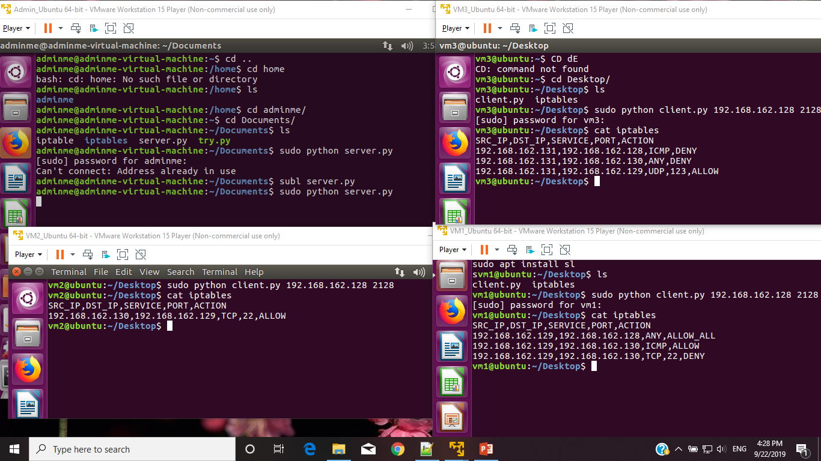
Socket Programming

Slide 9
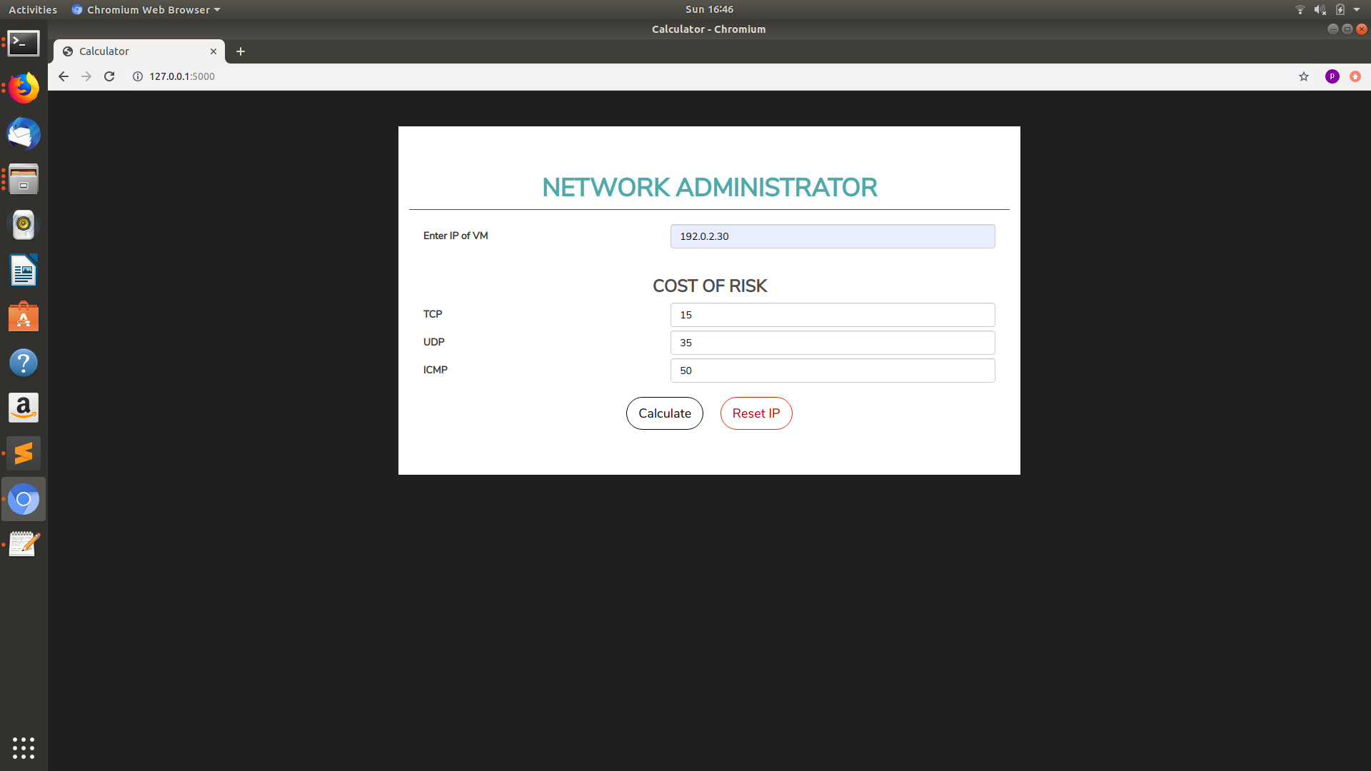
Graphical Interface

Slide 10
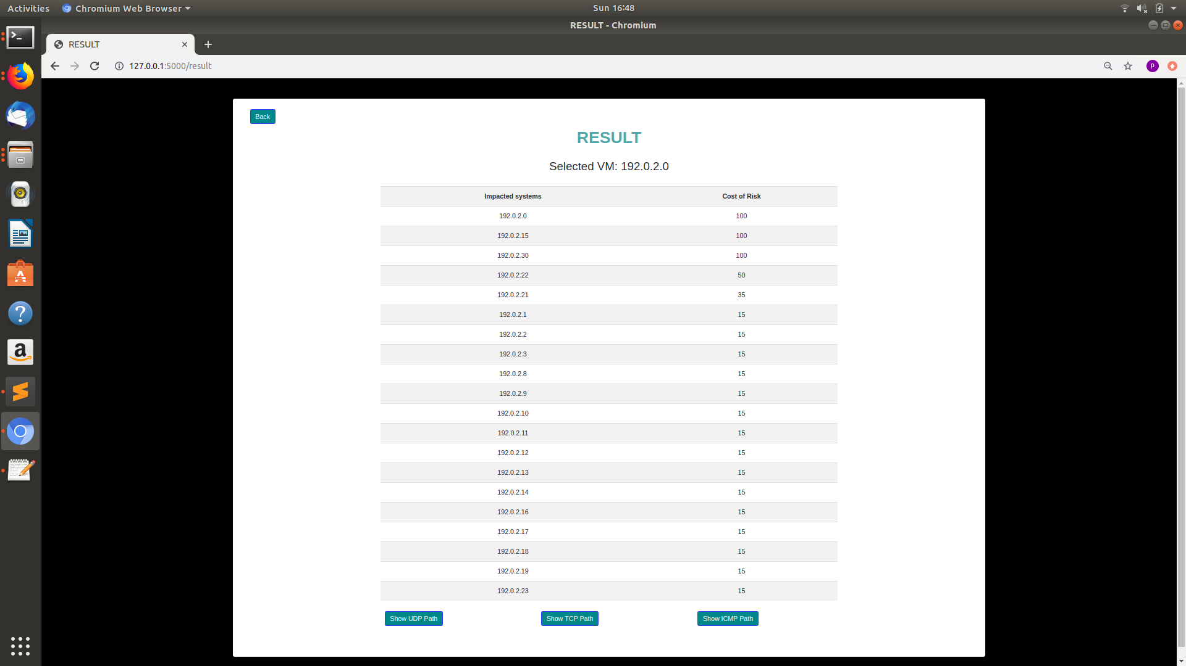

Slide 11
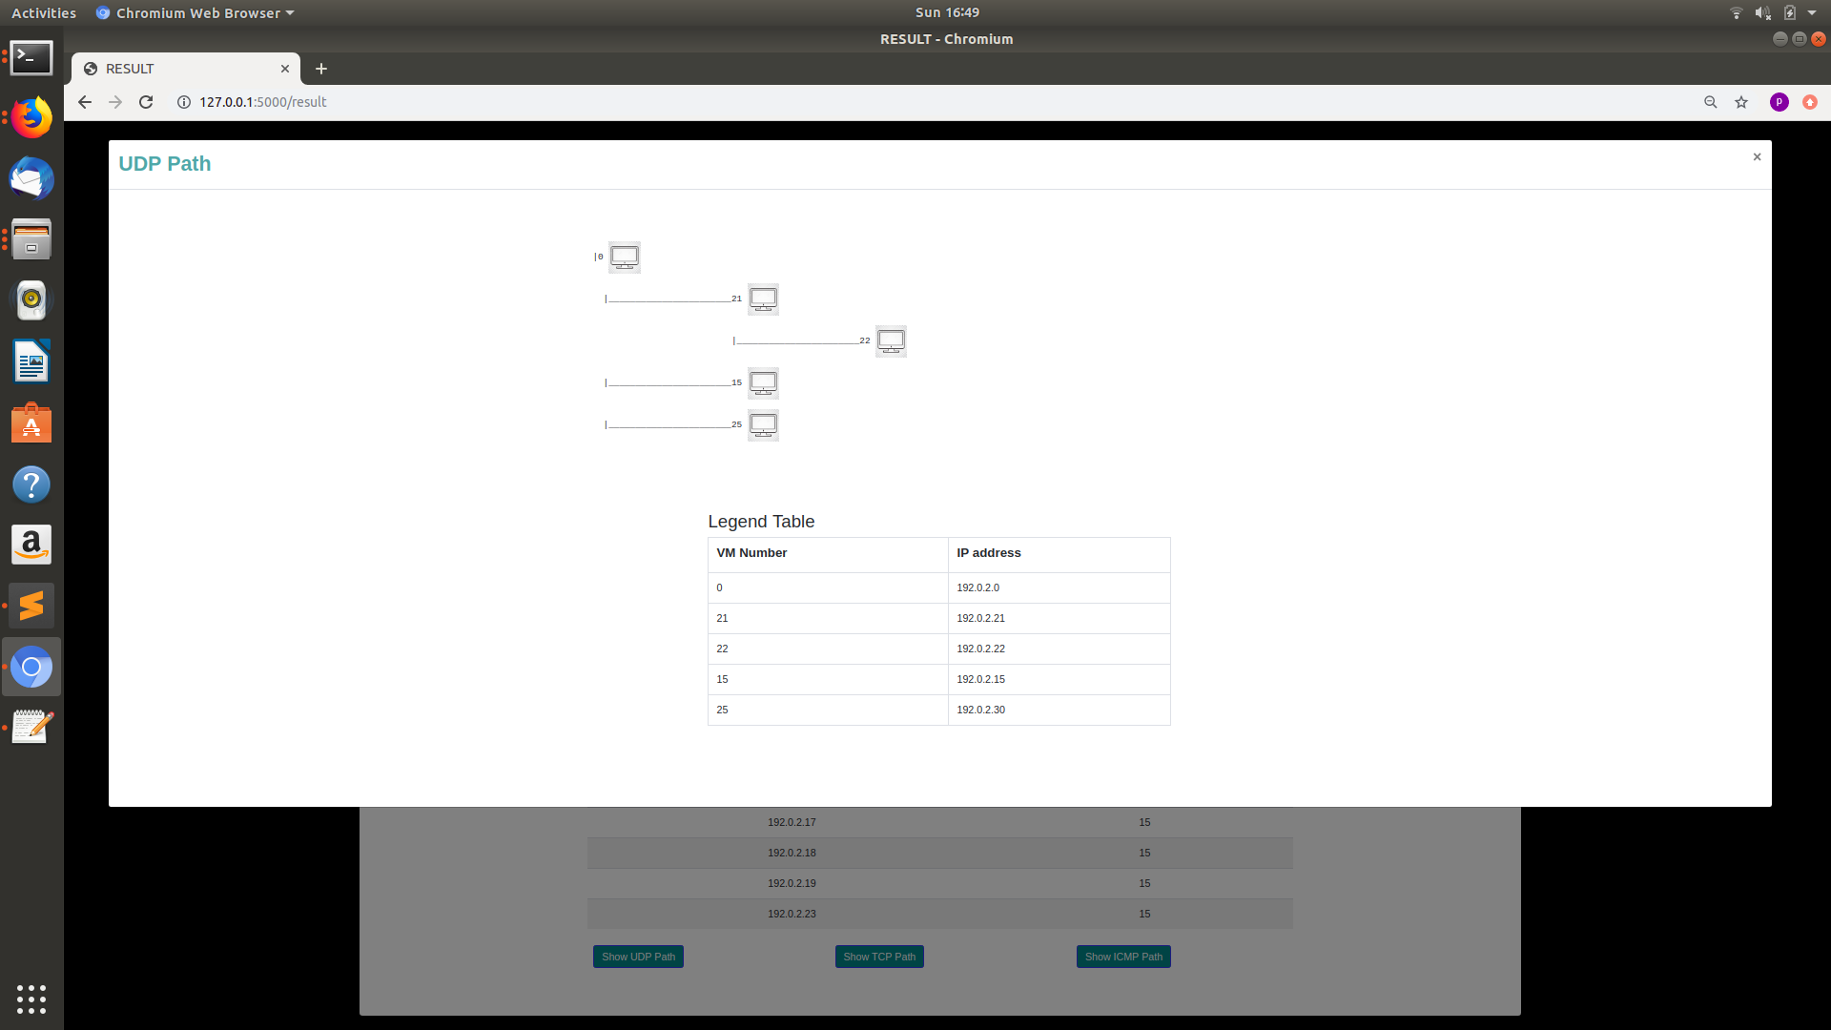

Slide 12
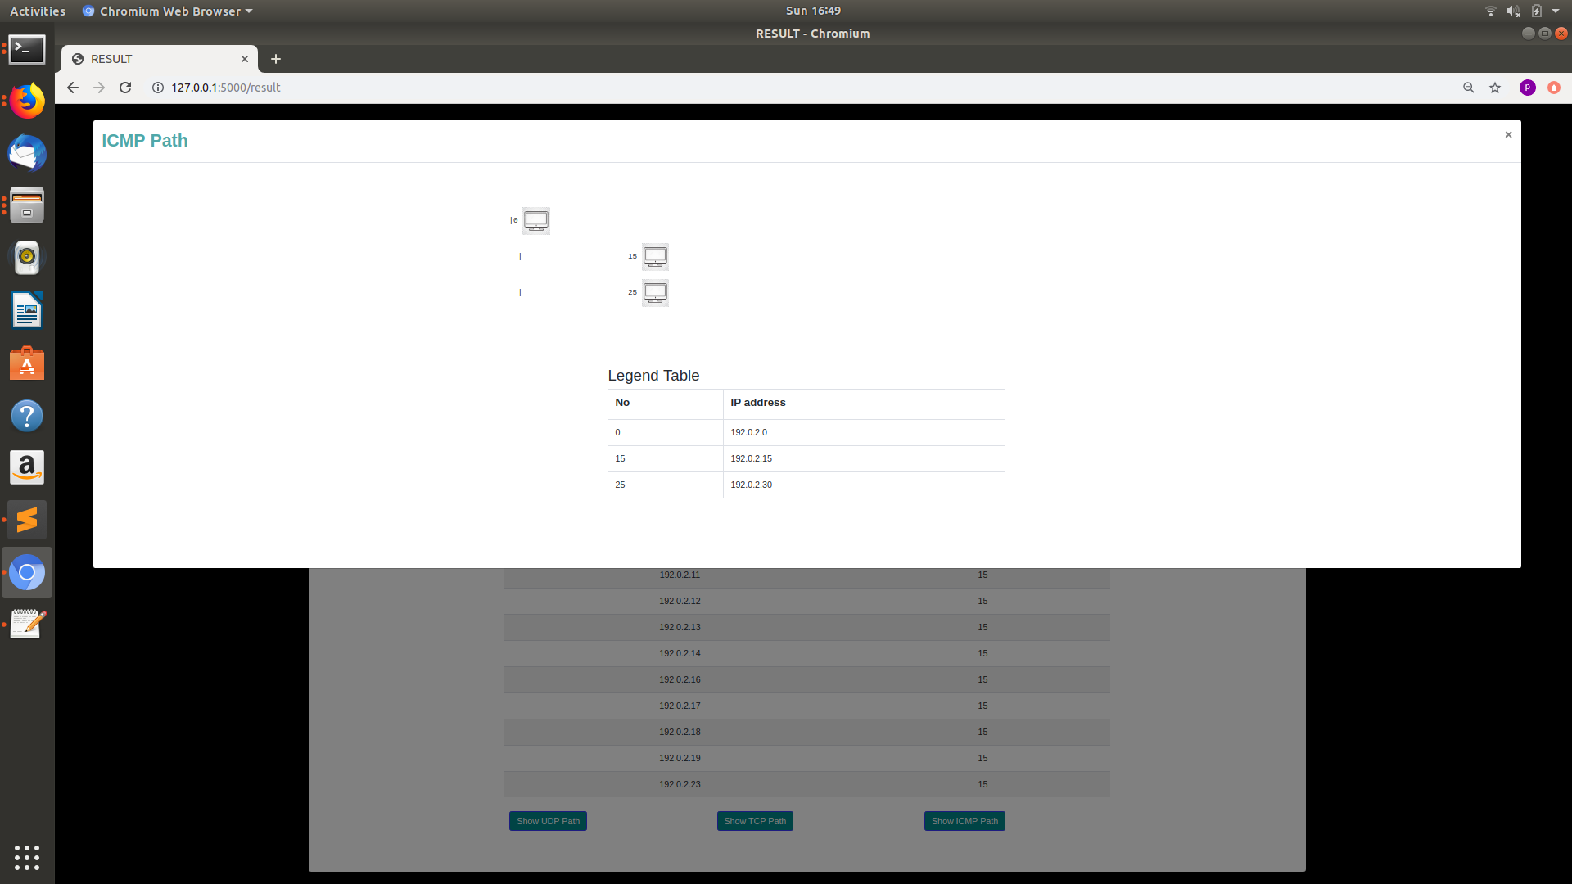

Slide 13







TECHNOLOGY STACK

Slide 14
FUTURE SCOPE
Decentralizing our software on host computers on the network
Decreasing time-complexity by using Dynamic Programming
Automatic sending of Iptables from clients to admin PC, whenever changed.

