Slide 1


YOUTUBE SONGS ANALYSIS USING POWER BI
Presentation By Prajwal Ambadkar

Slide 2

PROBLEM STATEMENT
This internship project aims to conduct a comprehensive analysis of YouTube songs data using Power BI. The dataset contains key attributes such as video ID, channel title, title, description, tags, published date, view count, like count, favorite count, comment count, video duration, video definition, and caption details. The goal is to utilize Power BI to create insightful visualizations and reports that provide a deeper understanding of YouTube songs' performance, popularity, and user engagement. The analysis aims to uncover trends, preferences, and patterns in the data to aid content creators and stakeholders in optimizing their YouTube song content.

Slide 3

DATASET OVERVIEW
1. video_id: Unique identifier for each YouTube video.
2. channelTitle: Title of the YouTube channel publishing the song.
3. title: Title of the YouTube song video.
4. description: Description provided for the YouTube song video.
5. tags: Tags associated with the YouTube song video.
6. publishedAt: Date and time when the YouTube song video was published.
7. viewCount: Number of views received by the YouTube song video.
8. likeCount: Number of likes received by the YouTube song video.
9. favoriteCount: Number of times the YouTube song video has been marked as a favorite.

Slide 4

10. commentCount: Number of comments posted on the YouTube song video.
11. duration: Duration of the YouTube song video. 12. definition: Video definition or quality (e.g., HD, SD). 13. caption: Availability of captions for the YouTube song video.
PROJECT OBJECTIVES
1. Data Cleaning and Preparation:
-
Clean and preprocess the dataset, handling missing values or outliers.
-
Convert relevant columns to appropriate data types.
2. Exploratory Data Analysis (EDA):
-
Explore patterns and distributions in view counts, like counts, and comments.
-
Identify trends in the popularity and engagement of YouTube song videos.
3. Content and Channel Analysis:
- Analyze the distribution of videos across different channels. - Identify popular tags and their correlation with view counts.

Slide 5
4. Temporal Trends:
-
Explore how YouTube song video metrics vary over time.
-
Identify peak publishing times and their impact on engagement.
5. User Engagement Insights:
-
Investigate relationships between likes, comments, and views.
-
Identify factors influencing user engagement with YouTube song videos.

Slide 6
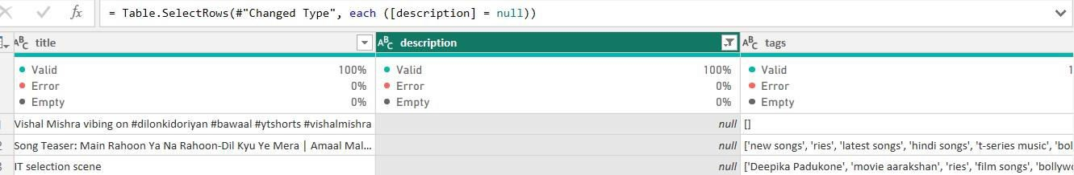

DATA CLEANING & PREPARATION
1. Removing Null Values :
The 'description' column had null values which I removed.

Slide 7
DATA CLEANING & PREPARATION
2. Creating new columns :-
Creating ‘durationSeconds’ columns
Converted video durations to seconds for easier analysis.
Formula
DurationSeconds = Duration.TotalSeconds(Duration.FromText([duration]))
DATA CLEANING & PREPARATION
2. Creating new Measure :-
Total Likes: Sum of all likes.
Total like = SUM(Sheet1[likeCount]

Slide 8
Total Comments: Sum of all comments
Total Comments = SUM(Sheet1[commentCount]
Total Songs: Count of all songs
COUNT Sheet1[video_id]
Total Minutes: Sum of all video durations in minutes
SUMX Sheet1 DATEDIFF 0 [duration]
SECOND 60
Average Views: Average number of views.
•
AVERAGE Sheet1[viewCount]

Slide 9

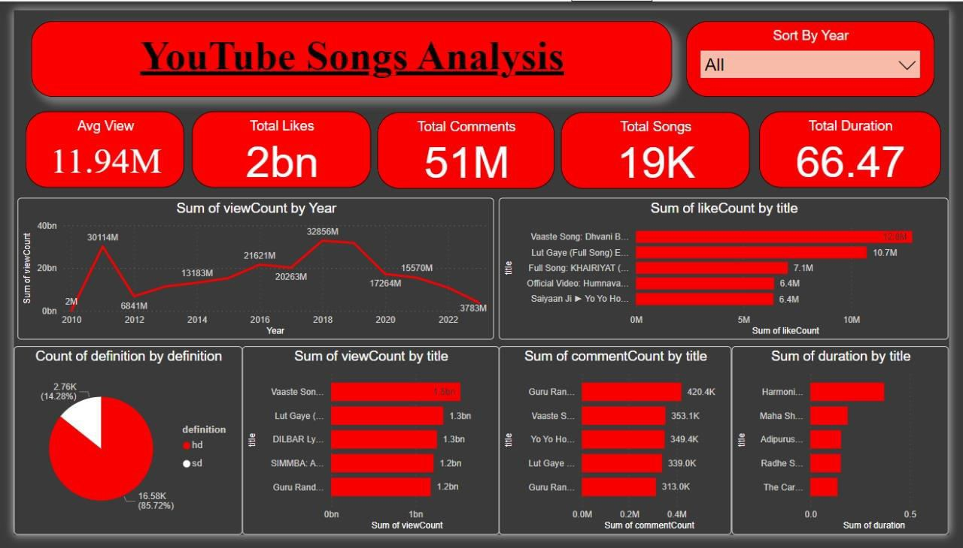


Slide 10
THANKS YOU
Presentation By Prajwal Ambadkar

