Slide 1


Splunk Tutorial
©Great Learning. All Rights Reserved. Unauthorized use or distribution prohibited

Slide 2

Why Monitor?
©Great Learning. All Rights Reserved. Unauthorized use or distribution prohibited

Slide 3










Why Continuous Monitoring?
Continuous Monitoring is an important part of Software Development. It is something we take up as measure to maintain the health of a software and to improve the quality of the software, and this is based on the feed back we get from the insights gained from monitoring.
©Great Learning. All Rights Reserved. Unauthorized use or distribution prohibited

Slide 4






Why Continuous Monitoring?
Continuous Monitoring is an important part of Software Development. It is something we take up as measure to maintain the health of a software and to improve the quality of the software, and this is based on the feed back we get from the insights gained from monitoring.
©Great Learning. All Rights Reserved. Unauthorized use or distribution prohibited

Slide 5
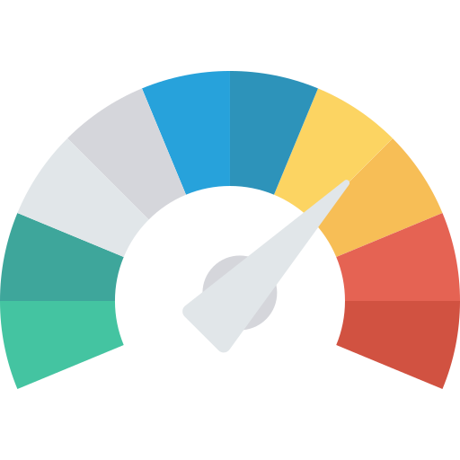


Why Continuous Monitoring?
Continuous Monitoring is an important part of Software Development. It is something we take up as measure to maintain the health of a software and to improve the quality of the software, and this is based on the feed back we get from the insights gained from monitoring.
©Great Learning. All Rights Reserved. Unauthorized use or distribution prohibited

Slide 6


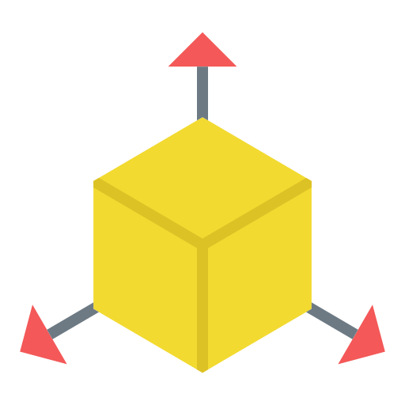
Why Continuous Monitoring?
Continuous Monitoring is an important part of Software Development. It is something we take up as measure to maintain the health of a software and to improve the quality of the software, and this is based on the feed back we get from the insights gained from monitoring.
©Great Learning. All Rights Reserved. Unauthorized use or distribution prohibited

Slide 7
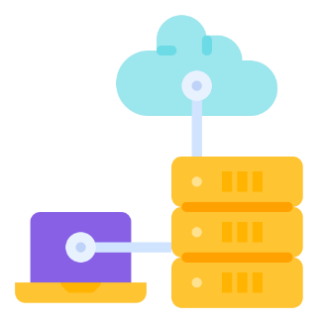
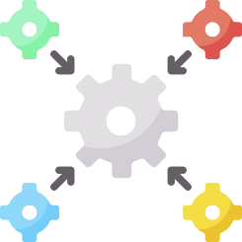



Types of Monitoring
System Performance
Process monitoring
Integration
Application Performance
Business Monitoring
©Great Learning. All Rights Reserved. Unauthorized use or distribution prohibited

Slide 8





Monitoring Tools
©Great Learning. All Rights Reserved. Unauthorized use or distribution prohibited

Slide 9
What is Splunk?
©Great Learning. All Rights Reserved. Unauthorized use or distribution prohibited

Slide 10

What is Splunk?
Splunk is data collection, analysis & Visualisation Tool. Companies use this tool to collect and monitor various types of data such as Application Metrics, Application logs, Transactional Data, Customer Data, Network Data, Configuration Settings, csv , Security data, and more.
©Great Learning. All Rights Reserved. Unauthorized use or distribution prohibited

Slide 11
What is Splunk?
It can collect all of the mentioned types of data and even more and then process all of that data based on conditions set by the user and finally visualize that data for further presentation and a better understanding of the Data collected.
©Great Learning. All Rights Reserved. Unauthorized use or distribution prohibited

Slide 12



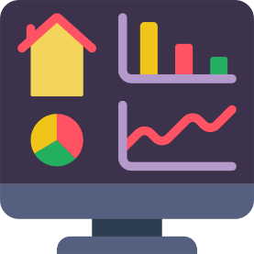
Splunk Benefits
Real-Time Performance Monitoring
Logging Tool
Stack Security & Alerting
Dashboards & Visualisations
Data Analytics
©Great Learning. All Rights Reserved. Unauthorized use or distribution prohibited

Slide 13



Splunk Benefits
Very easy to Use
Good customer support
ML abilities
©Great Learning. All Rights Reserved. Unauthorized use or distribution prohibited

Slide 14



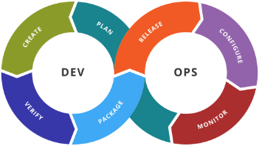
Splunk Products
Splunk Core
Splunk IT operations
Splunk Security
Splunk DevOps
©Great Learning. All Rights Reserved. Unauthorized use or distribution prohibited

Slide 15




Splunk Enterprise set of tools
Forwarder
Indexer
Search Head
Management tools
Deployment server
Index Cluster Master
Search Head Cluster
License Master
Cloud / Infrastructure
©Great Learning. All Rights Reserved. Unauthorized use or distribution prohibited

Slide 16

Splunk Enterprise Layout
Management Tools
Server
Forwarder
Indexer
Search Head
Security & Alert
©Great Learning. All Rights Reserved. Unauthorized use or distribution prohibited

Slide 17

Splunk Enterprise Licensing

Slide 18
Splunk Enterprise Licensing
There are different types of licenses in splunk that you can purchase to make use of different services within splunk enterprise. These can be:
Slunk Platform License,
Splunk Enterprise infrastructure license
Splunk Enterprise Trial license
Sales Trial license, Dev/Test licenses,
Free license
©Great Learning. All Rights Reserved. Unauthorized use or distribution prohibited

Slide 19
Splunk Enterprise Licensing
There are different types of licenses in splunk that you can purchase to make use of different services within splunk enterprise. These can be:
Forwarder license
Beta license
Splunk Premium App license
Splunk for Industrial IoT license
©Great Learning. All Rights Reserved. Unauthorized use or distribution prohibited

Slide 20

Splunk Case Study

Slide 21

Splunk Case Study
©Great Learning. All Rights Reserved. Unauthorized use or distribution prohibited

Slide 22

Splunk Installation & Setup

Slide 23



Splunk Installation & Setup
Linux
Windows
MAC

Slide 24
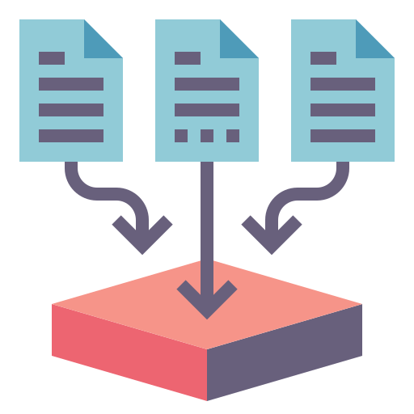
Discovering static data Logs

Slide 25

Splunk Enterprise Roles

Slide 26



Splunk Enterprise Roles
Administrator
Knowledge Manager
Search User

Slide 27

Splunk Enterprise Roles
Pivot User
Developer

Slide 28

©Great Learning. All Rights Reserved. Unauthorized use or distribution prohibited

