Slide 1
EXAMINATION SYSTEM
BY
CHANNAKESHAVA S
PRAJWAL B S

Slide 2
INTRODUCTION
This software Examination system is used by college to check weather the student is qualified for exam or not.
This software Examination system is used to store the student details for their examination purpose.

Slide 3
OBJECTIVES
This software is develop to maintain the details of the student in computerised format .
It can be used by teachers also for teachers also for monitoring the student attendence.

Slide 4
FUNCTION USED
void add()
void eligibleStudents()
void execute()
void printStudents()
void deleteRecord()

Slide 5
ADD STUDENT
In this function we’re going add no.of students,no.of working days.
And name,no.of days student attended the class,fees paid or not
”Student can pay the fees later also”.

Slide 6
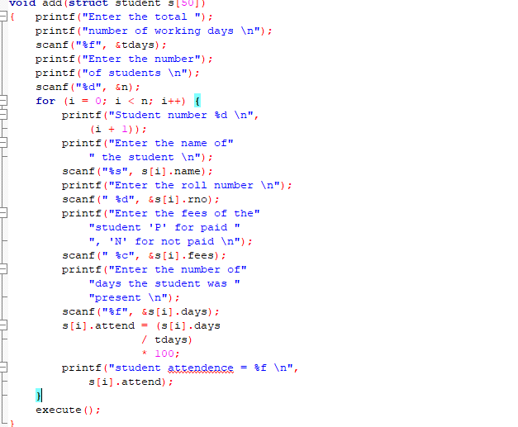
ADD STUDENT

Slide 7
ELIGIBLE STUDENTS
For eligible to exam student must required 75% of attendence and fees must be paid Fully.
If fees not paid fully the they can pay it later also.

Slide 8
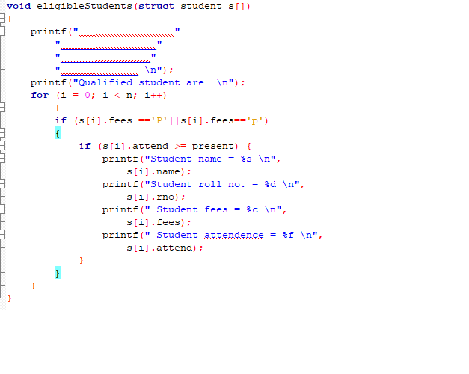
ELIGIBLE

Slide 9
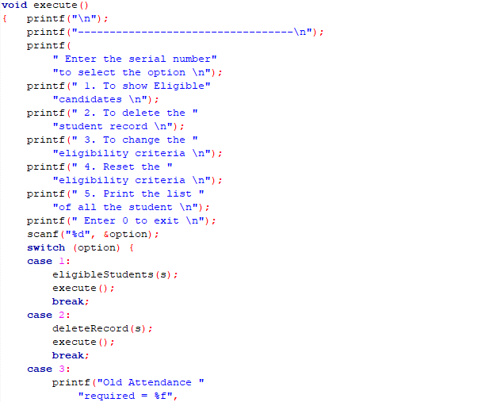
EXECUTE

Slide 10
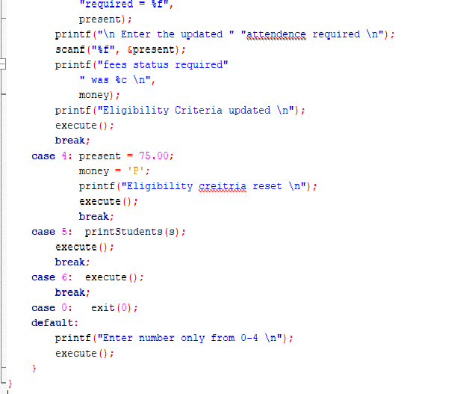
EXECUTE

Slide 11
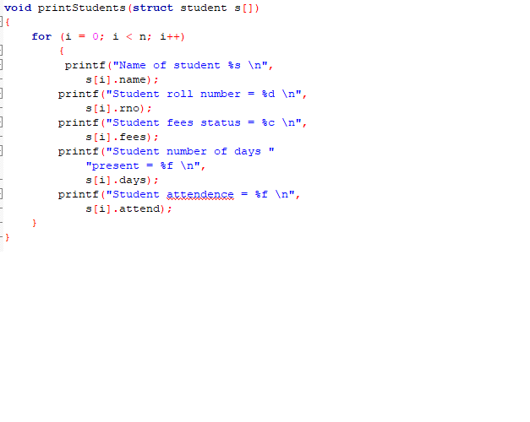
PRINT

Slide 12
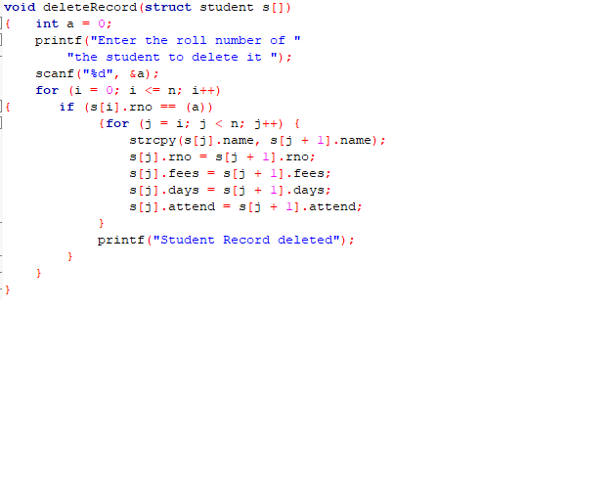
DELETE

Slide 13
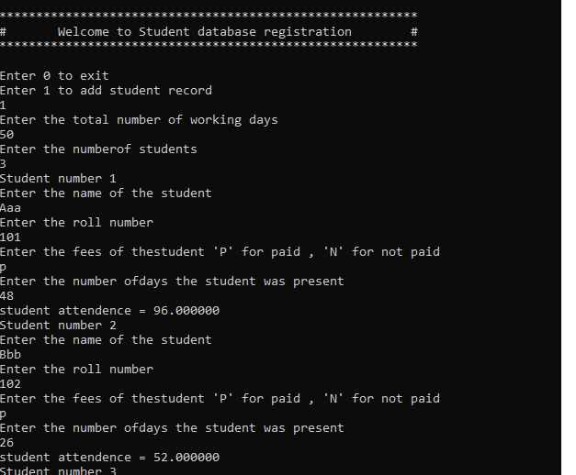
OUTPUT

Slide 14
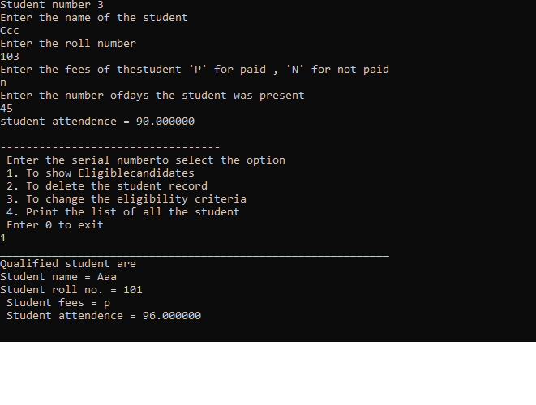

Slide 15
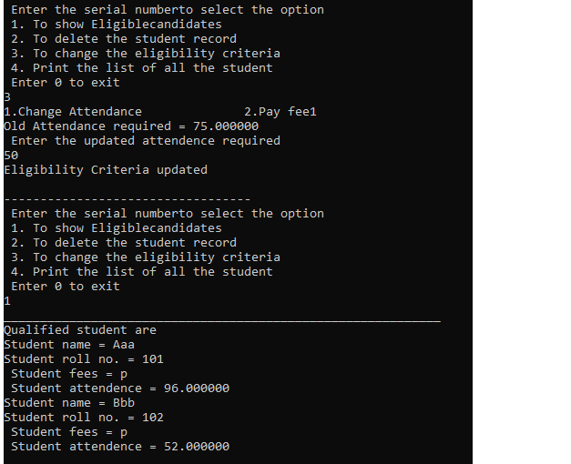

Slide 16
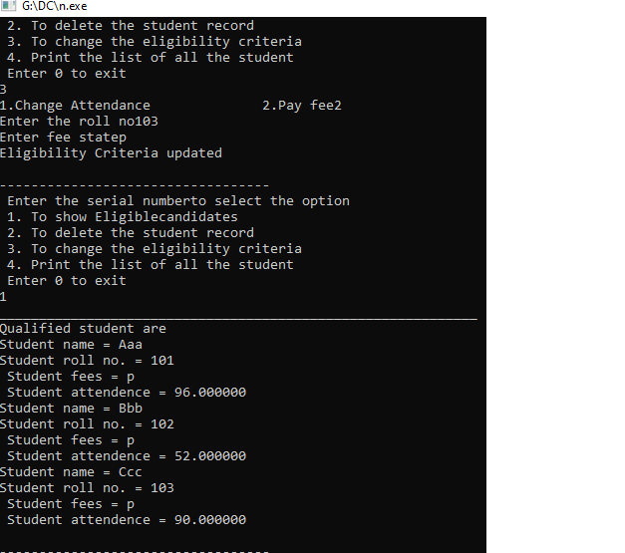

Slide 17
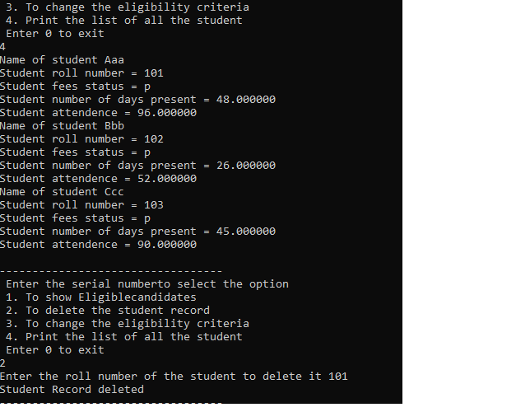

Slide 18
