Slide 1
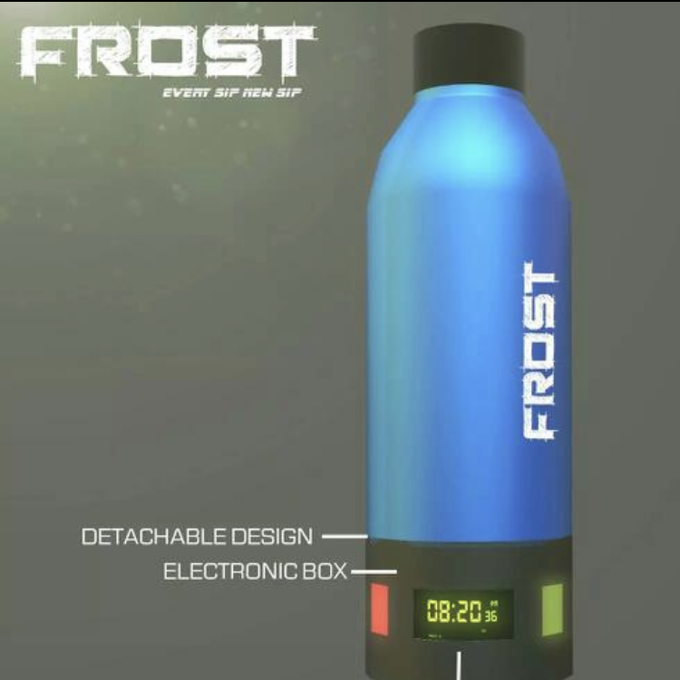

Slide 2



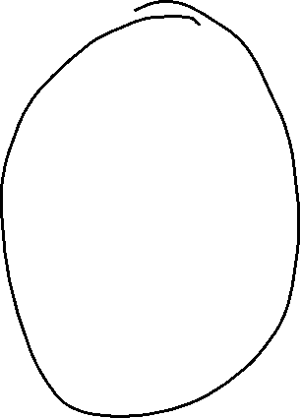

































Slide 3
Side view
Bottle base
OLED
H-Bridge
Button
C-type
Batteries
PCB-MC

Slide 4
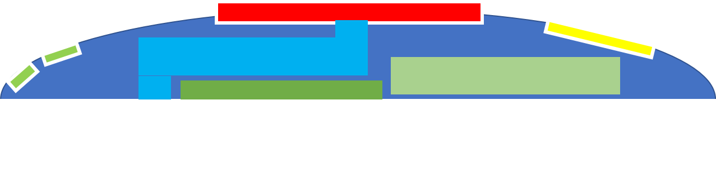
Bottom view

Slide 5
Top view

Slide 7
Side view
Bottle base
LEDs
H-Bridge
C-type

Slide 8



Side view
Bottle base
IR LED
Tinted LED Display
Buzzer
Drink
Clean
Keep bottle on dock
LDR
Battery
https://www.gograph.com/clipart/thirsty-man-dry-mouth-thirst-people-drinking-water-gg117972452.html

Slide 9
Frost will have IR sensor to sense if the bottle exists
Three symbol to show warnings (Black tinted LED)
Needed batteries (1.5 *3)
USB cable in case battery not used
Can be made up of wood carving
HW required : Arduino micro, 3LEDs, LDR, IR sensor, Battery holder, USB connector, Buzzer
Cost : Wood = 100, Arduino = 150, LEDs = 10, IR = 50, LDR = 20, USB = 50, Battery holder = 20. Total = 350 !

Slide 10
