Slide 1
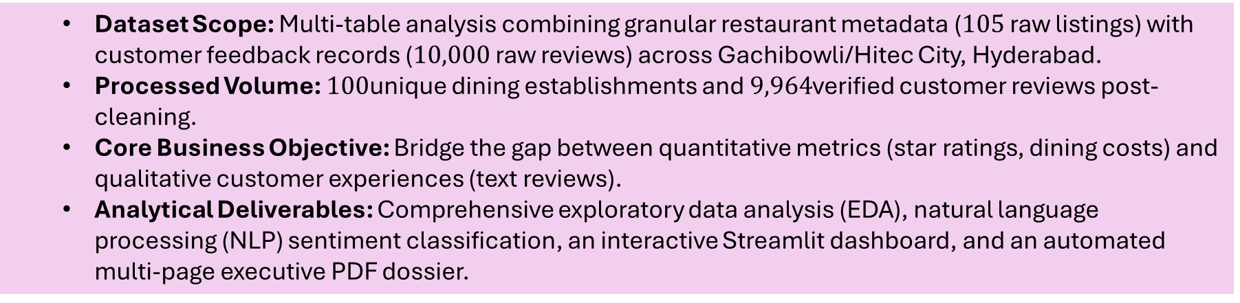
End-to-End Zomato Analytics And Sentiment Intelligence
Decoding Customer Satisfaction And Operational Bottlenecks Across the Hyderabad Dining Corridor
  Dataset Scope: Multi-table analysis combining granular restaurant metadata ($105$ raw listings) with customer feedback records ($10,000$ raw reviews) across Gachibowli/Hitec City, Hyderabad.
  Processed Volume: $100$unique dining establishments and $9,964$verified customer reviews post-cleaning.
  Core Business Objective: Bridge the gap between quantitative metrics (star ratings, dining costs) and qualitative customer experiences (text reviews).
  Analytical Deliverables: Comprehensive exploratory data analysis (EDA), natural language processing (NLP) sentiment classification, an interactive Streamlit dashboard, and an automated multi-page executive PDF dossier.
"This project provides an end-to-end analytical framework to understand what truly drives dining satisfaction in Hyderabad's prime tech corridor. Rather than looking purely at surface-level 1-to-5 star ratings, we connected tabular cost and cuisine attributes with natural language sentiment to reveal actionable operational levers for restaurateurs."

Slide 2
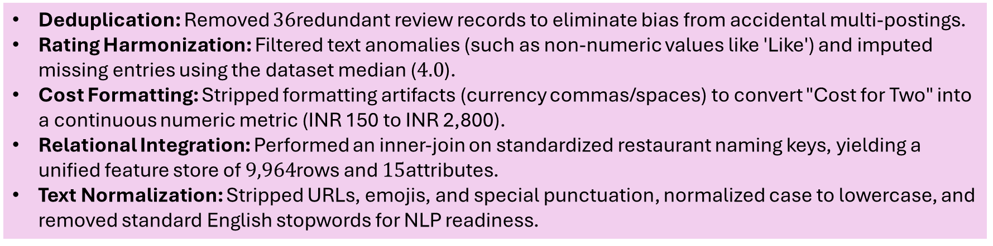
Data Integrity And Preprocessing Pipeline
Transforming Noisy Consumer Data into an Analysis-Ready Schema
Deduplication: Removed $36$redundant review records to eliminate bias from accidental multi-postings.
Rating Harmonization: Filtered text anomalies (such as non-numeric values like 'Like') and imputed missing entries using the dataset median ($4.0$).
Cost Formatting: Stripped formatting artifacts (currency commas/spaces) to convert "Cost for Two" into a continuous numeric metric (INR 150 to INR 2,800).
Relational Integration: Performed an inner-join on standardized restaurant naming keys, yielding a unified feature store of $9,964$rows and $15$attributes.
Text Normalization: Stripped URLs, emojis, and special punctuation, normalized case to lowercase, and removed standard English stopwords for NLP readiness.
"Real-world scraping produces inconsistencies. We coerced non-numeric ratings, standardized cost figures into integers, and normalized text by removing punctuation and stop words to ensure clean feature vectors for our downstream statistical and NLP models."

Slide 3
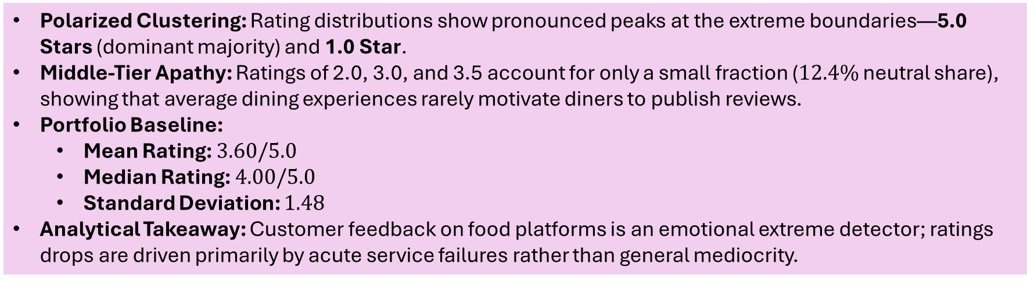
Customer Rating Distribution: The Bimodal Phenomenon
Extreme Emotional Triggers Drive Public Review Behavior
Polarized Clustering: Rating distributions show pronounced peaks at the extreme boundaries—5.0 Stars (dominant majority) and 1.0 Star.
Middle-Tier Apathy: Ratings of 2.0, 3.0, and 3.5 account for only a small fraction ($12.4\%$ neutral share), showing that average dining experiences rarely motivate diners to publish reviews.
Portfolio Baseline:
  Mean Rating: $3.60/5.0$
  Median Rating: $4.00/5.0$
  Standard Deviation: $1.48$
Analytical Takeaway: Customer feedback on food platforms is an emotional extreme detector; ratings drops are driven primarily by acute service failures rather than general mediocrity.
"Notice the sharp U-shaped or bimodal distribution. Customers rarely open Zomato to write a review for a 3-star, average meal. They write when they are delighted (5 stars) or furious (1 star). Because of this polarization, mitigating 1-star service failures is the single fastest way for a restaurant to protect its overall average."

Slide 4
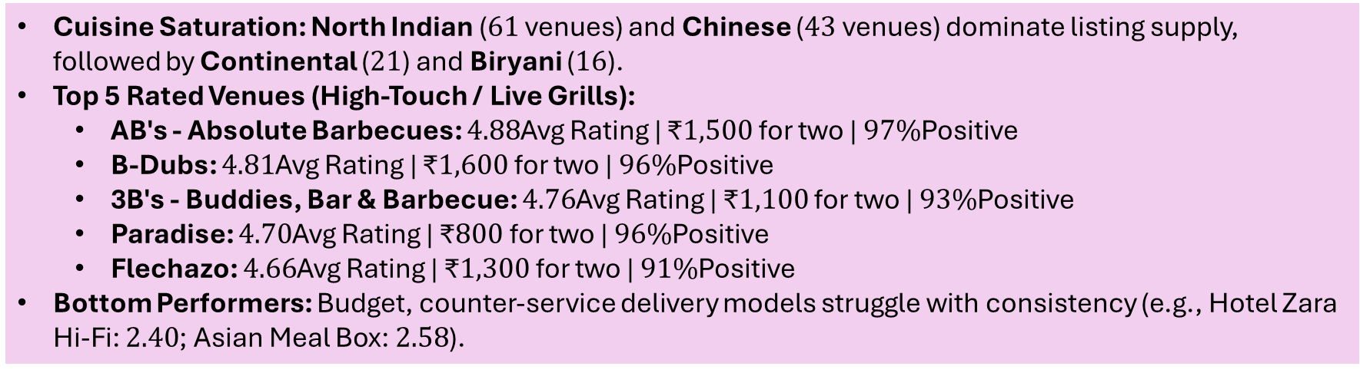
Market Structure And Establishment Performance
Live-Grills and Experiential Dining Outperform Mass-Market Cuisines Schema
Cuisine Saturation: North Indian ($61$ venues) and Chinese ($43$ venues) dominate listing supply, followed by Continental ($21$) and Biryani ($16$).
Top 5 Rated Venues (High-Touch / Live Grills):
  AB's - Absolute Barbecues: $4.88$Avg Rating | ₹$1,500$ for two | $97\%$Positive
  B-Dubs: $4.81$Avg Rating | ₹$1,600$ for two | $96\%$Positive
  3B's - Buddies, Bar & Barbecue: $4.76$Avg Rating | ₹$1,100$ for two | $93\%$Positive
  Paradise: $4.70$Avg Rating | ₹$800$ for two | $96\%$Positive
  Flechazo: $4.66$Avg Rating | ₹$1,300$ for two | $91\%$Positive
Bottom Performers: Budget, counter-service delivery models struggle with consistency (e.g., Hotel Zara Hi-Fi: $2.40$; Asian Meal Box: $2.58$).
"While North Indian and Chinese are the most competitive categories by volume, experiential buffet and live-grill concepts hold the highest customer ratings and sentiment scores above 90%. Conversely, low-price delivery kitchens suffer from inconsistent food temperatures and order mix-ups."

Slide 5
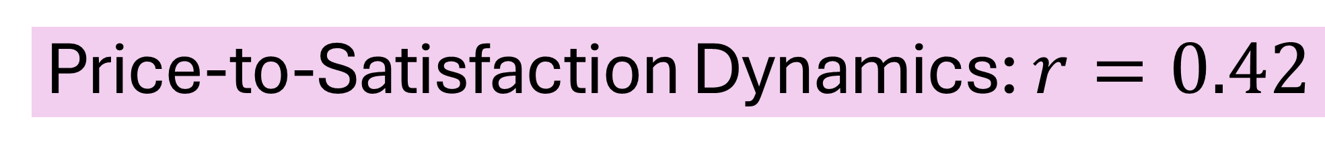
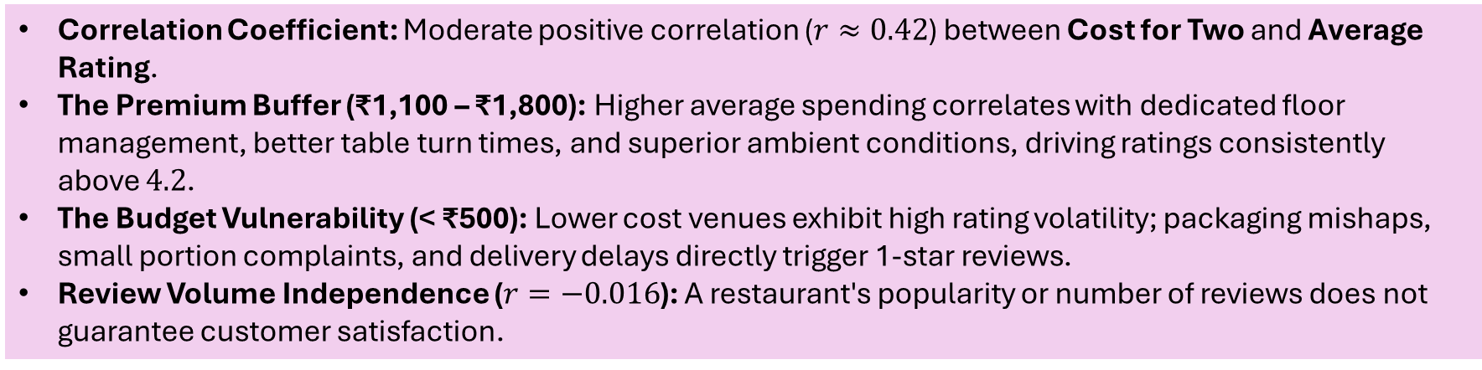
Price-to-Satisfaction Dynamics: $r=0.42$
Higher Price Points Function as a Buffer for Service Quality
Correlation Coefficient: Moderate positive correlation ($r≈0.42$) between Cost for Two and Average Rating.
The Premium Buffer (₹1,100 – ₹1,800): Higher average spending correlates with dedicated floor management, better table turn times, and superior ambient conditions, driving ratings consistently above $4.2$.
The Budget Vulnerability (< ₹500): Lower cost venues exhibit high rating volatility; packaging mishaps, small portion complaints, and delivery delays directly trigger 1-star reviews.
Review Volume Independence ($r=−0.016$): A restaurant's popularity or number of reviews does not guarantee customer satisfaction.
"Our regression analysis reveals a positive correlation of 0.42. Higher prices allow restaurants to invest in staff training, hygiene, and ambience, which insulates them from bad reviews. However, charging mid-to-high prices without matching service levels creates the fastest path to customer dissatisfaction."

Slide 6
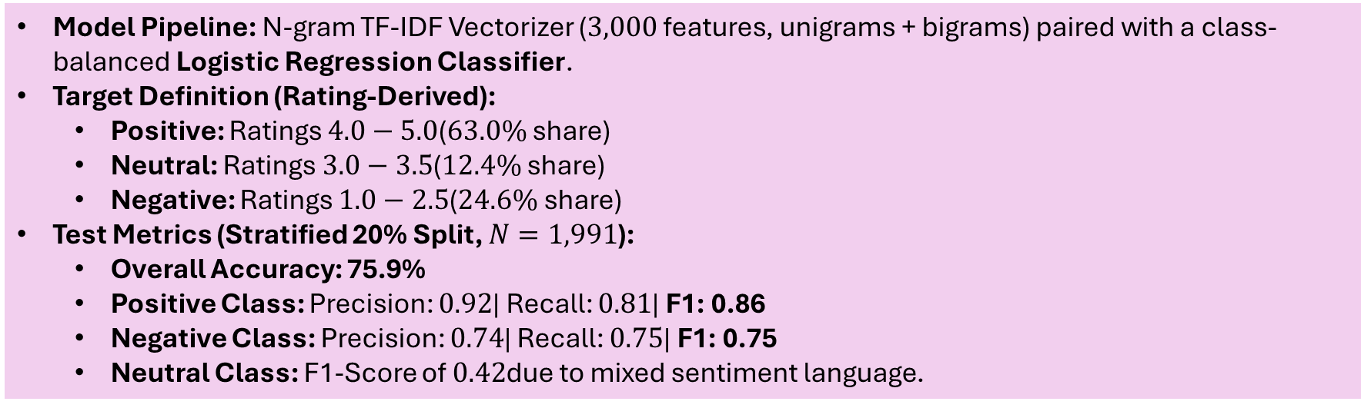
Supervised NLP Architecture And Evaluation
TF-IDF + Logistic Regression Delivering 76% Out-of-Sample Accuracy
Model Pipeline: N-gram TF-IDF Vectorizer ($3,000$ features, unigrams + bigrams) paired with a class-balanced Logistic Regression Classifier.
Target Definition (Rating-Derived):
  Positive: Ratings $4.0−5.0$($63.0\%$ share)
  Neutral: Ratings $3.0−3.5$($12.4\%$ share)
  Negative: Ratings $1.0−2.5$($24.6\%$ share)
Test Metrics (Stratified 20% Split, $N=1,991$):
  Overall Accuracy: 75.9%
  Positive Class: Precision: $0.92$| Recall: $0.81$| F1: 0.86
  Negative Class: Precision: $0.74$| Recall: $0.75$| F1: 0.75
  Neutral Class: F1-Score of $0.42$due to mixed sentiment language.
"We evaluated a TF-IDF and Logistic Regression model on an unseen 20% test split. It achieved strong precision on positive reviews (0.92) and balanced recall on negative reviews (0.75), making it a viable automated filter for detecting operational issues from raw customer text."

Slide 7
Feature Importance And Lexical Drivers of Sentiment
What Words Tell Us About Customer Delight vs. Churn
Negative Coefficients (Failure Drivers):
  Top tokens: worst, pathetic, bad, horrible, waste, poor, disappointed, bad experience.
  Insight: Complaints focus heavily on perceived financial loss (waste) and service breakdown, rather than subtle flavor profiles.
Positive Coefficients (Delight Drivers):
  Top tokens: awesome, amazing, best, love, loved, delicious, excellent, thanks.
  Insight: Diners express loyalty when staff show proactive hospitality (thanks, courteous) alongside food quality.
Neutral Coefficients (Mediocrity Markers):
  Top tokens: ambience, better, average, ok, okay, compared, fine.
  Insight: Words like 'okay' or 'decent' reflect met expectations without any memorable experience.
"Looking at model weights, the strongest negative signal is 'waste'—indicating poor value perception—and 'pathetic', pointing to service failures. Conversely, positive sentiment is heavily tied to words like 'thanks' and 'courteous', proving that staff hospitality often outweighs food taste alone."

Slide 8
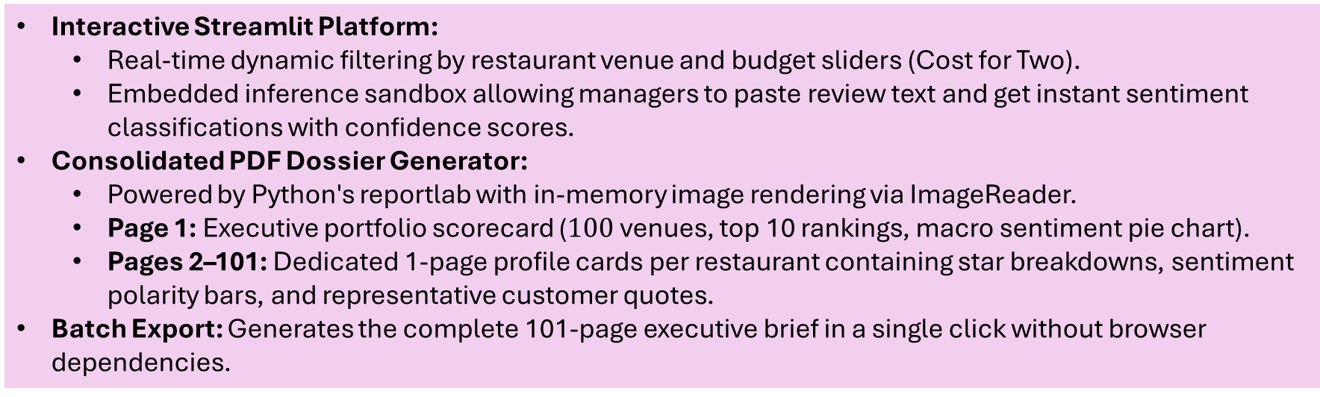
End-to-End Deployment: Streamlit And Automated Dossier
Bridging Data Science with Stakeholder Usability
Interactive Streamlit Platform:
  Real-time dynamic filtering by restaurant venue and budget sliders (Cost for Two).
  Embedded inference sandbox allowing managers to paste review text and get instant sentiment classifications with confidence scores.
Consolidated PDF Dossier Generator:
  Powered by Python's reportlab with in-memory image rendering via ImageReader.
  Page 1: Executive portfolio scorecard ($100$ venues, top 10 rankings, macro sentiment pie chart).
  Pages 2–101: Dedicated 1-page profile cards per restaurant containing star breakdowns, sentiment polarity bars, and representative customer quotes.
Batch Export: Generates the complete 101-page executive brief in a single click without browser dependencies.
"To make this actionable for business users, we deployed an interactive Streamlit application featuring live filtering and a real-time sentiment prediction sandbox. Finally, we engineered a single-click export function that creates a 101-page PDF dossier summarizing every individual restaurant alongside executive portfolio benchmarks."

Slide 9
Key Analytical Insights
A. Rating Distribution & Diner Reviewing Behavior
Bimodal Polarization: Ratings cluster at the opposing poles: 5.0 stars (the absolute majority) and 1.0 stars. Middle ratings like 2.0 and 3.0 are noticeably less frequent. This indicates that customer review volume on Zomato is largely driven by extreme emotional events: either exceptional customer delight or severe service failures.
Portfolio Mean vs. Median: The portfolio overall average rating is 3.60 / 5.0, while the median customer rating sits at 4.00 / 5.0. The lower mean relative to the median confirms that high-volume 1-star negative reviews exert a strong downward pull on overall scores.
B. Market Competition & Top Performers
Buffet and Experiential Formats Outperform: Across all 100 establishments analyzed, live-grill, barbecue, and sports-bar venues dominate customer satisfaction:
  AB's - Absolute Barbecues: Avg Rating 4.88, Cost INR 1,500, Positive Sentiment 97.0%
  B-Dubs: Avg Rating 4.81, Cost INR 1,600, Positive Sentiment 96.0%
  3B's - Buddies, Bar & Barbecue: Avg Rating 4.76, Cost INR 1,100, Positive Sentiment 93.0%
  Paradise: Avg Rating 4.70, Cost INR 800, Positive Sentiment 96.0%
  Flechazo: Avg Rating 4.66, Cost INR 1,300, Positive Sentiment 91.0%
Lagging Venues: Budget counter-service and quick-service outlets struggle with negative reviews:
  Hotel Zara Hi-Fi: Avg Rating 2.40, Negative Sentiment 64.0%
  Asian Meal Box: Avg Rating 2.58, Negative Sentiment 52.0%
  Pakwaan Grand: Avg Rating 2.71, Negative Sentiment 46.0%

Slide 10
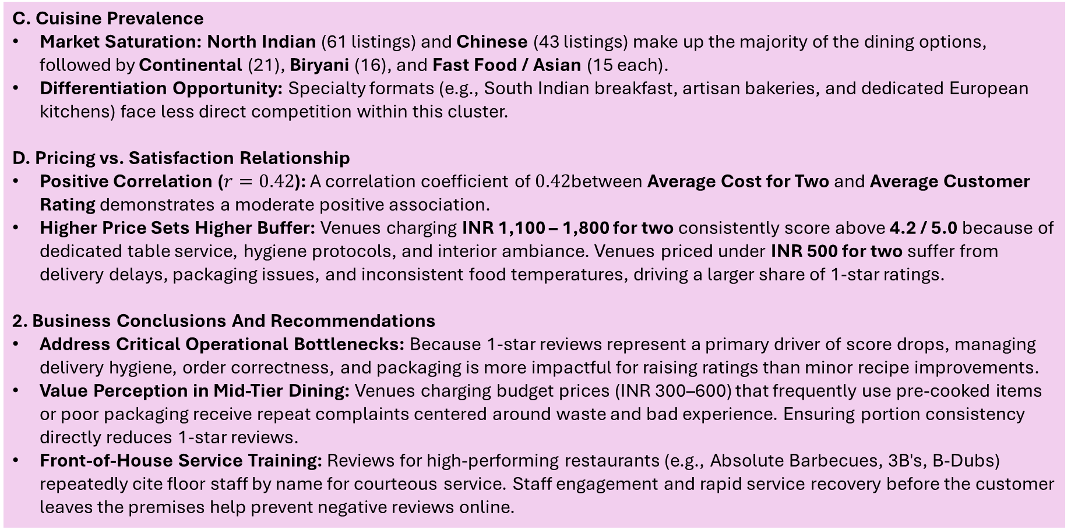
C. Cuisine Prevalence
Market Saturation: North Indian (61 listings) and Chinese (43 listings) make up the majority of the dining options, followed by Continental (21), Biryani (16), and Fast Food / Asian (15 each).
Differentiation Opportunity: Specialty formats (e.g., South Indian breakfast, artisan bakeries, and dedicated European kitchens) face less direct competition within this cluster.
D. Pricing vs. Satisfaction Relationship
Positive Correlation ($r=0.42$): A correlation coefficient of $0.42$between Average Cost for Two and Average Customer Rating demonstrates a moderate positive association.
Higher Price Sets Higher Buffer: Venues charging INR 1,100 – 1,800 for two consistently score above 4.2 / 5.0 because of dedicated table service, hygiene protocols, and interior ambiance. Venues priced under INR 500 for two suffer from delivery delays, packaging issues, and inconsistent food temperatures, driving a larger share of 1-star ratings.
2. Business Conclusions And Recommendations
Address Critical Operational Bottlenecks: Because 1-star reviews represent a primary driver of score drops, managing delivery hygiene, order correctness, and packaging is more impactful for raising ratings than minor recipe improvements.
Value Perception in Mid-Tier Dining: Venues charging budget prices (INR 300–600) that frequently use pre-cooked items or poor packaging receive repeat complaints centered around waste and bad experience. Ensuring portion consistency directly reduces 1-star reviews.
Front-of-House Service Training: Reviews for high-performing restaurants (e.g., Absolute Barbecues, 3B's, B-Dubs) repeatedly cite floor staff by name for courteous service. Staff engagement and rapid service recovery before the customer leaves the premises help prevent negative reviews online.

