Slide 1
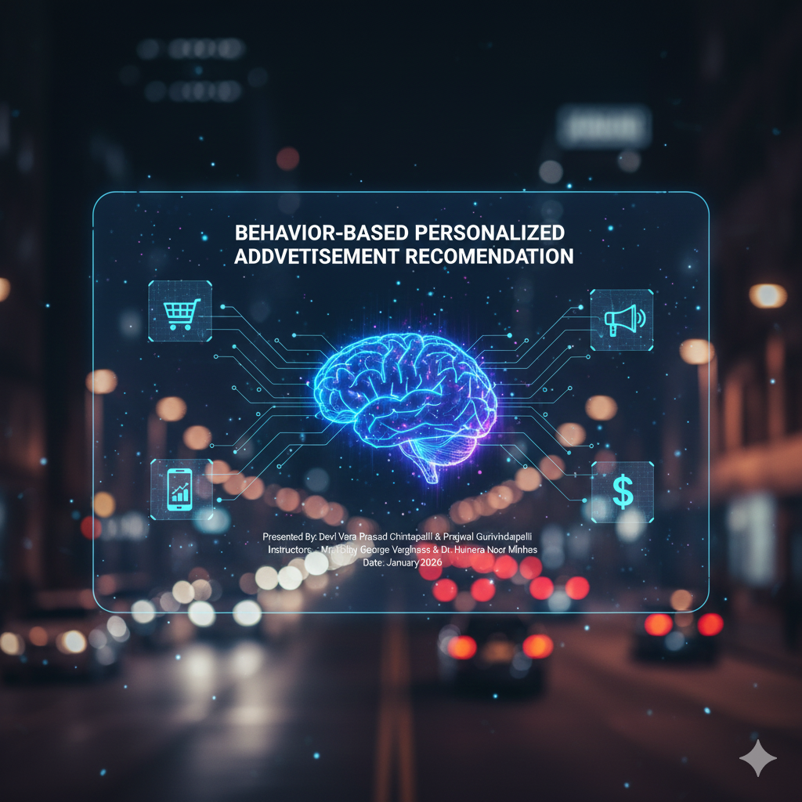
Presented by:
DEVI VARA PRASAD CHINTAPALLI -33023056
PRAJWAL GURIVINDAPALLI -30630894

Slide 2
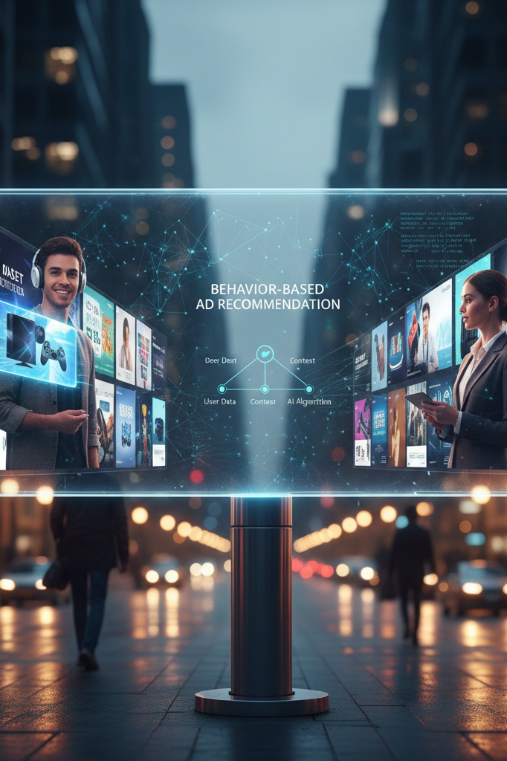
Introduction:
This project develops a Personalized Advertisement Recommendation System that utilizes machine learning to analyze user behavior and contextual data. By predicting the likelihood of a user clicking a specific ad, the system addresses issues like ad nausea and poor return on investment for advertisers. It examines factors such as device type, ad position, and historical engagement to deliver the right product to the right person at the ideal time. Ultimately, the system enhances user experience and maximizes advertising efficacy through data-driven personalization.

Slide 3

Problem Statement
The core challenge addressed by this project is the significant gap between online advertisement content and actual user interests, which frequently results in low engagement rates and "ad nausea". When advertisers fail to target the right audience, it leads to a poor return on investment (ROI) and wasted digital marketing budgets. To solve this, the project focuses on developing a predictive system that analyzes historical search patterns, online interactions, and specific device characteristics to determine exactly which advertisements a user is most likely to click. By modeling these behavioral and contextual factors, the system aims to transform digital advertising from a source of frustration into a source of relevant and useful information for the user

Slide 4
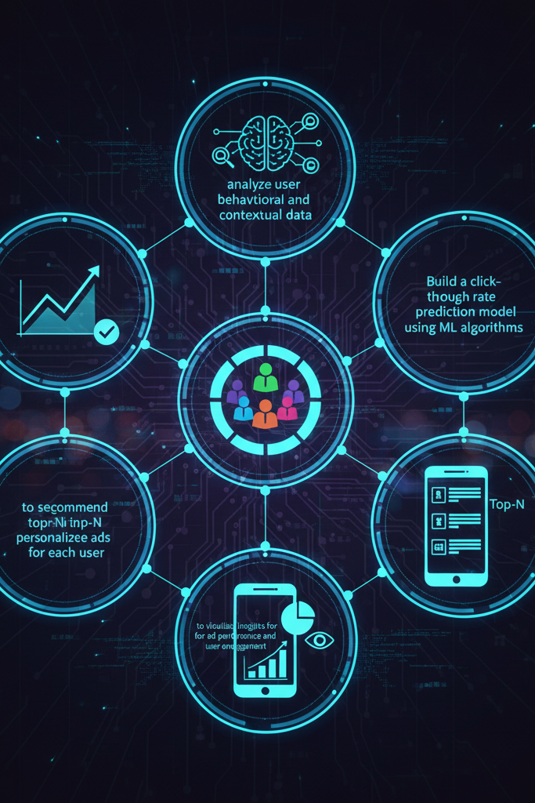
Objectives:
To analyze user behavioral and contextual data affecting ad engagement.
To build a click-through rate prediction model using ML algorithms.
To segment users into interest clusters for better targeting.
To recommend top-N personalized ads for each user.
To visualize insights for ad performance and user engagement.

Slide 5

Dataset Characteristics:
Source: Synthetic dataset based on Avizo Click-Through Rate (CTR) data.
Size: rows representing individual ad impressions.
Anonymity: Features C14–C21 are anonymized to protect user privacy while maintaining predictive power.
Class Imbalance: Typical of ad data, non-clicks outnumber clicks.

Slide 6

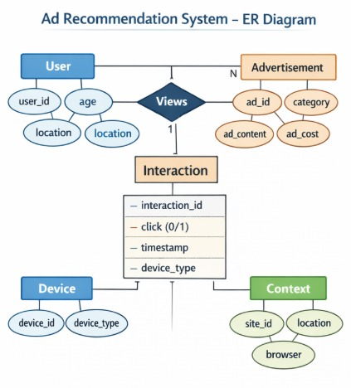
System Architecture (ER Diagram)
User Entity: Stores age and location.
Advertisement Entity: Stores category and cost data.
Interaction Entity: Captures the "Views" event, recording timestamps and click behavior (0/1).
Context & Device: Tracks site location, browser, and device type.

Slide 7
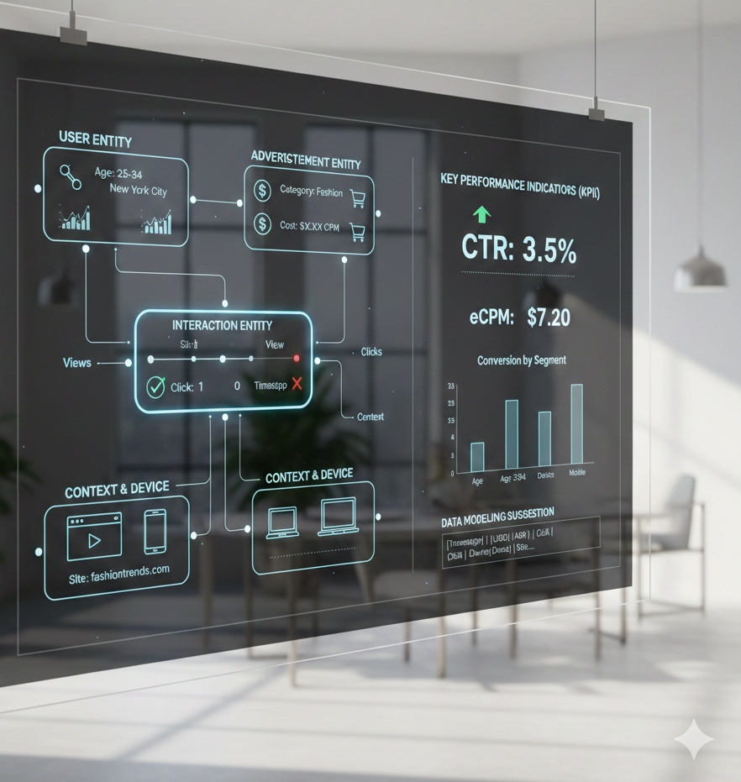
Data Preprocessing Steps
Data Cleaning:Verified for missing values, duplicates, and category consistency.
Encoding: Converted categorical data (ad category, device type) into numerical formats using One-Hot or Label Encoding.
Scaling: Brought numerical features (C14-C21) to a common scale for better mathematical comparison.

Slide 8

Exploratory Data Analysis (EDA)
Category Analysis: Identified that Tech and certain other categories receive higher engagement.
Device Insights: Mobile users demonstrate higher click-through rates than desktop users.
Positioning: Ad placement (central/visible) significantly impacts user responsiveness.

Slide 9
Methodology & Model Selection
Problem Formulation: Treated as a Binary Classification (Yes/No) problem.
Algorithms Used:
  Logistic Regression: For simplicity and interpretability.
  Decision Trees & Random Forests: To capture complex, non-linear patterns.
Validation Strategy: 80/20 Train-Test split to ensure the model generalizes to new data.

Slide 10
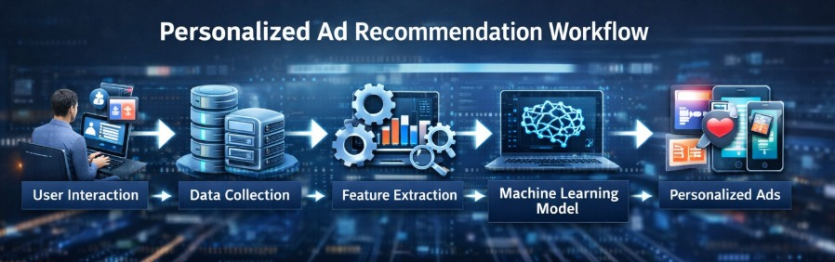

Slide 11
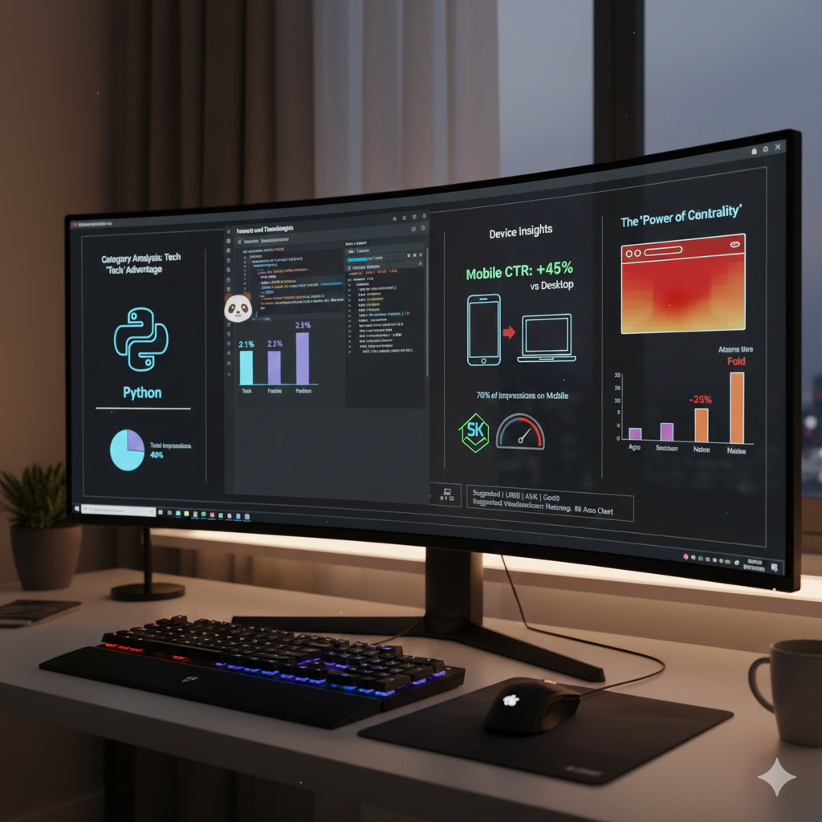
Tools and Technologies
Language: Python.
Libraries:
  Pandas: Data manipulation.
  Seaborn: Data visualization.
  Scikit-Learn: Machine learning model development.
Environment: Jupyter Notebook.

Slide 12
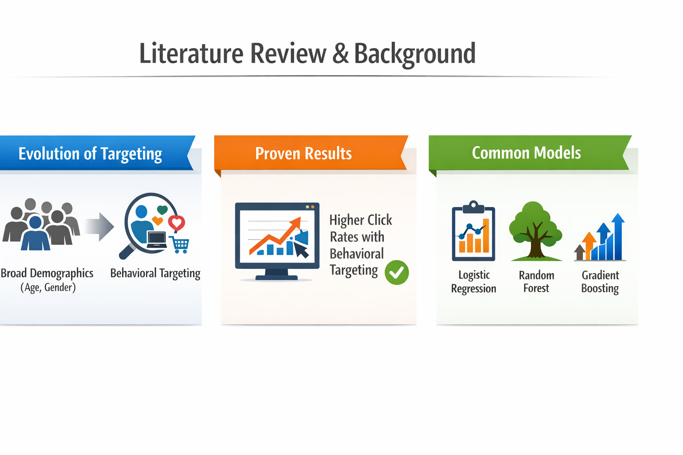

Slide 13

Results and Discussion
Performance: The models successfully identified engagement patterns beyond random guessing.
Key Findings: Behavioral and contextual factors (device, time, position) are stronger predictors than demographics alone.
Business Impact: Targeted ads maximize budget efficiency and improve user experience.

Slide 14
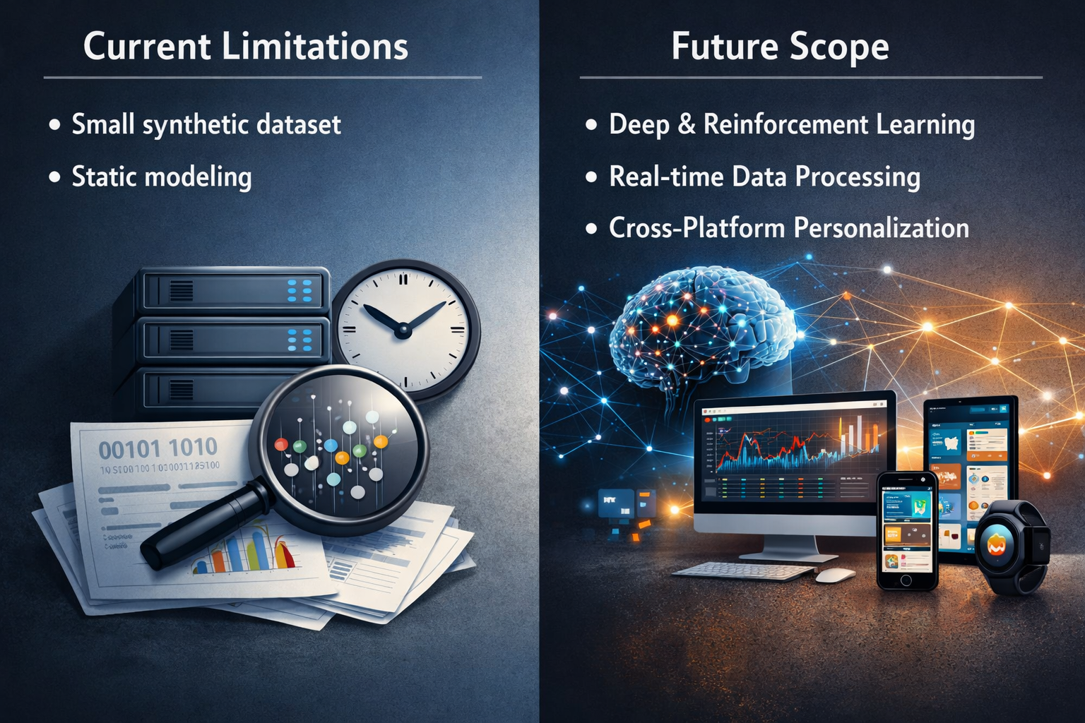

Slide 15
conclusion
Final Takeaway: Behavioral personalization is essential for modern digital marketing.
Summary: By utilizing machine learning, we can predict user response and create a "win-win" for both users and advertisers.
Ready for Implementation: This project provides a scalable framework for real-world advertising platforms.

Slide 16

Thank you.

