Slide 1

Predictive Maintenance Using Machine Learning for Early Fault Detection
Presented By:
Prajwal Gurivindapalli
Masters in Data Science
University of Europe for Applied Sciences
Professors: Iftikhar Ahmed
&
Shan Faiz

Slide 2

Problem Statement
Industrial equipment failures result in:
Unplanned downtime
Increased maintenance costs
Reduced productivity
Production losses
Traditional maintenance approaches are inefficient because they either react after failures occur or perform maintenance unnecessarily.
Proposed Solution
Use Machine Learning to predict failures before they occur.

Slide 3

Research Objectives
Primary Objective
Develop and evaluate machine learning models for predictive maintenance.
Specific Objectives
Analyze machine sensor data
Predict machine failures
Compare machine learning algorithms
Identify key failure indicators
Improve maintenance decision-making

Slide 4

RQ1
How accurately can machine learning models predict machine failures using sensor data?
RQ2
Which machine learning model provides the best predictive performance?
RQ3
Which operational parameters contribute most significantly to machine failure prediction?
Research Questions

Slide 5

Literature Review
Key Findings from Literature
Predictive maintenance is a core component of Industry 4.0
Machine learning significantly improves maintenance planning
Ensemble models often outperform traditional algorithms
Data quality strongly influences prediction accuracy
Explainable AI is becoming important in industrial applications
Research Gap
Limited comparative studies evaluate multiple machine learning models while also identifying critical failure factors.

Slide 6
Dataset Characteristics
Total Records: 10,000
Balanced Dataset: 5,000 Failure & 5,000 Non-Failure
Multiple sensor measurements
Industrial machine data
Features
Air Temperature
Process Temperature
Rotational Speed
Torque
Tool Wear
Machine Type
Target Variable
Machine Failure (0 / 1)
Dataset Overview

Slide 7
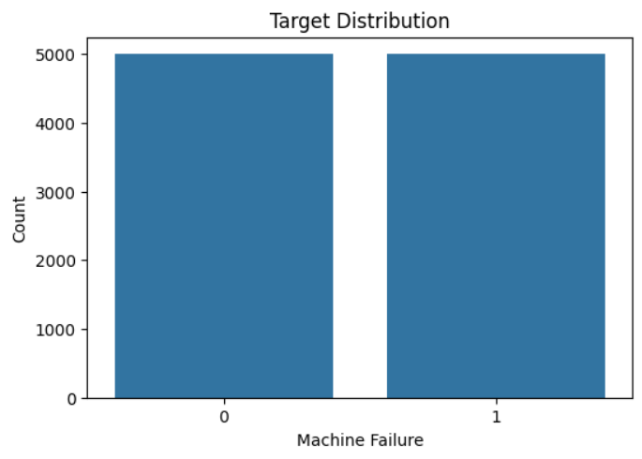
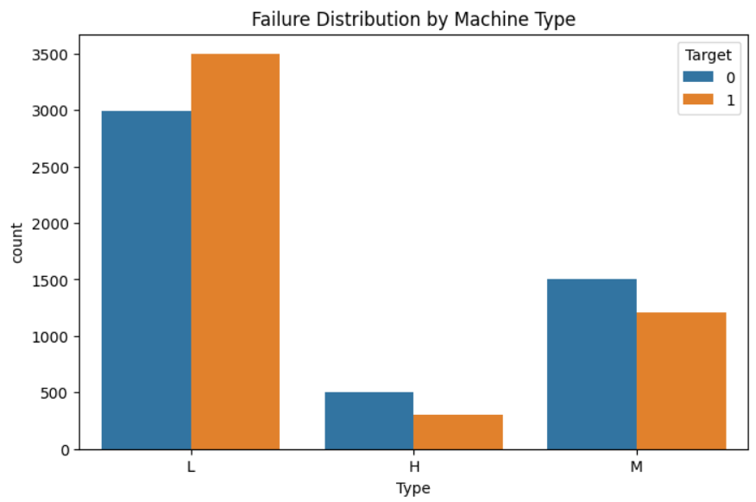
Data Visualization

Slide 8
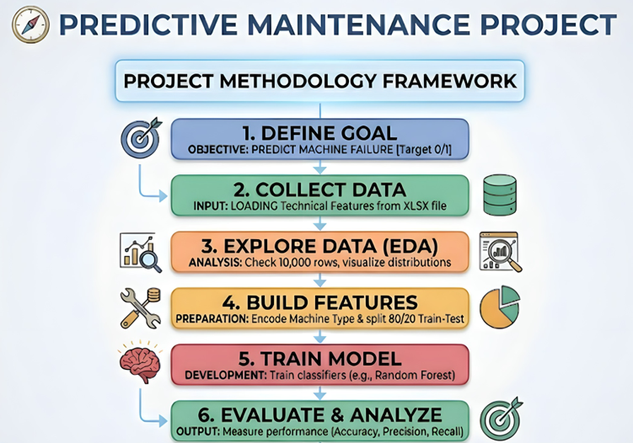
Methodology

Slide 9

Machine Learning Models
Models Evaluated :
Logistic Regression
Baseline classification model
Fast and interpretable
Random Forest
Ensemble learning method
High robustness and accuracy
XGBoost
Gradient boosting algorithm
State-of-the-art performance

Slide 10
Performance Evaluation Metrics
Evaluation Metrics :
→ Accuracy
Measures overall prediction correctness.
→ Precision
Measures reliability of positive predictions.
→ Recall
Measures ability to identify failures.
→ F1 Score
Balances precision and recall.
→ ROC-AUC
Measures model discrimination capability.

Slide 11
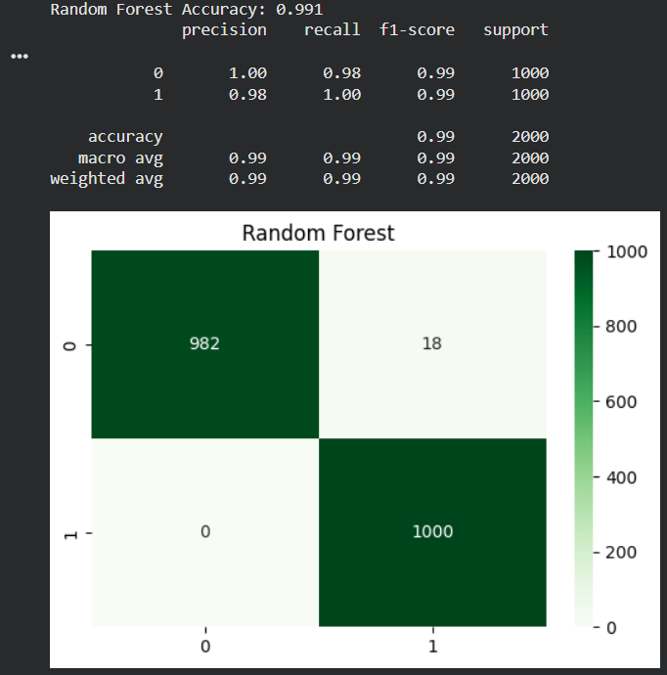
Results Comparison
Model | Accuracy
Logistic Regression | 82.1%
Random Forest | 99.1%
XGBoost | 98.4%

Slide 12
Research Question-Answers & Conclusion
RQ1 - Machine learning models successfully predicted failures with high accuracy.
RQ2 - Random Forest outperformed XGBoost and Logistic Regression.
RQ3 - Tool Wear, Torque, and Rotational Speed were identified as the most influential features.
Final Conclusion
Machine learning can effectively support predictive maintenance by enabling early fault detection and reducing unexpected downtime.

Slide 13

THANK YOU

