Slide 1

V_CALL APPLICATION

Slide 2
Introduction
Our aim is to develop an android application to give information about the details of People who are I need of an video call application for meeting purpose.
In this application user can add secret code and join the meeting and can also share the code with friend’s.
User can chat in the meeting also using emojis.

Slide 3
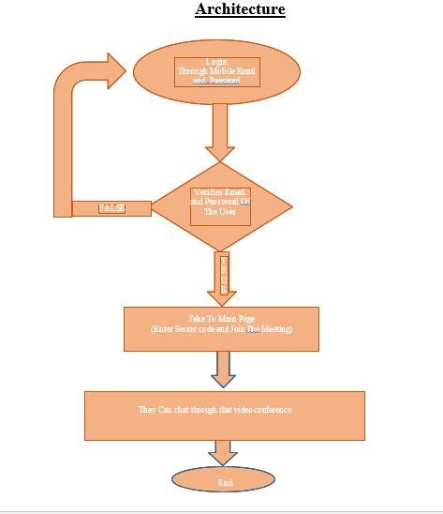
Architecture

Slide 4
software development kit
A software development kit (SDK) is typically a set of software development tools that allows the creation of applications for a certain software package, software framework, hardware platform.
To create applications you have to download this software development kit.
For example, if you want to create an Android app you require an SDK with java programming, for iOS apps you require an iOS SDK with swift language, and to develop MS Windows apps you require the.net language.

Slide 5
Problem Statement
To develop V_Call application to give information about user like email, name and password.
This application will allow all users to enter secret code and start the video meeting and can share the secret code via social media to their friends and colleagues.
User can access this application anywhere and anytime with internet connection using phone.

Slide 6
Objective
To setup Android software development kit.
Handling the verification of user entered email id and password.
Entering secret code and join the meeting.
Share the code with the friends.

Slide 7
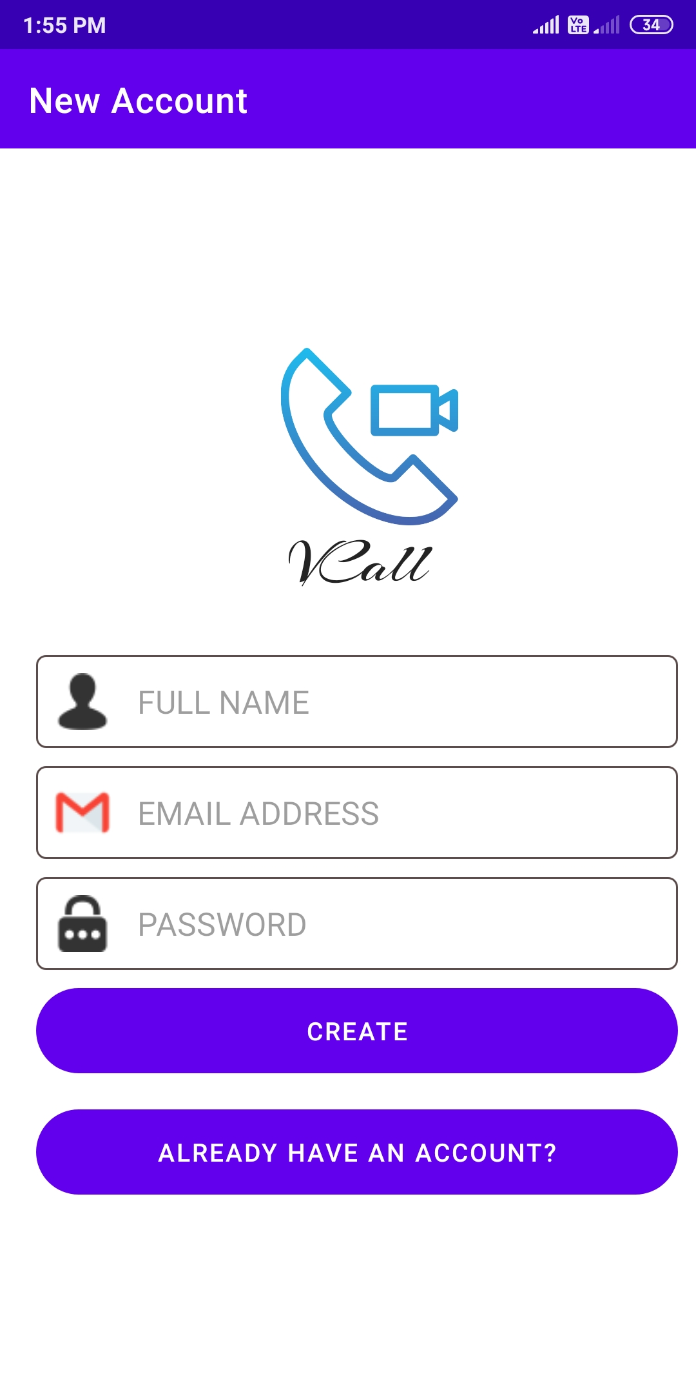
Snap Shot

Slide 8
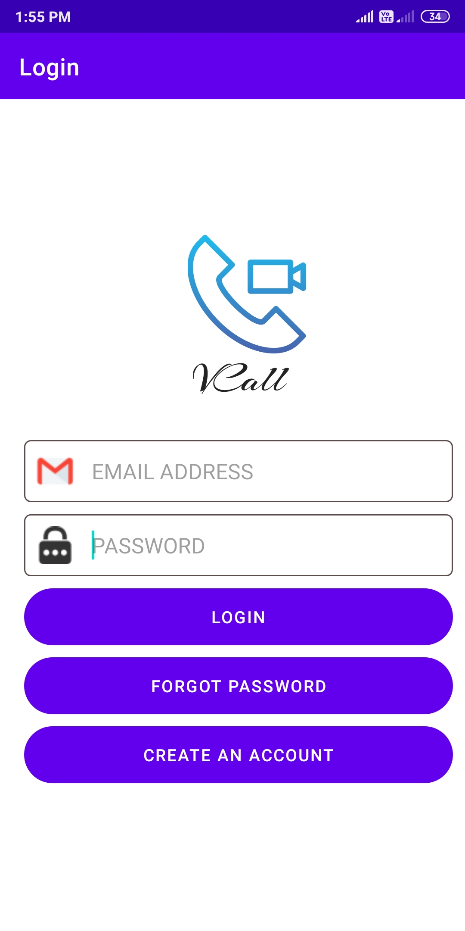
LOGIN PAGE

Slide 9
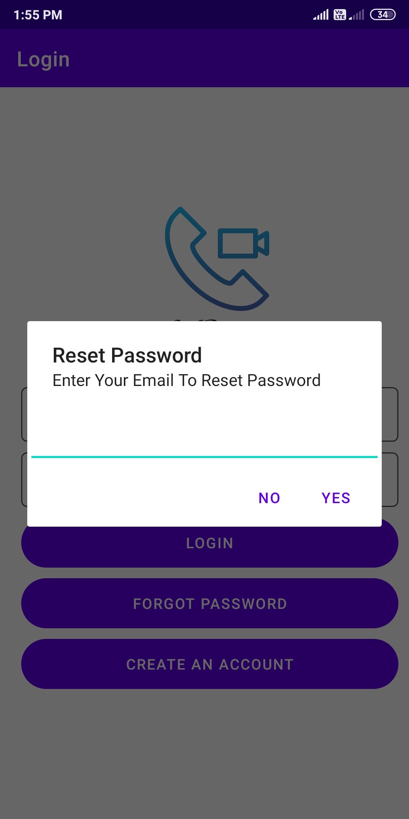
RESET PASSWORD

Slide 10
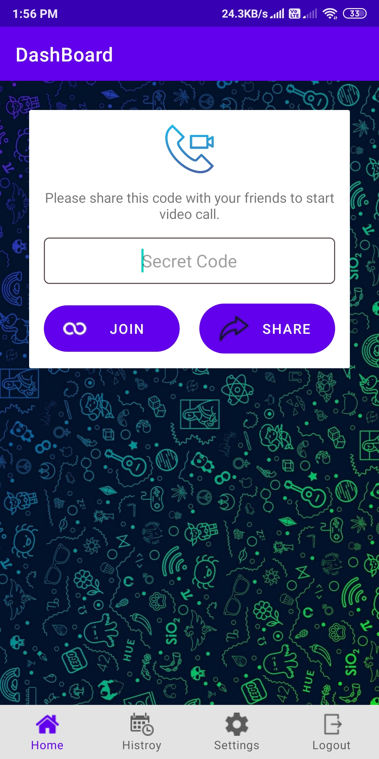
MAIN PAGE

Slide 11
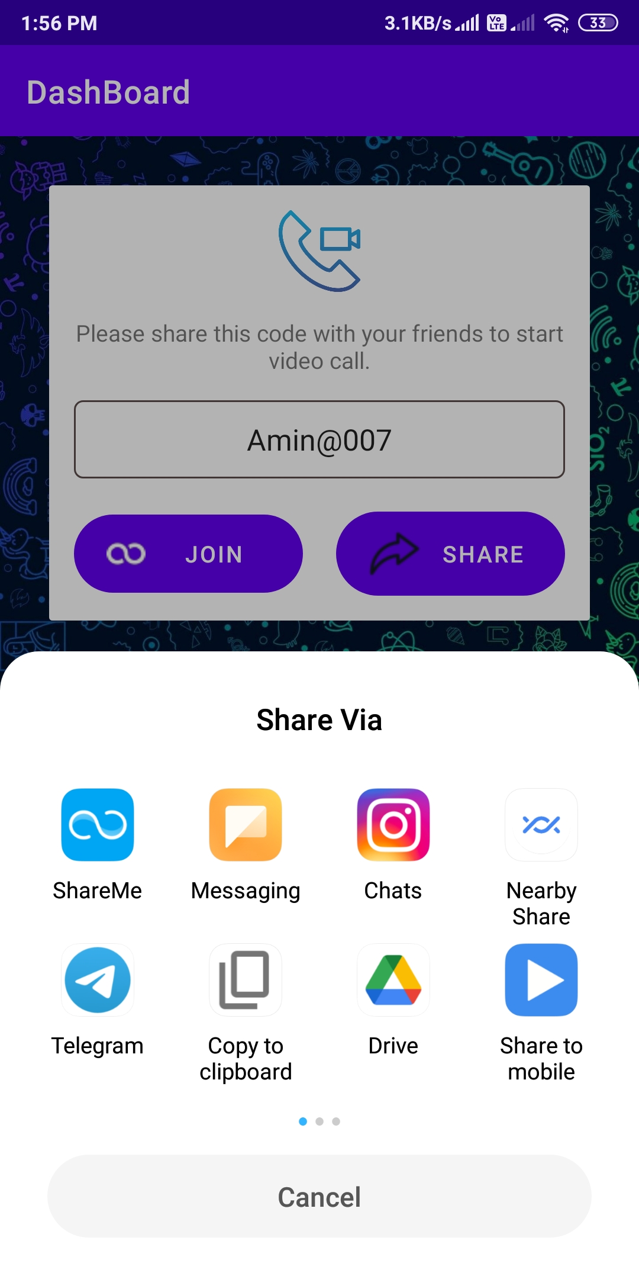
SHARE MEDIA

Slide 12
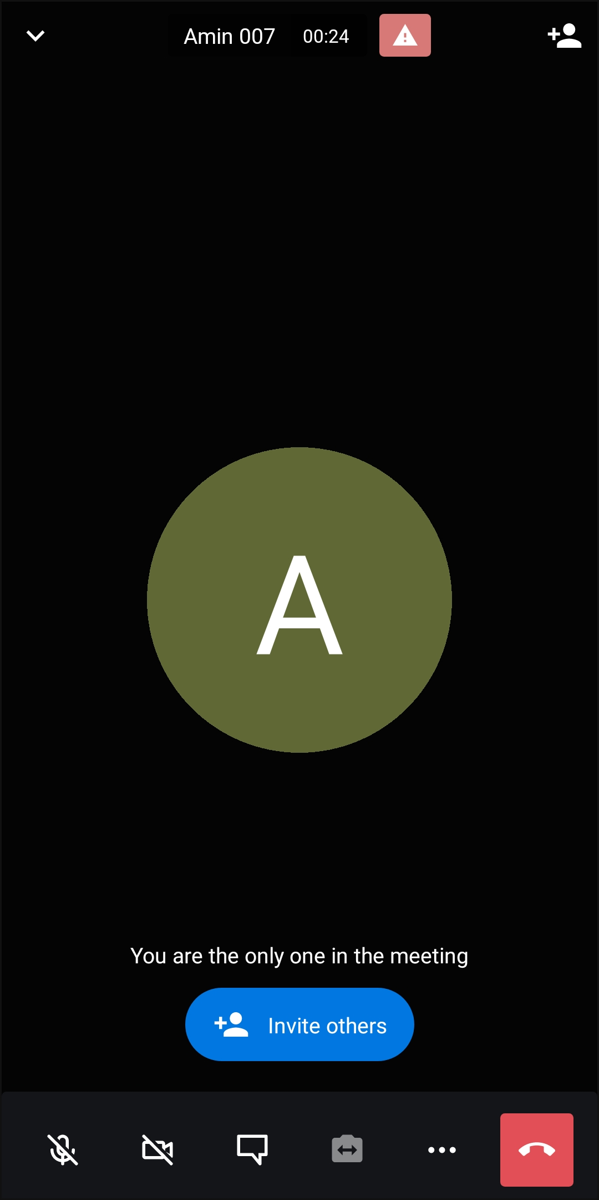
VIDEO PAGE

Slide 13
Conclusion
Android as a full, open and free mobile device platform, with its powerful function and good user experience rapidly developed into the most popular mobile operating system.
This report gives an overview of the different challenges and issues faced in android app development The experience of developing an android app is quite challenging, motivating as well as satisfying.

Slide 14
Reference
www.youtube.com
www.google.com
www.stackoverflow.com
www.ieeexplore.ieee.org

