Slide 1
EER Assurance December 2018
Agenda Item
8
December 12, 2018

Slide 2
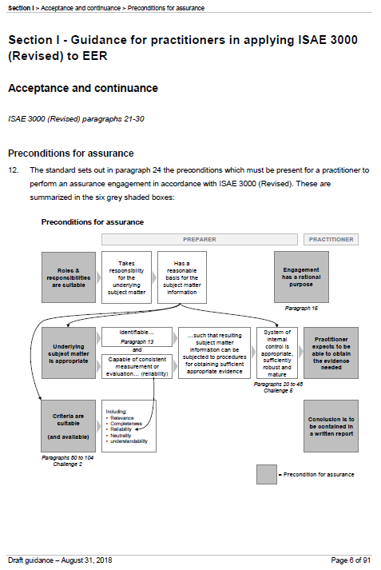
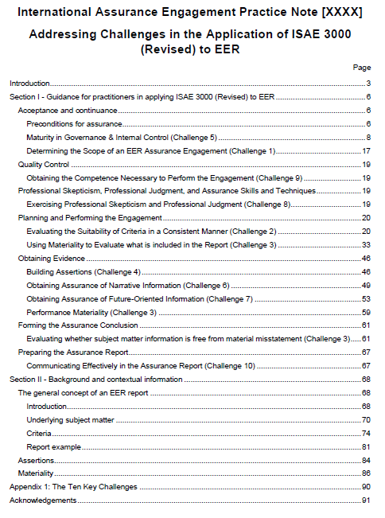
Recap of September Meeting
Presented a first draft of phase 1 guidance
Key areas for further consideration:
Guidance covering matters not explicitly addressed in ISAE 3000 (Revised) requirements
Consistency with ISAE 3000 (Revised) requirements
Suitability of criteria
Materiality
Structure and length need further work
Compliance with drafting conventions

Slide 3
Work since September
Updating draft guidance
Global discussion events
PAP calls & other outreach

Slide 4
This Meeting’s Agenda
Wednesday
Chapters 7 and 8
Chapters 1, 2 and 3
Suitability of Criteria
Materiality Processes
Introduction
New Overview Chapter
Preconditions
Friday
Chapter 6
Chapter 9
Chapters 10, 11 and 12
Governance & Internal Control
Performing Procedures & Building Assertions
Narrative
Future-Oriented
Misstatements
Next Steps
& agree process to finalize the exposure draft

Slide 5

Key issues raised in September
Guidance covering matters not explicitly addressed in ISAE 3000 (Revised) requirements
Preconditions for an assurance engagement
Assertions
Consistency with ISAE 3000 (Revised) requirements
Suitability of criteria
Materiality
Other
See issues paper
Chapter 3
Wednesday
Chapter 9
Friday
Chapter 7
Wednesday
Chapter 8
Wednesday

Slide 6

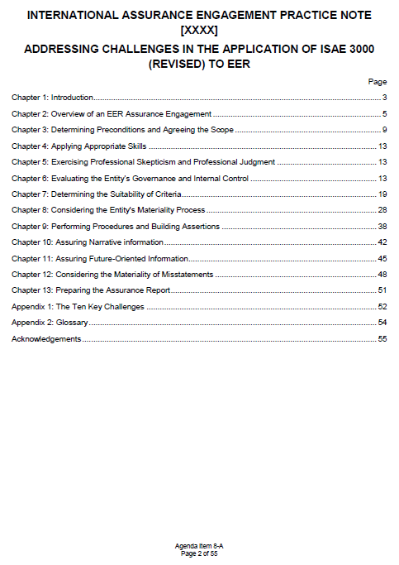
Consistency with ISAE 3000 (Revised) requirements
Suitability of criteria
Materiality

Slide 7
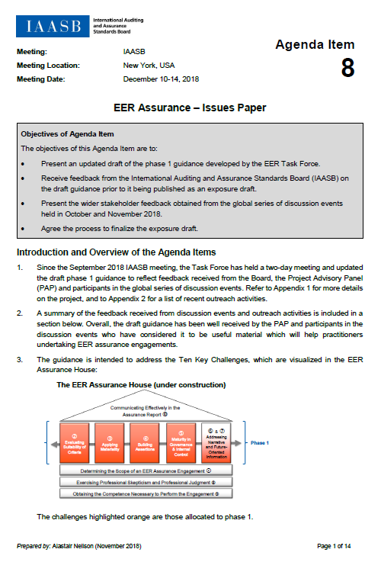

Suitability of Criteria
Criteria must be suitable in order for a practitioner to be able to accept the engagement – there are no ways around this.
Some measurement or evaluation uncertainty may exist, giving rise to some subjectivity. The criteria may still be reliable if they allow reasonably consistent measurement or evaluation.
Supporting disclosure about the level of uncertainty or precision may need to be included in the EER report.
Issues Paper
Paragraphs 19-23

Slide 8
‘Materiality Process’
A ‘materiality process’ is part of developing suitable criteria. This is what is covered in Chapter 8 of our guidance.
ISAE 3000 (Revised) mainly uses the term ‘materiality’ in relation to misstatements (Chapter 12 of our guidance), however ‘materiality process’ is the term widely used in practice for a preparer to develop relevant criteria.
Criteria from reporting frameworks are often not suitable on their own – they have to be developed further or supplemented by entity-developed criteria.
Issues Paper
Paragraphs 24-32

Slide 9


‘Materiality Process’
Two examples of criteria from different frameworks:
Issues Paper
Paragraphs 24-32
Example A
Example B
Framework requires the disclosure of the time spent by its employees on training during the period, measured in hours. Details on how to calculate this are provided.
Framework requires a description of the principal risks and uncertainties facing the entity.
Criteria for what items are relevant in the context of that specific entity
Excluding any immaterial items
Framework-setter has made a judgment about what the intended users want to know.
Left to the preparer to identify what the principal risks and uncertainties are for their entity (the relevant ones).
Preparer may not need to undertake a materiality process. Criteria already relevant.
Preparer may need to undertake a materiality process so that the criteria become relevant.

Slide 10
Discussion on the Updated Draft Guidance
Chapter 7
Determining the Suitability of Criteria
The IAASB is asked for its views on:
Whether the Task Force has appropriately responded to feedback given at the September 2018 meeting;
Whether the updated draft guidance is effective in assisting practitioners to address the issues related to each of the challenges that were allocated to phase 1; and
Whether further revisions are needed to the draft guidance in Agenda Item 8-A prior to it being published as an exposure draft for public comment.
Chapter 8
Considering the Entity's Materiality Process
Draft Guidance
Paragraphs 81 - 162

Slide 11
Chapter 1
Introduction
Chapter 2
Overview of an EER Assurance Engagement
Chapter 3
Determining Preconditions and Agreeing the Scope
Appendices

Slide 12
Matters considered further affecting whole document
Drafting Conventions
Issues Paper
Paragraphs 33, 34 and 38
Structure and Length
Name

Slide 13

Preconditions for an assurance engagement
Issues Paper
Paragraphs 11-13
Task Force has changed the focus in the guidance:
Explained more clearly the relationship of this to the preconditions in ISAE 3000 (Revised)
September 2018
December 2018
System of internal control needs to be sufficiently robust and mature
Process to prepare report needs to be appropriate in the engagement circumstances
adequate for the preparer to have a reasonable basis for the subject matter information and for the practitioner to expect to be able to obtain the evidence needed to support their conclusion.

Slide 14
Discussion on the Updated Draft Guidance
Chapter 1
Introduction
The IAASB is asked for its views on:
Whether the Task Force has appropriately responded to feedback given at the September 2018 meeting;
Whether the updated draft guidance is effective in assisting practitioners to address the issues related to each of the challenges that were allocated to phase 1; and
Whether further revisions are needed to the draft guidance in Agenda Item 8-A prior to it being published as an exposure draft for public comment.
Chapter 2
Overview of an EER Assurance Engagement
Chapter 3
Determining Preconditions and Agreeing the Scope
Appendices
Draft Guidance
Paragraphs 1 - 55

Slide 15
Chapter 6
Evaluating the Entity’s Governance and Internal Control

Slide 16
Discussion on the Updated Draft Guidance
The IAASB is asked for its views on:
Whether the Task Force has appropriately responded to feedback given at the September 2018 meeting;
Whether the updated draft guidance is effective in assisting practitioners to address the issues related to each of the challenges that were allocated to phase 1; and
Whether further revisions are needed to the draft guidance in Agenda Item 8-A prior to it being published as an exposure draft for public comment.
Chapter 6
Evaluating the Entity’s Governance and Internal Control
Draft Guidance
Paragraphs 56 - 80

Slide 17
Chapter 9
Performing Procedures and Building Assertions

Slide 18

Assertions
Included in the draft guidance as it was identified as a challenge for practitioners by respondents to the 2016 discussion paper.
Trying to explain more clearly the relationship between assertions and the characteristics of suitable criteria.
Issues Paper
Paragraphs 14-17
Subject matter information
Underlying subject matter
Assertions
Misstatement
Applicable criteria
The characteristics of subject matter information properly prepared using suitable criteria will reflect the five required characteristics of suitable criteria.

Slide 19
Characteristics of Suitable Criteria
Characteristics of Suitable Criteria | Paragraph A45 of ISAE 3000 (Revised)
Relevance | Relevant criteria result in subject matter information that assists decision-making by the intended users.
Completeness | Criteria are complete when subject matter information prepared in accordance with them does not omit relevant factors that could reasonably be expected to affect decisions of the intended users made on the basis of that subject matter information. Complete criteria include, where relevant, benchmarks for presentation and disclosure.
Reliability | Reliable criteria allow reasonably consistent measurement or evaluation of the underlying subject matter including, where relevant, presentation and disclosure, when used in similar circumstances by different practitioners.
Neutrality | Neutral criteria result in subject matter information that is free from bias as appropriate in the engagement circumstances.
Understandability | Understandable criteria result in subject matter information that can be understood by the intended users.

Slide 20
Assertions
Issues Paper
Paragraphs 14-17

Slide 21
Discussion on the Updated Draft Guidance
The IAASB is asked for its views on:
Whether the Task Force has appropriately responded to feedback given at the September 2018 meeting;
Whether the updated draft guidance is effective in assisting practitioners to address the issues related to each of the challenges that were allocated to phase 1; and
Whether further revisions are needed to the draft guidance in Agenda Item 8-A prior to it being published as an exposure draft for public comment.
Chapter 9
Performing Procedures and Building Assertions
Draft Guidance
Paragraphs 163 - 175

Slide 22
Chapter 10
Assuring Narrative information
Chapter 11
Assuring Future-Oriented Information
Chapter 12
Considering the Materiality of Misstatements

Slide 23
Discussion on the Updated Draft Guidance
Chapter 10
Assuring Narrative information
The IAASB is asked for its views on:
Whether the Task Force has appropriately responded to feedback given at the September 2018 meeting;
Whether the updated draft guidance is effective in assisting practitioners to address the issues related to each of the challenges that were allocated to phase 1; and
Whether further revisions are needed to the draft guidance in Agenda Item 8-A prior to it being published as an exposure draft for public comment.
Chapter 11
Assuring Future-Oriented Information
Chapter 12
Considering the Materiality of Misstatements
Draft Guidance
Paragraphs 176 - 221

Slide 24

Next steps
& agree process to finalize the exposure draft

