Slide 1
Redefining Value
IAASB Board Meeting
21 September 2017

Slide 2
About WBCSD and Redefining Value

Slide 3
WBCSD
The World Business Council for Sustainable Development is a global, CEO-led organization of around 200 forward-thinking businesses working together to accelerate the transition to a sustainable world.
Our mission is to accelerate the transition to a sustainable world by making more sustainable business more successful.
Our vision is to create a world where more than 9 billion people are all living well and within the boundaries of our planet by 2050.

Slide 4








































































































































































Our
Members

Slide 5
Redefining Value
Advancing the Measurement, Valuation and Reporting of non-financial aspects of business impacts and performance.​
The program’s objectives are to:​
Integrate natural and social capital measurement and valuation into corporate performance management and decision-making,​
Improve the effectiveness of both internal and external non-financial reporting, to reflect the true value of a company and to disclose true profit and cost,​
Accelerate progress to a world where more sustainable companies are recognized and rewarded - and are therefore more successful.​
​
​

Slide 6
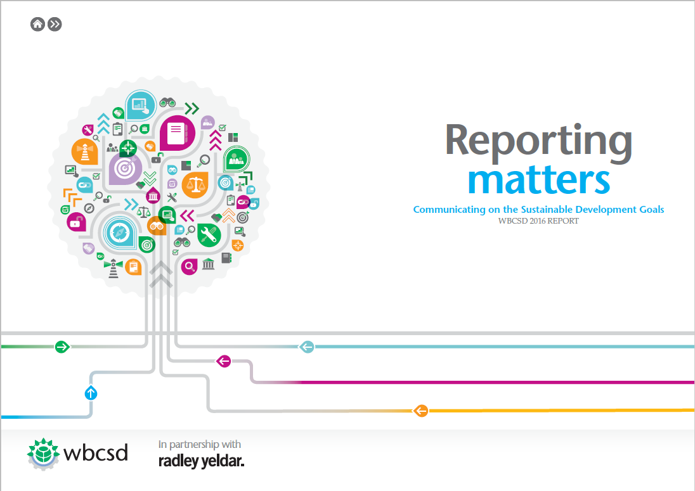



Redefining Value Projects
Reporting and Disclosure
Reporting Matters
The Reporting Exchange
Valuation
Natural Capital Protocol
Social Capital Protocol

Slide 7
Conservation and Financial Markets Initiative (CFMI)

Slide 8
CFMI Projects
Risk Management , Integrated Performance Management and Governance
Risk is seeking to achieve greater alignment in how sustainability risks are mainstreamed and managed
Purpose Driven Disclosure
PDD is designed to seek alignment on materiality & metrics as applied to sustainability information for internal management and for disclosure in mainstream reporting vehicles.
Assurance
Assurance aims to increase the number of companies obtaining assurance of their reports against international standards.

Slide 9
Assurance Project - Phases
Assurance 1.0
Understanding the issues
Assurance 2.0
Improving Standards
Assurance 3.0
Improving quality of practice

Slide 10
Assurance 1.0

Slide 11
Assurance 1.0 Project
WBSCD Report 2016
Strong member support for assurance
Not just about assurance but implications for all in the reporting supply chain
Maturity model
Assurance in the context of value creation
Revised standard or guidance to support ISAE 3000

Slide 12
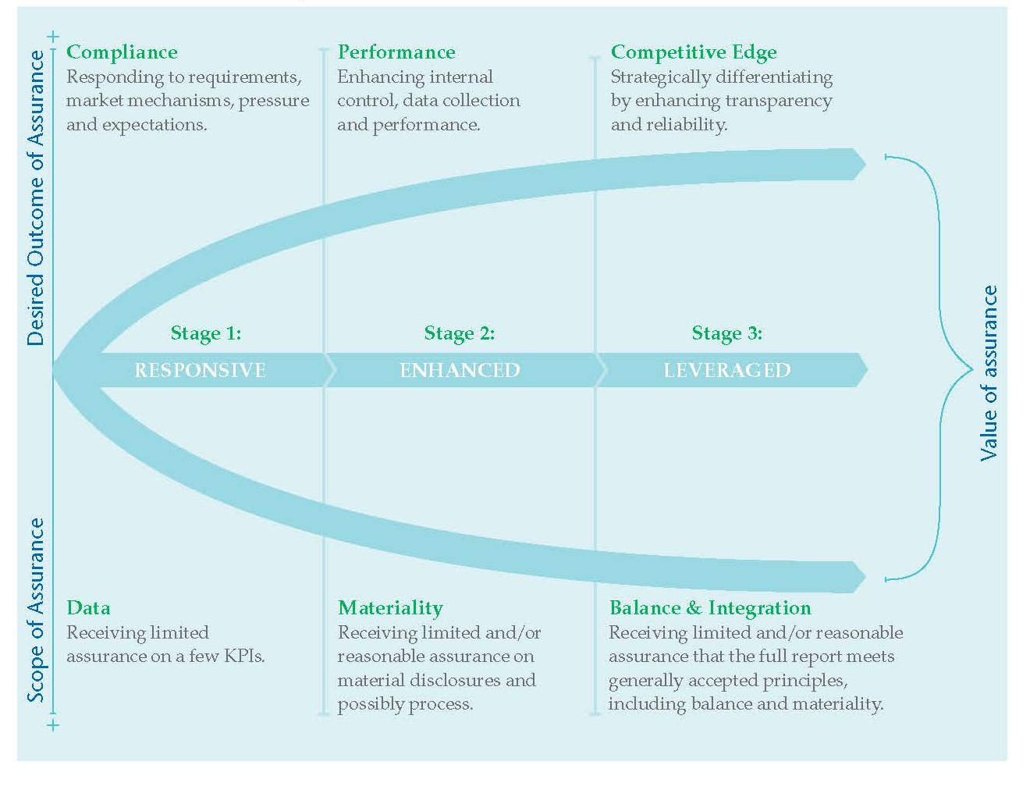
Assurance Maturity Model

Slide 13
Assurance 2.0

Slide 14
Assurance 2.0
Our aim is to ensure that sustainability information is considered alongside financial information in decision-making.
Achieving financial-grade quality for sustainability information integrated into a single report.
Assurance of sustainability information continues to be an issue for preparers and assurance providers. Investors have consistently stated that assurance is essential for them to have confidence in sustainability information.
Capital providers need to have trust and confidence in the information reported. To that end, external assurance provides a critical role in building that trust and confidence.

Slide 15
Understanding the Eco-System
Can I rely on and use the information…?
How assurance can add value…?
Financial Capital
Capital providers <Return on and of capital>
Objective: “Information is relevant and reliable for decision-making on resource allocation”
Activities, relationships and impacts
Company
<Business model>
Reporting
Nature of engagement:
consultancy
assurance
something else
External factors:
Regulations and regulators
Cultural/local factors
Resource constraints
Technical difficulties
Internal
Controls
Scope: “assurance of externally reported information to capital providers”
External Assurance
Provider
Board
Criteria:
Standards
norms
What is the risk of a material misstatement of…?
Subject matter:
Compliance
Performance
Outcomes

Slide 16
Terms of Reference – Project Aims
The aim of the new project is to strengthen the assurance of ESG information by:
Building consensus around the issues that need to be addressed to strengthen external assurance processes and outcomes;
Engaging with international and national standard setters such as the IAASB and participating in their processes to consider the development of guidance; and
Assisting the development of implementation tools to assist preparers, assurance providers and capital providers.

Slide 17
Assurance Working Group Members
Aditya Birla Group | GRI | Shift
AICPA | Honda | Social Value
Arcadis | IAASB | Solvay S.A.
CLP Group | International Integrated Reporting Council | Stora Enso
Deloitte | International Paper Company | Syngenta International AG
DNV GL | ICAEW | The Dow Chemical Company
ERM | KPMG | SAICA
EY | NBA | Volkswagen
Eskom | PwC
FSR Denmark | Philips
Denotes the companies that respondents to the IAASB consultation would advise that the IAASB collaborate with.

Slide 18
Assurance Work Streams
The Assurance 2.0 project will consist of a number of different strands of work all of which seek the support and engagement of our working group, and expert advisors.
Understanding investor needs and educating them on assurance
Company focused guidance
Assurance providers

Slide 19
Investor Needs
Whilst assurance of ESG information for many companies can be time consuming and expensive, it is imperative that businesses are aware of what it is investors are actually seeking from the assurance statement. Engaged with Ceres and PRI on this work.
This part of the project will involve a consultation with investors to establish the key issues around assurance of ESG information. We will also consider what education is needed to address the ‘expectation gap’ in external assurance

Slide 20
Company Focused Guidance
We are working with companies to develop a series of ‘pathfinder’ studies to support our work on developing practical guidance; these projects are more ‘experiments’ to test ideas and find new solutions.
We will seek to understand the current reporting and assurance issues faced by a member company and then work with key personnel to develop solutions drawing on existing frameworks and noting how those frameworks need to be modified or adapted to make them more effective. The results will be published as pathfinder studies and serve as an input to our work with standard setters and others to improve existing reporting frameworks.
We will develop guidance around the assurance engagement process.
Internal controls
We are developing guidance and a toolkit to help companies apply internal controls to non-financial data. This will be a fundamental step towards achieving reasonable external assurance

Slide 21
Standards and Guidance for Assurance Providers
National Standard Setters
We have established a group of leading national standard setting bodies and Accountancy Europe to establish common ground and ensure that all projects are aligned to fit within the frame of the IAASBs work but also address local needs
IAASB
We are currently seeking a key collaboration with IAASB for our work on assurance. This will be a significant opportunity to develop the guidance around external assurance of sustainability information and improve the quality of reported information, as an independent organization the IAASB will help to meaningfully develop the work in this field.

Slide 22
Project Plan
 | 2017 |  |  |  |  | 2018
 | Aug | Sep | Oct | Nov | Dec | Jan | Feb | Mar | Apr | May | Jun | Jul | Aug | Sep | Oct | Nov | Dec
INVESTORS*
White paper setting out issues
Education sessions
COMPANIES
Pathfinder studies x 3
Internal control toolkit
Guidance on assurance engagements
ASSURANCE PROVIDERS
IAASB EER Project
Network – National Assurance Standard Setters
Mapping
B. Knowledge Sharing
C. Mainstreaming practice guidance
ASSURANCE WORKING GROUP MEETINGS
Face-to-Face |  |  | CM |  |  |  |  | LD |  |  |  |  |  |  | CM
Conference Call
to be discussed and co-ordinated with Ceres
CM – Council Member
LD – Liaison Delegate

Slide 23
Next Steps
Finalisation of funding proposal and collaboration arrangements with IAASB
Complete some pathfinder study reports to share at the Council Meeting in Mexico
Draft of Internal Controls Toolkit for October/November
Assurance Working Group Closed Session – Council Meeting Mexico Wednesday 18 October 8.30am – 12.30pm.
Potential National Standard Setters Workshop in December

Slide 24
abela@wbcsd.org Our website: www.wbcsd.org

