Slide 1
ISA 600 – Group Audits
Len Jui, Task Force Chair
IAASB Meeting December 2019
Agenda Item 2

Slide 2
Task Force Members and Staff
Task Force members
Len Jui, Task Force Chair (supported by Susan Jones)
Robert Dohrer
Rich Sharko (supported by Jamie Shannon)
Wolf Böhm
Josephine Jackson
Dora Burzenski (Correspondent member)
Staff
Jasper van den Hout
Dan Montgomery
Page 2

Slide 3
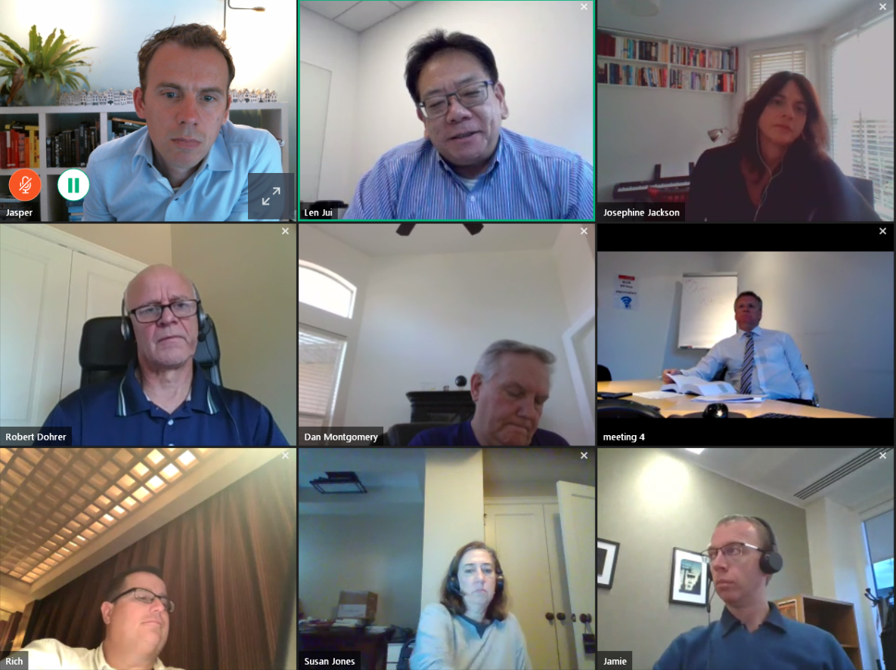
Task Force’s Activities
3-day Task Force meeting
4 Video conferences…
Page 3

Slide 4

Objectives
Obtain the Board’s views on the recommendations of the ISA 600 Task Force for the proposed revisions to ISA 600
Page 4

Slide 5
Overview
Proposed ISA 600 (Revised)
Outreach
Way Forward
Conforming and Consequential Amendments
Page 5 |

Slide 6
Outreach
Page 6 |

Slide 7
Outreach – IOSCO
Met with IOSCO Committee 1, Auditing Subcommittee and IOSCO Committee 1
IOSCO Committee 1, Auditing Subcommittee
Support for definition engagement team
Focus on how group engagement team can overcome access issues
Risk-based approach: clarify that auditor still needs to test material account balances, classes of transactions and disclosures (330.18)
IOSCO Committee 1
Going Concern: would like to see more application material on going concern matters at the component that would impact the group financial statement and/or other components
Call for separate standard for component auditors
Agree it is outside of the scope of 600

Slide 8
Outreach – Forum of Firms
Deep dive session
Presentation
Break out session on risk-based approach
Panel discussion on access and documentation
Matters raised include
Group engagement team needs to do additional work on fraud, going concern, related parties
Group engagement team should treat component auditors as extension of group engagement team
Restrictions to access to people and information
Often there are ways to overcome access issues – focus on overcoming restrictions and identifying restrictions timely
Documentation
Guidance needed on what should be documented when reviewing component auditor’s work
Implementation support will be very important

Slide 9
Outreach – GPPC
Clarify scope of the standard and clarify that it builds on other standards
For example, when GET audits all components – does ISA 600 apply?
Is it management’s or auditor’s view on what is a component?
Further develop guidance on how to overcome access issues
Support for removing concept of group-wide controls
Risk-based approach
The GET will likely spend more time on coordination/ communication with component auditors
Clarify involvement of component auditors in risk assessment and identifying, assessing and responding to RoMM
Clarify communications between group engagement team and component auditors
Why remove option to ‘review financial information of component’?
Address group engagement team’s work on fraud, going concern, related parties
Time is needed for field testing – 120-day exposure period not enough

Slide 10
Outreach – SMPC and Hong Kong
SMPC
Held two teleconferences – September 30 and December 4
Generally supportive of changes
Concerns with respect to the definition of engagement team
Clarify involvement of component auditors in risk assessment and identifying, assessing and responding to RoMM – Communication should be two-way
Requirement on going concern (paragraph 41C) – include guidance about how this works in practice
Hong Kong Financial Reporting Council
Clarify documentation requirement – what is GET expected to document?
Signing partner issue

Slide 11
Outreach – Hong Kong Outreach
Hong Kong Institute of Certified Public Accountants
Two meetings – Quality Assurance Team (Inspectors) and Auditing Assurance Standards Committee
Quality management at the network level influences involvement of group engagement team in the work of component auditors
Clarify documentation requirement
What is GET expected to document?
Stronger linkage with ISA 230

Slide 12
Proposed ISA 600 (Revised)
Page 12 |

Slide 13
Key Enhancements
Materiality
New definition of aggregation risk
Changed ‘component materiality’ to ‘component performance materiality’
Clarified the interactions between the group engagement team and component auditor under the risk-based approach
Group engagement team has overall responsibility, component auditors may be involved
When component auditors are involved, the group engagement team needs to direct, supervise and review their work
Clarified and strengthened the group engagement team’s responsibilities related to fraud, related parties, going concern and subsequent events
Enhanced requirements and AM re: nature timing and extent of direction, supervision and review and two-way communication between the GET and CAs
Enhanced documentation requirement

Slide 14
Matter for IAASB Consideration
Question 1
The IAASB is asked for its views on the changes to proposed ISA 600 (Revised) as presented in Agenda Item 2-B.
Page 14

Slide 15
Structure of Board Discussion
Section | Requirement Paragraphs | Application Material Paragraphs
Scope, Objectives, Definitions | 1-10A | A1A-A5C
Leadership Responsibilities for Managing and Achieving Quality, Acceptance and Continuance | 11A-13 | A9A-A12H
Understanding the Entity and Its Environment | 17-17A | A23-A29B
Materiality | 17B | A29C-A29F
Assessing and Responding to RoMM | 20A-37 | A29G-A56
Quality Management when CA Are Involved:
RER, Competence and Capabilities | 37A-37C | A57A-A57Q
Engagement Performance, Two-way Communication | 37D-41A | A57R-A61
Related Parties, Going Concern, Subsequent Events | 41B-41E | A61A-A61B
Evaluating SAAE, Auditor’s Report, Communications with Group Management and TCWG | 44-49 | A61C-A66
Documentation | 50 | A67-A67A

Slide 16
Conforming and Consequential Amendments
Page 16 |

Slide 17
Conforming and Consequential Amendments
Consequential amendment made to ISA 300 based on discussion with Board in September 2019
Added requirement for the engagement partner to review the overall audit strategy and plan for all audits of financial statements
Staff performed an initial assessment on whether other conforming or consequential amendments are needed

Slide 18
Matter for IAASB Consideration
Question 2
The IAASB is asked for its views on the proposed conforming and consequential amendments as presented in Agenda Item 2-D.
Page 18

Slide 19
Way Forward
Page 19 |

Slide 20
Way Forward
Working towards the approval of the exposure draft of proposed ISA 600 (Revised) at the March 2020 IAASB meeting
After the December 2019 meeting the Task Force will focus on
Addressing comments from the Board, as well as feedback received on outreach
Updating the appendices in extant ISA 600
Staff performed an initial assessment to identify potential changes
Enhancing the application material in certain areas
Task Force continues to liaise with stakeholders, IESBA and other IAASB Task Forces
Outreach scheduled with IAIS, IFIAR, IOSCO, INTOSAI and PCAOB

