Slide 1
ISA 600 – Group Audits
Len Jui, Task Force Chair
IAASB Meeting December 2019
Agenda Item 2

Slide 2
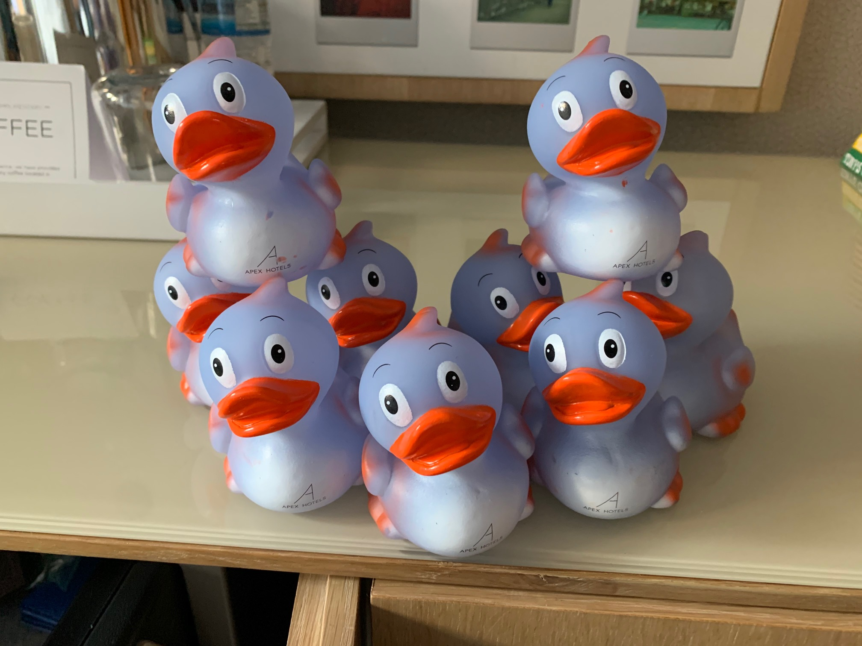
An Update from the Group Audit Pond
Page 2

Slide 3
Overall Comments
General support for direction and principles of risk-based approach
But wording doesn’t always describe what is intended
Need to better explain and highlight that the group engagement team has overall responsibility for identifying, assessing and responding to RoMM of the group financial statements, but component auditors may be involved (and, in many cases, may need to be involved)
Questions and concerns about
Consistency between requirements and application material
Consistency of terminology (e.g., engagement team, group engagement team, component auditor)
Expectations of the group engagement team or group engagement partner
More clarity or guidance would be helpful in certain areas (e.g., common controls, use of shared service centers)

Slide 4
Task Force Approach to Comments
Considered all comments raised by Board members during the Monday plenary session, as well as the written comments received
Staff developed a ‘heat map’ of comments to determine the paragraphs or sections of the standard to update this week
Generally have not at this point considered revisions to paragraphs that came directly from extant ISA 600
Task Force will further consider whether revisions to these paragraphs are needed based on other changes to the standard

Slide 5
Revised Sections
Introduction – responsibilities of group engagement team and involvement of component auditors (new paras. 6A and A1C-A1D)
Definitions – component, component performance materiality, and group engagement team (9(a), 9(d), 9(i) and new AM paragraph A4A)
Understanding the entity and its environment
17 and A23-A23C, 17A and A29A-A29B
Materiality (17B and A29C-A29F)
Assessing the risks of material misstatement (20A and A29Fa-A30)
Responding to the assessed RoMM (24 and A30A-A30M)
Involvement of component auditors (37B and A57L)
Related parties, going concern, subsequent events (41B-41D)
Some application material still to be developed

Slide 6
Other Board Comments to be Addressed in Next Complete Draft
Task Force will discuss all comments with a focus on the following areas based on the heat map of comments received:
Consolidation process – branches and divisions (A5B)
Access to people and information (11B-13)
Evidence from an audit of a component performed for another reason (24A)
Two-way communication (40-41)
Documentation (50)
Includes related application material for the requirements paragraphs above
Editorial comments and suggestions

Slide 7
Way Forward
Page 7 |

Slide 8
Way Forward
Still working towards the approval of ED at the March 2020 IAASB meeting
Staff will continue working on the complete draft of the standard to address Board comments and submit for Task Force review
Plan to submit an updated draft for Board review by December 20
Comments back to the Task Force no later than January 15, 2020
Task Force will consider those comments in its meeting in late January
Conforming amendments and appendixes will be presented in January Board call
Task Force will then further update the draft standard, with a goal to provide the updated draft to the Board by February 21, 2020 for the March 2020 meeting
Board would be asked to submit comments in advance of the March meeting
Continued liaison and coordination with the ISA 220 Task Force
Planned outreach in Q1 2020, including to obtain feedback on the application of the proposed standard in practice

