Slide 1

Audits of Less Complex Entities (LCEs)

Slide 2
LCE Working Group
LCE Working Group Members
Roger Simnett (Chair)
Isabelle Tracq-Sengeissen
Kai Morten Hagen
Chun Wee Chiew
Rich Sharko
Brendan Murtagh
Gordon Cummings
Christopher Arnold
Meetings since March 2019
One in person meeting (October 2019)
One teleconference (November 2019)
Supported by IAASB Staff
Beverley Bahlmann
Kalina Shukarova Savovska

Slide 3


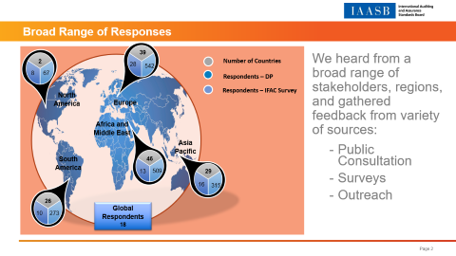
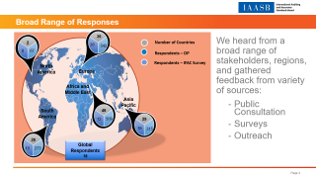
Broad Range of Responses
39
We heard from a broad range of stakeholders, regions, and gathered feedback from variety of sources:
Public Consultation
Surveys
Outreach
93
Respondents to the DP
2
28
Number of Countries
542
8
67
Respondents – DP
North America
Respondents – IFAC Survey
Europe
Africa and Middle East
Asia Pacific
South America
46
13
509
29
16
315
26
Global Respondents
18
10
273

Slide 4
Stakeholder Constituencies

Slide 5

Growing Regional and Jurisdictional Initiatives Targeted at LCEs
“Smaller entities make a critical contribution to the world economy, and quantitatively the majority of audits globally are audits of smaller entities.”
Jurisdictions who have developed or are in a process of developing LCE / SME requirements:
Nordic Federation
Sri Lanka
France
Belgium
India
Germany
Morocco
Page 5

Slide 6
Key Messages
Strong support for the IAASB’s work in this area
Need for a timely solution (urgency)
Need for a solution that is global
Concerns that regional and jurisdictional initiatives primarily related to a separate standard, are working against global solution
Solution is not limited to one action, encouragement that the IAASB consider all of the possible three actions
Standards need to become more accessible and searchable (electronic format)
Page 6

Slide 7
Overarching Themes
“Root Causes” of the Challenges Related to Applying the ISAs
Overall length and volume of the standards
Complexity is an issue, as well as increasing level of prescriptiveness
Some prescribed procedures in some cases do not have a benefit or add little value
Lack of support tools and guidance
Specific ISAs highlighted include ISA 230 (documentation), ISA 240 (fraud), ISA 315 (Revised) (identifying and assessing risks) and ISA 540 (Revised) (accounting estimates)
Description of “Less Complex Entity”
Support for a principle-based approach using qualitative characteristics
Further consideration needed about qualitative characteristics, including other risk-based factors
A number of views were expressed for excluding ‘listed’ or ‘public interest entities’ expressed
Caution that description needs to be in context of outcomes of IAASB’s work – so that description is relevant

Slide 8
Possible Actions (Part 1)
Revising the ISAs
Written Responses:
Preference for ‘building-blocks’ approach
Mixed views about targeted approach versus a ‘big bang’
Would be most effective solution in addressing issues/challenges, but recognition that not timely
Need simpler language and principles-based requirements
Need more scalability and proportionality
IFAC Survey:
Paris LCE Conference:
45% Building blocks
35% Greater Focus on what the auditor needs to do

Slide 9
Possible Actions (Part 2)
Separate Standard
Written Responses:
More timely - would be quicker than revising all of the ISAs
Needs to be a reasonable level of assurance
Little support for development of a separate standard using a different framework – i.e., not based on the ISAs
IFAC Survey:
Paris LCE Conference:
60% Based on ISAs
38% Based on a Different Framework

Slide 10
Possible Actions (Part 3)
Guidance
Written Responses:
Not seen as a standalone solution
Need identified, but should support the other two options as appropriate
IFAC Survey:
Paris LCE Conference:
44% Comprehensive ISA Guide
20% International Auditing Practice Note (IAPN)

Slide 11
Proposed Way Forward
Initial Discussion
December 2019
From the responses it is clear that changes to the standards are needed, but what those specific changes need to be is not yet clear
The LCE Working Group proposes a combination of approaches with two distinct workstreams that would run in the same time:
LCE Focused Workstream to explore and develop a separate standard for audits of LCEs
ISA Focused Workstream to explore different approaches to revise the ISA
Synergies between the two workstreams (work from one workstream will inform the other)
Recommendations
March 2020
LCE Focused Workstream
Medium-term actions
(3-4 years)
ISA Focused Workstream
Shorter-term actions
(1‒3 years)
Longer-term actions
(5+ years)
Page 11

Slide 12
Workstreams – Proposed Direction
LCE Focused Workstream | ISA Focused Workstream
In the short- to medium-term: Determine the most appropriate basis for developing a separate standard (taking into account feedback from DP and learning from the experience of others) Develop a standard (or other action) accordingly Explore if anything else is needed to support such a standard and work with others (such as IFAC and NSS) | In the shorter-to medium-term: Exploring different approaches to revising the ISAs, including consideration of whether (and how) more ‘immediate’ changes could be made Consideration of respondents comments about specific ISAs identified as challenging and how these challenges can be addressed
 | In the longer-term: Consideration of changes to the ISAs more broadly

Slide 13

Feedback Statement
Feedback Statement part of proposal for work on LCEs:
Summarizing what the IAASB has heard from stakeholders (DP, Survey and Paris roundtable)
To keep stakeholders informed of progress in relation to audits of LCEs
Page 13

Slide 14
Questions for IAASB
Question 1:
The IAASB is asked for its views about the direction for the possible way forward as described in paragraph 76 of Agenda Item 6?
Question 2:
The IAASB is asked whether it agrees that the draft Feedback Statement should be published?
Page 14

Slide 15
Page 15

