Slide 1

ISQM 1
Presented by:
Karin French, ISQM 1 Task Force Chair
IAASB Meeting December 2019
Page 1

Slide 2
ISQM 1 Task Force
Members
Karin French – Chair
Chun Wee Chiew
Julie Corden
Nicolette Bester
Denise Weber
Correspondent members
Robert Dohrer
Josephine Jackson
PCAOB Observers
Keith Wilson
Megan Zietsman
Page 2

Slide 3
ISQM 1 Task Force Focus Areas
Scalability of the standard
Firms tailoring the SOQM
PIOB public interest issue:
“The length and complexity of the standard are a major concern, as they may impede the implementation by smaller firms. Scalability needs to be addressed as well and guidance may be provided for smaller firms.”
Complexity and prescriptiveness of requirements
A standard that can be applied in all circumstances
SMPC: Supportive of focus areas, but still concerned about granularity of quality objectives and requirements being over and above extant requirements

Slide 4
Restructuring of Proposed ISQM 1 and Nature of the Components
Why restructure?
Reduce complexity and assist in clarifying the nature of the components and how they interrelate
Other benefits
More emphasis on leadership responsibility for SOQM
Components less siloed and more integrated
Applying, and complying with, relevant requirements | Applying, and complying with, relevant requirements
System of quality management | System of quality management, includes assigning responsibility for SOQM
Governance and leadership | The firm’s risk assessment process
The firm’s risk assessment process | Governance and leadership (QO only)
Relevant ethical requirements | Relevant ethical requirements (QO only)
Acceptance and continuance | Acceptance and continuance (QO only)
Engagement performance | Engagement performance (QO only)
Resources | Resources (QO only)
Information and communication | Information and communication (QO only)
 | Specified responses
Monitoring and remediation process | Monitoring and remediation process
Networks | Networks
Service providers | Service Providers
 | Evaluating the SOQM
Documentation | Documentation

Slide 5
Restructuring of Proposed ISQM 1 and Nature of the Components
Question 1:
Does the IAASB support the restructuring of the standard, including:
(a) Moving the firm’s risk assessment process before governance and leadership;
(b) Including essential application material to highlight governance and leadership;
(c) The location of the requirements dealing with the responsibilities of firm leadership; and
(d) The new sections for “specified responses” and “the evaluation of the SOQM”?
Page 5

Slide 6
The Firm’s Risk Assessment Process: Quality Risk Considerations
Why introduce quality risk considerations (QRCs)?
Tailoring the SOQM to the nature and circumstances of the firm and the engagements it performs is more prominent
Helps link between quality objectives and responses
Helps firms to identify quality risks
More robust risk identification and assessment process
Improve consistency in implementation across firms
Supports enforcement and “inspectability”
Some QRCs may also address certain issues / feedback, e.g., increased focus on expectation of stakeholders and focus on nature and circumstances of engagements (to emphasize public interest)
Approach to quality risk considerations
Introduce common QRCs (although not every QRC will be relevant to every quality objective in all circumstances)
Emphasis on nature and circumstances of the firm and engagements it performs
Application material includes specific examples of how QRCs apply to each component
Page 6

Slide 7
The Firm’s Risk Assessment Process: Quality Risk Considerations
Question 2:
Does the IAASB support introducing common QRCs and locating the QRCs in the firm’s risk assessment process?
Question 3:
Does the IAASB agree with the QRCs specified in paragraph 22E(b) of Agenda Item 7-A, and the related application material in paragraphs A24N and A24O of Agenda Item 7-A (i.e., are there additional QRCs, or do any QRCs need to be removed)?
Question 4:
With respect to the examples in paragraphs A24R, A35A, A112A and A159A of Agenda Item 7-A, does the IAASB support:
(a) The granularity of the examples; and
(b) Locating the examples in the application material in the standard, or in guidance separate from the standard?
Page 7

Slide 8
The Firm’s Risk Assessment Process: Other Matters
Revisions to demonstrate the flow of information across the SOQM and integration of components
Establishing additional quality objectives – increased scalability and clarity that firms may not always need to establish additional quality objectives
Essential application material to indicate that specified responses in the standard will not be sufficient
More proactiveness introduced through requiring the firm to establish policies or procedures to identify information that may indicate changes affecting the SOQM
Definition of “quality risks” – threshold now built in to definition and related application material
QRCs help with identifying quality risks, therefore lessen the need for the threshold in the requirement
Page 8

Slide 9
The Firm’s Risk Assessment Process: Other Matters
Question 5:
Does the IAASB support the proposed changes to paragraphs 22G and 22H of Agenda Item 7-A to improve the proactivity of the firm in identifying information that may indicate changes in the factors affecting the SOQM?
Question 6:
Does the IAASB support the changes to the definitions related to the firm’s risk assessment process (paragraphs 19(p), 19(q) and 19(qA) of Agenda Item 7-A)?
Page 9

Slide 10
The Approach to Quality Objectives and Responses in the Components
Why refine quality objectives and responses?
Reduce perceived prescriptiveness of the standard
Reduce complexity and length
Helps to address applicability across all firms performing other types of engagements
Reducing responses also emphasizes that the specified responses in the standard are not sufficient for a firm to achieve the objective of the standard
Addresses concerns about inconsistency in responses across components
All responses relocated to one section “specified responses”
Further emphasizes responses in the standard are not sufficient
Improves flexibility as responses may address multiple quality risks across components – also supports better integration of components
Page 10

Slide 11
The Approach to Quality Objectives and Responses in the Components
Question 7:
Does the IAASB support how the quality objectives and responses have been adjusted and refined in the governance and leadership component and engagement performance component (paragraphs 23 and 36 of Agenda Item 7-A)?
Question 8:
Does the IAASB support relocating responses for all components to a separate section of proposed ISQM 1, “Specified Responses” (paragraph 41A of Agenda Item 7-A)?
Page 11

Slide 12
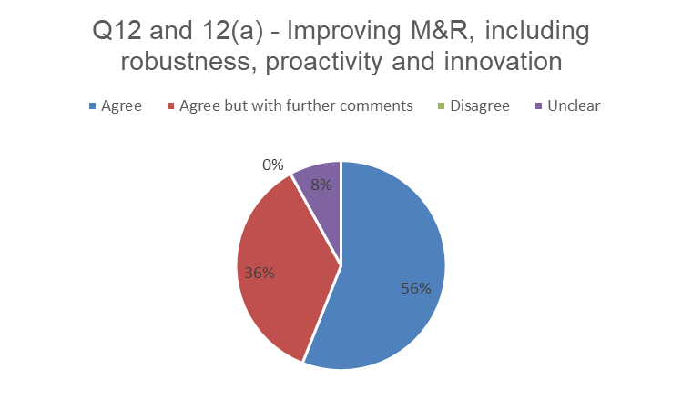
Monitoring and Remediation Process (M&R): Feedback from Respondents
Page 12

Slide 13
Monitoring and Remediation Process: Risk-Based Approach
Risk-based approach to M&R is important as it drives
The nature, timing and extent of the monitoring activities
The nature, timing and extent of root cause activities
Remediation activities (e.g., urgency of remediation)
But: The need to identify and assess quality risks is redundant as responses are fulsome in this component
Requiring firms to still apply the firm’s risk assessment process to M&R is causing complexity
Requirements in M&R already point to risk-based approach
Monitoring activities – factors to be considered in determining nature, timing and extent of the monitoring activities are risk-based
Root cause analysis and remediation - severity and pervasiveness of identified deficiencies drives the nature, timing and extent of root cause procedures, and remediation
Therefore propose to state what the quality risk is for M&R
Page 13

Slide 14
Monitoring and Remediation Process: Risk-Based Approach
Question 9:
Does the IAASB support the ISQM 1 TF’s proposed approach to embedding risk in the monitoring activities through directly stating the quality risk for monitoring activities?
Question 10:
Does the IAASB agree with the quality risk for monitoring activities, i.e., to identify deficiencies that, individually or in aggregate, could result in the system of quality management not providing reasonable assurance that the objectives of the system have been achieved?
Question 11:
Does the IAASB support how the concept of risk has been embedded in the root cause analysis and remediation activities, i.e., through focusing on the severity and pervasiveness of identified deficiencies?
Page 14

Slide 15
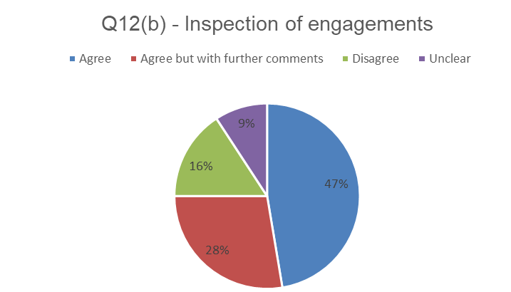
Monitoring and Remediation Process: Feedback from Respondents
Page 15

Slide 16
Monitoring and Remediation Process: Inspection of Engagements
ISQM 1 TF undertook outreach with GPPC firms to help understand:
What other types of monitoring activities firms currently perform and their benefits
What other mechanisms firms use to evaluate the quality of the work undertaken by the engagement partner (other than through engagement inspections)
Outreach feedback:
Other types of monitoring activities largely comprise inspection of in-process engagements, although these vary in nature:
Fulsome inspections
Focused inspections on particular aspects of the engagement
Inspections as the engagement progresses
Firms using a variety of indicators / factors for identifying engagements that need to be selected
Technology being used to identify characteristics in engagements indicating the need for selection
Although firms using indicators/factors to identify engagements, this is not the monitoring activity – the monitoring activity is still inspecting the engagements to determine if a deficiency has occurred, and rectify the issue before report is issued
Page 16

Slide 17
Monitoring and Remediation Process: Inspection of Engagements
Outreach Feedback:
Suggestion that if in-process reviews indicate an issue with an engagement partner, firm would likely inspect completed engagements for that partner
Challenges with other types of monitoring
Lack of clarity of difference between a response and a monitoring activity
Collating and documenting – monitoring is a continual information flow
Possible blurring of responsibility for quality (i.e., reviewers become the bearers of the responsibility)
Resource availability
Benefits
Focused on engagements where quality risks likely to arise
Continual and iterative process, more proactive and preventative and timely (completed engagements is after the fact)
More supportive and positive approach
Facilitates remediation sooner – including correcting other engagements where issue is more pervasive
Variety of other information is used to evaluate quality of engagement partners - e.g.:
360 feedback to evaluate culture partner creates on engagement, volunteering for quality initiatives, compliance with policies or procedures, involvement in consultations
Page 17

Slide 18
Monitoring and Remediation Process: Inspection of Engagements
ISQM 1 TF views: need to improve the flexibility and improve focus on risk
Inspection of completed engagements alone is not enough – firms will need to do more monitoring
Standard needs to do more to encourage proactive and preventative monitoring activities
Selecting engagements for inspection is a combination of:
Selecting engagements based on risk
Selecting engagement partners
….and taking into account other monitoring activities performed
Page 18

Slide 19
Monitoring and Remediation Process: Inspection of Engagements
Question 12:
Does the IAASB support the revisions to paragraph 45 of Agenda Item 7-A, that focuses on the effect of other monitoring activities on the selection of engagements for inspection, the appropriate combination of selecting engagements and engagement partners and the quality risks arising from the nature and circumstances of the firm’s engagements?
Question 13:
Does the IAASB support adjusting the application material to improve the flexibility of the standard, through removing the reference to three years in the context of the selection of engagement partners on a cyclical basis?
Page 19

Slide 20
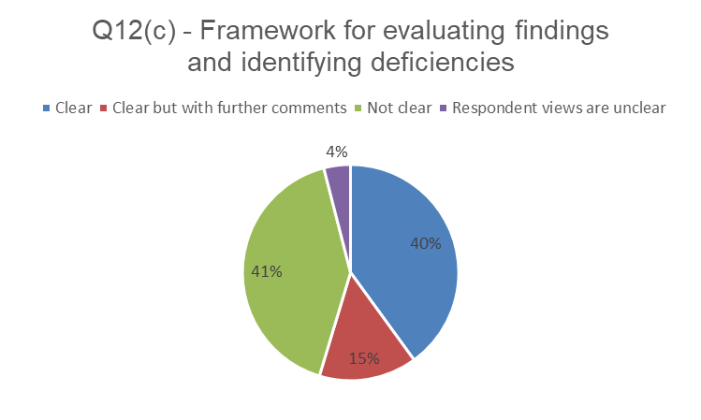
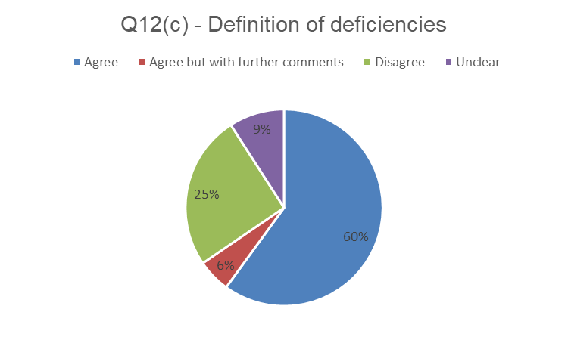
Monitoring and Remediation Process (M&R): Feedback from Respondents
Page 20

Slide 21
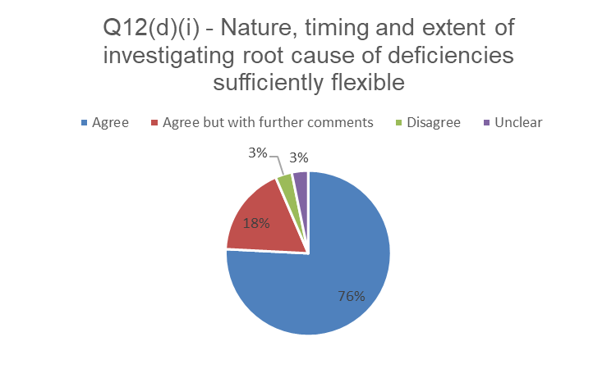
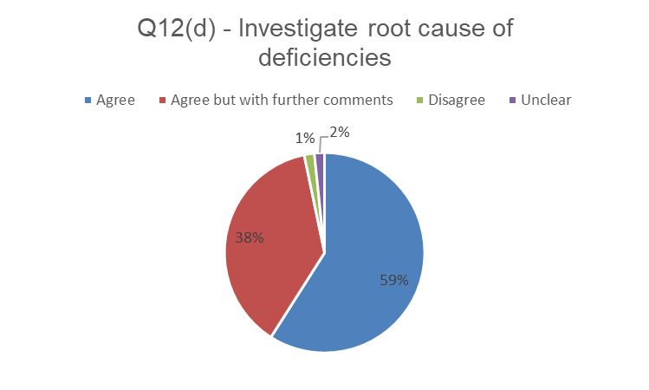
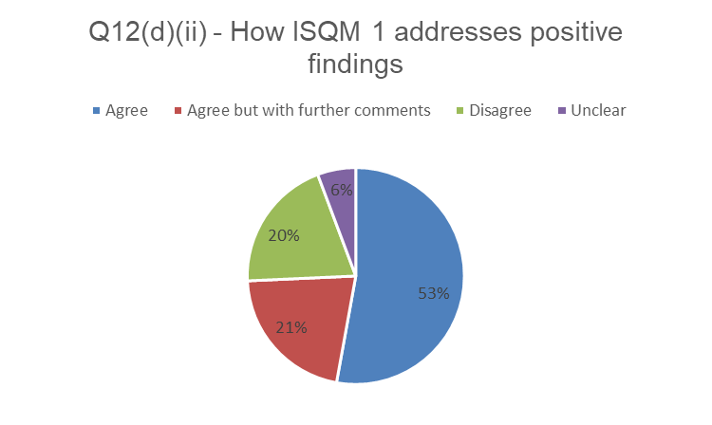
Monitoring and Remediation Process (M&R): Feedback from Respondents
Page 21

Slide 22
Monitoring and Remediation Process: Findings and Deficiencies
Question 14:
Does the IAASB support the definitions of “deficiency” and “finding,” and is the difference between a “finding” and a “deficiency” clear (see paragraphs 19(a) and 19(gA) of Agenda Item 7-A)?
Question 15:
How could the requirements for evaluating findings and identifying deficiencies be made clearer?
Page 22

Slide 23
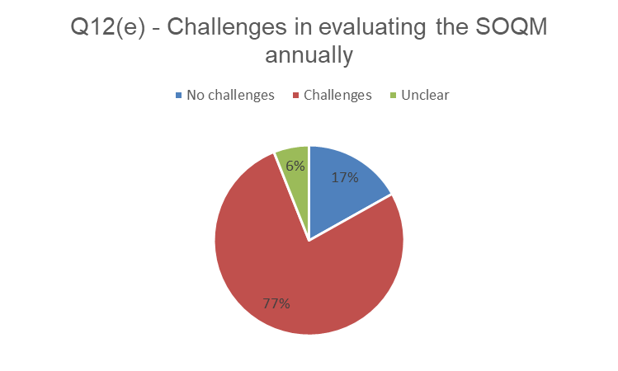
Evaluating the SOQM: Feedback from Respondents
Page 23

Slide 24
Evaluating the SOQM
Purpose: Reinforces that leadership is responsible for the SOQM
Self-review threat does exist, but purpose is for leadership to be responsible, accountable and aware of whether the system is operating so that appropriate action can be taken
What is the evaluation of the SOQM – what is focuses on affects the information leadership would use in undertaking the evaluation, and whether it is over a period, or at a point in time
Backward-looking: Did the SOQM provide reasonable assurance that engagements performed and reports issued over a period were appropriate?
As-of date: Does the SOQM provide reasonable assurance that engagements that are being performed, or that will be performed, and reports to be issued will be appropriate?
Performance evaluations of leadership relocated to this section
Evaluation of the SOQM may be an indicator of the performance of leadership
Reinforces leadership’s responsibility for the SOQM
Page 24

Slide 25
Monitoring and Remediation Process: Findings and Deficiencies
Question 16:
Does the IAASB support the intended purpose of the evaluation of the SOQM, i.e., that it reinforces the responsibility and accountability of firm leadership for the SOQM and their responsibility to take further action in response to the outcome of the evaluation?
Question 17:
The IAASB is asked to share their views what the evaluation of the SOQM should be focused on in the standard, i.e.:
The evaluation determines whether the system provides reasonable assurance that the objectives of the system have been achieved over a period of time; or
The evaluation determines whether the system provides reasonable assurance that the objectives of the system will be achieved?
Page 25

Slide 26
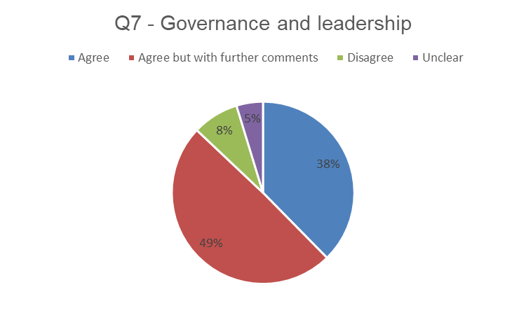
Governance and Leadership
Page 26

Slide 27
Governance and Leadership
Question 18:
Does the IAASB agree with the revised quality objectives for governance and leadership in paragraph 23 of Agenda Item 7-A?
Page 27

Slide 28
Engagement Performance
Question 19:
Does the IAASB agree with the revised quality objectives for engagement performance in paragraph 36 of Agenda Item 7-A?
Page 28

Slide 29
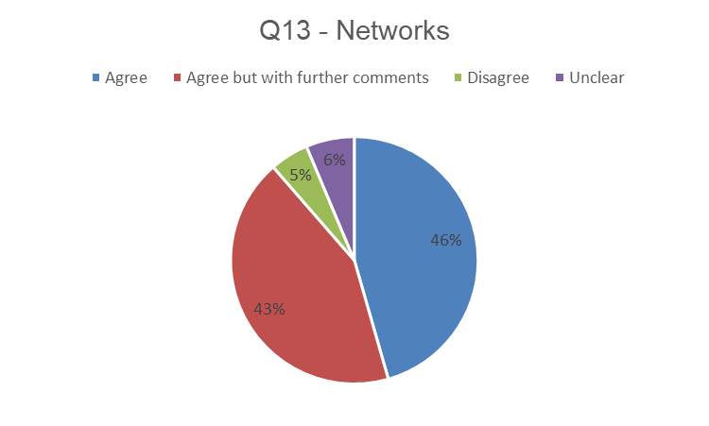
Networks - Feedback from Respondents
PIOB public interest issue:
“Investors and those who use audit services from a global “branded firm” should receive uniform quality from that brand. ISQM 1 should contemplate the coordination at network level of all those aspects that affect AQ of that brand. The standard has made some progress, but QMS should also be set at network level with a focus on internal inspections and quality control monitoring.”
Page 29

Slide 30
Networks
ISQM 1 TF view:
Requirements for networks are not appropriate for the reasons explained in the ED
Some enhancements can be made in ISQM 1 to help promote consistency when it is appropriate
Networks will be impacted by ISQM 1, but this impact needs to be better understood
ISQM 1 TF undertook outreach with GPPC firms to help understand impact of ISQM 1
Outreach feedback:
ISQM 1 has created multiple opportunities:
Implement activities in the SOQM targeted at improving quality (i.e., more firm buy-in as it is now a must, rather than a nice to have)
Stand-back on how SOQMs are currently implemented across the network, and how can get to more commonality
Emphasize network role is to support firms (not direct) and that firms are the owners of their SOQM and can’t just accept what they get
Currently looking for good practices in network firms that can globalize
Some networks set up global groups, e.g., “governance group”
Networks focused on documenting network requirements and services - goal is to push consistency as impracticable to have multiple member firms seeking the same information
Page 30

Slide 31
Networks
Outreach feedback:
Varying approaches in terms of how networks are planning to approach implementation and involvement of network firms – noted that a feedback loop is needed from the firms back to the network
Networks developing various tools to support firms, e.g., a tool for firms to use to facilitate risk identification and assessment
Networks may set common quality objectives and responses across the network, but will depend on the extent of similarities in risks, and commonality across firms
Firms expected to supplement at a jurisdictional level as risk at firm level may differ
Monitoring of network requirements and services – a portion will be monitored through engagements, and some will need to be monitored at the network level (e.g., similar to internal audit function)
Networks may need to become more agile and nimble in responding to information from firms
Collating information from firms is a challenge - continue to enhance technology tools at network level to collate input from firms
Further outreach still to take place: other firms, regulators and respondents who raised concern about networks
Page 31

Slide 32
Networks
Revisions to the standard:
New requirement proposed: firm to obtain information from the network about how the network determines that network requirements have been appropriately implemented across the network firms
Enhancements to clarify what the firm is expected to evaluate with respect to network requirements and network services
Clarity on the work effort needed to support the evaluation of network requirements and network services
Page 32

Slide 33
Networks
Question 20:
Does the IAASB support the direction proposed by the ISQM 1 TF to address concerns regarding how networks are being addressed, i.e., undertaking further outreach and addressing the appropriate implementation of network requirements in paragraph 61 of Agenda Item 7-A?
Question 21:
Does the IAASB agree with the changes to paragraphs 59 of Agenda Item 7-A, as explained above?
Page 33

Slide 34
Other Proposals
Paragraph 22 - deemphasize the focus on compliance
Firm leadership’s understanding of the standard
Drafting and presentation
Application material to external guidance
Examples in boxes and signposting scalability examples
Remove duplication
Removing material considered unhelpful
Page 34

Slide 35
Other Proposals
Question 22:
Does the IAASB support:
(a) The revisions made to the presentation of examples in the application material (i.e., the use of boxes and more clear identification of scalability examples);
(b) Moving certain application material to implementation guidance, as indicated in the draft;
(c) Reducing the explanations in the introduction; and
(d) Removing the appendix?
Page 35

Slide 36
How the Proposals Address the Key Areas of Concern
Question 23:
Are there any further actions that need to be taken to address the key issues, i.e., scalability, tailoring, complexity, prescriptiveness and applicability of the standard?
Page 36

