Slide 1

IAASB’s Strategy for 2020‒2023 and Work Plan for 2020‒2021
Presented by:
Tom Seidenstein, IAASB Chair
Willie Botha, IAASB Technical Director
Beverley Bahlmann, IAASB Deputy Director
IAASB Meeting December 2019

Slide 2

Objective
Approve
IAASB’s Strategy for 2020–2023
Work Plan for 2020–2021
Discuss any substantial issues relating to the Framework for Activities
Page 2 |

Slide 3
Significant Changes from September ‒ Strategy
Chair’s Foreword has been added
Clarifications and enhancements to show the IAASB’s areas of focus in the new strategy period
Refinements to the description of the Framework for Activities as it has been further developed
Revised the:
First strategic objective to better illustrate the emphasis on emerging areas
Second strategic objective to emphasize innovation and agility and responsiveness

Slide 4
Significant Changes from September ‒ Work Plan
Refinements to the description of the various components of the Framework for Activities as it has been further developed, in particular in relation to information gathering and implementation activities
Revisions to the detailed work plan table
Shading of colors to illustrate differing nature of work effort
Reorganization to be consistent with Framework for Activities; also added workstreams to illustrate ALL of the work being undertaken (although questions about clarity in relation to future work streams where these have not been specified)
Appendix 2 revised (including addition of fraud and going concern)

Slide 5
Detailed Work Plan
OUR DETAILED WORK PLAN | 2020 |  |  |  | 2021
Project | March | June | Sept | Dec | March | June | Sept | Dec
Increasing the Emphasis on Emerging Issues to Ensure that Our International Standards Provide a Foundation for High-Quality Audit, Assurance and Related Services Engagements
Revising and Developing Standards
ISQM 1 | X | F
ISQM 2 | X | F
ISA 220 (Revised) | X | F
Conforming Amendments to Other Standards Arising from Quality Management Standards |  |  | X | E |  | X | F
ISA 600 (Revised) | E |  | X | X | X | F
New Project Placeholder (Note 1)
New Project Placeholder (Note 1)
Maintenance of Standards
New Project(s) Placeholder (Note 1)
Activities to Support Implementation‒Development of Non-Authoritative Guidance and Other Activities Related to Standard-Setting
Extended External Reporting (EER) (non-authoritative guidance) |  | X | X | F
Technology (ongoing) (Note 2) |  | X | X | X |  | X |  | X
Professional Skepticism (ongoing) (Note 2) |  |  | X |  | X |  | X
Work Plan 2022‒2023 |  |  |  |  | X |  | X | F
Handbook‒accessibility and changes to standards
Activities to Support Implementation‒First-time Implementation Activities (Note 3)
ISA 540 (Revised)
ISA 315 (Revised 2019) |  |  | X
Revised Quality Management Standards (ISQM 1, ISQM 2, ISA 220 (Revised)) |  |  |  |  | X
ISA 600 (Revised)

Slide 6
Detailed Work Plan (Cont.)
Information Gathering and Research
Matters Related to Audits of Less Complex Entities (Category C) (Note 4) | R | P | X | X | R
Audit Evidence (Category C) (Note 4) | X | X | P
Fraud (Category B/C) (Note 4) |  |  | X | X |  | P
Going Concern (Category B/C) (Note 4) |  |  | X |  | X |  | P
Other (Category B or C) (Note 4) |  |  |  |  |  | X | X | P
Category A Monitoring |  |  | X |  |  |  | X
Auditor Reporting Post-Implementation Review (Note 5) |  |  |  | X |  | X
ISA 540 (Revised) Post-Implementation Review (Note 5) |  |  |  |  |  |  | X
Innovate Our Ways of Working to Strengthen and Broaden Our Agility, Capabilities and Capacity
Developing the Framework for Activities (Note 6) | X | X | X | X
Strengthening collaboration efforts with NSS and the International Federation of Accountants (IFAC)
Maintain and Deepen Our Relationships with Our Stakeholders
Outreach program (see Appendix 3)
Coordination with the International Ethics Board for Accountants (IESBA) |  |  | X |  |  |  | X
Liaison activities with the International Accounting Standards Board (IASB) |  |  | X |  |  | X

Slide 7
New Changes from Posted Version
More clarity in relation to the Framework for Activities – still being developed
Further consideration of what needs to be described, in particular in the strategy
Changes to the expected work effort in relation to going concern and fraud
Stronger messaging in the Chair’s Foreword
Changes to address Board comments

Slide 8
Framework for Activities
Page 8 |

Slide 9

Framework for Activities
Still being developed – will go into 2020
Will be a ‘living’ document – changes made as necessary
Further thinking in relation to the various components of the Framework

Slide 10
Framework for Activities ‒ Information Gathering and Research
Initial thinking on categories A,B,C – criteria for moving between the categories still to be developed
Balance between prescriptiveness and progressing topics
Not necessarily a linear movement
Provide transparency as to why (why not) a topic progresses
Category A topics – ongoing monitoring and annual (?) update to the Board
Working with others

Slide 11
Framework for Activities ‒ Narrow Scope Maintenance of Standards
Staff to explore and develop in 2020
Due process considerations

Slide 12
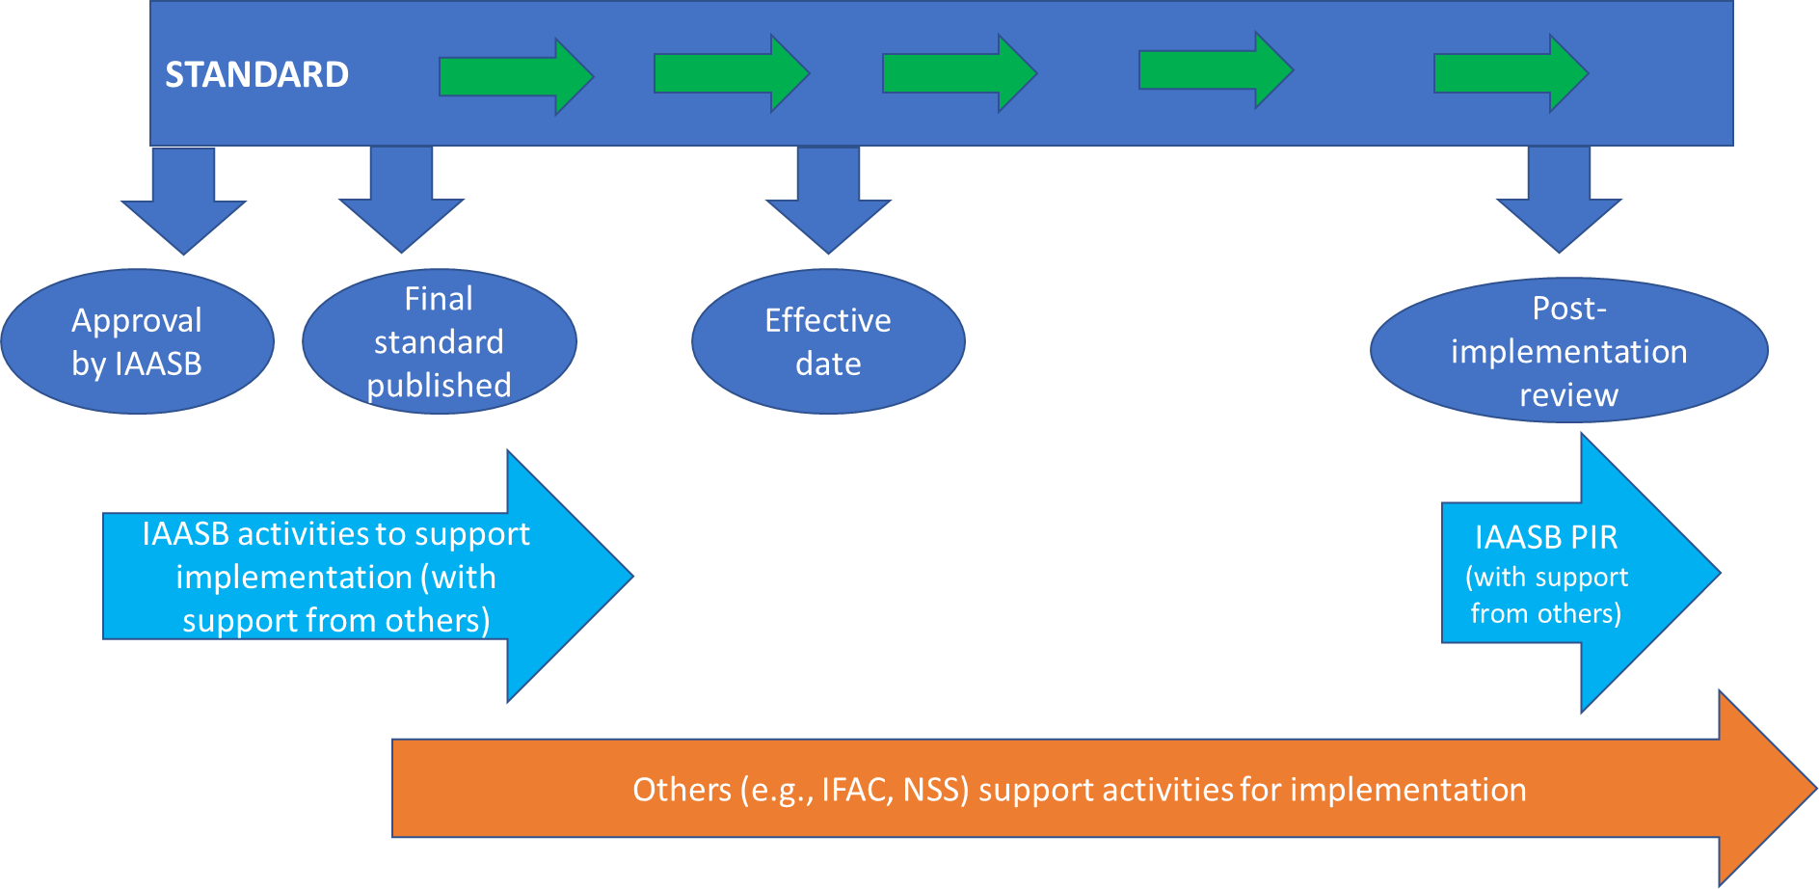
Framework for Activities ‒ Activities to Support Implementation
Supporting implementation of new and revised standards as they are published

Slide 13
Framework for Activities ‒ Activities to Support Implementation
Developing non-authoritative materials
To address an ongoing issue (practice notes, other non-authoritative)
Technology and professional skepticism included
Develop an established ‘approval’ process (will vary depending on nature
of document):
Different channels of review – in Framework will make clear the different channels for each type of non-authoritative guidance
Always final approval by Technical Director and Chair of IAASB
Working with others

Slide 14
Matter for IAASB Consideration
Question:
The IAASB is asked:
For its views on the revised proposed Strategy as presented in Agenda Item 3-A.
For its views on the revised proposed Work Plan as presented in Agenda Item 3-B, including the detailed Work Plan table and the indicative timing of projects and initiatives.
Whether there are any additional matters the Steering Committee should consider relating to the development of the Framework for Activities
Page 14 |

