Slide 1
ISA 315 (Revised) Identifying and Assessing the Risks of Material Misstatement through Understanding the Entity and Its Environment
Fiona Campbell, ISA 315 Task Force Chair
IAASB Meeting, June 2018
Agenda Item 3

Slide 2
ISA 315 (Revised) - Introduction
Agenda Papers:
Agenda Item 3–A: sets out the Task Force’s views on all the proposed changes to the requirements, revised for comments from the March 2018 IAASB discussions (marked to extant ISA 315 (Revised)).
Agenda Item 3–B: sets out proposed changes to the application material, revised for comments from the March 2018 IAASB discussions (marked to extant ISA 315 (Revised)).
Agenda Item 3–C: Conforming amendments arising from proposed changes to ISA 315 (Revised) (ISAs 200,240 and 330 and Table presenting other conforming changes)
Agenda Item 3–D: sets out proposed changes to the requirements at June 2018 marked to March 2018 (for reference only)
Agenda Item 3–E: sets out proposed changes to the application material at June 2018 marked to March 2018 (for reference only)
Flowcharts – Overall Standard and Understanding the Entity’s System of Internal Control

Slide 3
Task Force
Fiona Campbell (Chair) (assisted by Denise Weber)
Megan Zietsman
Marek Grabowski (assisted by Josephine Jackson)
Susan Jones
Katharine Bagshaw
Correspondent member: Chuck Landes (assisted by Hiram Hasty)
Staff:
Bev Bahlmann & Phil Minnaar

Slide 4

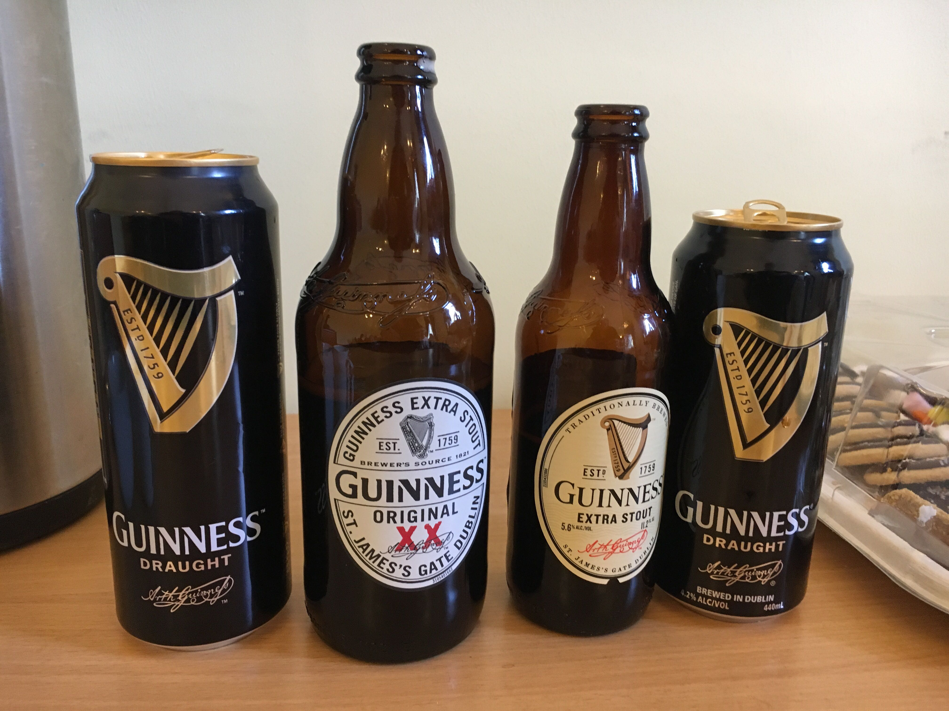
Task Force Meetings

Slide 5
ISA 315 (Revised) – Significant Changes Made Since March 2018
Further clarification of risk identification and assessment process
Identified risks of material misstatement – at financial statement and assertion levels
Risks at the financial statement level – evaluate pervasive effect on financial statements
Assess inherent risk and control risk separately
As part of assessment of inherent risk determine significant classes of transactions, account balances and disclosures, and relevant assertions
Scalability: input from SMPC Task Force member
IT: with assistance from firm IT expert, as well as IT experts from other firms and other stakeholders
Public sector: with assistance from representatives from INTOSAI FAAS
Conforming amendments – changes to respond to comments from Board call

Slide 6
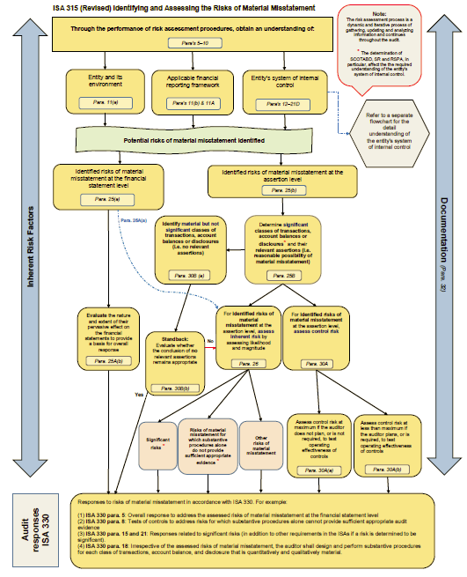
ISA 315 (Revised) – Flowchart: Overall Standard
Page 6

Slide 7
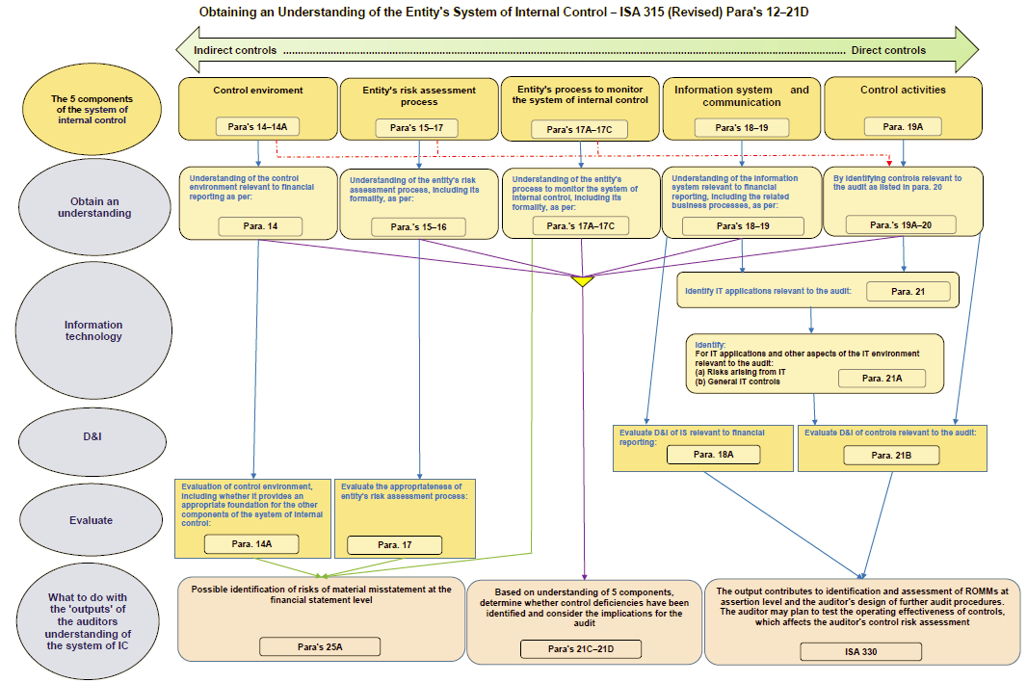
ISA 315 (Revised) – Flowchart: System of Internal Control
Page 7

Slide 8
Outreach Feedback – June 2018
Outreach activities: IOSCO, IFIAR SCWG, GPPC, CAG
Broadly supportive of direction of the Exposure Draft, including modernization
All highlighted importance of aligning with ISA 540 (Revised)
Concern about interaction of stand-back in para 30B with ISA 330.18 (do we need both?); introduction of ‘qualitative’ materiality in 330.18
Areas where further consideration still needed
Fraud as an inherent risk factor – further clarity re some aspects of AM
Definition of significant risk: ‘magnitude or likelihood’ – unintended consequences?
Scalability – standard still complex (flowcharts may help)
Some aspects of IT: further consideration of scalability; interaction between identifying IT application and other aspects of IT environment and controls relevant to the audit; nature and extent of understanding if going to take a substantive approach

Slide 9
Feedback from SMPC
Support for:
Placement of matters related to scalability at beginning of some sections
New material relating to characteristics of direct and indirect components of internal control
Clarifications regarding ‘controls relevant to the audit’
Implementation guidance; consideration needed for implementation working group
Concern about:
The description of certain audit procedures
Scoping of “smaller AND less complex”
Inconsistency of wording regarding separate assessment of inherent and control risk; should risk identification also be separate?
Distinction between identifying and assessing risks – process not clear between para’s 25 and 26
Not clear whether identification of whether a reasonable occurrence exists is based on inherent risk alone
The stand-back in para 30B – is it needed?
“Reasonable possibility” and “more than remote likelihood” impact on auditor’s work effort
Conforming amendments – no change being made in ISA 265 for “significant control deficiency”
Exposure period

Slide 10
ISA 315 (Revised) – Matters for Exposure?
Smaller AND less complex
Significant risk – magnitude OR likelihood
Stand-back – para 30B

Slide 11
Matters for IAASB Consideration
Scalability
The IAASB is asked whether the changes made relating to scalability, as explained in paragraphs 10 to 13, will adequately illustrate how the standard is scalable in a wide variety of circumstances. Are there other changes that should be made?
What are the Board’s views about matters relating to further implementation support for the proposed changes (as set out in paragraphs 4–5), and what is the nature of such implementation guidance?
Page 11

Slide 12
Matter for IAASB Consideration
Fraud
3. The IAASB is asked, based on the explanation in paragraphs 14 to 15, whether further changes in respect of the auditor’s consideration of fraud in ISA 315 (Revised) is needed?
Page 12

Slide 13
Matter for IAASB Consideration
Public sector, data analytics and professional skepticism
4. Does the IAASB believe, based on the explanation set out in paragraphs 16 to 23, that changes made in respect of the public sector considerations, data analytics and professional skepticism are adequately addressed in the proposed changes?
Page 13

Slide 14
Matters for IAASB Consideration
Requirements and application material, including the stand-back requirement
5. The IAASB is asked:
For its views on the proposed changes to ISA 315 (Revised) (requirements as set out in Agenda Item 3-A and application material as set out in Agenda Item 3-B, including the Appendices).
Whether it agrees that a requirement for the stand-back, described in paragraphs 66–71, should be included in the Exposure Draft, with a specific question included in the Explanatory Memorandum, as described in paragraph 69, to obtain respondents views.
Page 14

Slide 15
Matters for IAASB Consideration
Discussion of requirements and application material:
No: | Description in ISA 315 (Revised): | Reference: | Reference in application material:
1. | Scope, introductory paragraphs and objective | 1A–1G 3 | -
2. | Definitions, excluding significant risk | 4(a)–4(f) | A0a–A0i
3. | Risk assessment procedures and related activities | 5–10 | A1–A23a
4. | Understanding the entity and its environment; and the applicable financial reporting framework | 11–11A | A24a–A49k
5. | Understanding the entity’s system of internal control; and the control environment | 12–14A | A50–A82
6. | The entity’s risk assessment process; and the entity’s process to monitor the system of internal control | 15–17C | A88–A89r
7. | The information system and communication | 18–19 | A90–A97a
8. | Control activities; and controls relevant to the audit | 19A–20 | A99–A100m
Page 15

Slide 16
Matters for IAASB Consideration
Discussion of requirements and application material:
No: | Description in ISA 315 (Revised): | Reference: | Reference in application material:
9. | IT applications relevant to the audit (including risks arising from IT and general IT controls); evaluation of the design and implementation of controls relevant to the audit; and control deficiencies | 21–21D | A106a–A109g
10. | Identifying and assessing the risks of material misstatement; and inherent risk | 25–26 | A121a–A127j
11. | Significant risk, including the definition | 4(e), 27 | A0h, A140–A144a
12. | Risks for which substantive procedures alone do not provide sufficient appropriate audit evidence; and control risk | 30–30A | A148–A150d
13. | Stand-back requirement | 30B | A150e–A150g
14. | Revision of risk assessment and documentation | 31–32 | A151–A155
15. | Appendices | - | Appendices 1–4
Page 16

Slide 17
Matter for IAASB Consideration
Conforming Amendments
6. The IAASB is asked for its views on the proposed Conforming Amendments as set out in Agenda Item 3-C.
Page 17

Slide 18
Matters for IAASB Consideration
Other Matters
The IAASB is asked for its views on the exposure period and planned effective date.
Paragraph 10–13 describes the Task Force’s views about scalability in the standard, and the development of further non-authoritative guidance. Does the IAASB believe that further non-authoritative guidance is necessary, and in what form (i.e., for example, Staff Questions and Answers)?
Page 18

Slide 19
Matter for IAASB Consideration
Other Matters
9. The IAASB is asked whether there are any other matters, not noted in paragraph 82, that should be addressed in the Explanatory Memorandum.
Page 19

