Slide 1
The IAASB’s Future Strategy
Prof. Arnold Schilder, IAASB Chairman
Dan Montgomery, Interim Technical Director
IAASB Meeting, New York
Agenda Item 3
September 18, 2018

Slide 2

Strategy Survey
First step in developing Consultation Paper on future Strategy and Work Plans (for IAASB discussion in December 2018)
Targeted outreach also being undertaken
Objective: obtain directional views to develop future Strategy for 2020–2023
Global issues, trends, developments
Key challenges
Opportunities
Where balance of efforts should be focused
Detailed work plans to be developed in context of future strategy

Slide 3
Strategy Survey - Responses
Survey was open for 90 days May to July 2018
76 respondents, including
One Monitoring Group member (IOSCO)
Twelve global organizations
42 responses from individuals

Slide 4

Strategy Survey – What We Heard
Global issues, trends or developments
Advances in technology
Changing reporting needs of stakeholders (integrated reporting, sustainability reporting)
Changing environment for small and medium sized practices (importance of scalable standards)
Future of the profession, including the perceived value of the audit and the competencies and training of audit personnel
Key challenges
MG consultation and changes therefrom
Timeliness of standard-setting
Demands from different stakeholder groups

Slide 5

Strategy Survey – What We Heard
Key opportunities
Change how the Board operates (more strategic)
Improvements or changes to the standard-setting process (balance timely guidance vs. due process)
Increased use of technology to be more efficient
Collaboration with other standard-setting boards (in particular IESBA) and others (NSS)
How the IAASB should focus its activities in 2020–2023
Important to complete current projects underway
Development of standards still important, but also need implementation efforts on recently completed revised standards / standards currently being revised
More needs to be done to support specific activities (e.g., standard-setting versus development of guidance, including non-authoritative guidance or other Staff documents)
Focus on scalability of standards

Slide 6

Targeted Outreach – What We Heard (To Date)
Targeted outreach with stakeholders from which we don’t traditionally hear from (investor groups, company director groups, those charged with governance, preparers, smaller firms)
Ongoing outreach
Key themes:
IAASB focus on ‘core activities’
More needs to be done to ensure effective implementation of standards
Post-implementation reviews important
Needs of stakeholders is key (in changing environment) → continuing outreach important
Specific areas of focus: technology, assurance on non-financial information / emerging forms of external reporting, skepticism, fraud
Speed of standard-setting to address issues and challenges, particularly in context of evolving environment
Consideration about how the changing environment (e.g., changing business models or skills needed for undertaking the work) affects the standards

Slide 7
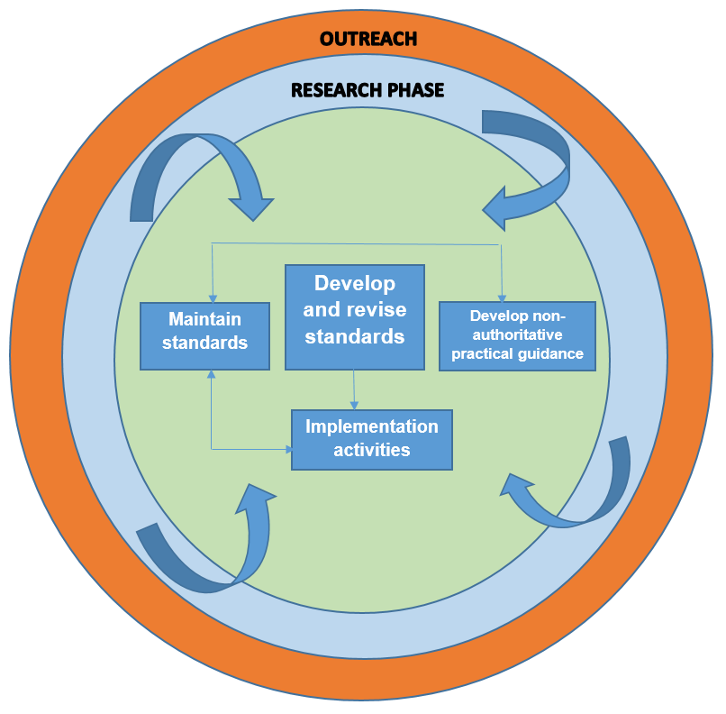
Moving Forward on Strategic Direction
Further consideration will be given to formalizing the Board’s policies and procedures in structured activity streams
Research phase
Developing and revising standards
Developing non-authoritative practical guidance
Maintenance of standards
Implementation activities
Ongoing interactions between activity streams
Outreach to support all phases

Slide 8
Future Strategy – Supporting Future Proposed Strategic Direction
Board operations:
More strategic discussion at Board meetings
Detailed drafting done by Staff and comments dealt with offline
For some activities, using another mechanism other than discussion and deliberation at a physical Board meeting (e.g., use of more Board teleconferences)
Enhancing the Board’s communication processes about the progress of its activities
Consideration given to whether measures or other indicators of success need to (or can effectively be) developed
Further consideration how others (e.g., NSS) can be leveraged

Slide 9

Perspectives from Sep 2018 CAG Meeting
Generally supported shifting some of the IAASB’s efforts to implementation support
Board has (with other stakeholders) shared responsibility to support the implementation of its standards
Board may identify new projects through implementation activities
Implementation activities will require time from the Board and Staff
Need to balance resources between developing standards and implementation support
Supported collaborating with other standard setters
Highlighted the importance of the research phase
Noted strategic importance of being transparent about what we are doing in relation to technology

Slide 10

Matters for IAASB Consideration
The IAASB is asked for views:
On the summary of responses as included in Agenda Item 3-A and any overall takeaways from the responses to the survey.
On the recommendations for strategic direction described in paragraphs 16-35 of Agenda Item 3. If Board members do not support such an approach, should the allocations to different categories be retained to help develop the work plans with specific projects?
2. If Board members support the strategic direction in paragraphs 16-35 Agenda Item 3, Board members are asked for views on the specific activity streams, in particular the ‘research phase’, the ‘maintenance stream’, and the ‘implementation stream.’

