Slide 1
EER Assurance Presentation of Issues and Project Update June 2018
Agenda Item
4
June 19 & 20, 2018

Slide 2
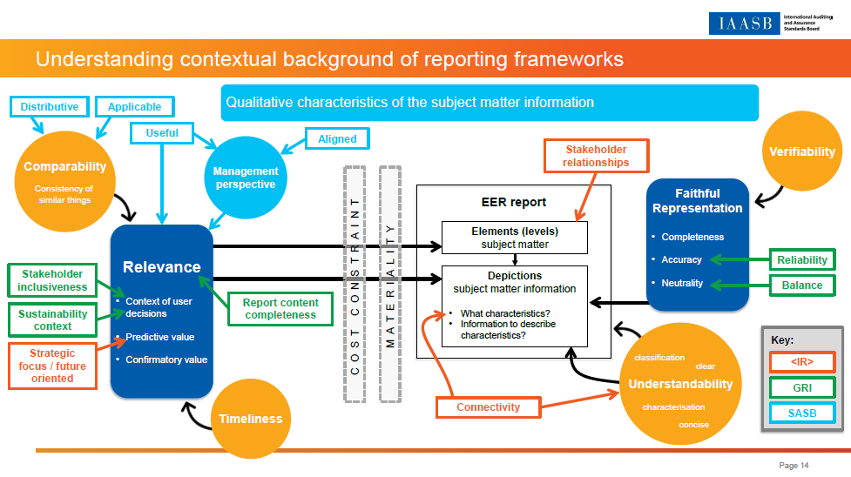
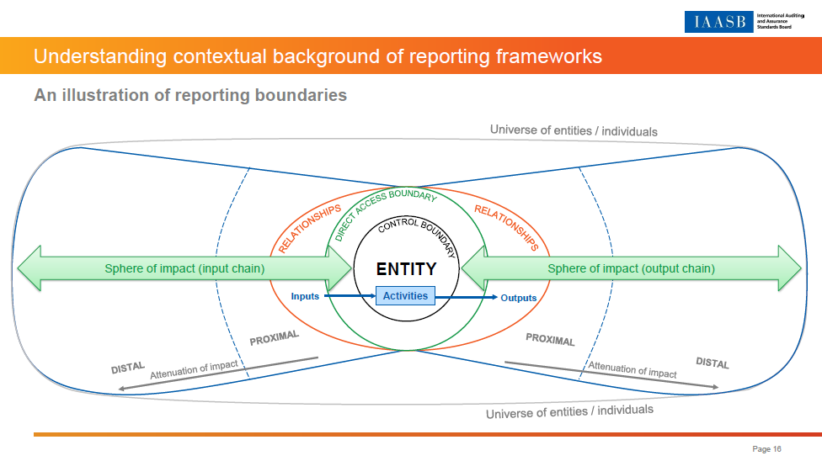
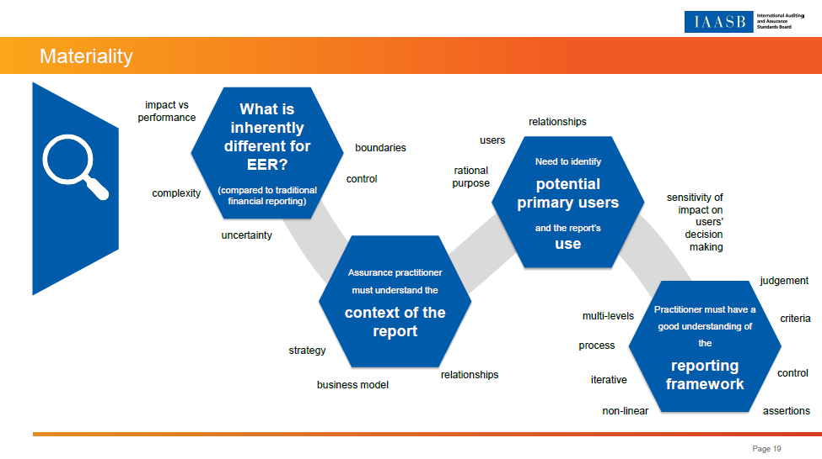
Recap of March update
Understanding contextual background of reporting frameworks
Introduction to work begun on Challenge 3 (Materiality)
Update on project planning, research and outreach

Slide 3
Agenda
Presentation of the issues relating to three of the Ten Key Challenges - refer to Issues Paper (Agenda Item 4)
Receive board feedback on the concepts and principles presented
The EER Assurance House (under construction)
Communicating Effectively in the Assurance Report ⑩
② Evaluating Suitability of Criteria
③ Applying Materiality
④ Building Assertions
⑤ Maturity in Governance & Internal Control
⑥ & ⑦ Addressing Narrative and Forward Looking Information
Phase 1
Determining the Scope of an EER Assurance Engagement ①
Challenge discussed in issues paper
Exercising Professional Skepticism and Professional Judgment ⑧
Work underway – issues to be presented in September
Obtaining the Competence Necessary to Perform the Engagement ⑨

Slide 4




Structure of issues paper
Tuesday
Wednesday
Challenge 3
Challenge 2
Challenge 4
Generalized construct of an EER report and its relationship to assurance concepts
Addressing Materiality for Diverse Information with Little Guidance in EER Frameworks
Evaluating the Suitability of Criteria in a Consistent Manner
Building Assertions for Subject Matter Information of a Diverse Nature

Slide 5




Generalized construct
Materiality
Criteria
Assertions
Introduction and Overview of the Agenda Items
Non-authoritative guidance
Application guidance for practitioners
Background information
Q1
The IAASB is asked for its views on the possible form of the guidance.

Slide 6

Generalized construct of an EER report and its relationship to assurance concepts
Generalized construct
Materiality
Criteria
Assertions
underlying
subject
matter
criteria
subject
matter
information
Definitions
Underlying subject matter
The phenomenon that is measured or evaluated by applying criteria.
Criteria
The benchmarks used to measure or evaluate the underlying subject matter.
Subject matter information
The information that results from applying the criteria to the underlying subject matter.
Resources
A suggested generalized description of subject matter elements – the resources available to, or affected by, the entity and the causes of change in those resources.
categories
topics
r
e
s
o
u
r
c
e
s
measure or evaluate

Slide 7
Generalized construct of an EER report and its relationship to assurance concepts
Generalized construct
Materiality
Criteria
Assertions
Environmental, social and governance information about company X
Percentage of people employed by company X who are male
50% of employees are male
Definitions
Underlying subject matter
The phenomenon that is measured or evaluated by applying criteria.
Criteria
The benchmarks used to measure or evaluate the underlying subject matter.
Subject matter information
The information that results from applying the criteria to the underlying subject matter.
Resources
A suggested generalized description of subject matter elements – the resources available to, or affected by, the entity and the causes of change in those resources.
Social
a simple example
Staff diversity
e
m
p
l
o
y
e
e
s
measure or evaluate

Slide 8
Generalized construct of an EER report and its relationship to assurance concepts
Generalized construct
Materiality
Criteria
Assertions
Q2
The IAASB is asked for its views on:
The generalized construct of an EER report and related concepts presented in the issues paper;
The consistent use of terms in the guidance, particularly to refer (in a framework neutral way) to matters that either are not explicitly addressed in ISAE 3000 (Revised), such as ‘categories’ and ‘topics’, or are described diversely in EER frameworks, such as the term ‘resources’ to describe elements of the underlying subject matter; and
The extent to which it is helpful to practitioners to further clarify similarities and differences between financial reporting and EER concepts.

Slide 9

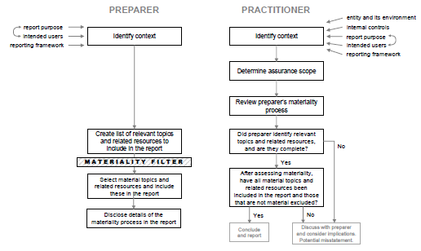
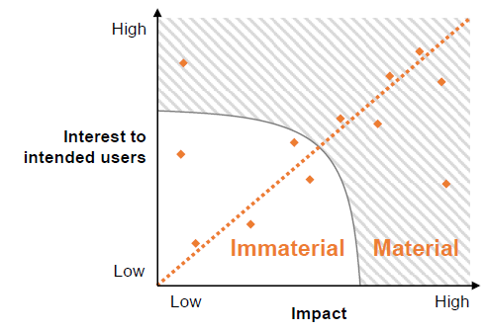
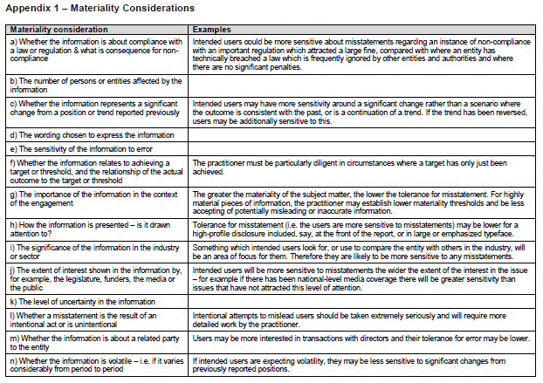
Addressing Materiality for Diverse Information with Little Guidance in EER Frameworks
Generalized construct
Materiality
Criteria
Assertions
materiality
PART 1
PART 2
Evaluating which topics and related resources are to be included in the report
Evaluating whether the subject matter information included in the report for material topics and related resources is free from material misstatement

Slide 10
Addressing Materiality for Diverse Information with Little Guidance in EER Frameworks
Generalized construct
Materiality
Criteria
Assertions
Q3
The IAASB is asked for its views on:
the conceptual thinking presented in the issues paper;
whether it is helpful to present aspects of materiality which are relevant for preparers as well as those relevant to practitioners; and
the draft outline of the materiality framework presented in Agenda Item 4-A.

Slide 11
Evaluating the Suitability of Criteria in a Consistent Manner
Generalized construct
Materiality
Criteria
Assertions
relevant
complete
reliable
neutral
understandable

Slide 12
Evaluating the Suitability of Criteria in a Consistent Manner
Generalized construct
Materiality
Criteria
Assertions
Q4
The IAASB is asked for its views on the section in the issues paper, in particular the usefulness of the factors presented in paragraph 77.

Slide 13
Building Assertions for Subject Matter Information of a Diverse Nature
Generalized construct
Materiality
Criteria
Assertions
Required characteristics for
Criteria
per ISAE 3000 (Revised)
Reliability
Completeness
Understandability
Relevance
Neutrality
Characteristics of
Subject matter information
in a fair presentation framework such as IFRS
Faithful representation
Relevance
Free from error / accuracy
Completeness
Neutrality
Verifiability
Understandability
Comparability
Timeliness
Examples of related characteristics in EER frameworks (generalized)
Conciseness
Clarity
Connectivity
Usefulness
An example basic set of
Assertions
Free from error
Completeness
Presentation
Relevance
Occurrence
Existence
Cutoff
Understandability
Comparability
Classification
Neutrality

Slide 14
Building Assertions for Subject Matter Information of a Diverse Nature
Generalized construct
Materiality
Criteria
Assertions
Q5
The IAASB is asked for its views on:
whether the approach proposed in paragraph 80 in the issues paper is a helpful starting point for practitioners;
the other concepts presented in the issues paper; and
the guidance skeleton presented in Agenda Item 4-B.

Slide 15
Summary
context
assertions
purpose
users
underlying
subject
matter
criteria
subject
matter
information
MATERIALITY FILTER
categories
topics
r
e
s
o
u
r
c
e
s
measure or evaluate

