Slide 1

ISQM 1: Overview of Feedback from the Exposure Draft
Presented by:
Karin French, ISQM 1 Task Force Chair
IAASB Meeting September 2019
Page 1

Slide 2
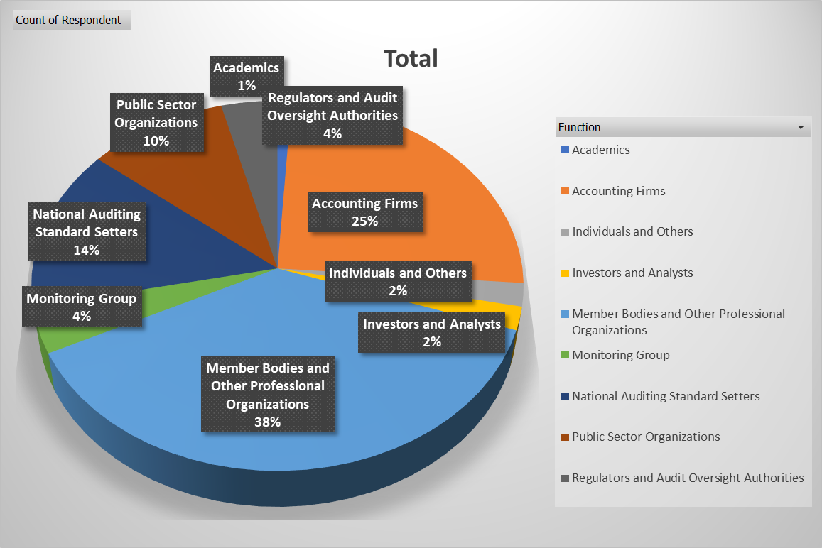
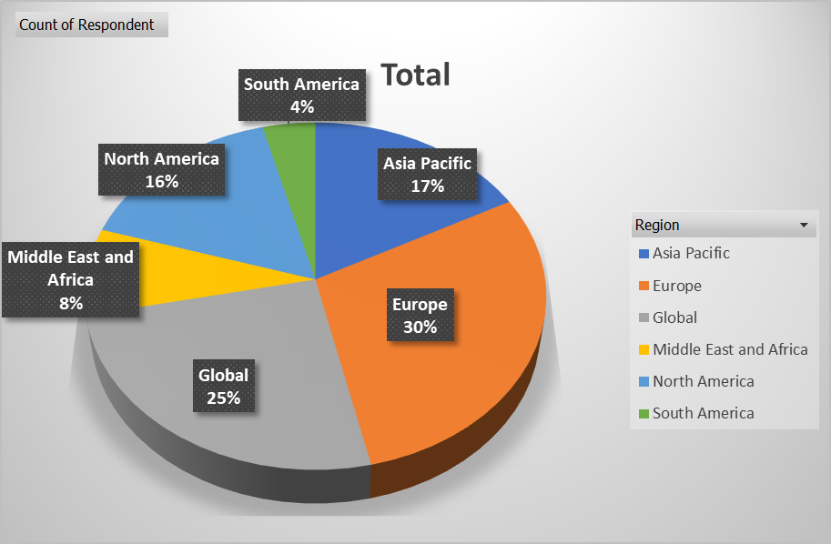
Overview of Respondents
Page 2

Slide 3
New Quality Management Approach (QMA)
MG:
Enhancements needed to improve proactive and preventative approach
Needs to be able to support enforcement
Other respondents:
Positive:
Promotes tailored systems and a proactive, integrated and thinking approach to quality management (QM)
Will help firms meet challenges facing the profession
Concerns:
How ED-ISQM 1 incorporates a QMA - hybrid of a risk-based approach and prescriptive requirements
Length and complexity of the standard
Suggestions included:
Reducing prescriptiveness of quality objectives and responses and more explicitly addressing quality risks
Restructuring the standard
Emphasis on aligning QM with the firm’s business strategy and incorporating QM into enterprise risk management
Page 3

Slide 4
Benefits for Engagement Quality and Professional Skepticism (PS)
MG:
Support how ED-ISQM 1 addresses PS
Also address PS in governance and leadership
Other respondents:
SOQM is the foundation for consistently delivering high quality engagements
Governance and leadership is critical to embedding and supporting a culture of quality and a focus on professional skepticism
Effect of the standard and expected benefits would vary from firm to firm
Address PS in other areas of the standard, particularly governance and leadership
Concerns:
Benefits may be limited for SMPs
Prescriptiveness = checklist mindset = unlikely to improve engagement quality
Implementing standard will be resource intensive – possible negative effect on engagement quality
Cost-benefit analysis needed
Extent of documentation needed to demonstrate compliance with the standard
Page 4

Slide 5
Scalability
MG:
Need for larger firms to scale-up (i.e., additional to what is in the standard)
Length of standard and proposed additional guidance – need for a critical review and improved clarity of standard
Other respondents:
Examples and guidance will be needed to demonstrate scalability – however, the need for examples and guidance indicates lack of clarity of standard
Concerns:
Prescriptiveness of the standard - not scalable, and having required responses with no quality risks indicates approach is not risk-based
Length and complexity
Threshold for identifying quality risks is too low
Documentation burden (“comply or explain”)
Standard appears written for large firms – bottom-up approach needed
Firms that perform non-audit services – increasing trends to perform other engagements instead of audits, wide variance in degree of public interest, ITC addressed audit issues, ED-ISQM 1 very audit focused, ED-ISQM 1 not suitable for firms performing related services engagements
Page 5

Slide 6
Scalability (continued)
Suggestions:
Separate requirements or standards for managing quality for non-audit engagements or audits of less complex entities
Simplify requirements and reduce repetitiveness
Use certain explanations and diagrams from the Explanatory Memorandum
More clearly signpost paragraphs that address scalability
Use the same approach that is being considered in the project on ISA 315 (Revised) (i.e., the what/how/why approach)
Place material outside of the standard
Digitize the standard
Page 6

Slide 7
Challenges for Implementation
Time, resources and expertise to implement the standard
Firm-wide impact:
Need for a firm-wide mindset change, and influences the culture of the firm
Organizational restructuring, new IT systems
Affects other areas of the firm, e.g., human resources and IT functions
Professional judgment – differing interpretations and concerns about level of documentation needed
Firm’s risk assessment process (FRAP) – identified as particularly challenging to implement
Other areas of challenge:
Monitoring and remediation (M&R) - root cause analysis, identifying and evaluating findings and deficiencies and firm leadership’s annual evaluation of the system of quality management
Consistent application for networks – includes challenges around consistency of global standards
Documentation – some consider standard too burdensome, others suggesting more clarity needed about what needs to be documented
Length and complexity of standard – difficult to read and understand
Strong call for support materials and guidance, including clarity regarding what has changed from extant ISQC 1
Page 7

Slide 8
Components and Structure
Standard has a logical organization and support flexibility of the components
Concerns and suggestions
FRAP should be the first component – helps provide context to standard, even though governance and leadership is very important
Also clarifies that FRAP applies to the other components
FRAP and M&R are processes in nature and should not be described as components or treated in the same way as other components – “what” is managed vs. “how” it is managed
FRAP should not apply to M&R
Requirements in M&R already prescriptive – establishing quality objectives and identifying and assessing risks causes circularity
Information and communication are necessary for other components to function – should be integrated into the other components
Page 8

Slide 9
Establish Quality Objectives (QO)
MG:
Clarity needed on when and how additional QO should be developed
Suggested requirements that support establishing more granular quality objectives to support identifying and assessing quality risks (QR)
Other respondents:
Mixed views
QOs are comprehensive, outcome-based and give a steer to firms about the starting point
QOs are too prescriptive – should be more high-level and fewer
Suggestions included
Include specificity of QO in quality risks
Clarify circumstances when additional QO should be established
More explicit in the standard that additional QO are not always required
Change the requirement to “a consideration” of whether additional QO are necessary
Page 9

Slide 10
Identify and Assess Quality Risks (QR)
MG:
QR with remote likelihood / significant impact should be considered by firms
Other enhancements needed:
Assess changes in the external environment and a firm’s own business model, need to be dynamic
Take findings from regulators into account as part of identifying and assessing QR
Other respondents:
A threshold leads to a consistent approach, standard supports enhanced understanding of QR
Concerns about the threshold, i.e., “reasonably possible” and “more than remote”
Clarify meaning of “significant effect on the achievement of a QO”
Process for identifying and assessing QR overly prescriptive and does not provide flexibility - 2-step process is confusing and overengineered
Lack of required QR – illogical
Suggestions to repurpose required responses and granularity of QO or provide examples of QR
Clarity needed on how to document
General need for guidance
Page 10

Slide 11
Design and Implement Responses
MG:
Firms may be overly focused on required responses
Responses should be more proactive and preventative
Other respondents:
Responses prescriptive = checklist mindset, limited tailoring
Firms may “backfill” QR to match responses – perpetuates inappropriate QR
Inconsistency in (or lack of) responses across components – appears some components more important than others
Firms should not be expected to design and implement additional
responses in all circumstances, i.e., responses in the standard may be
sufficient
Varying views on how to deal with responses
Application material vs. requirements
Repurpose as QR
Other suggestions to clarify requirement to design and implement additional responses
Page 11

Slide 12
CAG Feedback
General support for proposed direction
Firms overwhelmed by proposals, could be a deterrent for firms to operate in the audit market, need for firms’ support
Building block approach needed: basic principles applicable to all, with layered on requirements for larger or more complex firms
Other representative indicated the need for appropriate balance between principles and prescriptive requirements
More integrated approach is needed, i.e., SOQM is integrated into firm’s day to day activities
Referred to COSO ERM framework as example
Also need to recognize in Proposed ISQM 1 other sources of information coming from within the firm
Standard needs to encourage “scaling-up” for larger or more complex firms
Consider drafting and presentation approach used in ISA 315
Components and structure
Consider whether G&L is a “how”, rather than a “what”
Caution not to overengineer differentiating between different types of components or describing how they interrelate
Page 12

Slide 13
CAG Feedback (cont.)
Support for proposed approach for QO, QR and responses
Consider how required responses are addressed in the standard
Support for proposed approach for FRAP
Threshold for identifying QR is still important and necessary for appropriate rigor
Varying views on proposal for separate standard to address quality management for related services engagements
Encouragement for IAASB to further consider and undertake consultation
Views that could be a good approach, although caution that it shouldn’t lead to bifurcation of firms
Should not be a distinction between quality for audits and quality for other engagements – poor quality on other engagements could taint firm’s reputation and credibility
Emphasis on concerns about implementation date and effort needed by firms to implement the standard
Page 13

Slide 14
The Components and Structure of Proposed ISQM 1
Question 1:
Does the IAASB support reordering the standard, including relocating paragraphs 24(a) and 25, as proposed by the ISQM 1 TF?
Question 2:
Does the IAASB support that the firm’s risk assessment process and monitoring and remediation processes are “processes”? In particular, does the IAASB agree with:
(a) Introducing new overarching requirements for the firm to establish a risk assessment process / monitoring and remediation process?
Removing the concept that the firm’s risk assessment process is applied to the monitoring and remediation process?
Question 3:
Does the IAASB support the conclusion that information and communication should remain a separate component, and that the firm’s risk assessment process would continue to apply to information and communication?
Page 14

Slide 15
How Proposed ISQM 1 Should Address QO, QR and Responses
Question 4:
Does the IAASB support the proposals to revise the approach to required quality objectives, quality risks and responses in the components by:
(a) Revising the quality objectives to be higher level, which may result in fewer quality objectives;
(b) Introducing quality risk considerations; and
(c) Reducing the required responses?
Page 15

Slide 16
How the Standard Addresses the FRAP
Question 5:
The IAASB is asked to provide their views on the proposals addressing the requirements for the identification and assessment of quality risks, including whether:
(a) The IAASB supports simplifying the requirements, including condensing the two-step process and addressing the quality risk threshold through the definition of “quality risks” and application material?
(b) Proposed ISQM 1 should retain the concept of “reasonable possibility” in the context of likelihood, or whether another term should be used?
Question 6:
Does the IAASB agree with the suggestion to adjust the requirement to establish additional quality objectives to a “consideration”?
Page 16

Slide 17
The Scope of Firms and Services Covered by Proposed ISQM 1
Question 7:
Does the IAASB agree that there is a need to develop separate requirements for firm-level quality management over related service engagements? If so:
(a) Does the IAASB agree that the requirements apply to firms as it relates to their management of quality for related services engagements?
(b) Should the separate requirements be included in:
(i) A separate quality management standard (e.g., ISQM 3)?
(ii) Proposed ISQM 1 as separate requirements?
(iii) The related services standards themselves, i.e., in ISRS 4400 and ISRS 4410 (Revised)?
Question 8:
Does the IAASB support issuing a survey to obtain stakeholder input on the proposed way forward?
Page 17

Slide 18
General Matters
Question 9:
Are there other issues arising from the comments on the questions summarized in Section B of this paper (i.e., question 1 and related subquestions, question 2, question 4, and question 6 and related subquestions) that should be considered by the ISQM 1 TF?
Page 18

Slide 19
Feedback on Other Aspects of ED-ISQM 1: Initial Impressions
References to the public interest in the standard
Support for references, although suggestions to clarify meaning of public interest
Objective of the standard
Support for the objective
Additional suggestions include:
Incorporating public interest in the objective
Adjusting the objective to be more outcome-based
Clarifying concept of reasonable assurance in the context of a SOQM
Governance and leadership
Support for the proposals in ED-ISQM 1
Concerns about prescriptiveness of requirements and scalability for SMPs – including requirement to assign responsibility for SOQM and aspects of the SOQM and undertaking performance evaluations
Clarity needed on certain requirements, e.g., requirement to assign responsibility for SOQM
Mixed views regarding the appropriateness of a requirement to assign responsibility for relevant ethical requirements and/or independence
Page 19

Slide 20
Feedback on Other Aspects of ED-ISQM 1: Initial Impressions (cont.)
Relevant ethical requirements
Strong support for how ED-ISQM 1 addresses network independence
Resources
Support for how ED-ISQM 1 addresses technological resources
Suggestions to clarify the scope of technological resources addressed by ED-ISQM 1
Calls for additional guidance
Information and communication
Overall mixed views
Concerns that requirement is too prescriptive regarding reference to transparency reports (e.g., creates a de facto requirement)
Others (incl. investors) suggesting ED-ISQM 1 should do more in addressing external communication
Further clarity needed on who external stakeholders may be
M&R
Overall views that will improve robustness of firms’ M&R
Concerns about scalability of requirements, level of prescriptiveness and whether will drive innovation
Page 20

Slide 21
Feedback on Other Aspects of ED-ISQM 1: Initial Impressions (cont.)
M&R (continued)
Mixed views on the requirement addressing inspection of completed engagements
Requirement is prescriptive - suggestions that requirement should be more risk-based
The “3 year suggestion” in AM is a de facto requirement
Discourages or creates barriers to firms developing other monitoring techniques
Clarity needed on references to “in-process reviews”
Concerns that a lack of clarity of framework for evaluating findings and identifying deficiencies
Difference between findings and deficiencies is not clear
Consider a concept of “significant deficiencies”
Various comments and suggestions on definition of deficiencies
Support for new requirement to investigate root causes – further suggestions
Clarify the scope of root cause analysis
Mixed views about how standard addresses positive findings
Clarify the iterative nature of identifying and evaluating deficiencies and undertaking root cause analysis
Page 21

Slide 22
Feedback on Other Aspects of ED-ISQM 1: Initial Impressions (cont.)
M&R (continued)
Many challenges identified regarding annual evaluation of SOQM
Too onerous for SMPs, suggestions that the evaluation is too frequent
Clarity needed on whether it is “a point in time” vs. “a periodic” assessment, including how to consider deficiencies in the process of being remediated
Clarity needed on meaning of “reasonable assurance” and how severity of deficiencies affects the evaluation
Suggestions that it is a self-evaluation so may not be effective
Expectations on an individual may be onerous (also in context of other requirements in the standard)
Networks
Overall support for the requirements proposed in ED-ISQM 1
Proposals that firms should determine that network requirements / services are appropriate for use
Concerns about challenges in obtaining the information from the network
Various comments on information that is to be obtained by the firm about the overall scope and results of the monitoring activities across the network firms’ SOQM
Respondents seeking guidance on how requirements should be implemented
Ad-hoc concerns about whether standard is sufficiently robust to address networks themselves
Page 22

Slide 23
Feedback on Other Aspects of ED-ISQM 1: Initial Impressions (cont.)
Service providers
Overall support for addressing service providers in the standard
Concerns about
The scope of service providers
Obtaining information from service providers
Requirement being too onerous and not practical to implement
Respondents seeking guidance on how requirements should be implemented
Application material
More examples needed of how standard is scalable
Reduce length of application material
Include helpful material from the Explanatory Memorandum
Support for additional FAQ and examples
Strong call for additional support materials and guidance, particularly guidance supporting first time implementation, SMPs, monitoring and remediation, root cause analysis and documentation
Page 23

