Slide 1
ISA 315 (Revised) Identifying and Assessing the Risks of Material Misstatement
Fiona Campbell, ISA 315 Task Force Chair & Deputy Chair of the IAASB
IAASB Meeting – New York, USA
Agenda Item 2
September 16, 2019

Slide 2
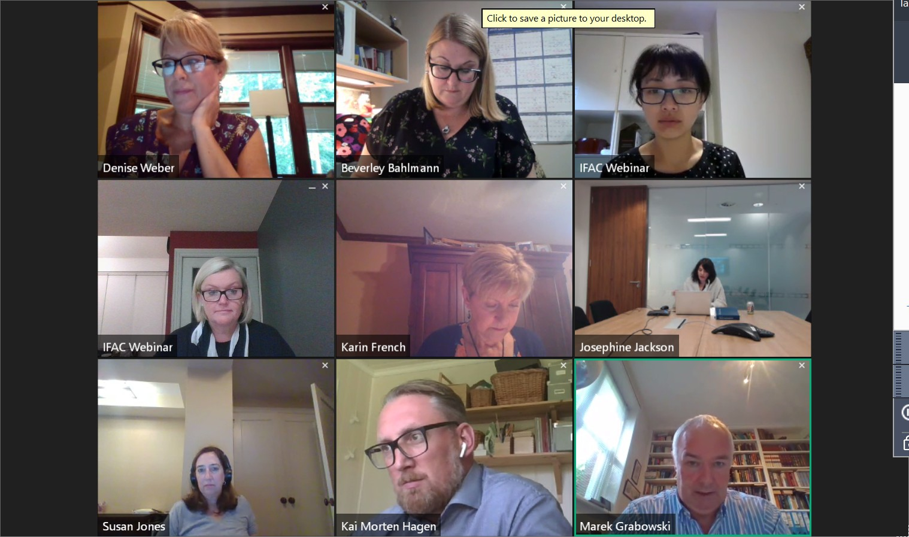
Notes:
We have had a Face to Face TF meeting (plus and extra “staff day”),
3 days of Denise, Bev and I working together in Cleveland
And then three (quite long) video conferences using the “GoTo Meeting” technology – and it worked very well (although it did look a bit like the ‘brady bunch’ opening credits – feel free to google the brady bunch if you’re not sure what that is – but it was a TV show in the 70’s and early 80’s).

Slide 3
ISA 315 (Revised)‒NEW in September
Introductory paragraphs
Public sector
Automated tools and techniques
Supported by Technology Working Group Q&A
Translations
Effective date
Page 3
Notes:
We will not be discussing re-exposure today. That will be on Friday after the decision is made on whether the standard is ready.

Slide 4
Summary of CAG Representatives Comments
Broadly supported the changes to address understandability and length; a few concerns about use of tables
Significant risk definition
“Combination” of likelihood and magnitude – should it rather be the ‘intersection’
Clarify ‘in rare circumstances’ where may not be a significant risk
Inherent risk factors – supportive of changes to use fraud risk factors
Paragraph 39(a)(ii) is confusing, and may go further than intended in particular in relation to documentation
Threshold for identifying risks of material misstatement – description in revised ISA 200 conforming amendments clearer
SMP Committee Representative thanked the IAASB for the opportunity to input to the revisions; encouraged that the standard is finalized but had the view that a longer implementation period is needed
Majority CAG Representatives would like standard finalized (i.e., no re-exposure)
Notes:
Had a really good CAG meeting – using a new format for CAG papers and presentation to drive the CAG discussion (which a number of us used this time) which I think worked really well to get the CAG feedback on the key issues without them having to wade through hundreds of pages of documents.
Jim, once I’ve been through this slide, perhaps you can add your comments/observations

Slide 5
Offline Comments – Significant Aspects for Further Consideration
Definition of relevant assertions
Hanging paragraph – Para 17
Inherent risk factors and the way we describe consideration of the inherent risk factors in paragraph 23(c)
Paragraph 39(a)(ii)
Threshold for identifying risks of material misstatement (ISA 200 CA)
Notes:
I will be stepping through the definitions and requirements of the std at the same time as the AM.
Then any feedback on the Appendices will be received.
Then we will discuss effective date.
Then we will discuss the conforming amendments.
Will not be discussing the NAG (1st Time Guide) – not shared with you yet but doesn’t require Board approval (but will be issued hot on the heels of the standard).
Significant Aspects for Further Consideration – What we Have Heard
Definition of Relevant Assertions
Clarification of whether all assertions or only relevant assertions relating to a COTABD needs o be identified
Inadvertently changed definition - revert to “before consideration of controls” – plan to test operating effectiveness seems to suggest something else than what is intended here
Hanging paragraph – para 17
How is this demonstrated in practice – difficult to do
Problems with the way articulated (particularly in relation to corroboration and contradictory evidence) – suggestions received
Inherent Risk Factors – para 23 (c)
Wording change may suggest that there is an expectation that all IRFs need to be considered and documented
Inconsistency with ISA 540
“How they do so” seems problematic
Paragraph 39(a)(ii)
Confusing
Seems to be introducing a new concept and goes beyond what the intention is
Threshold for identifying ROMM
Still not clear in amendment what the threshold is
Diagram does not help as its confusing that there are two ‘thresholds’ which many think are the same

Slide 6
ISA 315 (Revised)
What are the Board’s views about:
Definitions
Requirements
Application material
Appendices
Full standard presented in clean – Agenda Item 2-E
(The Task Force Chair will walk through the standard – relevant paragraph numbers to follow)
Question 3
Page 6

Slide 7
ISA 315 (Revised)‒Introductory Paragraphs
Effective Date & Objective to be added back
Par # | Paragraph # | Relevant Application Material:
2-10 | Introductory paragraphs | -
Page 7
Notes:
Was an oversight – effective date will be discussed at the end of these questions on the requirements and AM. Objective hasn’t changed from ED (and there was no call to change it).

Slide 8
ISA 315 (Revised)‒Definitions
Par # | Definitions | Application Material
16(b) – 16 (g) | Assertions to IT environment | A1 – A6
16(h) – 16(l) | Relevant Assertions to System of Internal Control | A9 – A10
Page 8

Slide 9
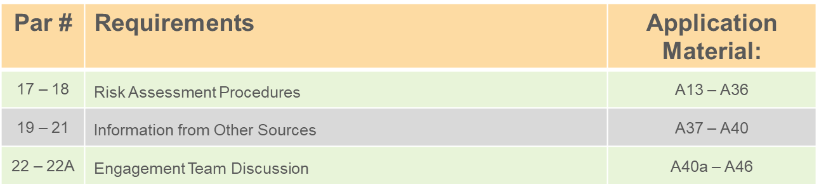
ISA 315 (Revised)‒Risk Assessment Procedures and Related Activities
Page 9

Slide 10
ISA 315 (Revised)‒Understanding the Entity & Its Environment / Applicable Financial Reporting Framework
Par # | Requirements | Application Material:
23 | Understanding the Entity and Its Environment and the Applicable Financial Reporting Framework | A46a – A78 (Entity & its Environment) A79 ‒ A82 (Financial Reporting Framework) A88a ‒ A88d (IRFs)
24 | Evaluating the Entity’s Accounting Policies
Page 10

Slide 11
ISA 315 (Revised)‒Understanding the Components of the Entity’s System of IC
Par # | Requirements | Application Material
 | Understanding the Components of the Entity’s System of Internal Control | A89 – A104a
 | Control Environment, Risk Assessment Process & Entity’s Monitoring of System of IC | A104a – A104d
28 | Understanding the Entity’s Control Environment | A106 – A114b
30 ‒ 31 | The Entity’s Risk Assessment Process | A117 – A120
31A | The Entity’s Process for Monitoring the System of Internal Control | A123 – A135c
Page 11

Slide 12
ISA 315 (Revised)‒Understanding the Components of the Entity’s System of IC
Par # | Requirements | Application Material
 | Information System and Control Activities Components | A135d – A135m
36 | Understanding the Entity’s Information System and Communication | A135n – A159a
39 | Control Activities Component | A160 – A177 A179a – A189 (IT) A194 – A200 (D&I)
43 | Deficiencies in the Entity’s System of Internal Control | A200a – A200c
Page 12

Slide 13
ISA 315 (Revised)‒Identifying & Assessing the Risks of Material Misstatement
Par # | Requirements | Application Material
 | Identifying and Assessing the Risks of Material Misstatement | A201 – A206
45, 47, 48 | Identify and Assessing Risks of Material Misstatement | A206a – A207e (financial statement level) A208 – A221 (except A211 – A214) & A226 – A228 (assertion level) A221a – A225 (spectrum of risk)
46. | Determine Relevant Assertions and Significant Classes of Transactions, Account Balances and Disclosures | A211 – A214
Page 13

Slide 14
ISA 315 (Revised)‒Assessing the Risks of Material Misstatement
Par # | Requirements | Application Material
49 | Determining Significant Risks | A228a – A229b
50 | Determining Whether Substantive Procedures Alone Cannot Provide Sufficient Appropriate Audit Evidence | A231a – A231e
51 | Assessing Control Risk | A232 – A235a
Page 14

Slide 15
ISA 315 (Revised)
Evaluating Audit Evidence from Risk Assessment Procedures
Stand-back
Par # | Requirement | Application Material
51A | Evaluating the Audit Evidence from Risk Assessment Procedures | A239a – A239c
Par # | Requirement | Application Material
52. | Stand-back – Material Classes of Transactions, Account Balances or Disclosures that have Not Been Identified as Significant Classes of Transactions, Account Balances or Disclosures | A240 – A242
Page 15

Slide 16
ISA 315 (Revised)
Revision of Risk Assessment
Documentation
Par # | Requirement | Application Material
53 | New Inconsistent Information | A243
Par # | Requirement | Application Material
54 | Documentation | A244 – A248
Page 16

Slide 17
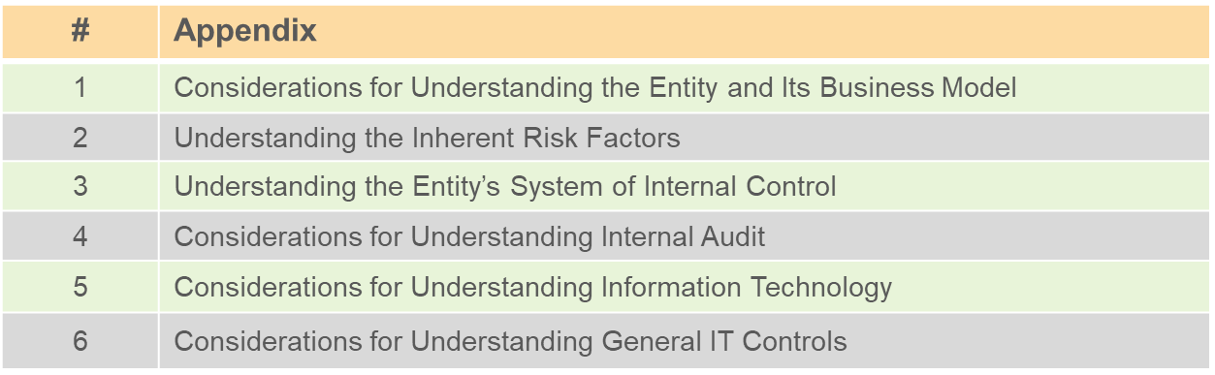
ISA 315 (Revised)‒Appendices

Slide 18
Effective Date
Question 2
What are the Board’s views about the proposed implementation date?

Slide 19
ISA 315 (Revised) ‒ Conforming Amendments
ISA | Conforming Amendments
200 | Overall Objectives of the Independent Auditor and the Conduct of an Audit in Accordance with International Standards on Auditing
240 | The Auditor’s Responsibilities Relating to Fraud in an Audit of Financial Statements
330 | The Auditor’s Responses to Assessed Risks
540 (Revised) | Auditing Accounting Estimates and Related Disclosures
Other | Various – Supplement to Agenda Item 2-I
Page 19

Slide 21
Changing the interpretation of “could” in Definition of RoMM and re-defining Significant Risks

Slide 22
Notes:
Not sure if Fiona will want to make this much change but my suggestion (to show how little we are changing and where the changes are occurring) is a “before” and an “after” picture (the sequential slides move from before to after) showing:
The risk model (with no change)
The interpretation of “could” in the definition of RoMM (moves from “have the possibility to” to “have a reasonable possibility to”, which moves the threshold for identifying RoMMs up from zero to nearer the acceptably low level)
The introduction of the term “Spectrum” of IR/RoMM and
The effect of the change in definition of Significant Risks, which places them near the upper end of the Spectrum.

