Slide 1
ISA 315 (Revised) Identifying and Assessing the Risks of Material Misstatement
Fiona Campbell, ISA 315 Task Force Chair & Deputy Chair of the IAASB
IAASB Meeting – New York, USA
Agenda Item 2
Wednesday, September 18, 2019

Slide 2
Significant Aspects Focused on by ISA 315 Task Force
Definition of relevant assertions
Hanging paragraph – Para 17
Inherent risk factors and the way we describe consideration of the inherent risk factors in paragraph 23(c)
Paragraph 39(a)(ii)
Threshold for identifying risks of material misstatement (ISA 200 CA)
We are looking for fatal flaws, including if drafting has not addressed your concern adequately
We need words! Please provide drafting offline

Slide 3
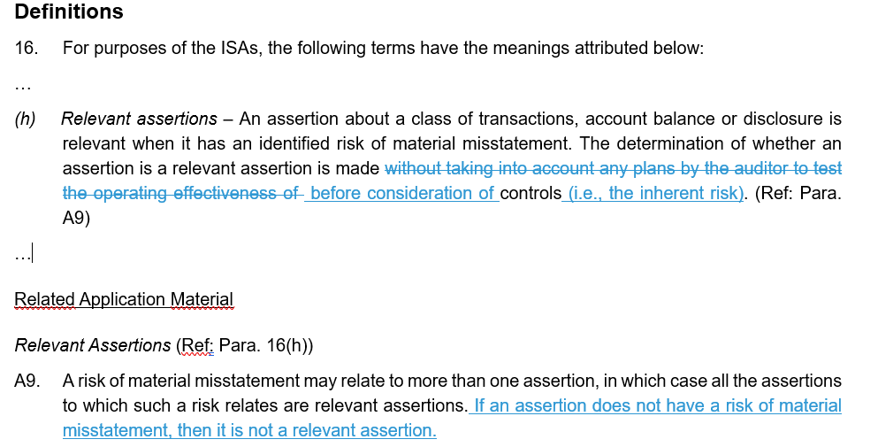
1. Definition of Relevant Assertion

Slide 4
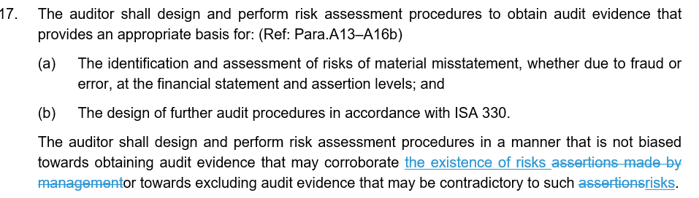
2. Hanging paragraph to paragraph 17

Slide 5
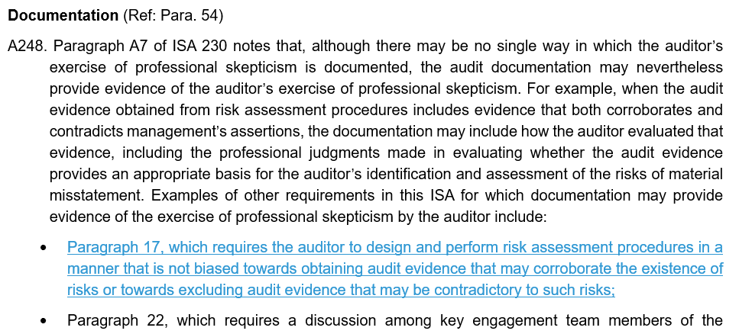
2. Application Material to Para 17

Slide 6
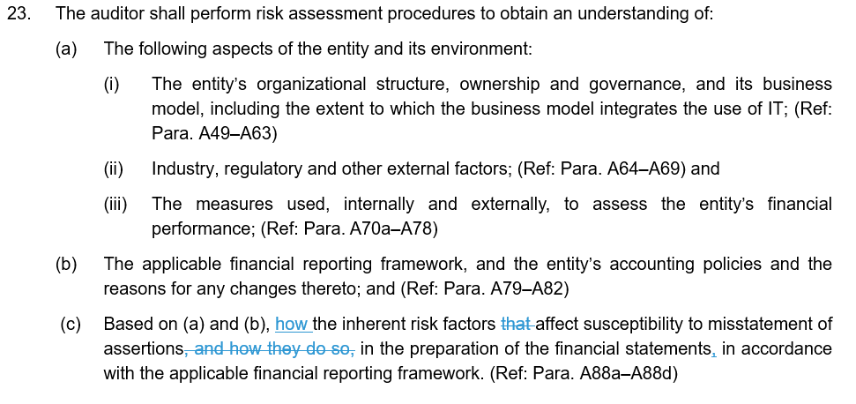
3. IRF’s and Para 23(c)

Slide 7
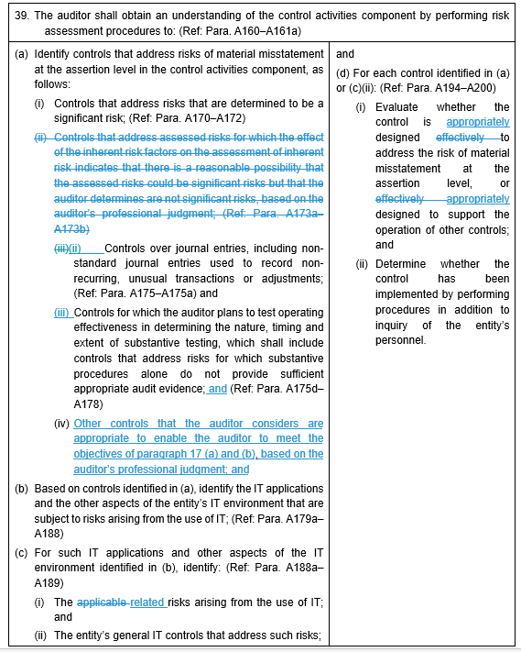
4. Para 39(a)(ii)

Slide 8
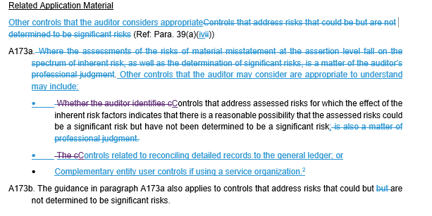
4. Application Material to Para 39

Slide 9
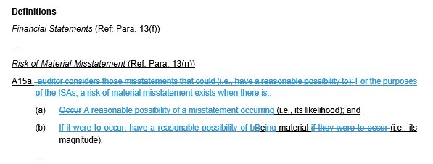
5. Conforming Amendment to ISA 200 - Threshold

Slide 10
Question 1 from Issues Paper
Matter for IAASB Consideration
1. The IAASB is asked to comment on the Task Force’s proposals in respect of the public sector, automated tools and techniques, or translations. The IAASB is also asked whether there are any other matters raised by respondent’s in relation to these areas that need to be further considered.
We are looking for any additional fatal flaws that were not already raised during Monday’s discussion on ISA 315

Slide 11
Next Steps
Taskforce to reflect on feedback from today
All of the other offline feedback received from Board (up to Monday pm) is being considered by TF:
Full standard
Conforming Amendments
Thursday (end of day) marked versions of documents to be provided for reading time
Taskforce members and staff will be available during Friday reading time

