Slide 1
EER Assurance Engagements Applying ISAE 3000 (Revised) – Non-authoritative Guidance
Marek Grabowski, EER Task Force Chair & IAASB Member IAASB Meeting – New York, USA Agenda Item 6 September 17, 2019

Slide 2

Agenda for Today
14:00 – 15:00 Consultation Paper responses and Task Force proposals
15:00 – 15:30 Phase 2 draft guidance to date: Chapter 3
15:30 – 16:00 Break
16:00 – 17:30 Phase 2 draft guidance to date: Chapters 4,5, 10-12, 14

Slide 3
Consultation Paper (‘CP’) Responses
Generally positive support
Comments related in the main to:
Length and complexity
Examples to cover broader range of EER frameworks
Work effort for preconditions pre- and post-acceptance
Determining suitability of criteria is challenging
Materiality process including terminology
Assertions
Limited vs reasonable assurance
Many detailed drafting suggestions
Some comments on matters related to phase 2 or not in scope

Slide 4
CP Responses – Overarching Themes Relating to Guidance as a Whole
Guidance long, complex, difficult to navigate
Focus should be on EER-specific challenges, but useful to also provide educational background
Sustainability reporting addressed well; value creation not sufficiently addressed
Differential requirements for limited and reasonable assurance
‘Future-proof’ guidance: consider evolution in EER reporting (including technological) and implications for assurance
Clarify linkages between guidance, Standard and other subject-specific standards

Slide 5
TF Proposals to Address Overarching Themes Relating to Guidance as a Whole
Restructure guidance:
Main body of guidance: practical guidance and short examples
Appendix: longer/more complex examples
Supplement: Background and Contextual Information
Use hyperlinks between main body of guidance, Appendix and Supplement
Broaden range of examples
Address differential requirements for limited and reasonable assurance
Acknowledge technology and other developments, but principles remain the same
Address detailed drafting suggestions in drafting combined guidance

Slide 6
Question 1 Themes on Scope of Guidance (paras 9-15 of CP) and TF proposals to address themes
Clearly define EER engagements, intended audience and purpose
Guidance would be helpful on:
Using the work of others
Financial information in EER reports
Quality control (and compliance with ISQC 1 or similar standard)
Direct engagements
Task Force proposals:
Identify subject matters covered under ISAE 3000 (Revised) and whether they are EER engagements
Clarify focus is non-authoritative guidance for assurance practitioners on EER key challenges
Guidance on using work of others, ISQC 1, and financial information to be developed in phase 2:
Direct engagements outside of project proposal, but clarify that guidance may be applied where challenges present

Slide 7
Comments and Questions on Structure and Scope

Slide 8
Question 1 Themes on Preconditions and Internal Control (paras 25 of CP)
Guidance generally supported
Some concerns raised about:
Differentiating work effort pre- and post-acceptance, and iterative nature
Apparent inconsistencies between paragraphs 45 and 60 of draft guidance
Interrelationships between preconditions
Further guidance needed:
On readiness assessments
To recognise a substantive approach is possible
On rational purpose: point in time engagements; inappropriate association of the practitioner’s name; direct contact with users

Slide 9
TF Proposals to Address Themes on Preconditions and Internal Control
Guidance cannot provide a ‘bright line’ on work effort pre- and post- acceptance, but can indicate factors and give examples of factors
Further guidance on readiness assessments included in phase 2 material
Clarify paragraphs 46 and 60 to address apparent inconsistencies
Other comments to be considered during further development of phase 2 guidance

Slide 10
Question 1 Themes on Suitability and Availability of Criteria (paragraph 29 of CP)
ma
Determining suitability of criteria challenging in practice
Call for examples to address non-prescriptive nature of principles-based frameworks, for example, Integrated Reporting, IASB’s Management Commentary Practice Statement, UK Strategic Report
Need for further guidance on:
Availability of criteria, and changes in criteria
Consideration of how preparer has identified user needs
Clarifying apparent inconsistency between presumption that established criteria are suitable and need for entity-developed criteria when using some established frameworks

Slide 11
TF Proposals to Address Themes on Suitability and Availability of Criteria
Further examples to illustrate thought process, including understanding user needs and changes in criteria
Clarify that criteria under an EER reporting framework are unlikely to be sufficient without supplementary entity-developed criteria
Clarify apparent inconsistency by explicitly stating that high-level principles-based framework is an indicator that framework may not be suitable on its own
Clarify that it is a precondition for criteria to be made available

Slide 12
Question 1 Themes on Materiality Process (paragraph 33 of CP)
ma
Chapter 8 provides useful guidance on a complex area
However:
Terminology is confusing
Clear linkage needed between practitioner’s consideration of the ‘materiality process’ and of preconditions
The needs of intended users are crucial
Guidance should not imply an obligation to review ‘materiality process’
There is a need for the preparer to consider more than ‘impact’ in developing criteria
Clarification needed on disclosure of materiality process
Guidance would be helpful on the use of multiple frameworks as sources of criteria

Slide 13
TF Proposals to Address Themes on Materiality Process
Develop different term to describe a preparer’s process
Further examples to show how criteria are developed and applied and link consideration of ‘materiality process’ and preconditions, and to illustrate considerations where multiple frameworks are used
Clarify that preparer’s ‘materiality process’ may be a useful source of evidence about suitability of criteria
Clarify that disclosure not generally required (although some frameworks may require), but may be helpful to users

Slide 14
Question 1 Themes on Materiality of Misstatements (paragraph 35 of CP) and TF proposals to address
ma
More guidance is needed on:
Qualitative materiality
Disparate aspects of underlying subject matter with no common basis for aggregation
The meaning of ‘clearly trivial’
Consideration of materiality in planning and performing the engagement
Considering the structure of the overall report and the priority with which the information is presented
One respondent noted that misstatements arising from ‘not knowing’ could be material
Task Force actions and proposals:
Some new guidance included and currently being developed further to address comments raised (subject to TF views in paragraphs 60-62 of the Issues Paper)
‘Not knowing’ is not a misstatement, but may be a reason for one occurring or not being detected
Guidance on considering materiality in planning and performing the engagement allocated to phase 2

Slide 15
Comments and Questions

Slide 16
Question 1 Themes on Assertions (paragraph 40 of CP) and TF proposals to address themes
ma
Respondents generally supportive of the guidance on assertions; some concerns about:
Length and complexity
Usefulness to practitioners not familiar with the concept of assertions
Apparent inconsistencies with ISA 315 and ISAE 3410
Whether assertions for an EER engagement should be consistent financial statement assertions
The omission of ‘valuation’ and ‘completeness’ assertions; the need to further explain ‘free from error’ and ‘connectivity’
One respondent considered that introducing the concept of proper application of criteria may imply a ‘fair presentation’ consideration
Task Force proposals:
Focus on practical use of assertions through illustrative examples
Clarify that assertions are categorizations; there may be different ways of categorizing them – as long as all the ‘what can go wrongs’ are addressed
Remove ‘free from error’ as it relates to all assertions
Clarify intention is not to imply the need for fair presentation criteria

Slide 17
Question 1 Themes on Narrative and Future-Oriented Information (paragraph 41 of CP)
ma
Respondents generally supportive, but offered some suggestions for further development of guidance:
Emphasize need for strong criteria, and include examples of suitable criteria and procedures to obtain appropriate evidence
Should not create the expectation that all narrative and future-oriented information is capable of being assured
Narrative and future-oriented information should be supported by a sufficient system of internal control
A clear definition of ‘narrative information’ needed so it is clear what is ‘other information’
Draw out that a stable history of accurate forecasting provides a stronger evidential basis for a forecast than where there is no such history

Slide 18
TF Proposals to Address Themes Narrative and Future-Oriented Information
Chapters 11 and 12 include draft phase 2 guidance on:
Need for preconditions to be present, including processes to prepare the subject matter information provide a reasonable basis
How subjective statements may be revised
What constitutes ‘other information’
Further consideration has already been given to the example in paragraph 195 example and changes made
Further examples to illustrate the challenges and considerations for narrative and future-oriented information

Slide 19
Question 2 Themes Relating to Use of Examples and Diagrams, and Terminology
Examples and diagrams generally considered useful, and a call for more, and a broader range of, examples, but:
Both financial and non-financial examples would be helpful
Some respondents in favour of an end-to-end case study
Examples should not suggest the only way to approach the requirements
Examples should illustrate possible courses of action
Terminology:
Avoid introducing new terminology when existing terminology could be used
Some terminology confusing (materiality process, elements, qualities, assertions)
A glossary or definitions of new terms would be helpful

Slide 20
TF Proposals to Address Question 2 Themes - Diagrams, Examples and Terminology
Focus on practical application through the use of more, and a broader range of, examples
Specific comments on diagrams and examples to be considered further
Revisit the terminology used and consider it can be simplified or clarified; consider need for including a glossary once terminology has been reconsidered

Slide 21
Question 3 Themes Relating to Structure
Themes included:
Use innovative ways to present guidance to assist in navigability
Use a flowchart to help navigate, to link the stages of the engagement, and show the iterative nature of considerations
Some reordering of chapters may be needed (e.g. chapter 8 earlier in the document)
The TF proposes to make the guidance more practical and user-friendly by:
Separating main body practical EER-specific guidance from longer examples and background material
Using a flow diagram to show each stage of the engagement
Using hyperlinks and icons to improve navigation
Considering the ordering of chapters once the combined phase 1 and phase 2 guidance is developed

Slide 22
Questions 4&5 Themes Relating to Potential Conflicts with and Matters not Addressed in the Standard and TF views
Concern about suggestion of preliminary knowledge needed of an entity’s internal control and implied obligation for practitioner to review the preparer’s ‘materiality process’ (considered under Question 1)
The guidance should not inadvertently suggest new requirements or best practice
Clearly identify matters that are not addressed by the Standard
Consider amending the Standard for the guidance developed
A number of individual comments noted – further consideration to be given to these in drafting phase 2 guidance
Task Force views:
Chapter 1 of the guidance states that it is not intended to introduce new requirements; wording to be carefully reconsidered
It would not be consistent with the guidance being non-authoritative to propose conforming amendments to the standard

Slide 23
Question 6 Themes and Task Force Proposals Relating to Additional Papers
Most respondents:
Agreed that the additional papers contained further useful information
Supported publication alongside the non-authoritative guidance
Provided additional suggestions for improvement
The Task Force proposes to:
Move useful background material from phase 1 guidance to a Supplement, combining with the additional papers in the CP
Clarify intended purpose and audience of the non-authoritative guidance, Appendix and Supplement and improve linkage

Slide 24
Question 7 Themes and Task Force Proposals on Other Matters
Various individual stakeholder perspectives noted:
Limited reference to the internal audit function
Greater prescription would assist smaller entities
No particular issues noted regarding developing nations
Ten respondents raised some specific concerns about translation due to complexity of language and new terminology
The Task Force:
Has developed some guidance on using the work of others (chapter 4); further consideration being given to examples to include the use of the work of Internal Audit and others
Acknowledges the need for scalability; more prescriptive guidance is outside the remit of this project
Terminology to be revisited

Slide 25
Comments and Questions

Slide 26
Phase 2 Guidance – First Draft
The EER Assurance House (under construction)
Communicating Effectively in the Assurance Report ⑩
Challenges allocated to phase 1
② Evaluating Suitability of Criteria
③ Applying Materiality
④ Building Assertions
⑤ Maturity in Governance & Internal Control
⑥ & ⑦ Addressing Narrative and Future-Oriented Information
Challenges split between phase 1 and phase 2
Challenges allocated to phase 2
Determining the Scope of an EER Assurance Engagement ①
Exercising Professional Skepticism and Professional Judgment ⑧
Obtaining the Competence Necessary to Perform the Engagement ⑨

Slide 27
Chapter 3 – paras 13-51: Determining the Scope of an EER Assurance Engagement
Wide variety in scope of assurance engagements in practice
Meaning of Scope of Assurance
Breadth
Can be an entire report or only part(s) of an EER report
Engagement acceptance linked to preconditions, especially rational purpose
Cherry picking
Increasing breadth – rolling program
Depth
Level of assurance – acceptably low engagement risk – in circumstances of the engagement
Other issues revisited
Other Information – work effort relating to preconditions – assurance readiness engagements

Slide 28
Comments and Questions

Slide 29
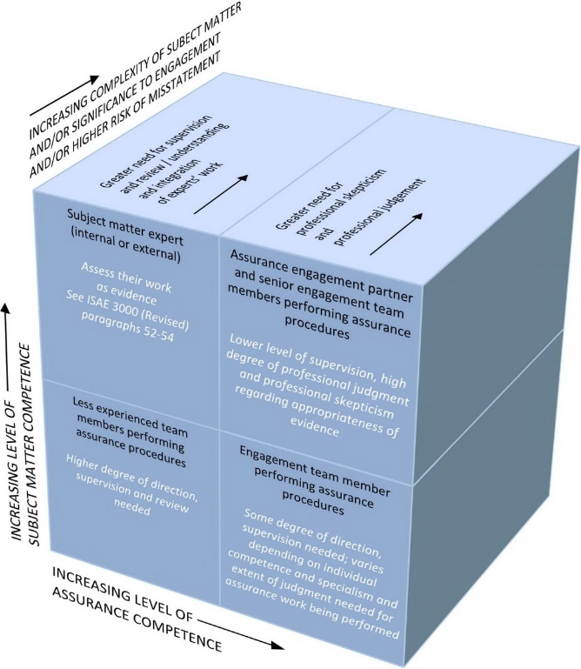
Chapter 4 – paras 52-74: Applying Appropriate Skills
Diversity, breadth and characteristics of subject matter
Increases complexity in some engagements
Drives need for wide range of skills and experience
Competence model different from financial statement audit
Engagement partner – high assurance competence; enough SM competence to take responsibility
Competence considerations in assignment of team may be complex
Assurance competence and subject matter competence
Multi-disciplinary teams – Skills matrix – Competence cube – Quality control
Engagement partner and engagement team competence

Slide 30
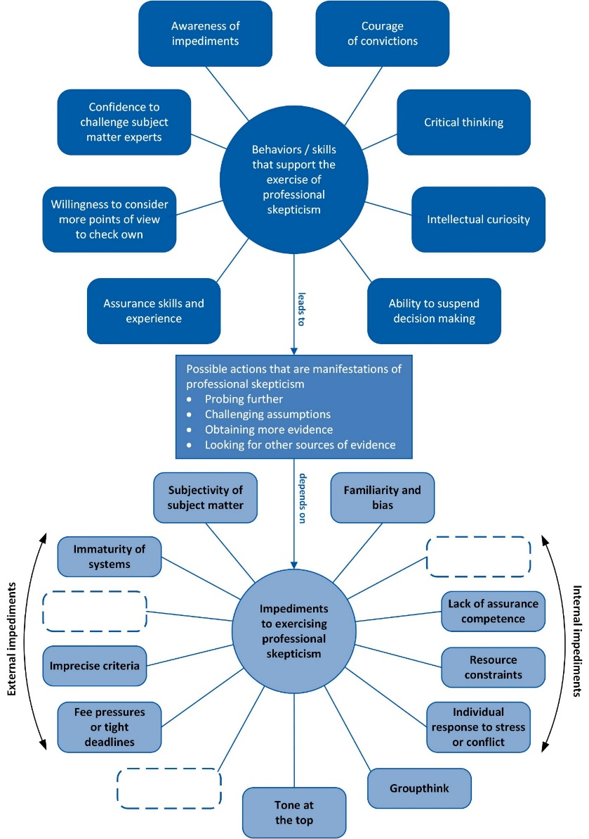
Chapter 5 – paras 75-92: Exercising Professional Skepticism and Professional Judgment
Many aspects of EER that require PS and PJ
Skills and experience needed to exercise PS and PJ
Professional Skepticism
Attitude of mind – actions taken as a result
Behaviours and skills that support exercise of PS
Impediments to exercise of PS
Professional Judgment
Application of training, knowledge and experience – decisions about courses of action
PJ/PS - Practical examples and icons to flag throughout guidance
PJ
PS

Slide 31
Comments and Questions

Slide 32
Chapters 10-12 – paras 93-148: Obtaining Audit Evidence in Respect of Narrative and Future-Oriented Information
New Chapter 10 on general aspects evidence and thought process
Evidence needed and sources
Design and performance of procedures
Evaluating sufficiency and appropriateness of evidence
Illustrative example for thought process (quantitative information)
How much evidence is enough?
Limited v reasonable assurance – Not discrete models – Procedures for obtaining evidence essentially the same
Guidance and examples to illustrate application of thought process to narrative and future-oriented information (integrated with guidance in previous Chapters 10 and 11 (now 11 and 12)

Slide 33
Chapter 14 – paras 149-196: Communicating Effectively in the Assurance Report
Convey conclusion and its basis to enhance user confidence – Scope and level of assurance obtained - criteria used
Complexity in underlying subject matter of some EER engagements ➔ impediments to effective communication
Short or Long form choice
Flexibility in including additional information, but needs professional judgment
Required summary of work performed
Additional information may facilitate effective communication and help address expectation gaps
Guidance and examples showing how additional information may enhance effectiveness of communication for each basic element of the assurance report

Slide 34
Comments and Questions

Slide 35
Next steps
Completion of combined phase 1 and 2 guidance
To be presented to IAASB in December to seek approval of exposure draft
Exposure draft planned for early 2020

