Slide 1

NETWORK BASED INTRUSION DETECTION SYSTEM USING MACHINE LEARNING
Presented by-
Sharath L R (4NN15CS042)
Nishchith J Hegde (4NN15CS025)
Ajaykrishnan S (4NN15CS007)
Prajwal N (4NN15CS028)
Guided by-
Smt. Vedhavathi N
(Assistant Professor CSE)

Slide 2

ABSTRACT
Intrusion Detection Systems play a crucial role in defending computer networks. However, there concerns regarding feasibility and sustainability of current approaches when faced with the demands of modern networks. More specifically, these concerns relate to the increasing levels of required human interactions and the decreasing levels of detection accuracy. Intrusion Detection System most commonly used in enterprise networks are signature based, because they can efficiently detect known attacks while generating a relatively low number of false positives. As technology has been developed many threats are emerged for the data and network security which is not all good for sensitive data transactions, but as network security also possess equal importance in the computer infrastructure. Thus to overcome this we are proposing this project which is based on machine learning algorithms and techniques.

Slide 3
INTRODUCTION
Dangerous hackers are inventing new techniques in a daily basis to bypass security layers and avoid detection. Thus it is time to figure out new techniques to defend against cyber threats. Intrusion detection systems are a set of devices or pieces of software that play a huge role in modern organizations to defend against intrusions and malicious activities.
There are two major intrusion detection system categories:
Host Based Intrusion Detection Systems (HIDS): they run on the enterprise hosts to detect malicious code in host devices
Network Based Intrusion Detection Systems (NIDS): their role is to detect network anomalies by monitoring the inbound and outbound traffic.
The detection can be done using two intrusion detection techniques:
Signature based detection technique: the traffic is compared against a database of signatures of known threats
Anomaly-based intrusion technique: inspects the traffic based on the behavior of activities.

Slide 4
EXISTING WORK
Ding et al., Min Xiao et al. and Ai-Wu Liu et al. proposed a snort-based hybrid intrusion detection system using frequent episode rules and the 10% of the KDD99 Cup dataset. They create an anomaly detection module for snort that can detect the unknown attacks and a signature generation module that extracts the signature of attacks that are detected by ADS module, and maps the signatures into snort rules.
Divyatmika et al. and Manasa Sreekesh et al. proposed a two-tier network based intrusion detection. The tier one uses misuse detection using the MLP algorithm. The tier two uses anomaly detection using Reinforcement algorithm where network agents learn from the environment and take decisions accordingly. They used the NSL-KDD dataset.
Naser Fallahi et al. , Ashkan Sami et al. and Morteza Tajbakshet al. created and automated flow based rule generator for Network Intrusion Detection Systems. This IDS is based on data flow rather than per packet data like the other once. This approach is implemented using RIPPER and C5.0 algorithms to generate the rules and the ISCX 2012 dataset adding 8 more features.
DRAWBACKS:
All of them are using an obsolete data set that doesn’t represent the behaviour of the modern attacks .
In Packet inspection system, it is hard ,or even impossible , to perform it at the speed of multiple Gigabits per second.
Zero day attacks are not handled in these systems

Slide 5
PROPOSED WORK
A Network based Intrusion Detection System
We implement flow based intrusion detection approach in which, the communication patterns within the network are analysed, instead of contents of individual packets.
Implementing a two tier hybrid Intrusion Detection System
one module for signature based detection techniques
second module for anomaly based detection techniques
Using supervised machine learning techniques such as decision trees, support vector machines and neural networks to implement signature based detection techniques.
Using unsupervised machine learning techniques Reinforcement model and clustering algorithms to implement a module that learns Zero day attacks and helps in detecting them in next attacks.
We have selected the UNSW-NB15 dataset ,a more recent dataset that has nine types of attacks. Each record has 45 features.

Slide 6

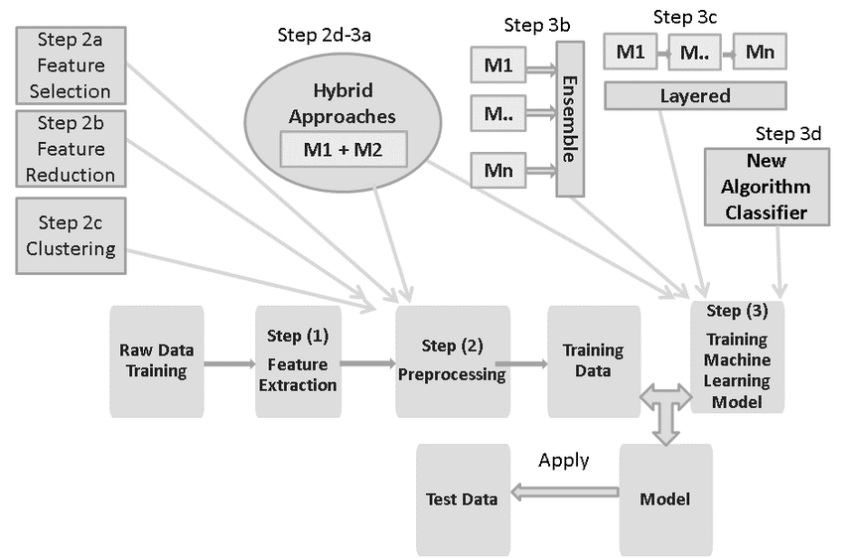
SYSTEM ARCHITECTURE

Slide 7
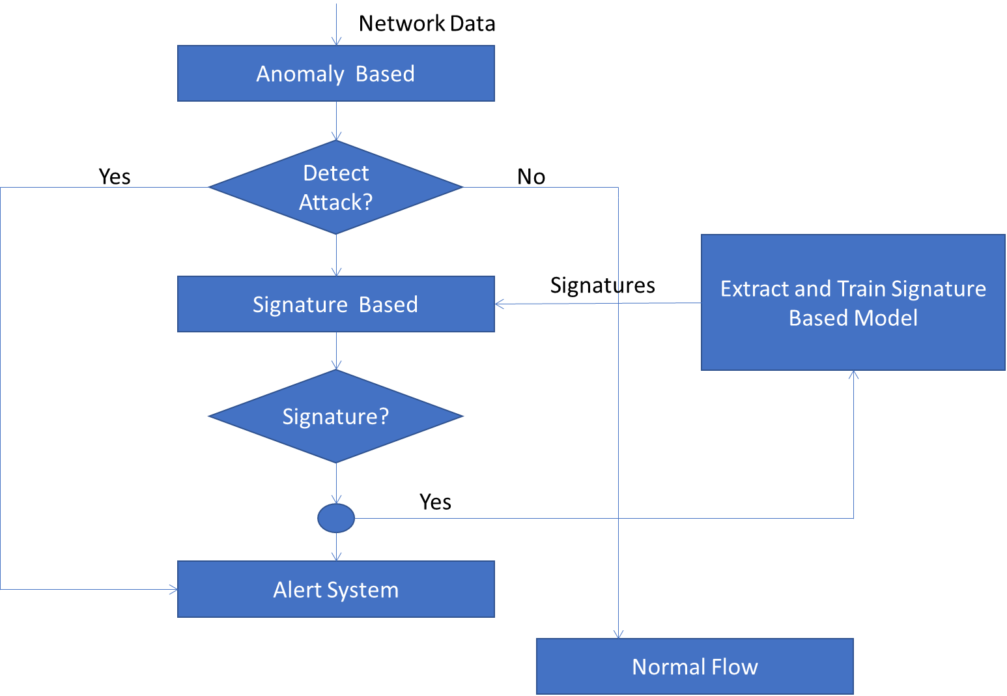
General Flow chart

Slide 8
Signature and anomaly detection module implementation:
Training Dataset
Testing Dataset
Feature Selection Method
Processed Learning Dataset
Processed Testing Dataset
Training model
Attack Data
Normal Data

Slide 9
DESIGN IMPLEMENTATION:
Stage1: Data Selection, Pre-processing and Transformation:
Step 1:Select Data
->KDDCUP99
->Simulation of network data
Step 2:Preprocess Data
->Formatting
->Cleaning
->Sampling
Step 3:Transform Data
->Scaling
->Decomposition
->Aggregation
Step 4:Creating Training datasets and Testing datasets

Slide 10
Stage2: Feature Selection and Extraction:
Selecting those feature which helps in higher prediction rate and extracting them from datasets.
Feature selection is the process where we can select those features which contribute most to our output in which we are interested in.
Feature extraction is a dimensionality reduction process, where an initial set of raw variables is reduced to more manageable groups(features) for processing, while still accurately describing the original data set.
Stage3: Implementing algorithms and Creating training models:
->Neural network:
CNN, RNN,DNN,LSTM,GRU and ANN.
-> Ensemble Learning Techniques: Majority voting.

Slide 11
ANN(Artificial neural network):An ANN is an interconnected group of nodes, inspired by simplification of neuron in brain.
It has circular nodes represents artificial neuron and an arrow represents connection from output of one neuron to input of another.
CNN(Convolutional neural network):CNN is a class of deep neural networks, most commonly applied to analyzing visual imagery.
DNN(Deep neural network): A deep neural network is a neural network with certain level of complexity, a neural network with more than two layers.
They use sophisticated mathematical modeling to process data in complex ways.
RNN(Recurrent neural network):A RNN is a class of artificial neural network where connections between nodes form a direct graph along a temporal sequence.
This allows it to exhibit temporal Dynamic sequence.
RNN can use their internal state to process sequence of inputs.
LSTM(Long-Short Term Memory):It is an artificial recurrent neural network used in the field of deep learning.
LSTM cell can process data sequentially and keep its hidden state through time.
LSTM networks are well suited to classifying, processing and making predictions based on time series data.
GRU(Gated Recurrent Units):GRU’s are a gating mechanism in recurrent neural networks. GRUs have been shown to exhibit even better performance on certain smaller datasets.

Slide 12
Activation functions:
In artificial neural networks, the activation function of a node defines the output of that node, or "neuron," given an input or set of inputs.
This output is then used as input for the next node and so on until a desired solution to the original problem is found.
ReLU(Rectified Linear Units):

Slide 13
Stage4: Training:
Training the model with training dataset.
Stage5: Testing:
Testing the model with training dataset.
Stage6: Performance evaluation:
Accuracy=TP+TN/TP+TN+FP+FN
Recall=TP/TP+FN
Precision=TP/TP+FP
F1 score=Harmonic Mean( Precision, Recall)
Support
Stage7: Implementing IDS and alert system.

Slide 14
Dataflow Diagram
A data flow diagram shows the way information flows through a process or system.
It includes data inputs and outputs, data stores, and the various sub-processes the data moves through.
DFDs are built using standardized symbols and notation to describe various entities and their relationships.

Slide 15
DATA FLOW DIAGRAM LEVEL 0
HYBRID INTRUSION DETECTION SYTEM
NETWORK
(INTRUDERS AND SERVICE PROVIDERS)
Attacks detected
ALERTING SYSTEM
(ALERTS)
Sending data
No attack detected
NORMAL FLOW IN THE SYTEM

Slide 16
DATA FLOW DIAGRAM LEVEL 1
Network
Sniffed data packet
Converted into the input form for a anomaly based model
KDDCup99 data
Anomaly based module
Signatures
comparison
normal data packet
signatures
malicious data
packet
Continue normal flow
signatures
Signature based module
train found new signatures to signature based module
Alerting system
Malicious request

Slide 17
Sequence Diagram
A sequence diagram shows object interactions arranged in time sequence.
It depicts the objects and classes involved in the scenario and the sequence of messages exchanged between the objects needed to carry out the functionality of the scenario.
Sequence diagrams are sometimes called event diagrams or event scenarios.

Slide 18
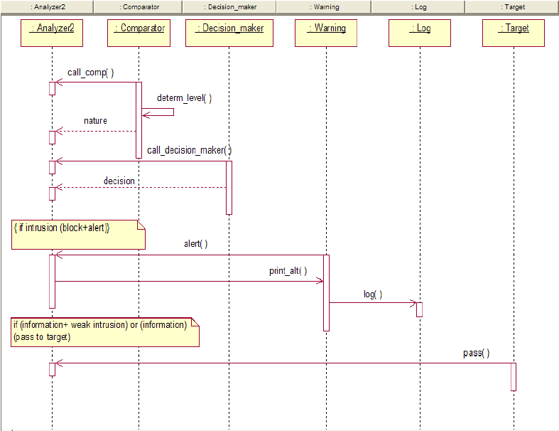
Sequence Diagram

Slide 19
Activity Diagram
Activity diagrams are graphical representations of workflows of stepwise activities and actions with support for choice, iteration and concurrency.
In the Unified Modeling Language, activity diagrams are intended to model both computational and organizational processes (i.e., workflows), as well as the data flows intersecting with the related activities.
Although activity diagrams primarily show the overall flow of control, they can also include elements showing the flow of data between activities through one or more data stores.

Slide 20
Activity Diagram
Attacker/Service Provider | HIDS | ML Model
Send Packet data
Process Packets
Anomaly based detection
Yes
No
Attack?
Send Data AP/Node
yes
Signature detection
Yes
Send more data?
Attack?
Allow Normal Flow
yes
Report Intrusion
No

Slide 21
Use-case Diagram
A use case diagram is a dynamic or behaviour diagram in UML.
Use case diagrams model the functionality of a system using actors and use cases.
Use cases are a set of actions, services, and functions that the system needs to perform.

Slide 22

Use Case Diagram
Detect Type of Attack
Identify Attack
Report Intrusion
Algorithm
Legitimate
Detecting Attack
HIDS
ML Model
Response on Attack
Attacks
Monitoring
Filtering
Pre-processing
Attack 1
Attack 2
…..
Attack n

Slide 23
ARTIFICIAL NEURAL NETWORK
BACKPROPAGATION(training_examples,ղ,nin,nhidden,nout)
Each training example is a pair of the form (x’, t’), where x' is the vector of network input
values, and is the vector of target network output values.
ղ is the learning rate (e.g., .O5). ղin is the number of network inputs, ղhidden the number of
units in the hidden layer, and ղout the number of output units.
The input from unit i into unit j is denoted xji, and the weight from unit i to unit j is denoted
wji.
Create a feed-forward network with ղin inputs, ղhidden hidden units, and ղout output units.
Initialize all network weights to small random numbers (e.g., between -.05 and .05).
Until the termination condition is met, Do
For each (x’, t’ ) in training_examples, Do
Propagate the input forward through the network:
1. Input the instance x' to the network and compute the output oµ of every unit u in the network.
Propagate the errors backward through the network:
2. For each network output unit k, calculate its error term δk
δk ← ok(l - ok)(tk - ok)
3. For each hidden unit h, calculate its error term δh
4. Update each network weight wji
wji ← wji + ∆wji
where
∆wji =ղδj xji

Slide 24
GAUSSIAN NAIVE BAYES
Algorithm: Continuous-valued Features
Conditional probability is often modelled with the normal distribution
Learning Phase:
Output: normal distributions and
Test Phase: Given an unknown instance
calculate conditional probabilities with all the normal distributions achieved in the learning phase
Apply the MAP rule
Assign a label C* to X’ if

Slide 25
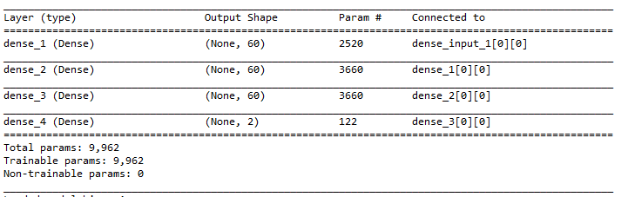
Testing and Implementation
ANN Model Summary:

Slide 26
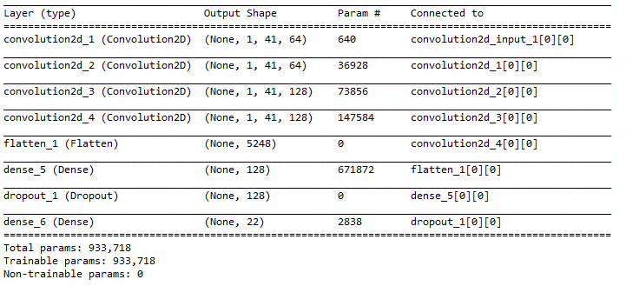
CNN Model Summary:

Slide 27
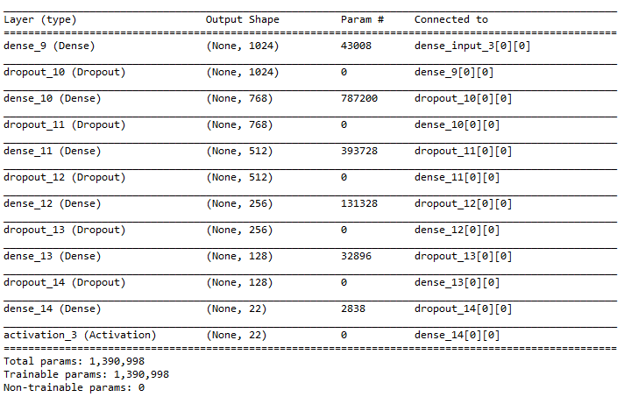
DNN Model Summary:

Slide 28
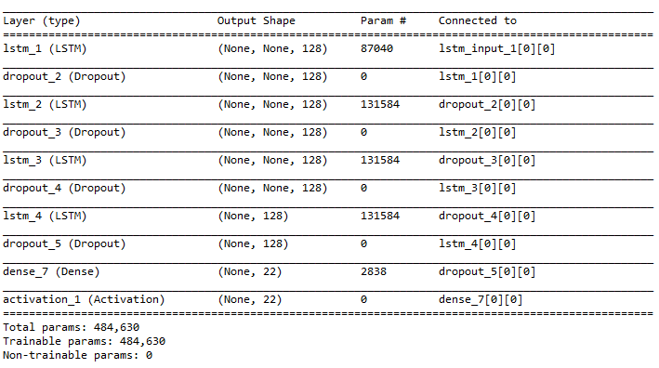
LSTM Model Summary:

Slide 29
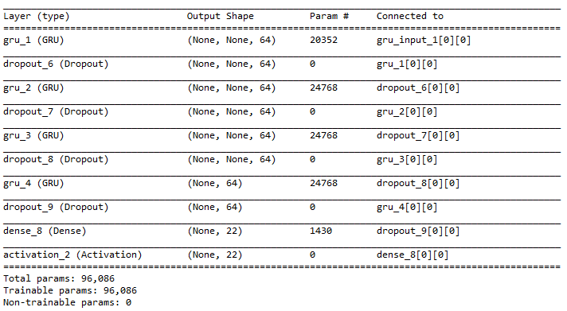
GRU Model Summary:

Slide 30
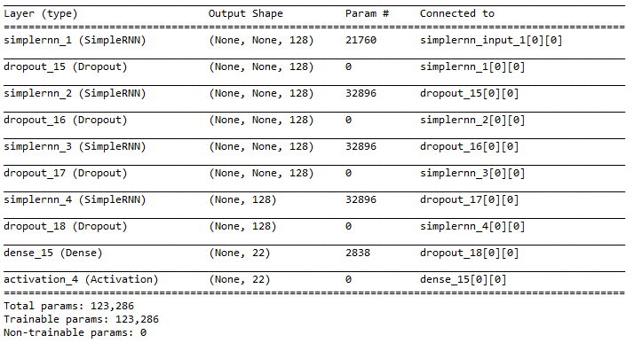
RNN Model Summary:

Slide 31
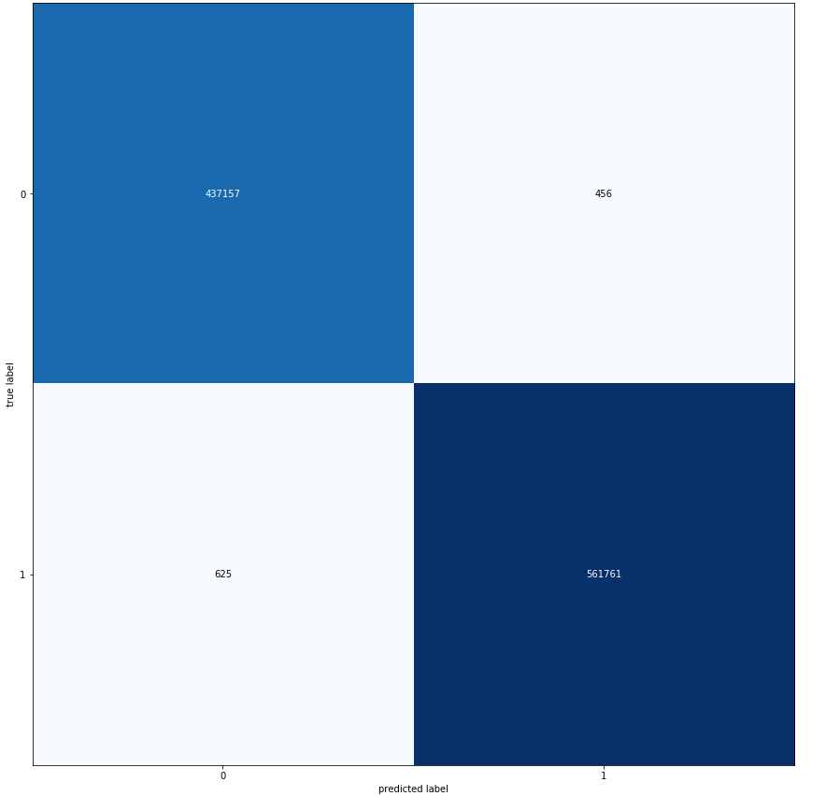
Testing:
ANN Confusion Matrix:
For testing data set:

Slide 32
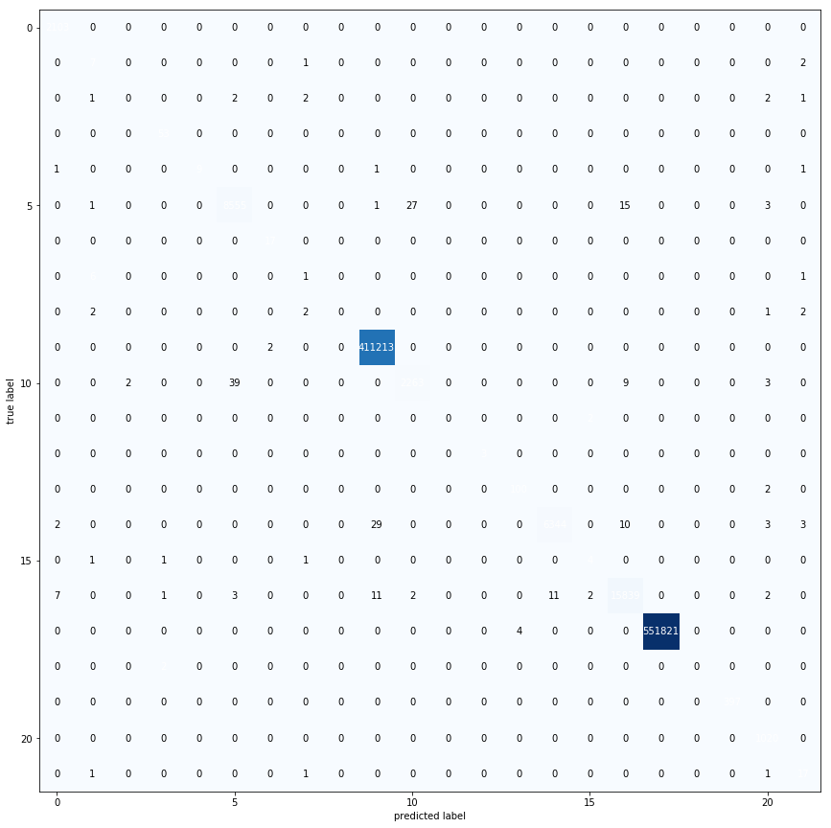
CNN Confusion Matrix:
For testing dataset:

Slide 33
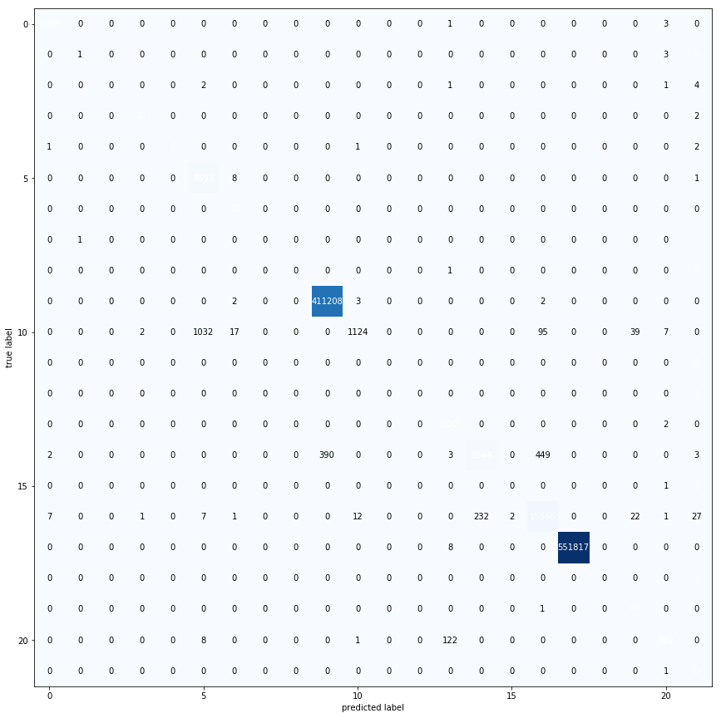
LSTM Confusion Matrix:

Slide 34

DNN Confusion Matrix:

Slide 35
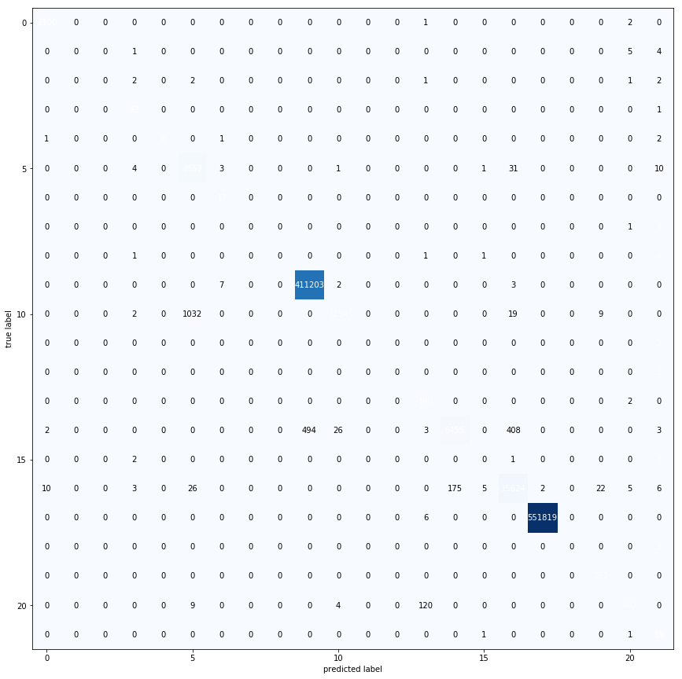
GRU Confusion Matrix:

Slide 36

RNN Confusion Matrix:

Slide 37
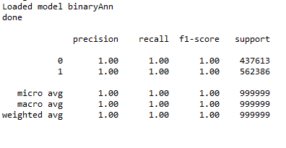
ANN Classification Report:

Slide 38
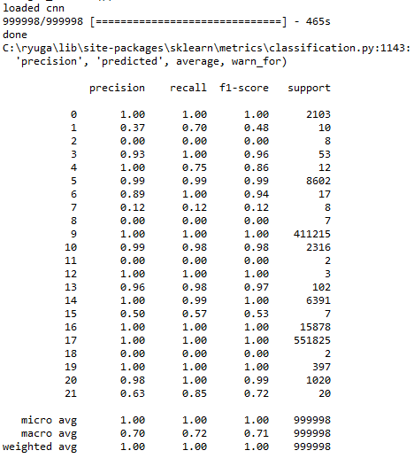
CNN Classification Report:

Slide 39
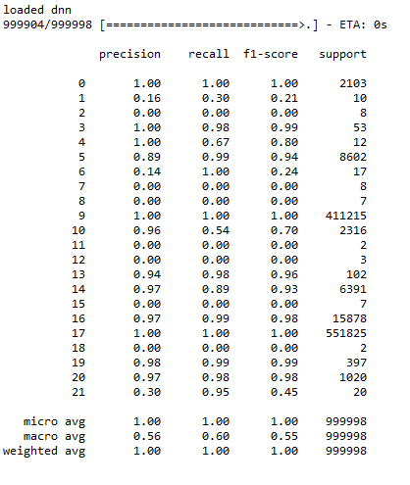
DNN Classification Report:

Slide 40
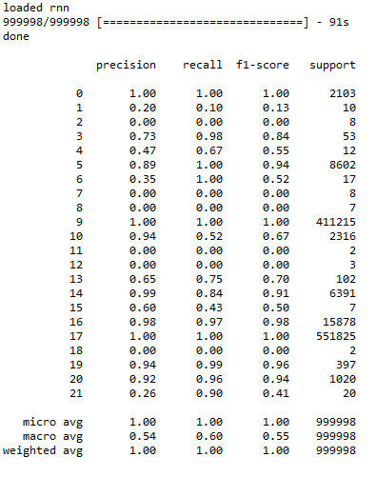
RNN Classification Report:

Slide 41
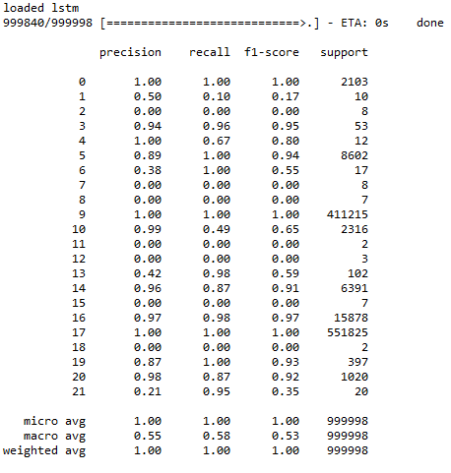
LSTM Classification Report:

Slide 42
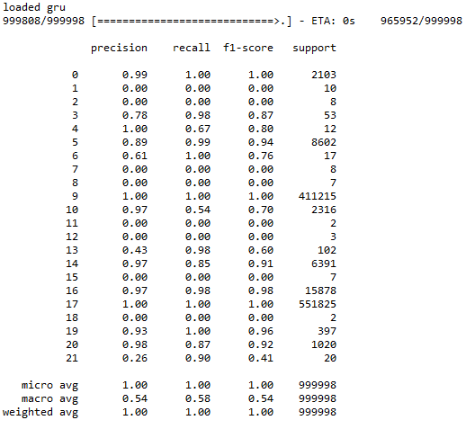
GRU Classification Report:

Slide 43
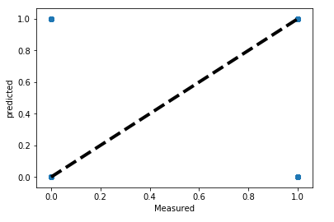
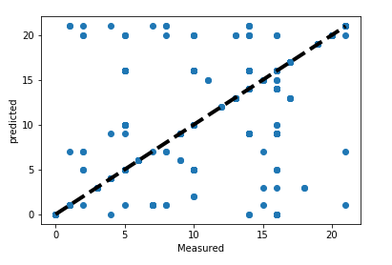
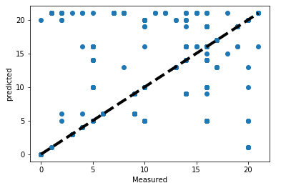
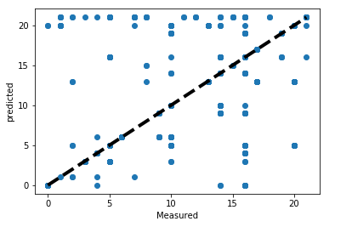
Scatter Plot
ANN :
CNN:
DNN:
RNN:

Slide 44
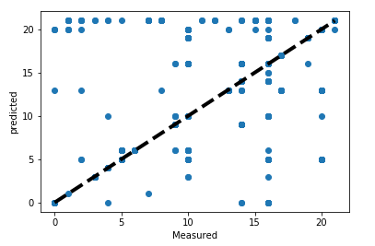
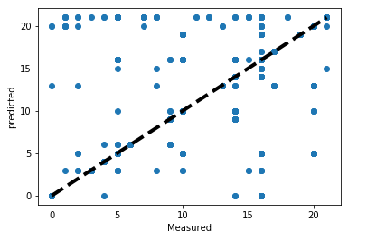
LSTM:
GRU:

Slide 45


