Slide 1


The National Degree College Bagepalli-561207
Department of Computer Science
A Technical Project Report
On
"An Intelligent Student Performance Prediction Using ML"
Submitted in partial fulfilment of the requirement for the award of the degree of
Bachelor Of Computer Applications
Submitted By
PRAJWAL (USN: XXXX001)
VARADARAJU (USN: XXXX002)
GIRISHA A (USN: XXXX003)
Head of the Department
Prof. [HOD Name], B.E., M.Tech., (Ph.D)
Head, Department of Computer Science
Under the guidance of
Mr. [Guide Name]
Assistant Professor,

Slide 2
Agenda
1. Introduction
2. Problem Statement
3. Objectives
4. Proposed Methodology
5. Dataset & Features
6. ML Algorithms & Results
7. System Architecture
8. Web Application Features
9. Visualisations & Charts
10. Conclusion
11. Future Enhancement
12. References

Slide 3
Introduction
An Intelligent Student Performance Prediction System offers a data-driven digital solution to identify at-risk students early. Using Machine Learning algorithms such as Logistic Regression, SVM, Random Forest, and XGBoost, the system predicts whether a student will PASS or FAIL based on academic, social, and personal attributes. It empowers educators with actionable insights and personalised feedback for every student.

Slide 4


The importance of an intelligent prediction system has increased in the era of data-driven education, where student outcomes can be analysed using ML models trained on real-world lifestyle and academic datasets to support timely interventions.
Educational institutions today handle vast amounts of data related to students — including attendance, study habits, family background, and academic performance. Traditionally, identifying at-risk students has been a manual and subjective process, leading to delayed interventions. Our ML-powered Flask web application addresses this gap by providing instant, automated, and explainable predictions for each student.

Slide 5
To predict student academic outcomes: The primary goal is to accurately predict whether a student will PASS or FAIL using ML models trained on real student data.
To ensure efficient ML model selection: The system automatically selects the best performing algorithm using StratifiedKFold cross-validation for robust and fair evaluation.
To support decision-making: The system provides teachers and administrators with comprehensive ML-generated insights, feature importance charts, and SHAP explanations to support informed, data-driven decisions about at-risk students.
To increase transparency with SHAP: By providing SHAP (SHapley Additive exPlanations) values, the system explains each prediction so stakeholders understand the key factors influencing every student's result.
To save time and automate reporting: The system automates prediction, chart generation, and report creation — producing downloadable CSV reports, 10+ visualisation charts, and personalised improvement tips for each student.

Slide 6
Problem Statement
Educational institutions face significant challenges in identifying students at risk of failure.
Manual Assessment: Identifying struggling students is subjective and time-consuming for teachers.
Delayed Intervention: Without early warning systems, teachers only notice failure after it occurs.
Data Disorganization: Student records — grades, attendance, social factors — are stored in separate systems, making holistic analysis difficult.
Limited Insights: Without ML-driven analytics, schools cannot identify patterns across multiple student features like study time, family support, and past failures.
Lack of Personalised Feedback: Each student has unique risk factors, but current systems cannot generate personalised, actionable improvement tips at scale.

Slide 7
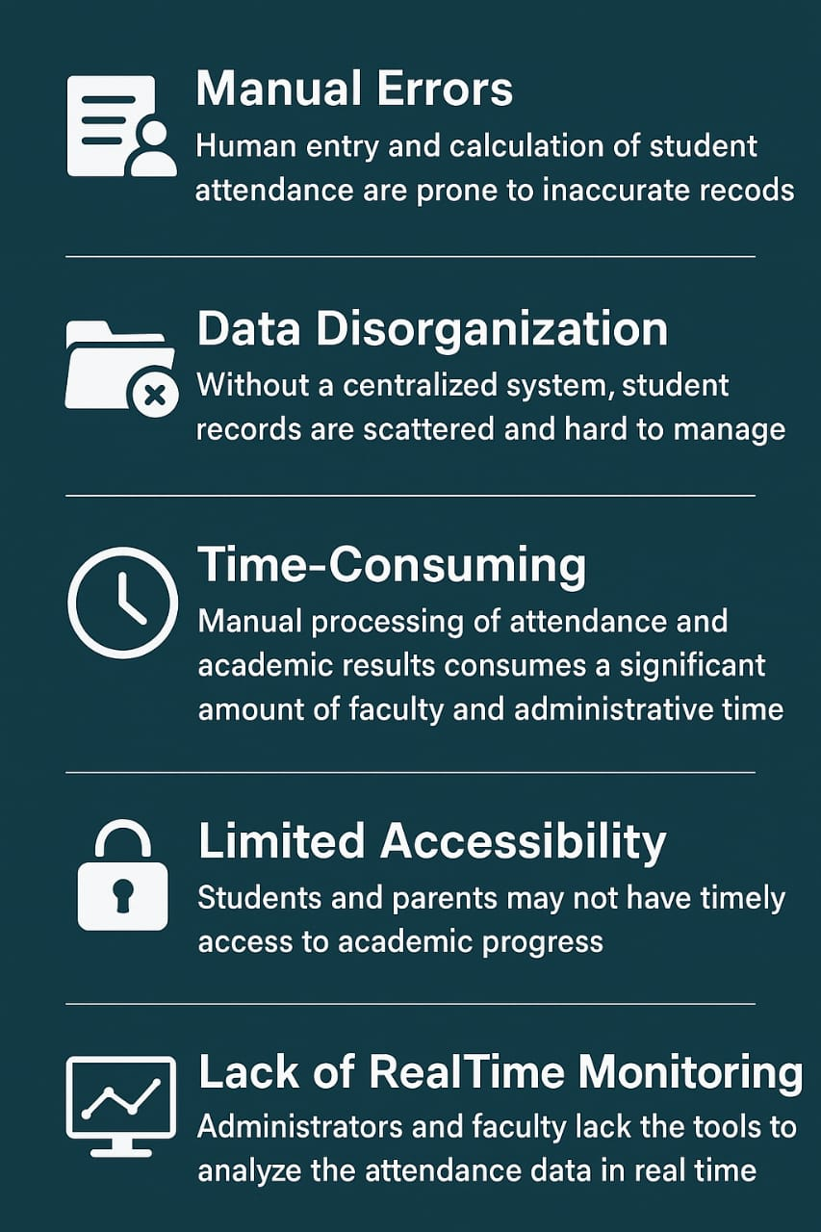
System Architecture & Data Flow
End-to-end pipeline: from raw student data to intelligent predictions and reports
1
2
3
4
5
6
Dataset
Input
Pre-
processing
ML Model
Training
Prediction
Output
Visuals &
Charts
Report &
Export
CSV / Excel
upload or
default dataset
▶
OneHotEncode
+ numeric
passthrough
▶
5 algorithms
trained — best
chosen by CV
▶
Pass / Fail
+ Probability
per student
▶
10 auto charts:
SHAP, heatmap,
confusion
▶
Personalised
tips + CSV
download
Technologies Used:
Python 3.x + Flask
scikit-learn
XGBoost
SHAP
Pandas / NumPy
Bootstrap 5
★ The Flask app auto-selects the best ML model via StratifiedKFold CV, generates 10 visualisation charts, provides SHAP explanations, and exports timestamped CSV reports.

Slide 8
Objectives
1. Efficiently predict whether each student will Pass or Fail
2. Maintain automated ML model training and selection pipeline
3. Automate chart and report generation for every prediction run
4. Provide quick access to individual student performance predictions
5. Enhance transparency between teachers, students, and parents
through SHAP-based explainable AI

Slide 9
6. Reduce manual assessment errors using data-driven ML predictions
7. Save time and resources by automating the full prediction pipeline
8. Generate 10+ visualisation charts for analysis and decision-making
9. Secure model storage using model.pkl serialisation (Joblib)

Slide 10
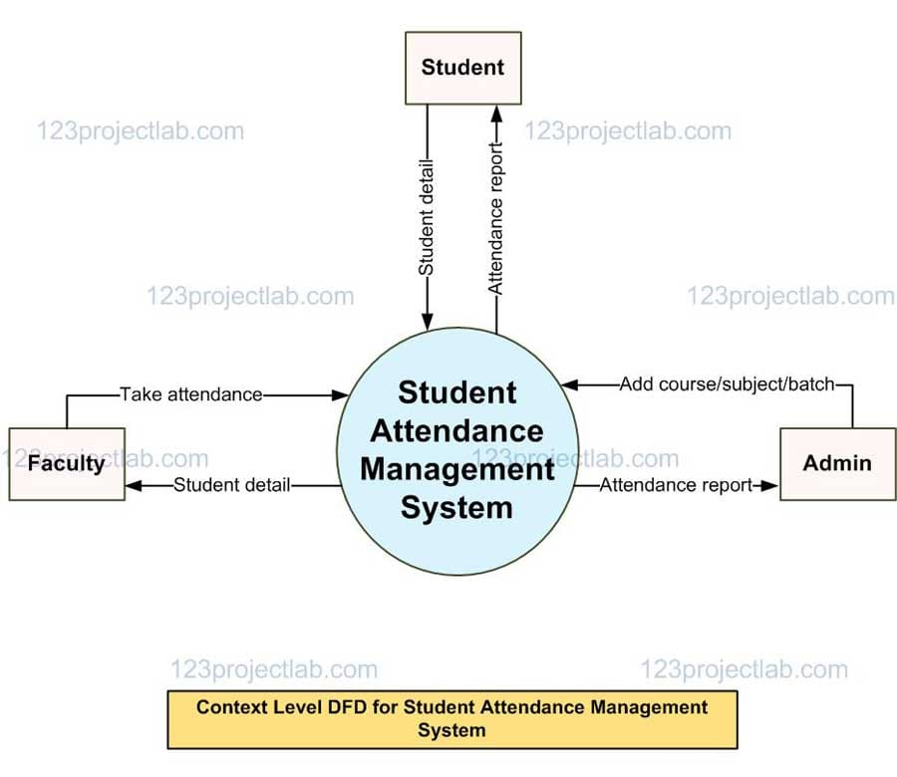
Proposed Methodology

Slide 11
1. Dataset Design and Pre-processing
Student Dataset:
* Student ID, School, Sex, Age, Study Time, Failures, Absences, etc.
Data Preprocessing:
* OneHotEncoding for categorical features (school, sex, address, etc.)
* Passthrough for numeric features (age, absences, study time, etc.)
* Handling class imbalance using balanced class weights
2. Feature Implementation
ML Model Training:
* 5 algorithms: Logistic Regression, SVM (linear & RBF), Random Forest, XGBoost
* Best model selected via StratifiedKFold cross-validation

Slide 12
* Prediction Pipeline:
CSV/Excel upload → Preprocessing → Prediction → Pass/Fail + Probability %
Single student manual entry → Instant prediction with risk factor analysis
3. System Integration and Interface
* Frontend:
Bootstrap 5 responsive web interface
3 tabs: Upload Dataset / Manual Entry / Default Dataset
* Backend:
Flask web framework with Jinja2 template rendering
Automated chart generation (10+ PNG visualisations)
SHAP explainability, feature importance, confusion matrices
Downloadable timestamped CSV prediction reports

Slide 13
Results
The system produces accurate and timely student performance predictions.
Best Model: SVM (RBF kernel) — CV Accuracy: 70.1% | F1-Score: 0.765
All 5 ML models evaluated: Logistic Regression, SVM (linear), SVM (RBF), Random Forest, and XGBoost — best selected automatically by cross-validation.
10 automated visualisation charts generated per prediction run, including SHAP summary plots, confusion matrices, feature importance, and heatmaps.
Personalised, AI-generated improvement tips provided for each student prediction.

Slide 14
Conclusion
The Intelligent Student Performance Prediction System modernises the way educational institutions identify and support at-risk students. By replacing manual assessment with an automated, ML-powered web platform, the system:
* Reduces subjectivity and administrative overhead in student evaluation.
* Improves transparency through SHAP-based explainable AI predictions.
* Enables proactive intervention with early, personalised risk identification.
* Empowers educators with data-driven decision-making tools and visual analytics.
* Delivers a complete end-to-end solution from data upload to downloadable reports.

Slide 15
Future Enhancement
* Integration with Deep Learning (LSTM / Neural Networks) for richer pattern detection
* Automated Real-Time Predictions for live student data streams
* Mobile Application for Students, Teachers, and Parents (React Native / Flutter)
* Cloud-Based Deployment on AWS / Heroku with CI/CD pipeline
* Email & SMS Alerts for at-risk student early warning notifications
* Role-Based Access Control for Admins, Teachers, and Students
* Multi-Subject & Multi-Grade Extension to cover all academic subjects
* REST API Integration with LMS platforms like Moodle and Canvas

Slide 16
References
WEBSITES
1. scikit-learn.org — Machine Learning library documentation
2. xgboost.readthedocs.io — XGBoost documentation
3. shap.readthedocs.io — SHAP explainability library
4. flask.palletsprojects.com — Flask web framework
5. pandas.pydata.org — Data manipulation library
6. python.org — Core language reference
RESEARCH PAPERS
* Cortez, P. & Silva, A.M.G. (2008). Using Data Mining to Predict Secondary School Student Performance. EUROSIS.
This project demonstrates how open-source ML tools can be effectively used for intelligent student performance prediction. Libraries and frameworks such as Python, Flask, scikit-learn, XGBoost, SHAP, Pandas, Matplotlib, and Bootstrap 5 were used.

Slide 17
Thank You!
We are grateful for your time and attention.
Team: Prajwal | Varadaraju | Girisha A
Please let us know if you have any questions or suggestions!

