Slide 1
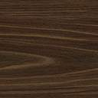
Machine Learning Project UE17CS303 Classification into Stars and Quasars
Algorithm Used: K-Nearest Neighbors
Serial No. | Name | SRN
1 | V.S.Vishruth | PES1201701878
2 | Vithal P Nakod | PES1201701746
3 | Prajwal Pothalkar | PES1201701703

Slide 2
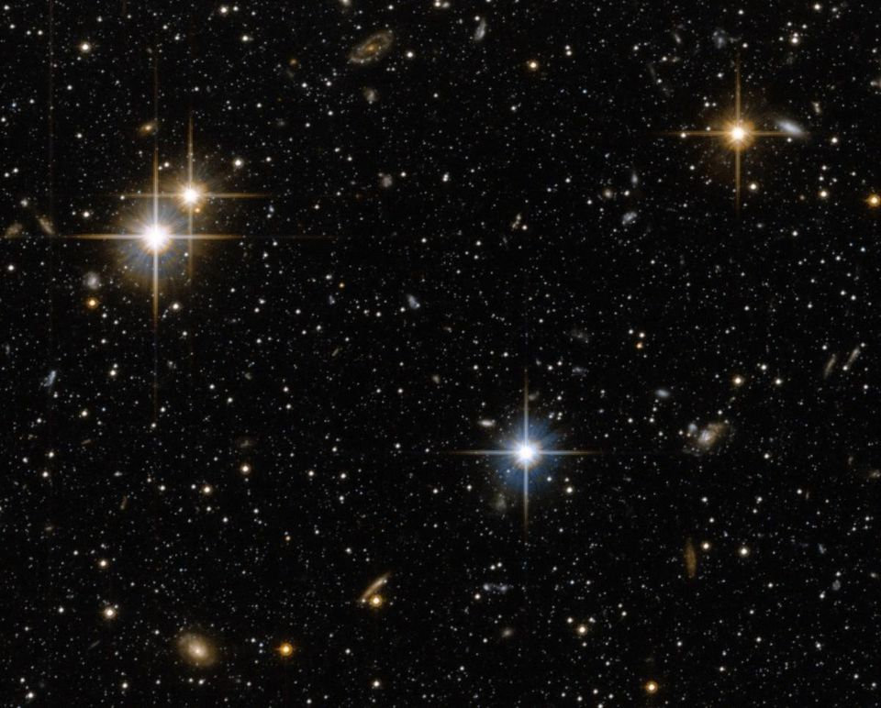
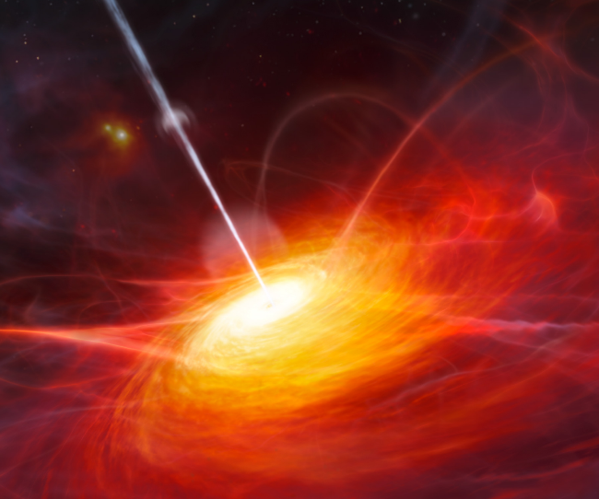
Problem Statement
Classifying matched sources in the Galex (Galaxy Evolution Explorer) and SDSS (Sloan Digital Sky Survey) catalogs into stars and quasars and report the accuracy of the algorithm you have used to classify the dataset into stars and quasars.
Stars Quasars

Slide 3
Algorithm Used: K-Nearest Neighbors
K-Nearest Neighbours is one of the most basic yet essential classification algorithms in Machine Learning. It belongs to the supervised learning domain and finds intense application in pattern recognition, data mining and intrusion detection.
We can implement a KNN model by following the below steps:
Load the data
Initialise the value of k
For getting the predicted class, iterate from 1 to total number of training data points
Calculate the distance between test data and each row of training data. Here we will use Euclidean distance as our distance metric. Sort the calculated distances in ascending order based on distance values
Get top k rows from the sorted array
Get the most frequent class of these rows
Return the predicted class

Slide 4
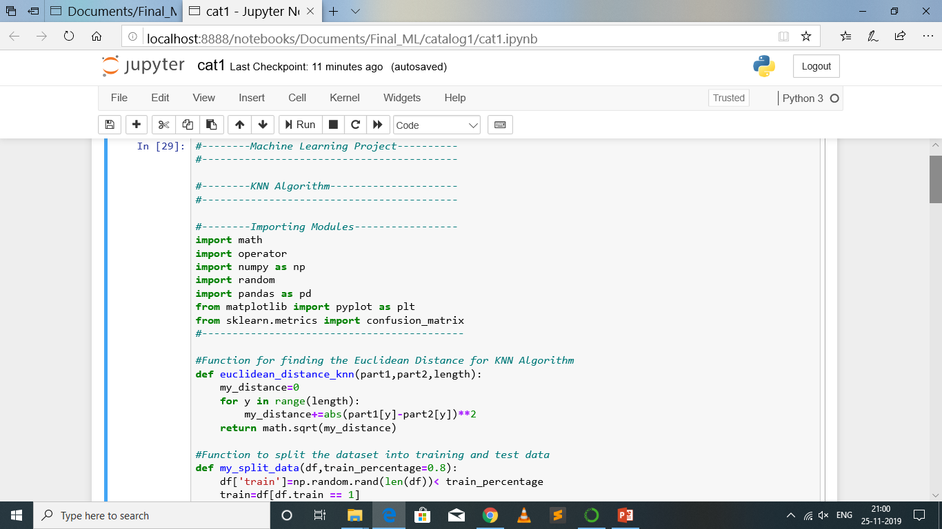
Code Snippets

Slide 5
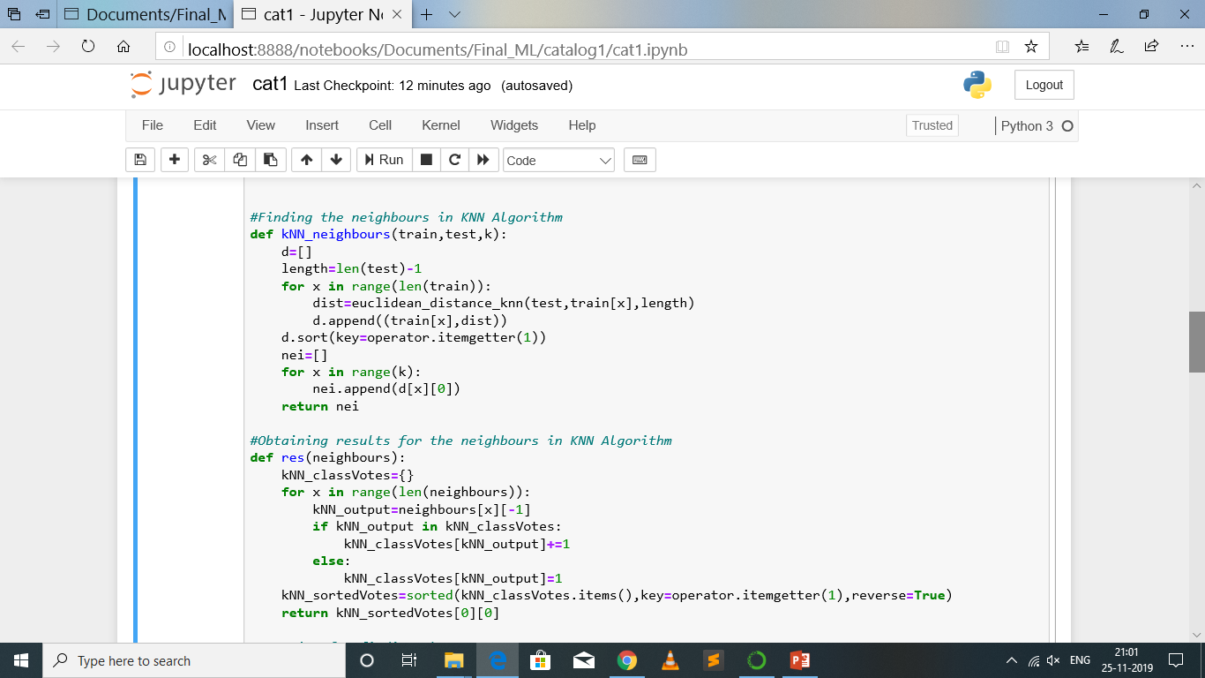
Code Snippets

Slide 6
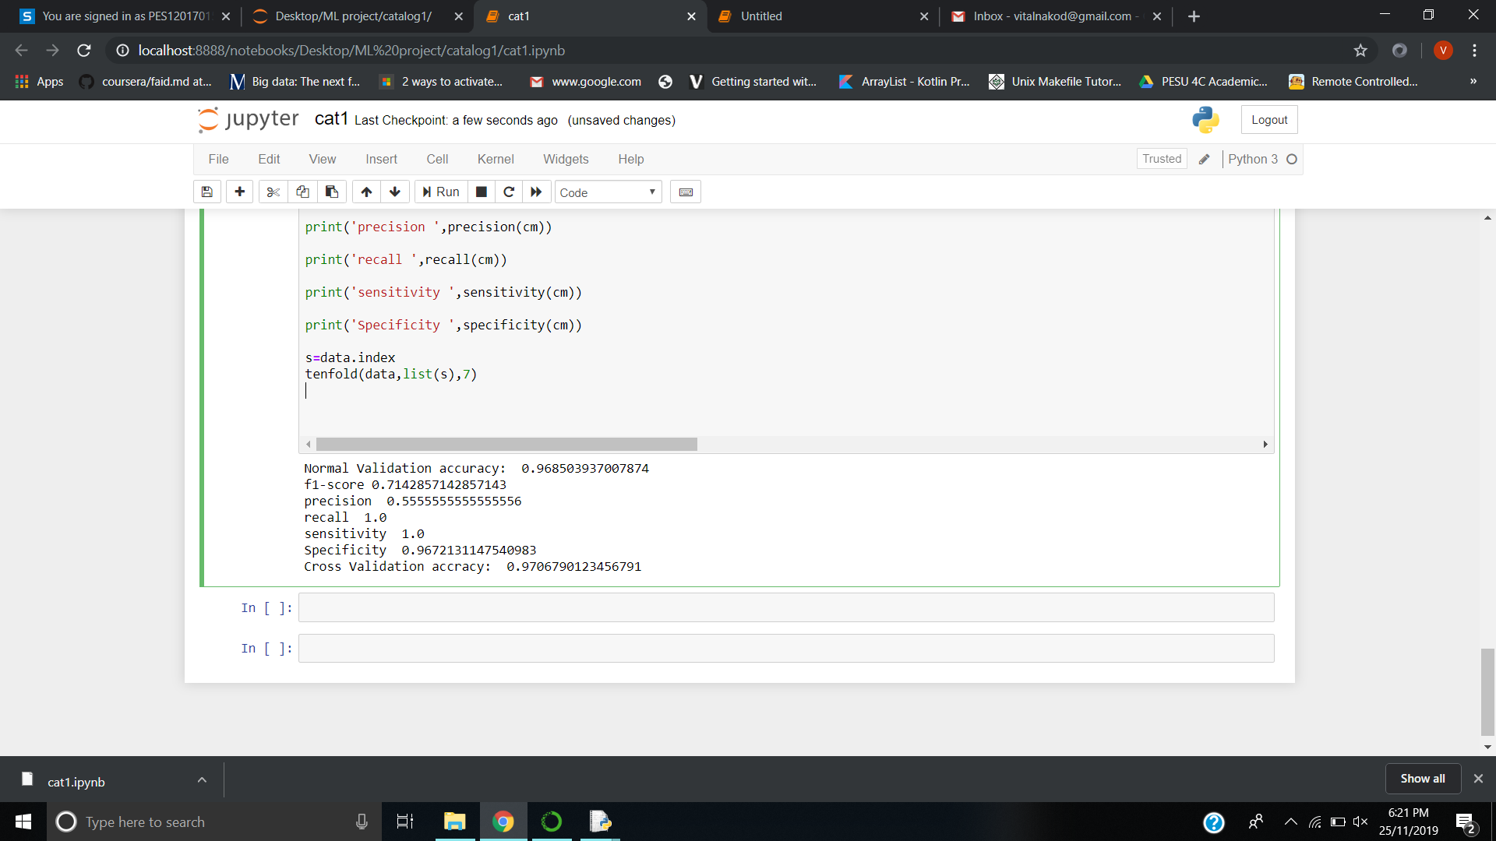
Summary of Results Catalog 1

Slide 7
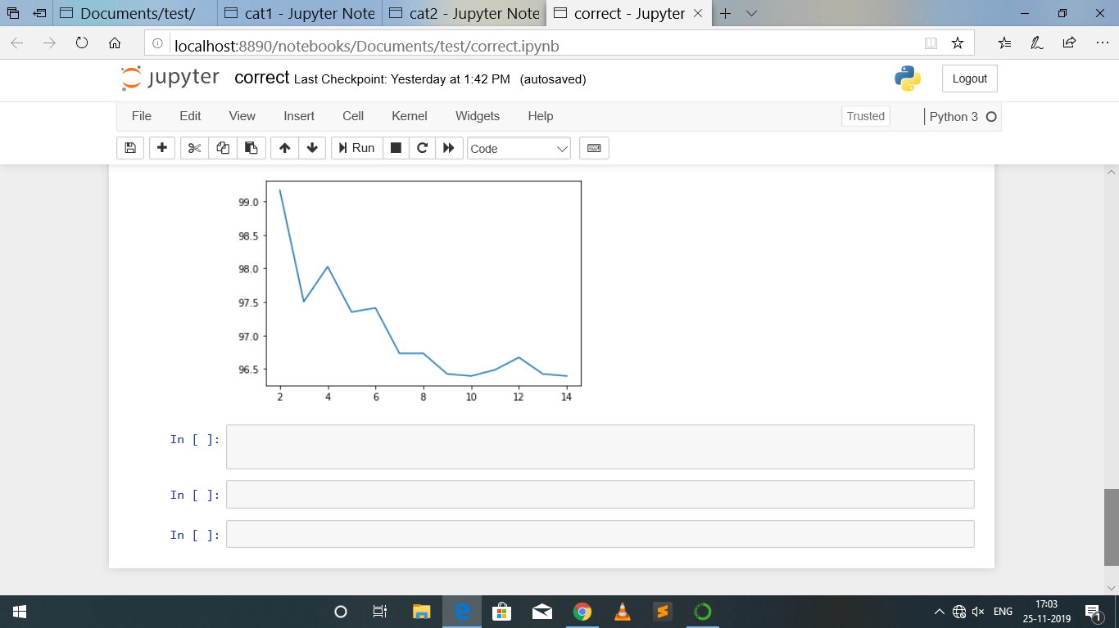
Visualization on Catalog 1

Slide 8
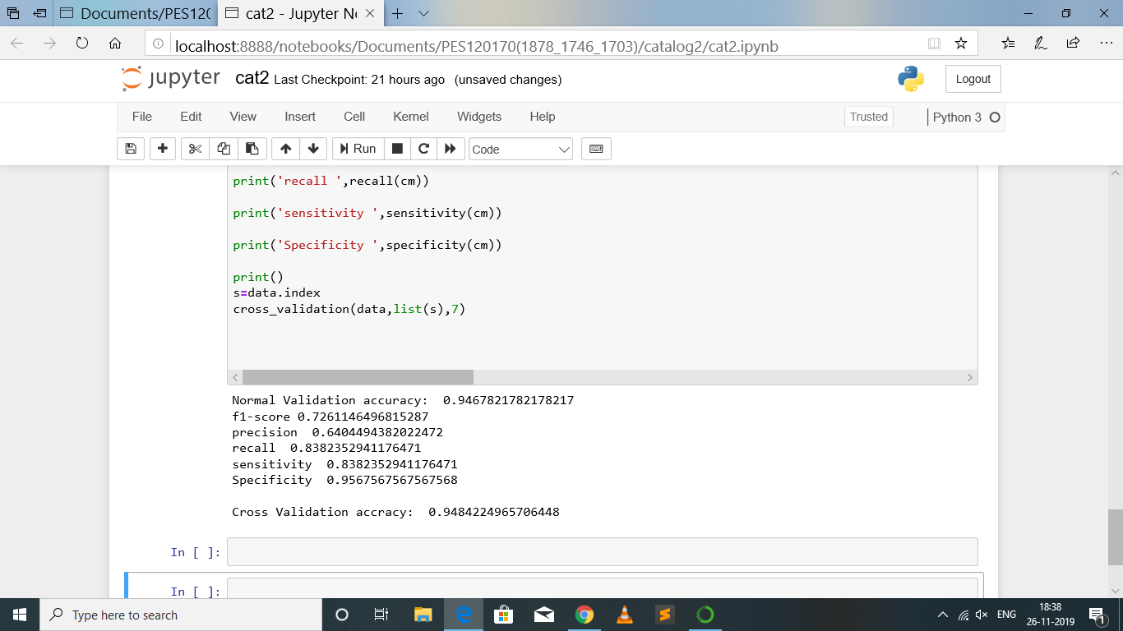
Summary of Results Catalog 2

Slide 9
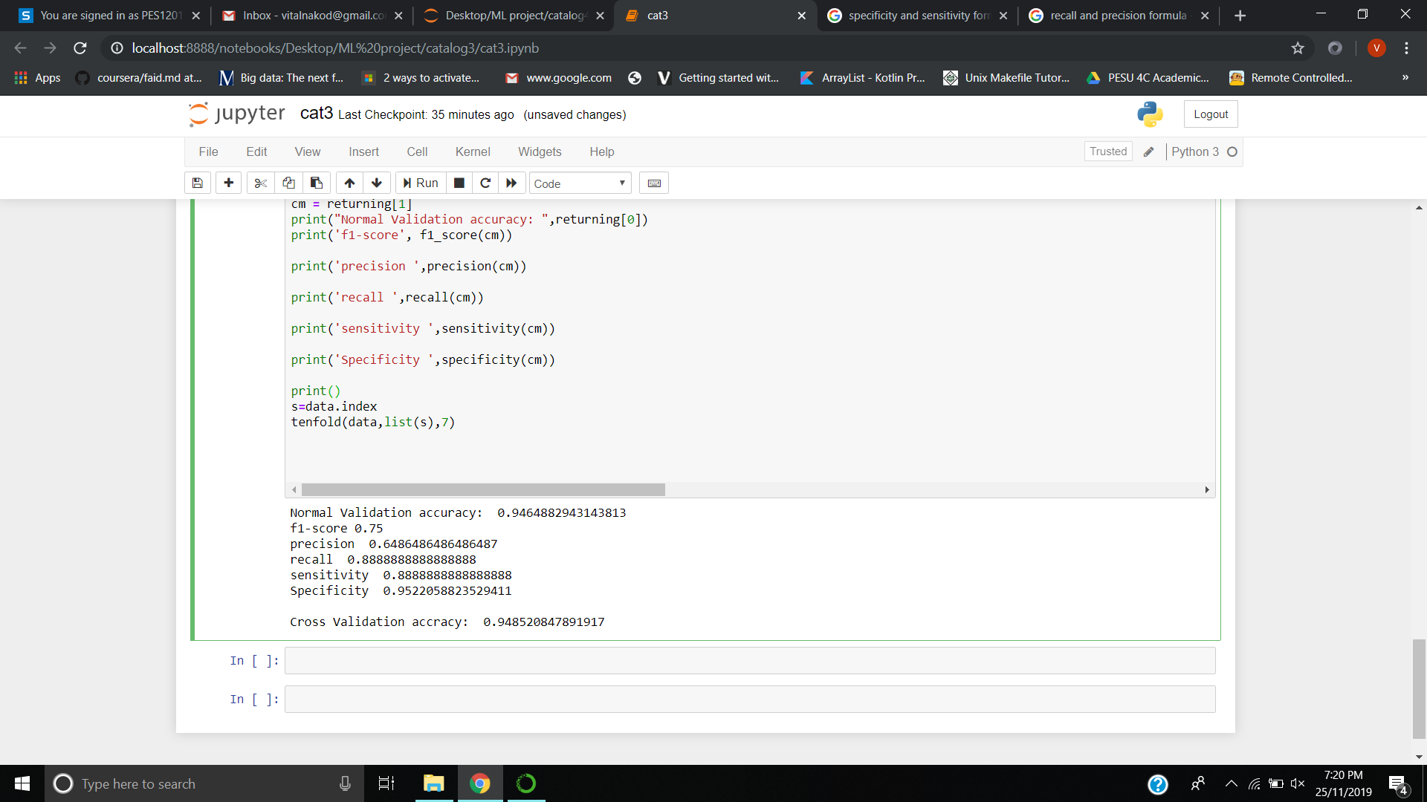
Summary of Results Catalog 3

Slide 10
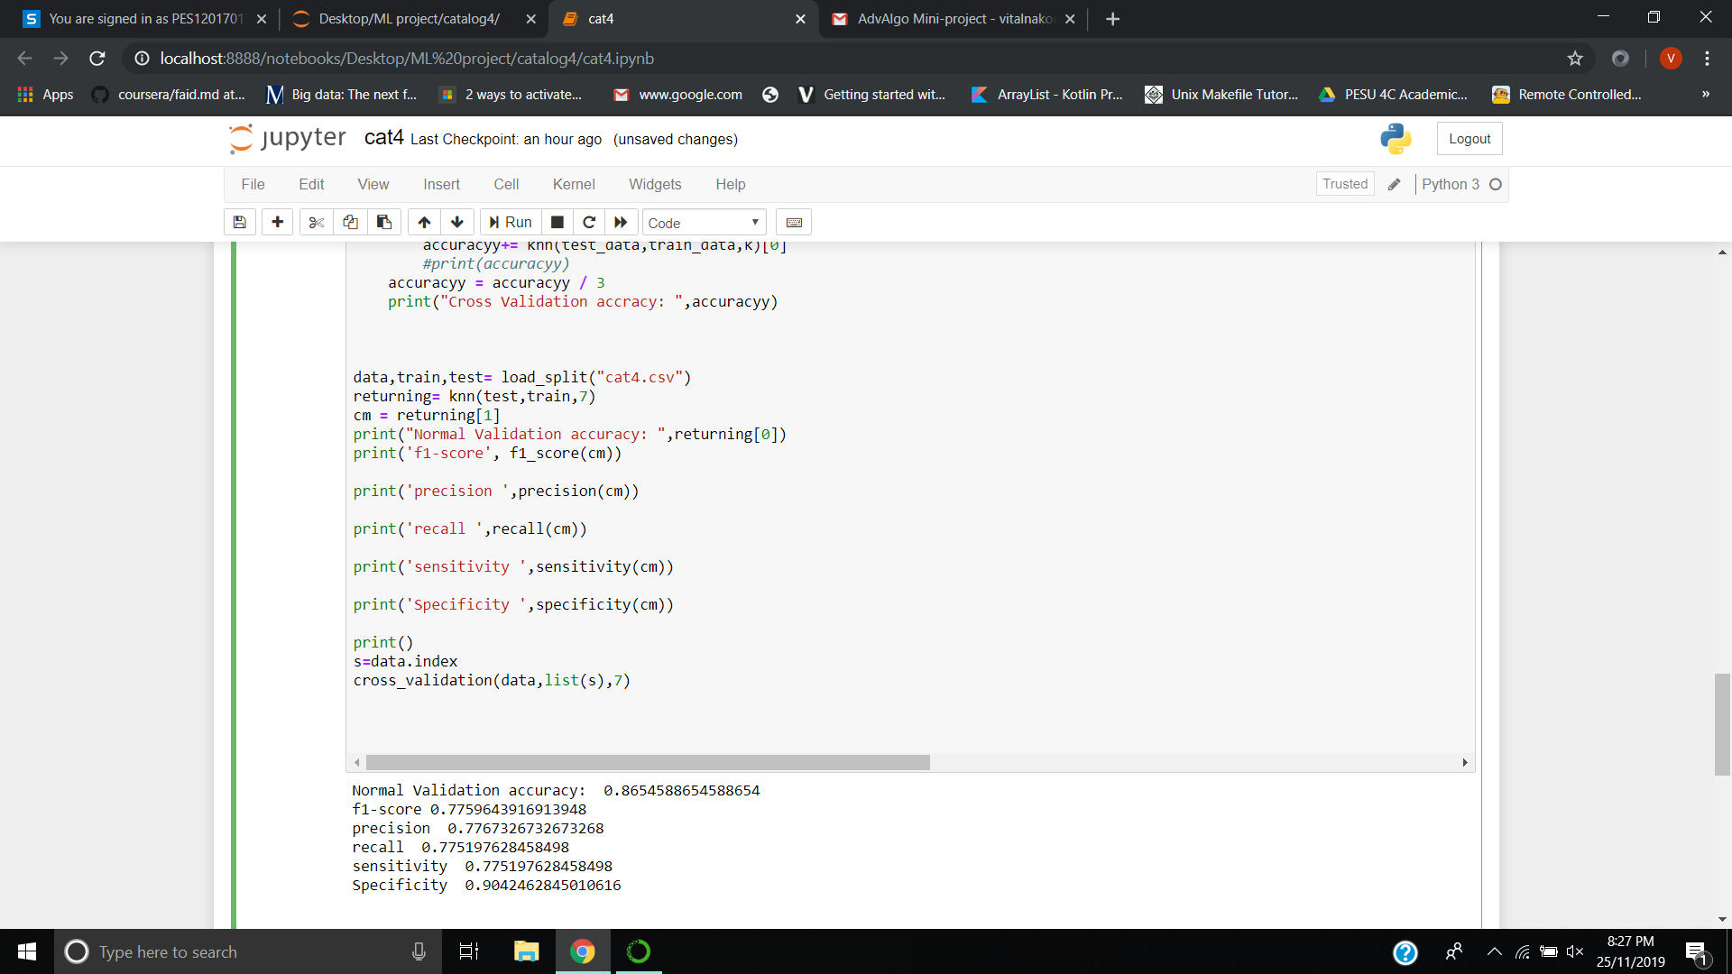
Summary of Results Catalog 4

Slide 11
Comparison:
Normal Validation
Cross Validation
Cat1=> Accuracy: 0.9685
Cat2=> Accuracy: 0.9467
Cat3=> Accuracy: 0.9464
Cat4=> Accuracy: 0.8654
Cat1=> Accuracy: 0.9760
Cat2=> Accuracy: 0.9484
Cat3=> Accuracy: 0.9485

Slide 12
Conclusion:
Hence we have found out the accuracies for each catalog based on normal and cross validation for the given classification problem of separating stars from quasars.
Thus we can also observe that the accuracy obtained with cross validation is better than just splitting the data into train and test data once and using the KNN Algorithm in the case of normal validation.

