Slide 1

Stock Market Prediction using Machine Learning
Submitted by:
Aditya S (U25UV23T064004) Prajwal S (U25UV23T064040)
Uzairulla (U25UV23T064064)
6th Sem, B.Tech (ISE)
Under the Guidance of:
Dr. Prathibhavani P M,
Assistant Professor,
Department of Computer Science and Engineering,
University of Visvesvaraya College of Engineering (UVCE)
Notes:
1

Slide 2

INTRODUCTION
Basics of the Stock Market
What is the Stock Market?
Why Predict Stock Prices?
A regulated marketplace where publicly listed companies issue shares and investors trade them, enabling capital formation and wealth creation.
Investor Decisions
Guides buy/sell timing to maximize returns
Key Exchanges
  BSE (Bombay Stock Exchange) — Asia's oldest, est. 1875
  NSE (National Stock Exchange) — India's largest by volume
Risk Reduction
Minimizes financial losses through informed strategy
Economic Insight
Reflects broader market health and GDP trends
Notes:
2

Slide 3
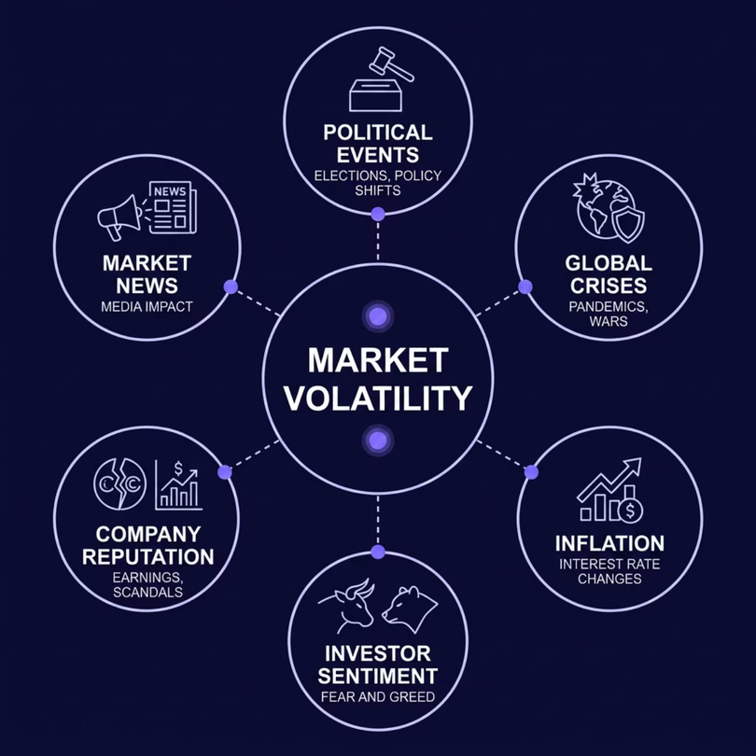

INTRODUCTION
Challenges in Stock Price Prediction
Why Markets Are Hard to Predict
Non-Linearity
Price movements follow complex, non-linear patterns that defeat simple models
Randomness & Noise
Sudden fluctuations driven by irrational investor behavior
High Dimensionality
Hundreds of interacting variables influence price simultaneously
Machine Learning and Deep Learning offer data-driven approaches that adapt to complex, volatile patterns — far beyond traditional statistical methods.
Notes:
3

Slide 4


OBJECTIVES
Project Objectives
Predict Stock Prices
Apply ML and Deep Learning to forecast future closing prices of Indian stocks
Compare Algorithms
Evaluate multiple models — LSTM, XGBoost, SVR, KNN, Decision Tree, Linear Regression
Identify Best Model
Determine the highest-accuracy algorithm using RMSE and R² metrics
Reduce Risk
Empower investors to make data-informed decisions and minimize financial exposure
Notes:
4

Slide 5
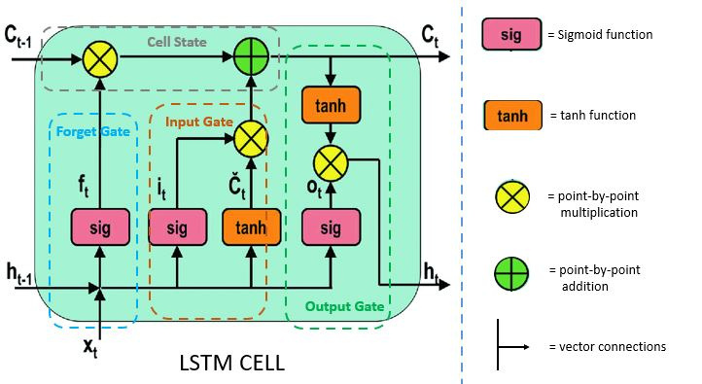
MODELS — LSTM
Long Short-Term Memory (LSTM)
What is LSTM?
A specialized Recurrent Neural Network (RNN) architecture designed to learn long-range temporal dependencies — critical for sequential financial data.
Unlike standard RNNs, LSTM retains gradients over long sequences using gated memory cells.
Forget Gate — discards irrelevant history. Input Gate — stores new information. Output Gate — determines cell output.
Why LSTM for Stock Prediction?
Solves Vanishing Gradient
Stock price sequences exhibit strong temporal dependencies — making LSTM a natural fit for this domain.
Three Gating Mechanisms
Ideal for Time Series
Vanishing Gradient Solution
Sequence Memory
Outperforms Simple RNN
Forget, input, and output gates selectively retain or discard historical information
Captures weekly, monthly, and yearly price trends simultaneously
Avoids short-term memory limitation that degrades traditional RNNs
Notes:
5

Slide 6

MODELS — LSTM
LSTM — Our Implementation
Data Collection
Preprocessing
Sequence Creation
Model Training
Evaluation
Historical stock data from 12 Indian companies was sourced and normalized using a Min-Max scaler before feeding into a stacked LSTM architecture. The model was evaluated using RMSE and R², achieving an average R² of 0.85 across all companies.
Notes:
6

Slide 7
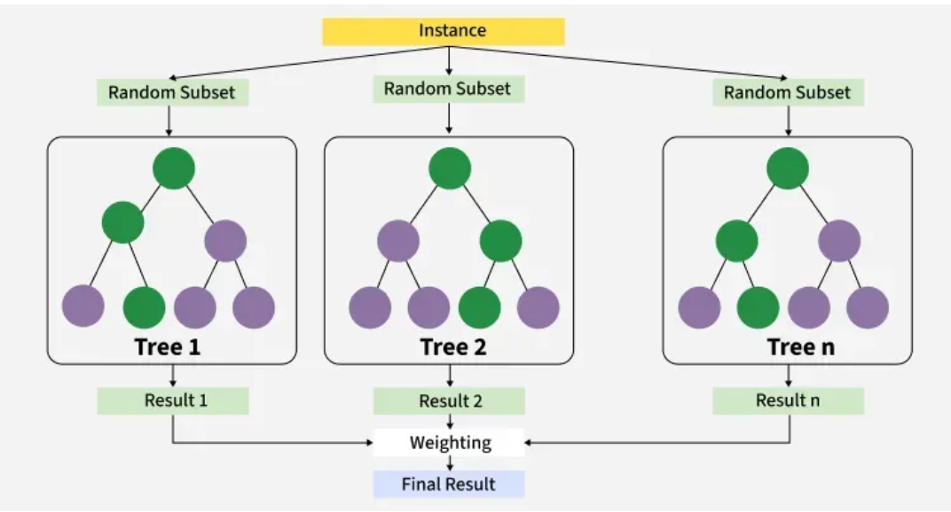
MODELS — XGBOOST
XGBoost — Extreme Gradient Boosting
How XGBoost Works
01
Weak Learners
Builds an ensemble of shallow decision trees sequentially
02
Error Correction
Each new tree corrects residual errors of its predecessor
03
Regularization
L1/L2 penalties prevent overfitting on noisy financial data
04
XGBoost's built-in regularization and boosting mechanism make it exceptionally resistant to overfitting — a critical advantage with noisy stock data.
Parallel Processing
Optimized tree construction for fast training at scale
Notes:
7

Slide 8

MODELS — XGBOOST
XGBoost — Our Implementation
Key Implementation Highlights
Feature Engineering
Lag features, rolling averages, and technical indicators (RSI, MACD) extracted as predictors
Preprocessing
Feature Engineering
Hyperparameter Tuning
GridSearchCV used to optimize learning rate, max depth, and number of estimators
Model Training
Evaluation
Outstanding Accuracy
Average R² of 0.97 — highest among all evaluated models
Notes:
8

Slide 9
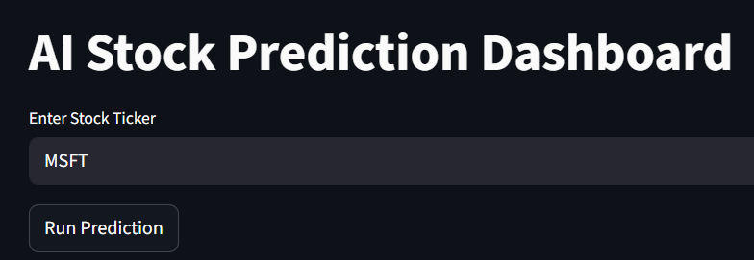
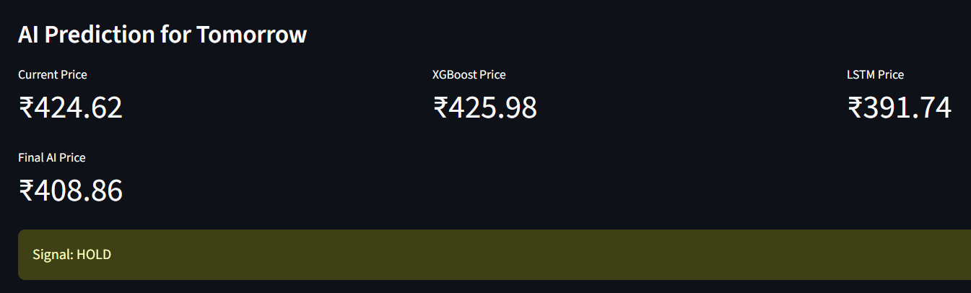
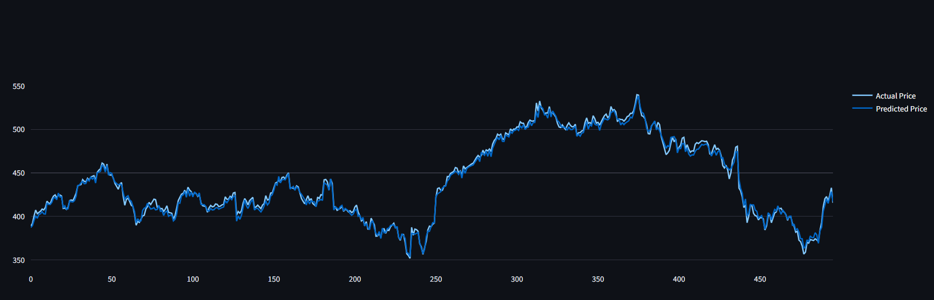
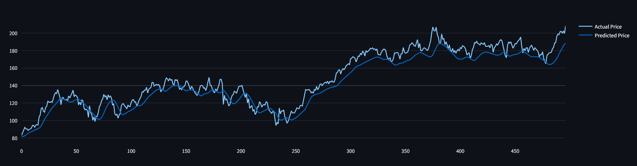
MODELS — LSTM & XGBOOST
Our Implementation Highlights
XGBoost Implementation
LSTM Implementation
Notes:
8

Slide 10
RESULTS
Evaluation Metrics
RMSE — Root Mean Square Error
Measures the average magnitude of prediction errors. Penalizes large deviations heavily.
Lower RMSE → More accurate predictions, smaller error margin
R² — Coefficient of Determination
Measures how well the model explains variance in the actual stock prices.
Higher R² → Model captures more variance; R² = 1 is a perfect fit
0.97
0.85
XGBoost R²
LSTM R²
Average across 12 Indian stocks
Average across 12 Indian stocks
23.11
22.55
XGBoost RMSE
LSTM RMSE
Average prediction error (₹)
Average prediction error (₹)
Notes:
9

Slide 11
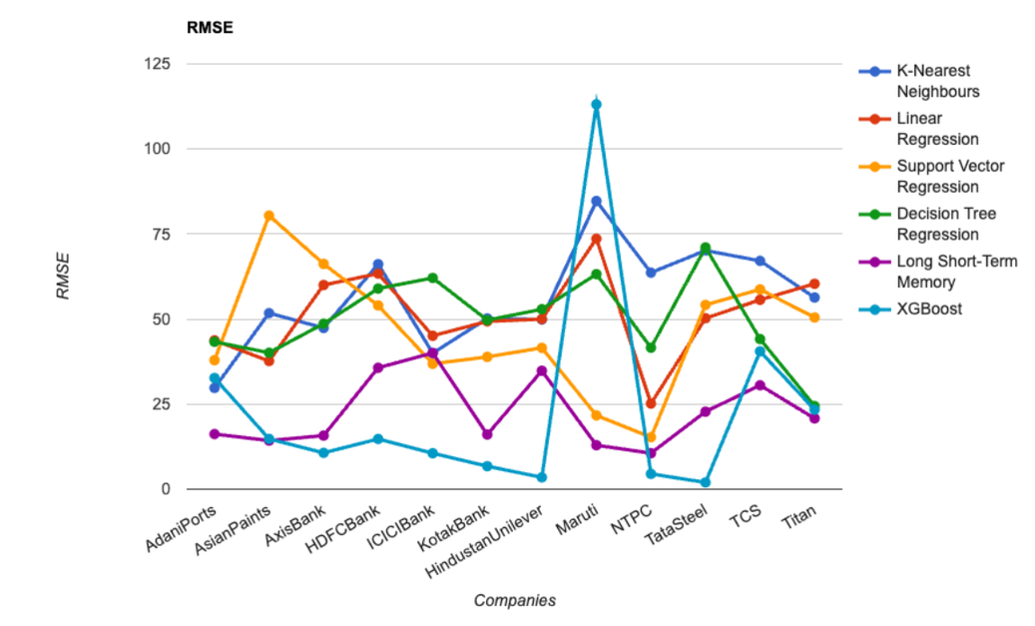
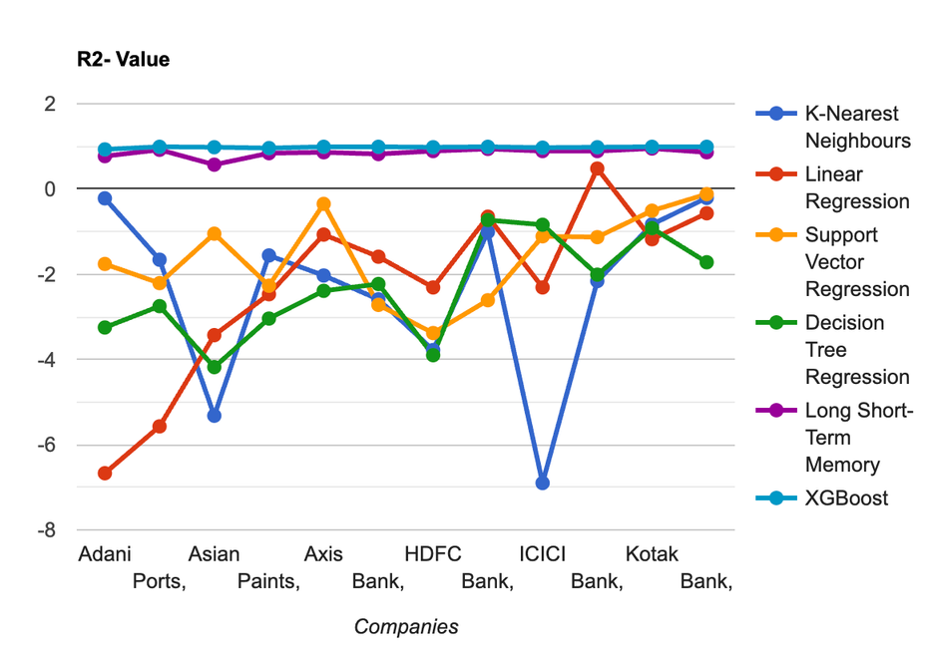
RESULTS
RMSE — Root Mean Square Error
R² — Coefficient of Determination
Lower RMSE → More accurate predictions, smaller error margin
Higher R² → Model captures more variance; R² = 1 is a perfect fit
23.11
0.97
XGBoost RMSE
XGBoost R²
22.55
0.85
LSTM RMSE
LSTM R²
Average prediction error (₹)
Average across 12 Indian stocks
Notes:
10

Slide 12
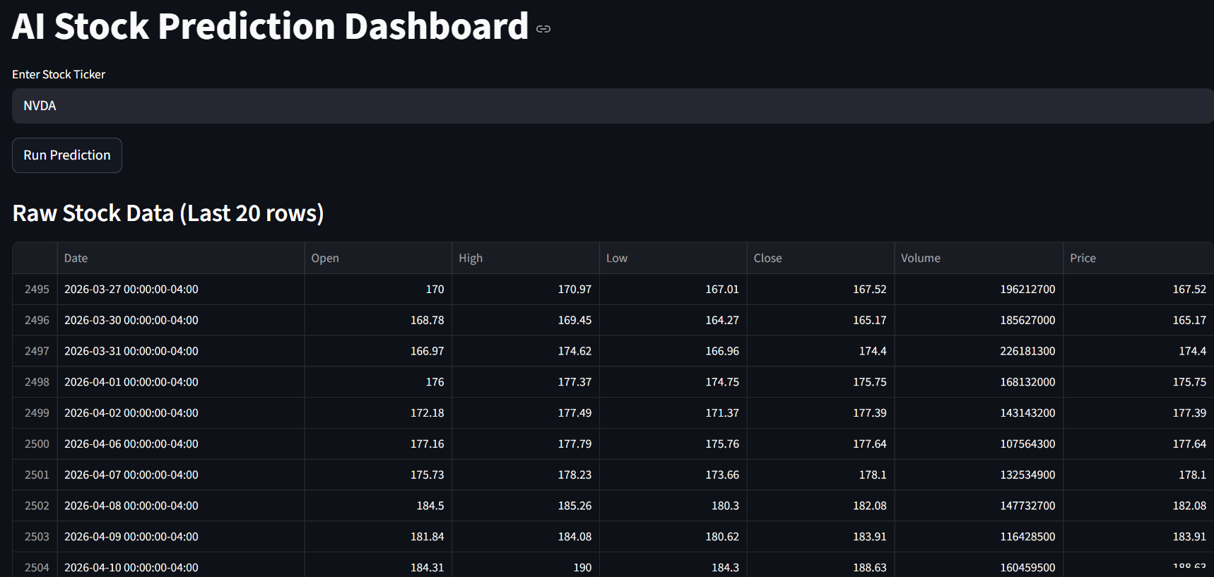
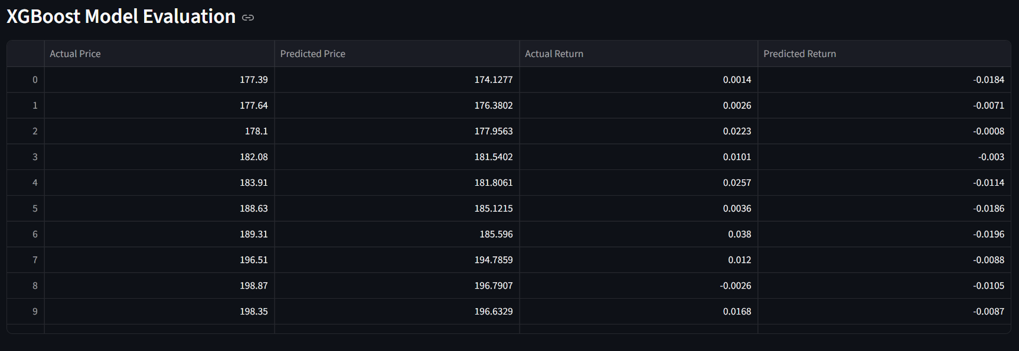
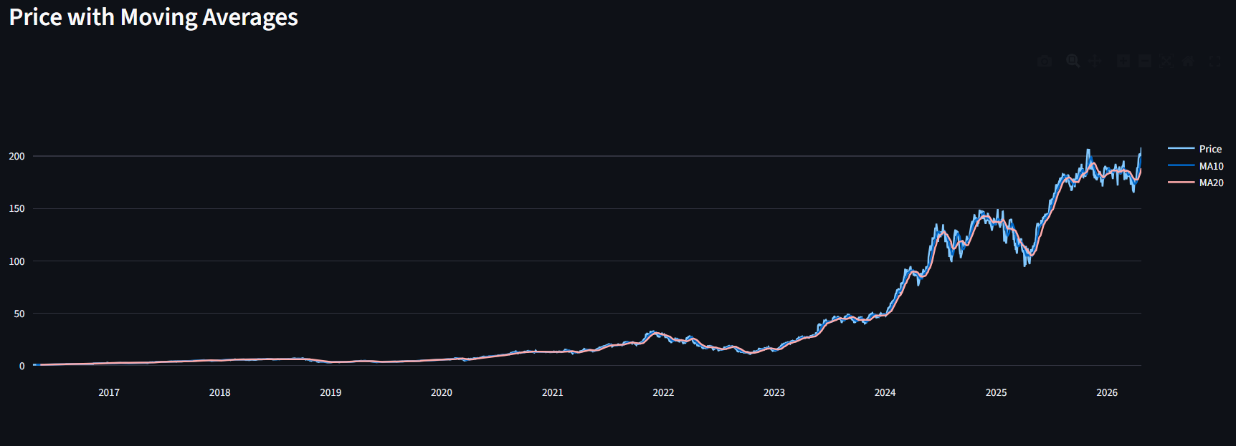
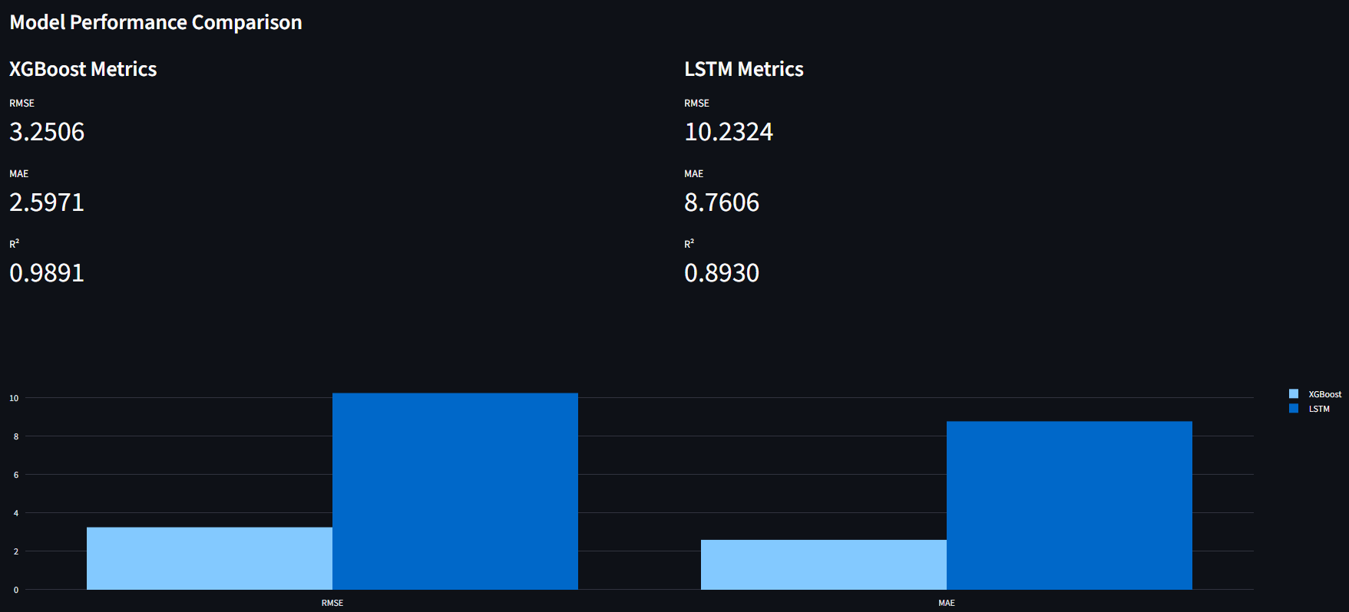
IMAGES
Notes:
10

Slide 13
CONCLUSION
Findings & Future Directions
Key Findings
Future Enhancements
Algorithm
Avg R²
Avg RMSE
Rank
"Machine Learning can significantly improve stock market forecasting and reduce investment risk."
XGBoost
0.97
23.11
🥇 Best
Real-Time Prediction
Live data pipeline for intraday forecasting
LSTM
0.85
22.55
🥈 Strong
Transformer Models
Explore attention-based architectures for superior sequence modeling
SVR
~0.78
~28.4
3rd
Sentiment Analysis
Decision Tree
~0.71
~32.1
4th
Integrate news and social media signals via NLP
KNN
~0.68
~34.7
5th
Web Deployment
Linear Regression
~0.61
~38.2
6th
Build an investor-facing prediction dashboard
Notes:
11

Slide 14
Thank You
Notes:
11

