Slide 1

Implementation of a Custom 16-Bit Core on FPGA
DAYANANDA SAGAR COLLEGE OF ENGINEERING
DEPARTMENT OF ELECTRONICS AND COMMUNICATION ENGINEERING
Presented By:
Aldrich Shawn Lewis 1DS16EC013
Paarthvi Sharma 1DS16EC090
Prajwal Shenoy K P 1DS16EC096
Sanath S Naik 1DS16EC115
Under the guidance of:
DRUVA KUMAR S. (Assistant Professor)

Slide 2
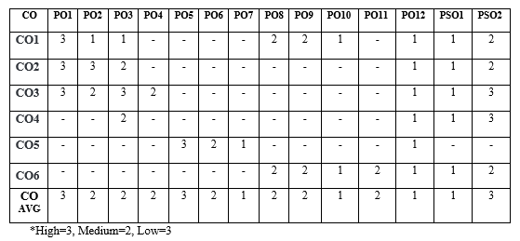
CO-PO Mapping

Slide 3
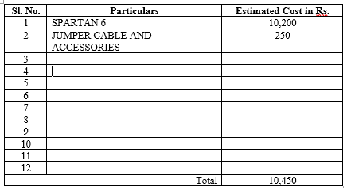
Budget

Slide 4
OVERVIEW OF THE PRESENTATION
Introduction
Abstract
Review of Literature
Aim / Objective
Proposed Block Diagram of Seminar Work
Translation
Component used
Hardware and Software used
Results
Applications of the seminar work undertaken
Conclusions & future scope
References

Slide 5
INTRODUCTION
Processors are small silicon chips which execute instructions to complete tasks. These instructions are written in the storage device connected to the processor.These instructions are executed one at a time in a logical manner by the processor. These instructions can be of varied sizes. The unit of an instruction is a bit, a digital value which can represent 2 states 1 (logic HIGH and 0 logic LOW). Some of the most common instruction sizes are 8bit, 16bit, 32 bit and 64 bits. An instruction of size 16 bits can represent a total of 2 16 unique instructions. These instructions decide which type of operation the processor should execute. The instructions are designed such that each bit has a specific function and controls a specific part of the processor. The 16 bit processor is designed in a modular manner such that any individual component could be swapped to a different component to observe performance changes without the need to redesign the whole processor again. The processor has also been designed in a bottom up approach (starting by creation of the logic gates using MOSFETS) so that any changes made in any level reflect upwards without any redesigning. The method of abstraction has also been implemented here such that an architect does not have to worry about the underlying core components present.

Slide 6
ABSTRACT
This paper presents the design and implementation of a 16-Bit hack CPU which is a modular processor. The paper is intended to showcase the process involved in building a complex circuit capable of performing real world computations, from the most basic component used for digital data representation that is the CMOS. The design methodology used is a bottom up approach, this starts with the construction of basic gates and moving up to major components like the program counter, ALU, etc. and ends with the complete construction of the CPU using the previously built components in a modular manner. The aim of this paper is to give the reader a complete understanding of the functioning of a simple computer in a digital electronics abstract. This paper will also give an idea about the data flow in a CPU triggered by a CPU. An idea regarding the way a low level programming language controls this data flow can also be understood. This CPU design is easily implementable on an FPGA and is hence a great tool to teach students about the basics of Computer Architecture and Digital System Design. The CPU reads instructions from the ROM and performs operations using the A register, D register, or the RAM memory units based on the instruction type. There are mainly 2 types of instructions, A instructions and C instructions. The A instructions have the sole purpose of storing values into the A register while the C instruction can perform multiple operations.

Slide 7
REVIEW OF LITERATURE
1]Lee, J. H., Lee, S. E., Yu, H. C., & Suh, T. (2012). Pipelined CPU Design With FPGA in Teaching Computer Architecture. IEEE Transactions on Education, 55(3), 341–348. doi:10.1109/te.2011.2175227
This paper presents a pipelined CPU design project with a field programmable gate array (FPGA) system in a computer architecture course.The goal of the project is to educate students effectively via hands-on learning. This paper was in alignment with the vision of our project. The disadvantage of this paper was that the CPU design was not structurally done. 2] Noam Nisan and Shimon Schocken, The Elements of Computing System: Building a Modern Computer from First Principles, 2005
This paper gave us a basic framework for the project’s execution. It deals with the fundamental requirements for designing a simple computer. The basic functioning of assemblers was a take away from this paper.
3]Nakano, K., & Ito, Y. (2008). Processor, Assembler, and Compiler Design Education Using an FPGA. 2008 14th IEEE International Conference on Parallel and Distributed Systems. doi:10.1109/icpads.2008.71
This paper uses a 16-bit processor TINYCPU, cross assembler TINYASM, and cross compiler TINYC. They are designed very simple and compact: The total number of lines of the source code is only 427. This paper helped us with the assembler design.

Slide 8
AIM OF THE PROJECT
The aim of this project is to give the reader a complete understanding of the functioning of a simple computer in a digital electronics abstract.It intends to showcase the process involved in building a complex circuit capable of performing real world computations, from the most basic component used for digital data representation that is the CMOS. Also,it aims to develop a processor which is completely modular that is every element in the layers of abstraction can be customized to an individual applications need and hence a great tool to teach students about the basics of Computer Architecture and Digital System Design.

Slide 9
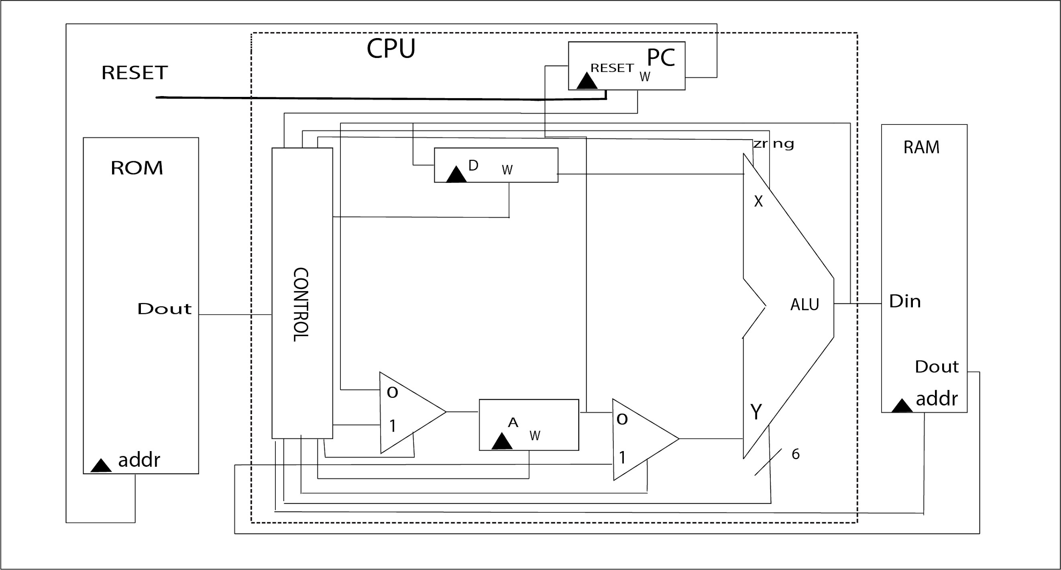
PROPOSED BLOCK DIAGRAM
This is the proposed block diagram of the structure of 16-Bit Processor with the CPU enclosed within the dotted lines.
The CPU reads instructions from the ROM and performs operations using the A register, D register, or the RAM memory units based on the instruction type.

Slide 10
TRANSLATION
The program to be translated is stored is an .asm file. The assembler translates the .asm file into the binary equivalent. These binary instructions are written onto the ROM. Each command is translated individually.
Each field of the assembly command is translated into machine code in accordance to the tables given in the next slides. To translate the assembly code to machine code the assembler first checks if the instruction is an A instruction or C instruction.
There are mainly 2 types of instructions, A instructions and C instructions. The A instructions have the sole purpose of storing values into the A register while the C instruction can perform multiple operations.

Slide 11
INSTRUCTION FORMAT
•For A instruction MSB=0 and for C instruction MSB is 1.
•A represents a bit pointing to the A register and also acts as a control bit for the instruction set.
•C represents the bits representing the operations that is computation bits.
•D represents Destination address.
•J represents jump instructions.
 |  |  | Computation |  |  |  |  |  |  | Destination |  |  | Jump
1 | 1 | 1 | a | c1 | c2 | c3 | c4 | c5 | c6 | d1 | d2 | d3 | j1 | j2 | j3

Slide 12
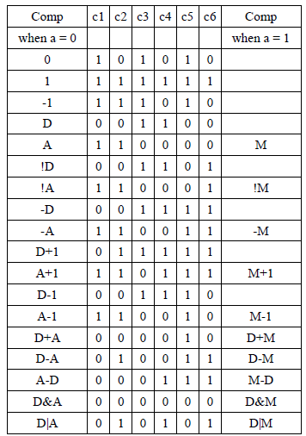
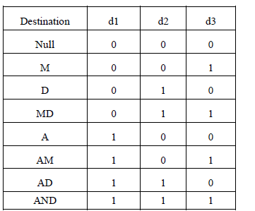
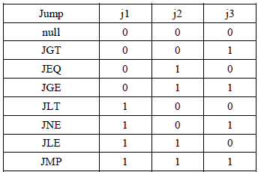
INSTRUCTION TABLE

Slide 13
COMPONENTS USED.
NOT
16 BIT NOT
AND
16 BIT AND
OR
16 BIT OR
XOR
16 BIT XOR
MUX
16 Bit MUX
DEMUX
16 Bit DEMUX
HALF ADDER
FULL ADDER
FLIP FLOP
DECODER
ALU
PROGRAM COUNTER
CPU

Slide 14
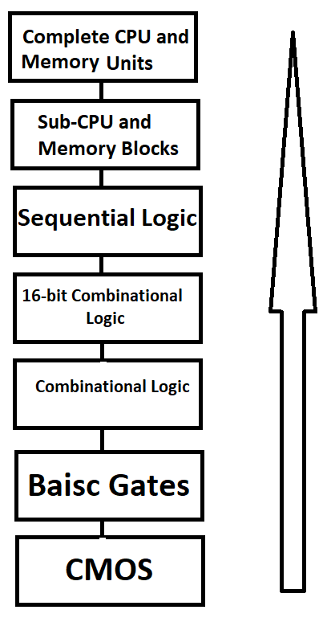
FLOW CHART
The bottom up approach is used to design the computer.
The basic gates are designed form MOS level using the CMOS logic.
The 16- bit version of these combinational logic circuits are used for the CPU design as the CPU deals with 16 bit instructions

Slide 15
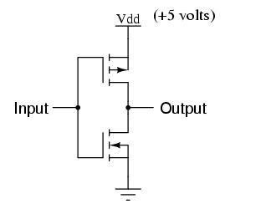
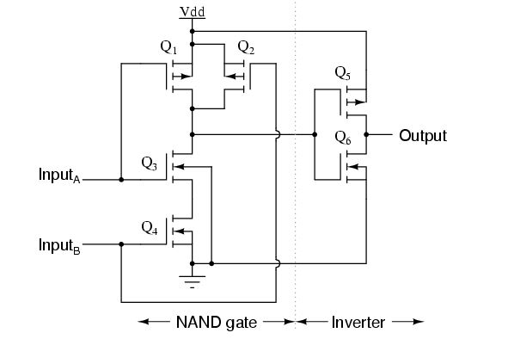
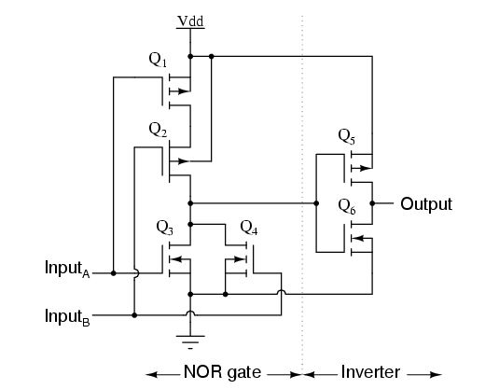
MOS LEVEL COMPONENTS
NOT GATE
AND GATE
OR GATE
The three basic gates are designed form MOS level using the CMOS logic

Slide 16
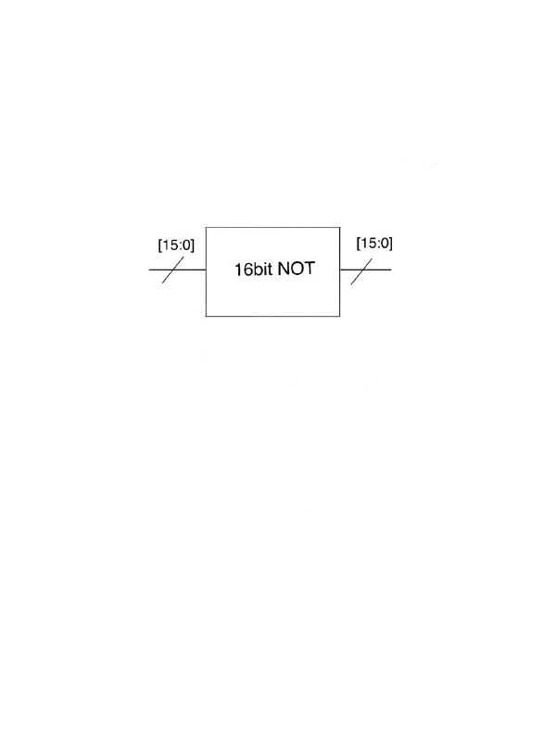
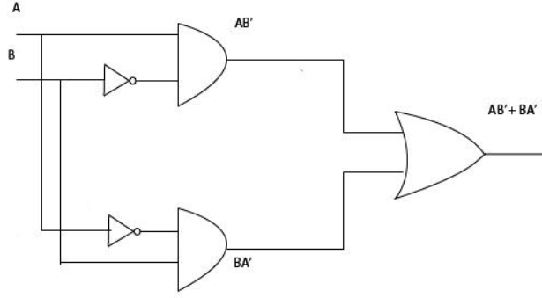
16-BIT NOT GATE AND XOR GATE
16-BIT NOT GATE
XOR GATE

Slide 17
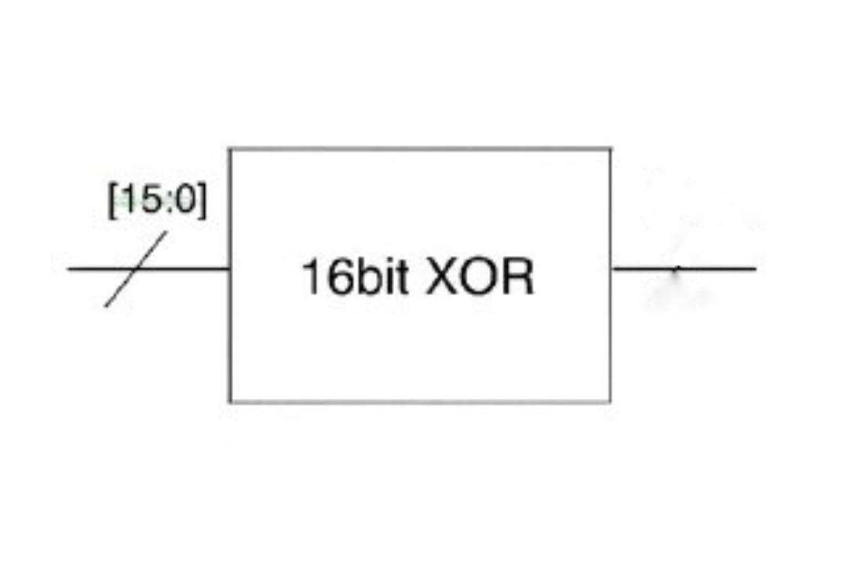
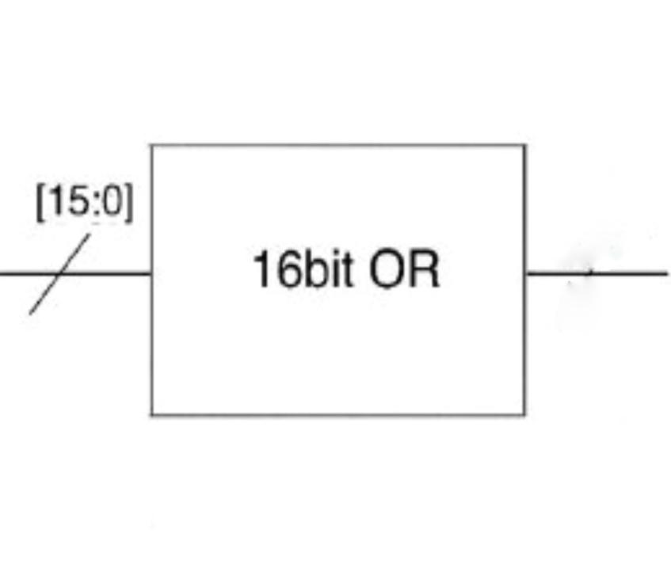
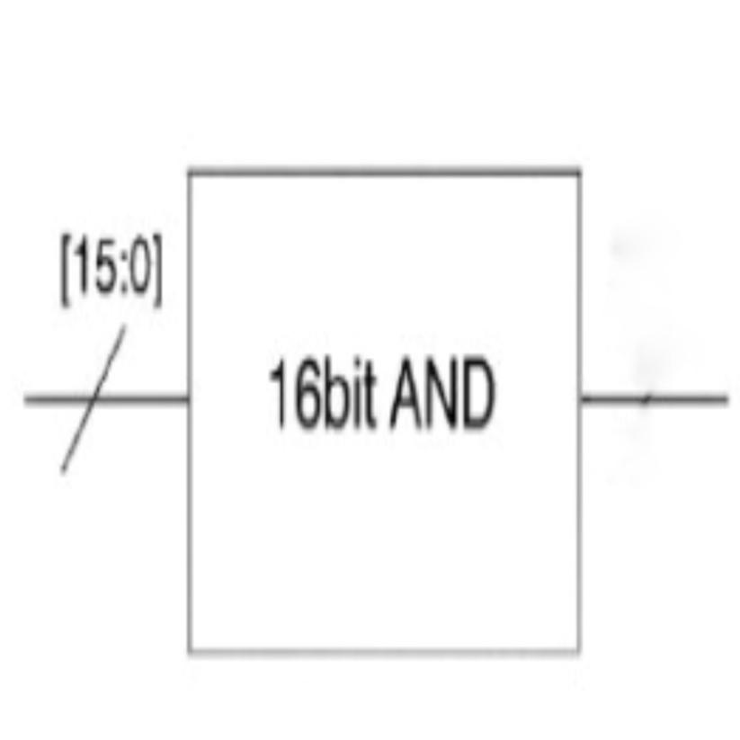
BLOCK DIAGRAM OF 16-BIT LOGIC GATES
16 BIT AND GATE
16 BIT XOR GATE
16 BIT OR GATE
The 16 bit basic gates are designed from the previously implemented mos level basic gates. The gates are cascaded together, the least significant bits are given to the first gate the output of which is given to the next gate and so on. The output of the 15 gate is the output of the 16-bit gate. This performs the operation on all the 16 bits of the data.

Slide 18
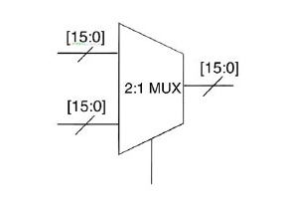
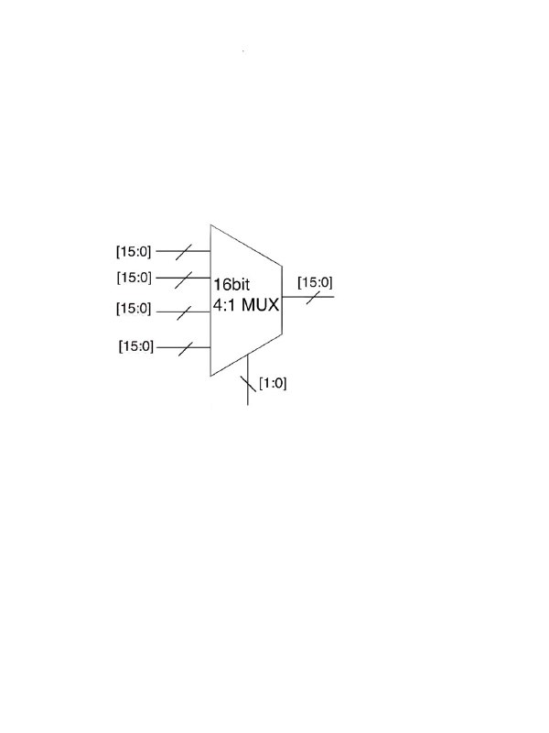
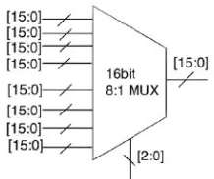
16-BIT MUX
16-BIT 2:1 MUX
16-BIT 4:1 MUX
16-BIT 8:1 MUX
The multiplexers have 16-bit input lines as inputs and select lines to select which input is given as output. if ‘N’ is the number of select lines then we can have is 2^{N}.

Slide 19
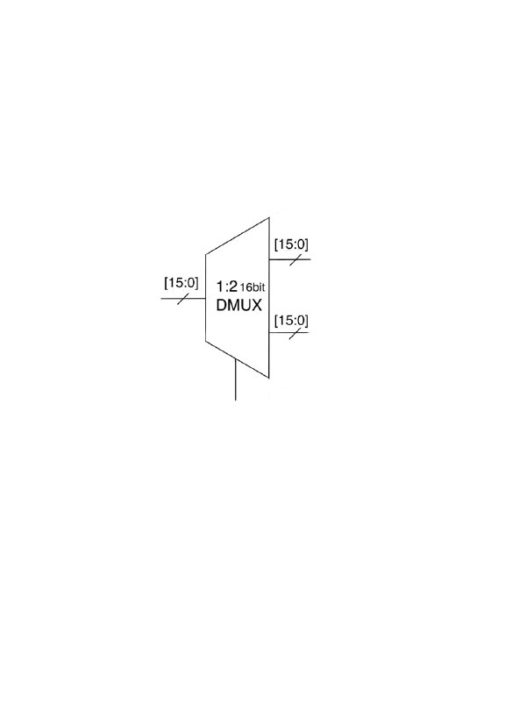
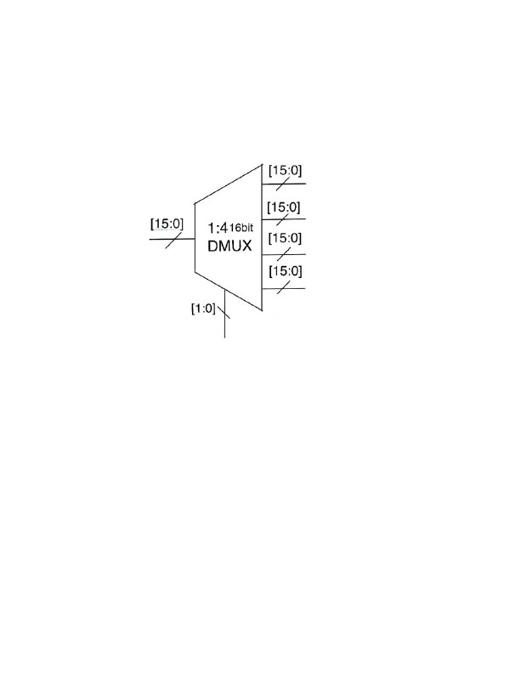
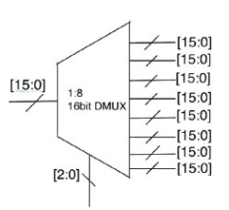
16-BIT DEMUX
16-BIT 1:2 DEMUX
16-BIT 1:4 DEMUX
16-BIT 1:8 DEMUX
The demultiplexers have one input line and 2^{N} output lines. where N is the number of select lines.

Slide 20
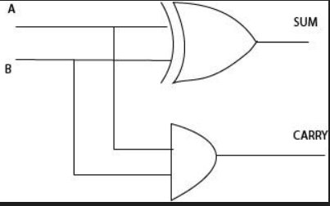
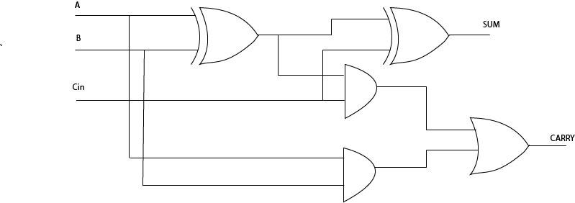
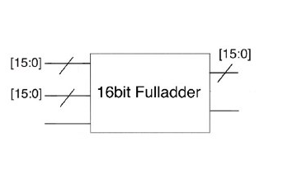
HALF ADDER, FULL ADDER
HALF ADDER
FULL ADDER
16 BIT FULL ADDER

Slide 21
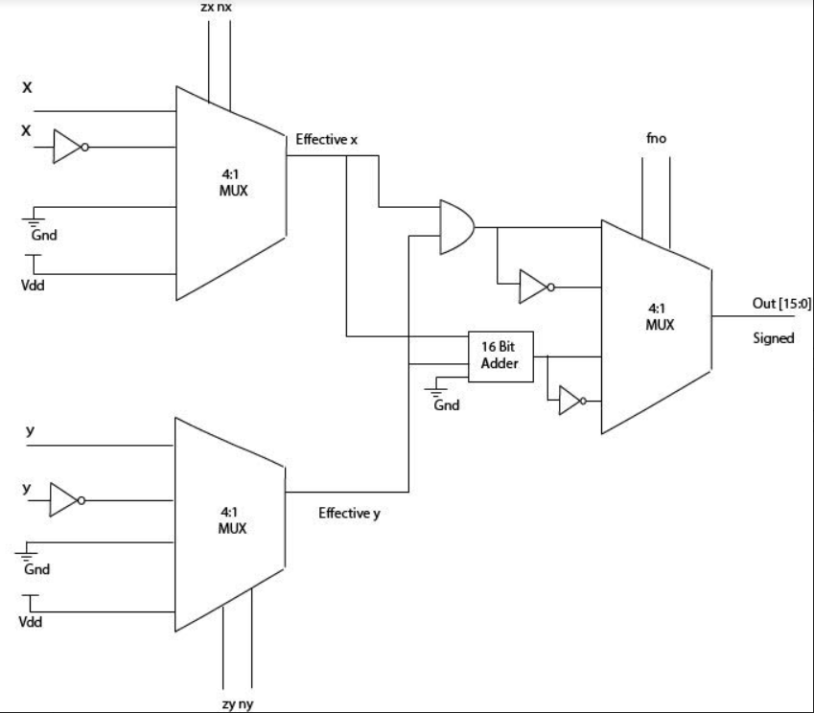
ALU
Alu is the digital circuit used to perform arithmetic and logic operations.
The alu is the fundamental part of the 16-bit hack cpu.

Slide 22
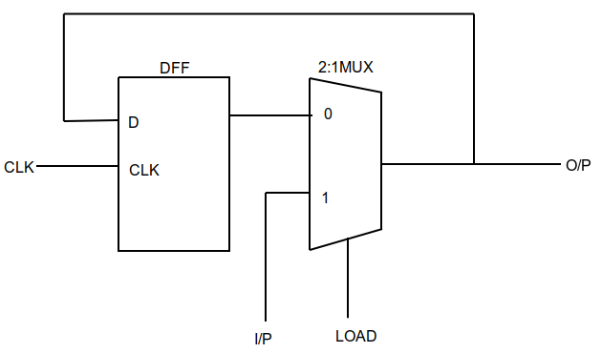
REGISTER
The register consists of a D Flip Flop and a 2:1 Multiplexer.
When the LOAD is high, the register stores the I/P value on the positive edge of the clock.
When LOAD is low, no changes are made in the register.
Q

Slide 23
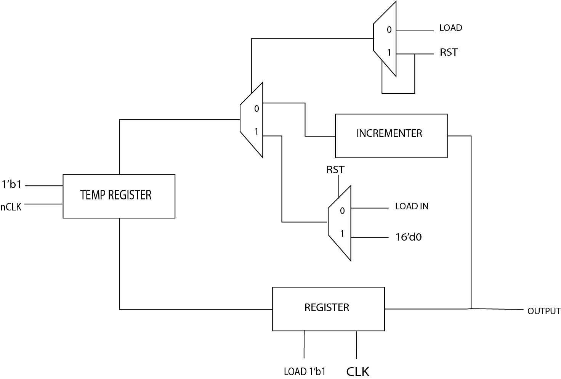
PROGRAM COUNTER
A program counter is a register that contains the address of the instruction being executed at the current time.
As each instruction is fetched, the program counter increases its stored value by 1.

Slide 24
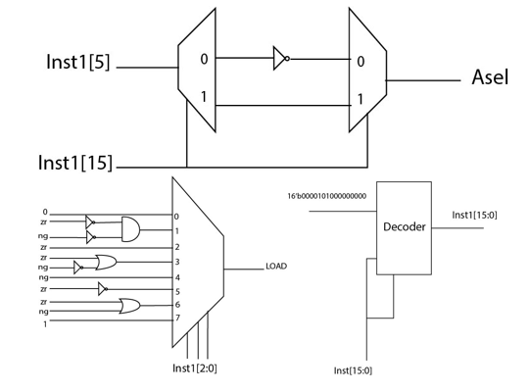
DECODER
The decoder uses combinational logic coupled with multiplexer logic to decipher the instruction input from the rom.
The decoder distinguishes the input instruction into the C type or the A type

Slide 25
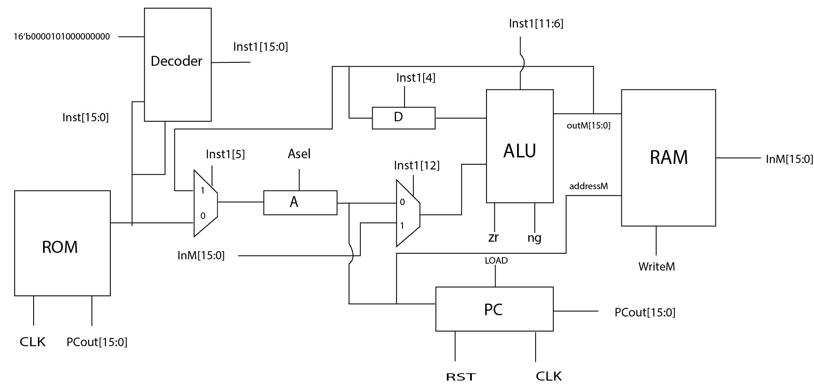
CPU
The combination of these components to forms the cpu.
The CPU deals with 16-bit operands at every positive edge instance of a clock.
The CPU consists of a decoder, two general-purpose registers a and d, an alu and a program counter. all cpu components are designed using multiplexer logic.

Slide 26
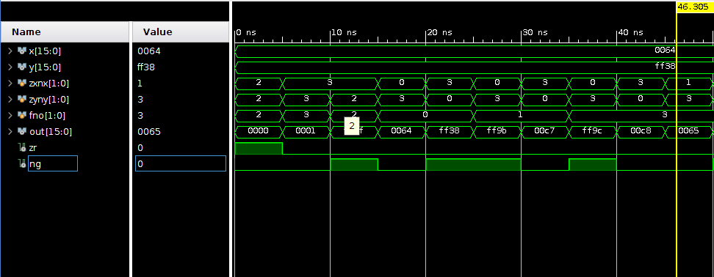
RESULTS
1. ARITHMETIC LOGICAL UNIT

Slide 27
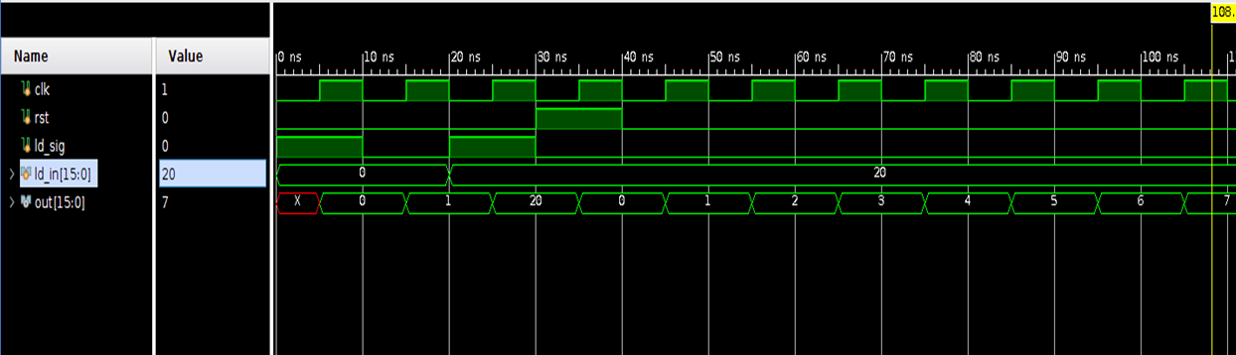
2. PROGRAM COUNTER

Slide 28
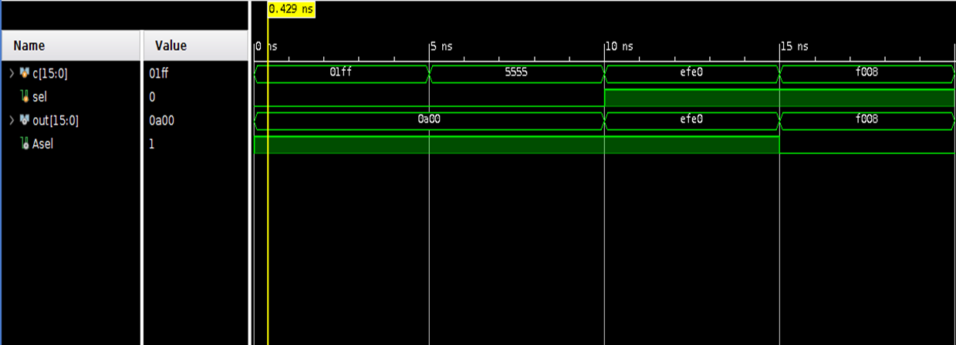
3.DECODER

Slide 29
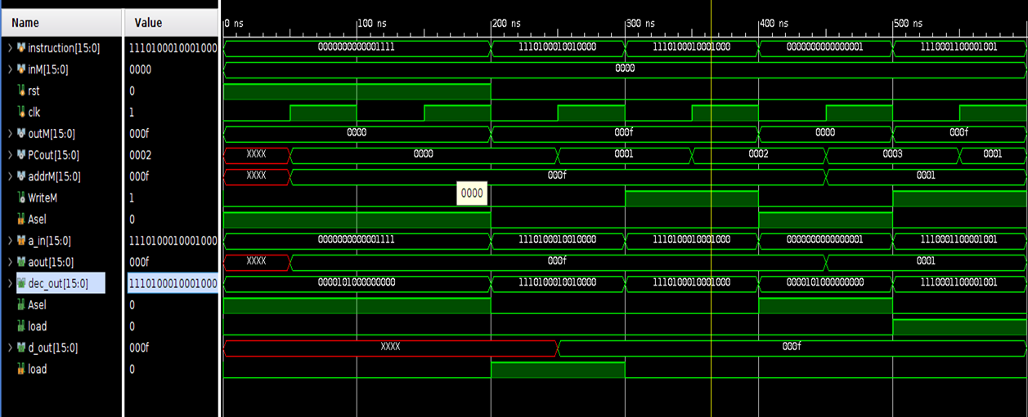
4. CENTRAL PROCESSING UNIT

Slide 30
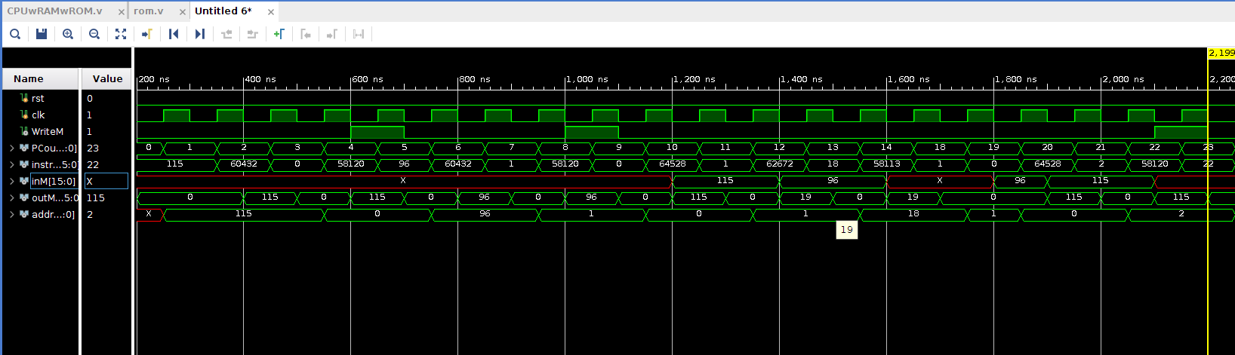
5. Simulation of program - maximum of two numbers

Slide 31
HARDWARE AND SOFTWARE TOOLS USED
Hardware tools used :
Spartan 6 - development board for the FPGA implementation of the processor
Software tools used :
Xilinx ISE for the development of Verilog code and simulations and uploading bit file to the FPGA.
Model Sim for simulation purposes and RTL diagrams.

Slide 32
COMPILER DESIGNED USING PYTHON
We designed a compiler using the python programming language to convert the assembly code into the CPU understandable machine code.
The file written in the assembly language is given as the input to the compiler program.
The compiler outputs two separate files -
A .txt file containing the machine code.
A .v code in the format of the ROM so that the machine code can be transfered to the ROM.

Slide 33
EXAMPLE CODE
Assembly code | Machine code
@R0 D=M @R1 D=D-M @OUTPUT_FIRST D;JGT @R1 D=M @OUTPUT_D 0;JMP (OUTPUT_FIRST) @R0 D=M (OUTPUT_D) @R2 M=D (INFINITE_LOOP) @INFINITE_LOOP 0;JMP | 0000000000000000 1111110000010000 0000000000000001 1111010011010000 0000000000001010 1110001100000001 0000000000000001 1111110000010000 0000000000001100 1110101010000111 0000000000000000 1111110000010000 0000000000000010 1110001100001000 0000000000001110 1110101010000111

Slide 34
APPLICATIONS
This can be used as a model to teach and experiment in schools and colleges for the students to learn computer architecture.
Also since the processor is modular and is highly customisable, it can be easily modified to meet the custom requirements as and when required.
This processor can be used in places where there are low processing power requirements to mitigate the high cost of processors when an FPGA is readily available.

Slide 35
CONCLUSION AND FUTURE SCOPE
This paper has explained the methodology of designing the 16bit processor, explaining the bottom up approach. This paper has also explained the translation of the Hack language to machine code which the processor can follow the instruction stored in storage. The implementation of the processor has also been explained along with the simulation results of the major components. From these simulations and the example program mentioned in the previous sections, this paper explains the implementation of a 16bit processor. In addition to this, creation of additional modules which can be swappable with the present existing modules such that ready customisation can be easy. Examples to this would be creation of different addition modules and swapping between them to check the performance factors of the processor. Future work for this project would be the creation of multiple swappable modules to swap out existing modules with the customised features for performance benefits, space constraints, etc.

Slide 36
REFERENCES
[1] Samir Palnitkar, Verilog HDL- A Guide to Digital Design and Synthesis, 2nd ed.,1996.
[2] Noam Nisan and Shimon Schocken, The Elements of Computing System: Building a Modern Computer from First Principles, 2005.
[3] Iftach Amit, Hack Project (Formerly: The I Computer), The Interdisciplinary Center, Herzlya
[4] Bertrand Russell, Computer Architecture: A Software Perspective.
[5] Kai Hwang, Advanced Computer Architecture,2001.
[6] Frank Vahid and Tony Givragis, Embedded System Design: A Unified Hardware/Software Approach,1999.
[7] Raj Kamal, Embedded System: Architecture, Programming and Design, 2nd ed.
[8] David A. Patterson, David R. Ditzel, The Case for the Reduced Instruction Set Computer.
[9] Sizhuo Zhang, Andrew Wright, Thomas Bourgeat, Arvind, Composable Building Blocks to Open up Processor Design.
[10] Shraddha M Bhagat, Sheetal U Bhandari. Design and Analysis of 16-bit RISC Processor.
[11] Supraj Gaonkar, Anitha M, Design of 16-bit RISC Processor.
[12] Abdullah Yıldız, H. Fatih Ugurdag, Barış Aktemur, Deniz İskender, Sezer Gören. CPU design simplified.

Slide 37
THANK YOU

