Slide 1
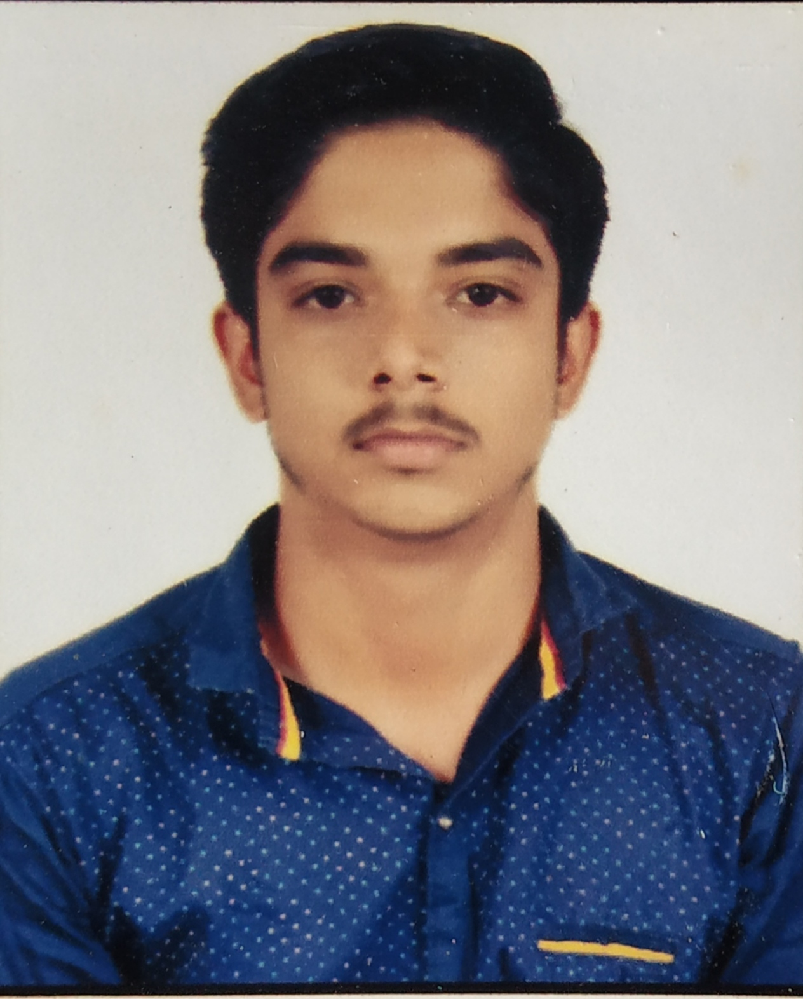



Prajwal Ravindra Bawner
Analyst/Software Engineer
Bachelor of Engineering
Electronics Engineering : 2018 - 2022
Skills
Java 8 /J2EE | Java Basics, OOPS, Generics, Collections, Arrays, Loops, Lambda Exp, Stream API Junit, Mockito, Servlets
Spring core | IOC & Dependency Injection, Autowire
Spring REST | REST controllers, Implementation of GET, POST, PUT & DELETE, Bean Validation & Exception Handling, Testing Services, Controller & Repository layer
Spring Data JPA | Implement DAO layer using spring Data repositories.
Spring Boot Microservices | Spring Boot Starters, annotations, Messaging Service, Sync/Async comms, Swagger API documents.
Spring Cloud | Eureka, Netflix , Feign Client, Netflix Hystrix, Netflix Zuul & Config Server.
Angular | Components, Services, Modules, Routing, Forms & Validation, Testing using Jasmine & Karma.
Database | MongoDB No Sql Basics , My SQL
UI Tech | HTML 5 & CSS 3,JavaScript, ES6 & TypeScript Optimized UI Designed
Tools | Git, Postman, Maven, IDE
Add On skills | Communications, Team management. Peer learning
Prajwalbawner03@gmail.com
+91 9359099545
A4
Full Stack Developer
Hands on experience in creating microservices with Springboot, Spring Security, Spring Cloud API Gateway, Eureka server, load balancing .
Proficient in creating Single page Web Application in Angular with Authentication with route guards, Angular reactive forms, angular routing, CSS .
Hands on experience in implementing microservice architecture with spring boot
Experience in creating documentation with Java docs and swagger and in unit testing using Junit, Mockito including code quality compliance using Sonar cube
Development experience in creating docker images and pushing to Docker Hub .
Online Railway Reservation Application
Completed end to end case study of Online Railway Application along with JWT authentication, Swagger and payment testing responsive UI ,CSS and Angular used for user interface.
Check out my work on GitHub & Video Profile

