Slide 1
Sentimental analysis for online reviews using Naïve Bayes and Logistic Regression.
PPT for Pattern Recognition[EEL 6825]
Prajwala Nagaraj
UFID[1099-2662]

Slide 2
Sentimental Analysis
What it is?
It is a field operating by using Natural Language Processing, Text Analysis, Statistics, Feature extraction and Machine learning to analyze the compound meaning of a sentence(positive, negative or neutral).
Sentiment analysis can be done on single words, or sentences or whole text files catering for various forms ranging from polarity (positive, negative and neutral), to detecting feelings (happy, sad, contempt) and to detecting intentions (interested or not interested).
Why is it done?
Results of sentiment analysis give profound insights for companies to understand their customers, to gauge effect of changes through releases, brand monitoring on social media, improve performance of customer services, market research and analysis.
Sentiment Analysis detects bias in a text, aiding businesses to improve certain areas that require attention.
Types/classification based on defining structure:
Rule-Based – System performs analysis by pre-defined rules(human intervention)
Automatic – Machine performs learning from data.
Hybrid – Combines both.

Slide 3
How is it done?
Data set - usually reviews, twitter messages are preprocessed to convert the data more accurate by eliminating ambiguous factors.
Features are selected by training the models with a certain set of pre classified data set.
Classifiers are fed with data to test the accuracy and sensitivity of the model.
Where is it used real time?
Target vendors in e-commerce platforms based on polarity
Track value for a product/idea over time
Determine Majority contributors for a new feature/development
Track new feature introductions in system
Determine what factors affect the system positively and negatively

Slide 4
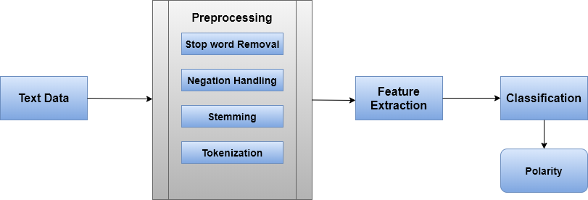
Proposed Method:
Involves preprocessing of the text, training of the classifiers and testing them.
This model uses word tokenization to ease the process of classification by converting each word to lowercase and restrict the characters in a word between a-z,0-9. This will help to eliminate Latin words and special characters

Slide 5
The elimination of stop words (‘and’, they’, ‘where’ etc.) to reduce data with only values that either fall under positive or negative polarity.
Data strengthening is performed by stemming as part of adding intelligence to the model to understand inflected sentences. Stemming is needed to remove verb forms, which will decrease the dimensionality of a word. Stemming make sure all the different verb forms will be in one type. (“I”, ”mine”, ”myself”, ”me” → all imply “I”)
Negation handling would identify the word “good” in the phrase “not good” and evaluate to negative sentiment rather that positive sentiment as the presence of “not” before it is taken into account.
Naïve Bayes Classifier
a probabilistic machine learning model that’s used for classification task
P(A|B) = P(B|A)P(A)/ P(B)
One can obtain the result(polarity) for each input(sentence or word) by looking at the dataset and substitute them into the equation above. For all entries in the dataset, the denominator does not change, it remain static representing the trained model with P(A) either falling under positive or negative values.
Bigrams implies two-word pair combination, work by capturing these permutations.

Slide 6
Logistic Regression classifier
Logistic Regression is a Statistical Learning technique categorized in Supervised Machine Learning (ML) methods dedicated to Classification tasks. It uses a logistic function to model the dependent features to a probability between 0 and 1. The logistic sigmoid activation function is given by: sig(t) = 1/(1 + e^−t)
Using a logarithmic transformation helps to deal with data by normalizing(scale) their values, which in turn fits the model more appropriately to detecting nuances in data-set.
Naive Bayes is a generative model and Logistic regression is a discriminative model.

Slide 7
Evaluation of Models
Model | Accuracy(%)
Naive Bayes | 71
Naive Bayes with Bigrams | 74.40
Logistic Regression | 76

Slide 8
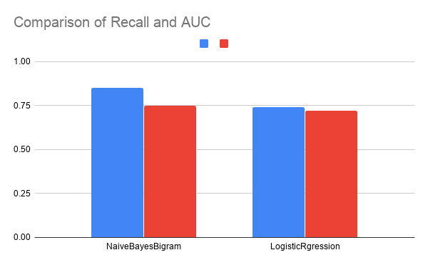

Slide 9
Thank you
Youtube links(2 parts): https://youtu.be/Z2Hbho5TVEM
https://youtu.be/aCj3qCAouc0

