Slide 1
ANALYSIS OF H1B_APPLICATIONS

Slide 2
BIG DATA
Big data is a term that describes the large volume of data – both structured and unstructured – that inundates a business on a day-to-day basis.
Big Data is a collection of large datasets that cannot be processed using traditional computing techniques.
Big data can be analyzed for insights that lead to better decisions and strategic business moves.

Slide 3
Characteristics of Big Data
Volume :- The name 'Big Data' itself is related to a size which is enormous. Size of data plays very crucial role in determining value out of data.
Variety :- Variety refers to heterogeneous sources and the nature of data, both structured and unstructured.
Velocity :- The term refers to the speed of generation of data.
Veracity :- Veracity: It refers to the biases, noises and abnormality in data. This is where we need to be able to identify the relevance of data and ensure data cleansing is done to only store valuable data.

Slide 4
Value: Refers to purpose, scenario or business outcome that the analytical solution has to address.
Variability: This refers to establishing if the contextualizing structure of the data stream is regular and dependable even in conditions of extreme unpredictability.

Slide 5
What Comes Under Big Data?
Black Box Data
Social Media Data
Stock Exchange Data
Transport Data
Search Engine Data
The data in it will be of three types.
Structured data: Relational data.
Semi Structured data: XML data.
Unstructured data: Word, PDF, Text, Media Logs.

Slide 6
Challenges of Big Data
Storage
Searching
Sharing
Transfer
Analysis
Presentation

Slide 7
HADOOP
Hadoop is used as an open-source software framework for storing data and running applications on clusters of commodity hardware.
It provides massive storage for any kind of data, enormous processing power and the ability to handle virtually limitless concurrent tasks or jobs.
It is designed to scale up from single servers to thousands of machines, each offering local computation and storage.

Slide 8
Features of Hadoop
It is Easily Scalable.
It Brings Flexibility In Data Processing.
It is Fault Tolerant.
It is Great At Faster Data Processing.
It’s Ecosystem is Robust.
It is Very Cost Effective.

Slide 9
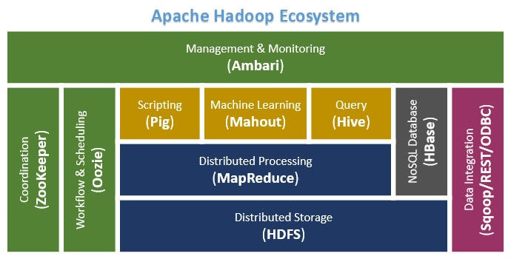
HADOOP ECOSYSTEM

Slide 10
HDFS
Hadoop comes with a distributed file system called HDFS.
Hadoop framework includes following four modules:
Hadoop Common
Hadoop Yarn
Hadoop Distributed File System
Hadoop MapReduce

Slide 11
MAPREDUCE
Map Reduce is a programming model and an associated implementation for processing and generating large and big amount of data sets with a parallel, distributed algorithm on a cluster.
It is this programming paradigm that allows for massive scalability across hundreds or thousands of servers in a Hadoop cluster.
Map Reduce programs work in two phases:
Map phase
Reduce phase.

Slide 12
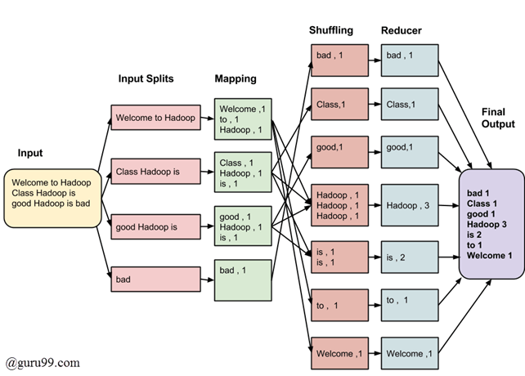

Slide 13
HIVE
.
Hive is a data warehouse infrastructure tool to process structured data in Hadoop. It resides on top of Hadoop to summarize Big Data, and makes querying and analysing easy.
Apache Hive is a data ware house system for Hadoop that runs SQL like queries called HQL (Hive query language) which gets internally converted to map reduce jobs.
Hive was developed by Face book. It supports Data definition Language, Data Manipulation Language and user defined functions.

Slide 14
PIG
Apache Pig is a platform for analysing large data sets that consists of a high-level language for expressing data analysis programs, coupled with infrastructure for evaluating these programs.
The salient property of Pig programs is that their structure is amenable to substantial parallelization, which in turns enables them to handle very large data sets.
Pig enables people to focus more on analyzing bulk data sets and to spend less time in writing Map-Reduce programs.

Slide 15
SQOOP
Apache Sqoop (SQL-to-Hadoop) is designed to support bulk import of data into HDFS from structured data stores such as relational databases, enterprise data warehouses, and NoSQL systems.
Sqoop can also be used to extract data from Hadoop and export it into external structured data stores.
It is used to import data from relational databases such as MySQL, Oracle to Hadoop HDFS, and export from Hadoop file system to relational databases.

Slide 16
FLUME
Apache Flume is a system used for moving massive quantities of streaming data into HDFS. Collecting log data present in log files from web servers and aggregating it in HDFS for analysis, is one common example use case of Flume.
Flume has flexible design based upon streaming data flows.
It is fault tolerant and robust with multiple failover and recovery mechanisms.
Flume carries data between sources and sinks. This gathering of data can either be scheduled or event driven.
Flume can also be used to transport event data including but not limited to network traffic data, data generated by social-media websites and email messages.

Slide 17
OOZIE
Apache Oozie is a scheduler system to run and manage Hadoop jobs in a distributed environment.
One of the main advantages of Oozie is that it is tightly integrated with Hadoop stack supporting various Hadoop jobs like Hive, Pig, Sqoop as well as system-specific jobs like Java and Shell.
Oozie is an Open Source Java Web-Application available under Apache license 2.0. It is responsible for triggering the workflow actions, which in turn uses the Hadoop execution engine to actually execute the task

Slide 18
ZOOKEPPER
Apache Zookeeper is a coordination service for distributed application that enables synchronization across a cluster.
Zookeeper in Hadoop can be viewed as centralized repository where distributed applications can put data and get data out of it.
It is used to keep the distributed system functioning together as a single unit, using its synchronization, serialization and coordination goals.

Slide 19
Conclusion
Hadoop has been very effective solution for companies dealing with the data in petabytes.
It has solved many problems in industry related to huge data management and distributed system.
As it is open source, so it is adopted by companies widely.
Among, these all the technologies specified above the usage of Mapreduce, Pig, Hive and Sqoop are used in analysing the data of H1B_Applications.

Slide 20
THANK YOU

