Slide 1
Friendbook: A Semantic-based Friend Recommendation System for Social Networks

Slide 2
INTRODUCTION
Existing social networking services recommend friends to users based on their social graphs, which may not be the most appropriate to reflect a user’s preferences on friend selection in real life.
In this paper, we present Friendbook, a novel semantic-based friend recommendation system for social networks, which recommends friends to users based on their life styles instead of social graphs.
Measures the similarity of life styles between users, and recommends friends to users if their life styles have high similarity.
We model a user’s daily life as life documents, from which his/her life styles are extracted by using the Latent Dirichlet Allocation algorithm.
We further propose a similarity metric to measure the similarity of life styles between users, and calculate users’ impact in terms of life styles with a friend-matching graph.
Upon receiving a request, Friendbook returns a list of people with highest recommendation scores to the query user.

Slide 3
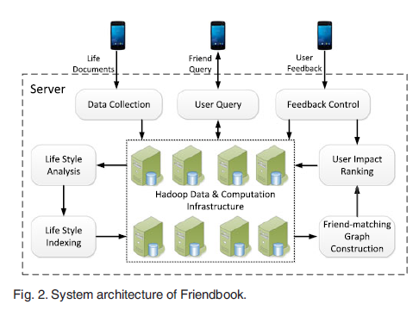
System Architecture

Slide 4
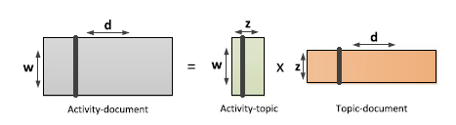
Life-Style Extraction
The activity recogniser is used to recognise and obtain the Activity-document matrix
The Latent-Dirchlet Allocation algorithm is used for the above computations.
The lifestyle vectors are obtained using p(z|d) values.

Slide 5

Similarity Metric
Two similarity indices are computed : a) Cosine similarity and b) Dominant Lifestyle Index

Slide 6
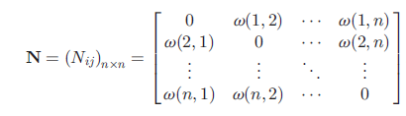
Friend-Matching Graph
A friend matching-graph is constructed using the similarity indices.
Where for i !=j and others its 0.

Slide 7
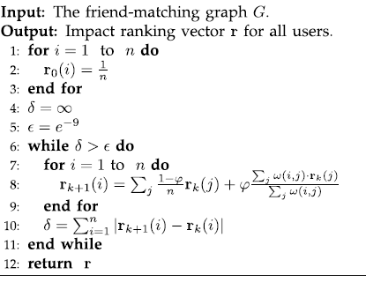
User Impact Ranking
The ranking vector is generated using the following pseudo code.

Slide 8
Query and Friend recommendation
The no of recommended friends is input by the user and the friend list is returned based on the weights given to similarity index and ranking vector.

Slide 9
Conclusion
The existing methods of social graphs is not very effective in friend recommendation.
The recommendation precision and recommendation values are obtained and graphs are plotted.
The results obtained using the simulation matched with those obtained in the paper.
The results show that friends are recommended with a good amount of accuracy, in comparison to those recommended using social graphs.

Slide 10
References
1) http://igraph.org/r/doc/page_rank.html
2) http://www.statmethods.net/advgraphs/ggplot2.html
3) http://www.pagerank.dk/Pagerank-formula/Damping-factor.htm
4) https://stat.ethz.ch/R-manual/R-devel/library/base/html/data.frame.html
5) https://stats.idre.ucla.edu/r/library/r-library-matrices-and-matrix-computations-in-r/
6) https://www.tutorialspoint.com/r/

