Slide 1


Visvesvaraya Technological University, Belgaum.
P E S Institute of Technology and Management,
Shivamogga.
Department of Electronics and Communication Engineering.
“DESIGN AND SIMULATION OF FFT PROCESSOR FOR VARIABLE INPUT LENGTH”
Presentation by Mr. HEMANTH D USN : 4PM21EC035 Ms. K S DEEKSHA USN : 4PM21EC038 Mr. PRAJWAL H D USN : 4PM21EC073 Ms. PRIYA B G USN : 4PM22EC419 7th Semester, Dept. of E&CE, PESITM, Shivamogga. Under the Guidance of Dr. Mahantesh P. Mattada Associate Professor Dept. of E&CE, PESITM, Shivamogga.

Slide 2
Agenda:
Introduction
Motivation
Literature Survey
Problem Statement
Objectives
Methodology
Results and Discussion
Conclusion
Future Scope
References

Slide 3
Introduction
The Fast Fourier Transform (FFT) is a widely used algorithm in digital signal processing (DSP) to compute the Discrete Fourier Transform (DFT) of a sequence.
One challenge in designing FFT processors is ensuring flexibility for variable input lengths. Traditional FFT processors are often optimized for a fixed input size, but real-world applications frequently require processing signals of varying lengths.
This project focused on designing an efficient FFT processor that supports variable input lengths, which would provide greater flexibility and resource optimization in DSP systems.

Slide 4
Motivation
The motivation for this project arises from the growing need for adaptable digital signal processing systems that can handle variable data sizes in real-time.
A processor that supports variable input lengths without significant degradation in performance or efficiency would significantly improve system adaptability and power efficiency.
This project aims to close this gap by developing a processor that can dynamically adapt to different input sizes while maintaining optimal performance in terms of power, area, and processing time.

Slide 5
Literature Survey
Sl.NO | Name of the Journal | Title | Vol. No & Issue. No | Month & Year | International/ National
1 | World Scientific Research Journal | Parallel 16‐point FFT Based on Real‐time Spectrum Analysis System and Its FPGA Implementation | Volume 8, Issue 3 | March-2022 | International
Presents a 16-point FFT architecture for real-time spectrum analysis. Provides a detailed study on chip performance for DSP applications
2 | International Journal of Electronics | Hardware Chip Performance Analysis of Different FFT Architecture | - | June- 2022 | International
Comparative analysis of different FFT architectures focusing on chip performance.
3 | Springer Journal of Signal Processing Systems | The Architectural Optimizations of a Low-Complexity and Low-Latency FFT Processor for MIMO-OFDM Communication Systems | Vol. 69 | May-2020 | International
Optimizes resource usage in FPGA and ASIC-based designs.

Slide 6
Literature Survey
Sl.NO | Name of the Journal | Title | Vol. No & Issue. No | Month & Year | International/ National
4 | Journal of Signal Processing Systems | Optimised Floating Point FFT Core for Improved OMP CS System | - | 2020 | International
Proposes an optimized floating-point FFT core to enhance performance in OMP compressed sensing systems.
5 | IEEE Transactions on Signal Processing | A Depth-First Iterative Algorithm for the Conjugate Pair Fast Fourier Transform | - | 2021 | International
Proposes a depth-first iterative algorithm for efficient FFT computation of conjugate pairs.
6 | RISC-V International Conference | Design and Implementation of Arbitrary Point FFT Based on RISC-V SoC | - | 2021 | International
Explores a design methodology for implementing arbitrary-point FFT on RISC-V System-on-Chip (SoC).

Slide 7
Problem Statement
The problem addressed in this project is how to design and simulate an FFT processor capable of handling variable input lengths while minimizing computational complexity, power consumption, and hardware resources. The design must adapt to different signal lengths without compromising performance, ensuring high-speed operation and scalability.

Slide 8
Objectives
To design an FFT processor capable of handling variable input lengths.
To minimize power consumption and computational complexity in the FFT design.
To simulate and validate the FFT processor using modern simulation tools.

Slide 9
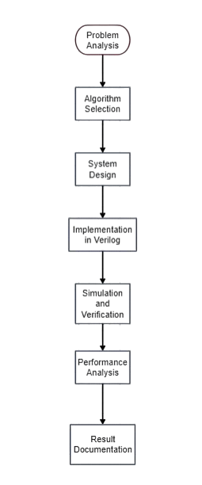
Methodology
Figure 1: Block Diagram for design of FFT processor

Slide 10
Chose the radix-2 FFT algorithm for computational efficiency.
Input Buffer
Stores input samples.
Butterfly Units
Execute FFT operations (additions, subtractions, twiddle factor multiplications).
Twiddle Factor Generator:
Computes required twiddle factors
Write Verilog HDL code for the modular and scalable design.
Validate functionality using Cadence simulation tools.
Performance Analysis
Accuracy of FFT outputs. Latency for different input lengths.
Result Documentation
Record simulation waveforms and performance metrics.
Compare results with theoretical values.
Methodology

Slide 11
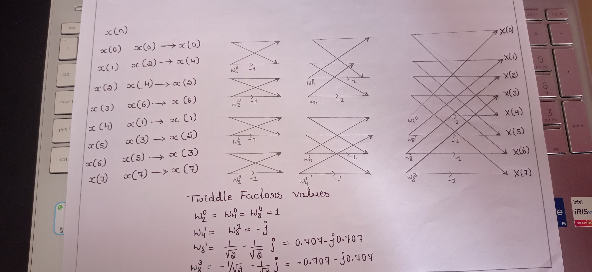
RADIX-2 DIT FFT

Slide 12

Outcome
Designed a Verilog-based FFT processor for variable-length inputs
Validated the design using Cadence simulation tools.
Demonstrated scalability and hardware efficiency.

Slide 13
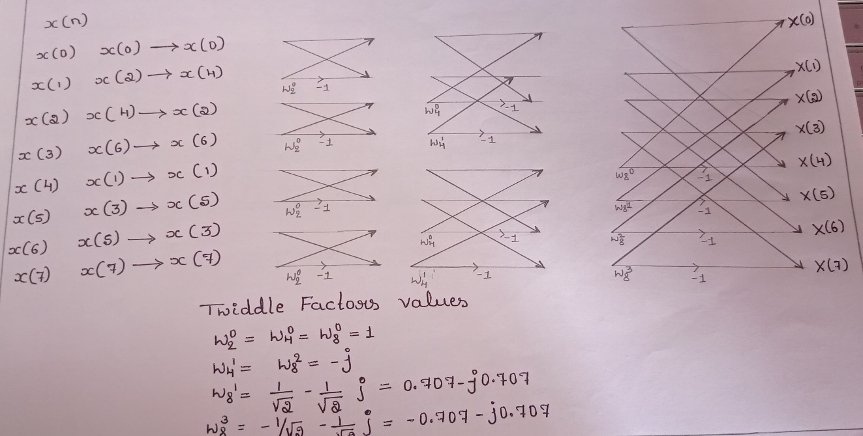
RADIX 2 FFT ALGORITHM

Slide 14
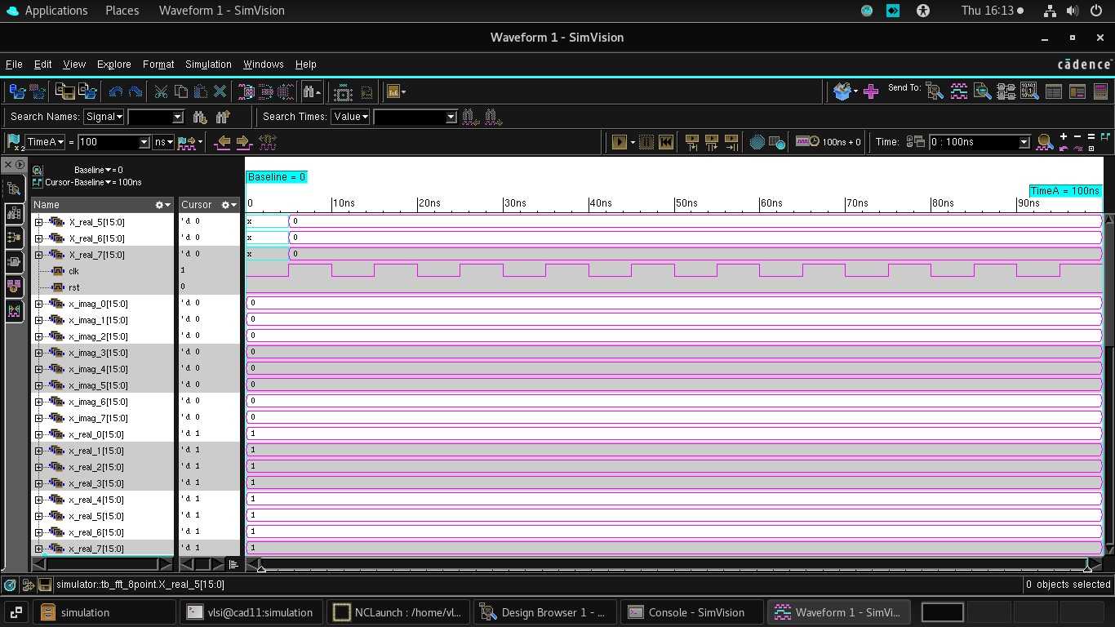
8-point FFT
Input x(n)= {1,1,1,1,1,1,1,1} Output X(k)={8,0,0,0,0,0,0,0}

Slide 15
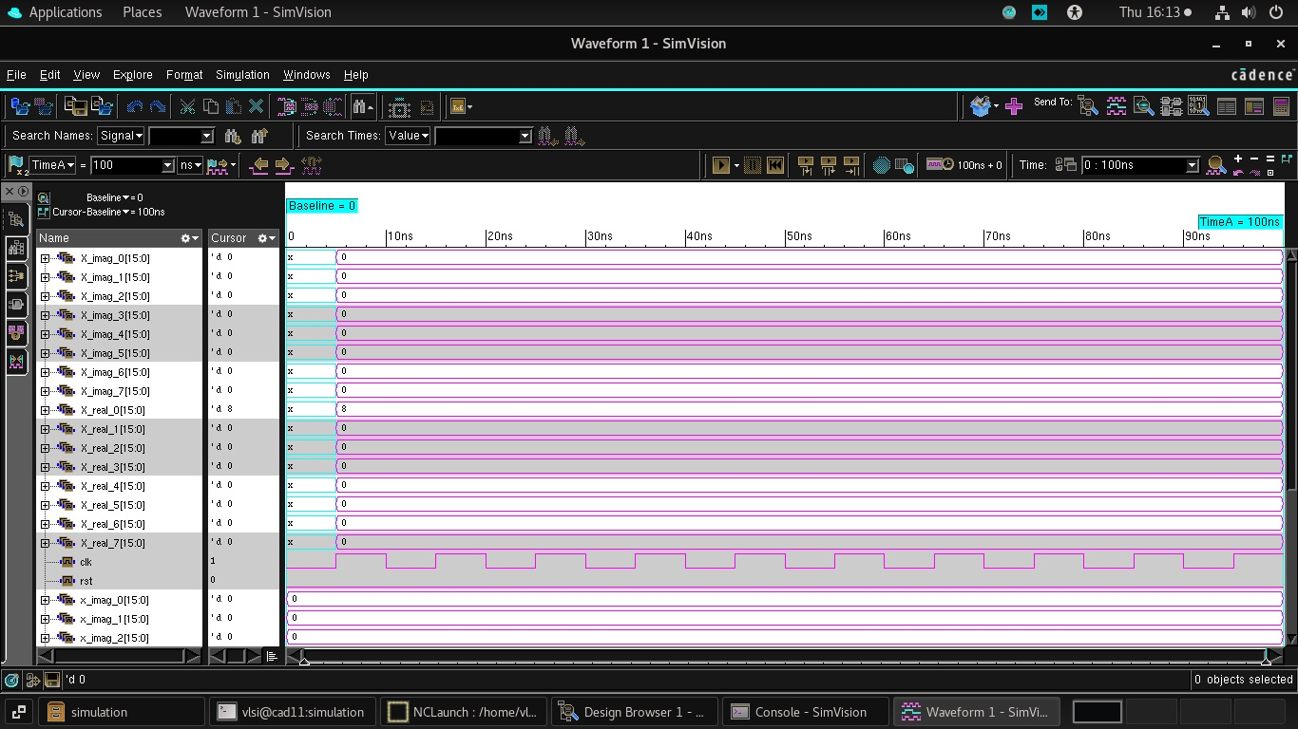

Slide 16

x(n) ={1,1,1,1}
X(k)= Real Part: {4, 1, 0, 1, 0, 1, 0, 1}
Imaginary Part: {0, -1, 0, -1, 0, 1, 0, 1}

Slide 17


Slide 18

Input x(n) ={1,2,3,4,5}
Output X(k)= Real Part: {15, 6, 3, -2, 3, -2, 3, 9}
Imaginary Part: {0, -9, 2, -3, 0, 3, -2, 9}

Slide 19


Slide 20
References
[1]. Wangwang Dai “Parallel 16‐Point FFT Based on Real‐Time Spectrum Analysis System and Its FPGA Implementation,” World Scientific Research Journal, Vol.8, Issue 3, pp. 11-18, 2022.
[2]. Amit Kumar, Adesh Kumar, and Aakanksha Devrari, “Hardware Chip Performance Analysis of Different FFT Architecture,” International Journal of Electronics, 2022.
[3]. Hung-Ju Lin and Chung-An Shen, “The Architectural Optimizations of a Low-Complexity and Low-Latency FFT Processor for MIMO-OFDM Communication Systems,” Journal of Signal Processing Systems, Springer, Vol. 69, pp. 1537-1548, 2020.
[4]. Alahari Radhika, K. Satya Prasad, and K. Kishan Rao, “Optimised Floating Point FFT Core for Improved OMP CS System,” International Journal of Electronics, 2021.
[5]. IEEE Transactions on Signal Processing, “A Depth-First Iterative Algorithm for the Conjugate Pair Fast Fourier Transform,” IEEE Transactions on Signal Processing, Vol. 69, Issue 2, pp. 1200-1210, 2021.
[6]. RISC-V Foundation, “Design and Implementation of Arbitrary Point FFT Based on RISC-V SoC,” Proceedings of the RISC-V International Conference, 2021.

Slide 21


