Slide 1
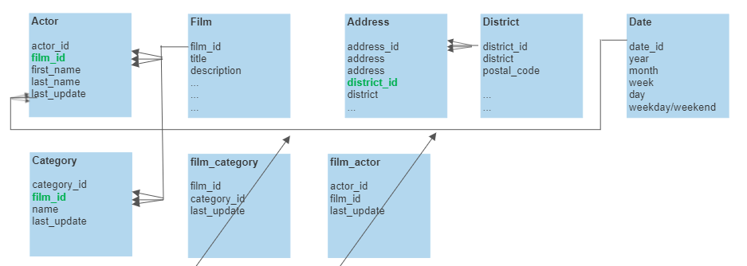
Few changes in schema to normalize the structure
Remove table film_category and join the film table directly to category table using 1 to many relation from film to category table using film_id column
Category table: film_id is the foreign key and category_id primary key
Remove table film_actor and join the film table directly to actor table using 1 to many relation from film to actor table using film_id column
Actor table: film_id is the foreign key and actor_id primary key
Add district table to detail district related information and connect to address table using new district_id column
Address table: district_id foreign key and address_id primary key
Add a date table to map to all date columns across the schema to be able to do time related/ aggregated queries
Actor table: last_update is foreign key from date_id primary key in Date table

