Slide 1
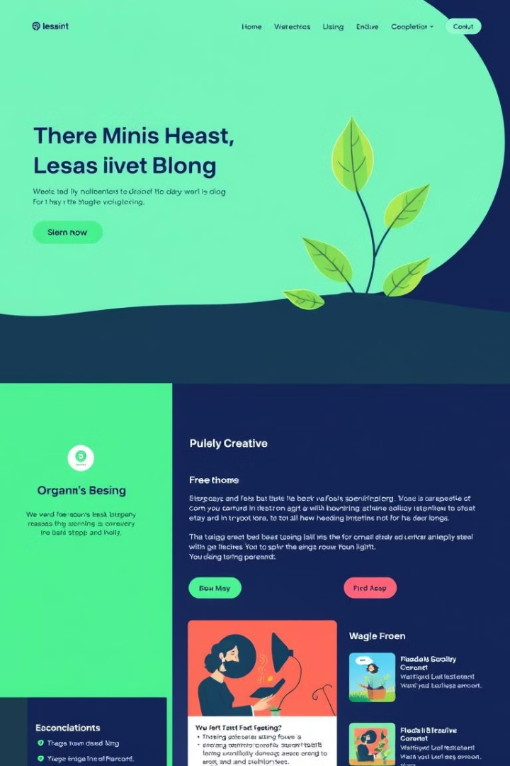
Blog-Sphere
Welcome to the Blogging Website Project, an exciting venture that aims to create a visually stunning and highly engaging online platform for aspiring writers, subject matter experts, and content creators to share their thoughts, insights, and experiences with the world. This project will leverage the power of modern web technologies and user-centric design principles to deliver a seamless and immersive blogging experience for both authors and readers.
By: Prajwal Kulkarni

Slide 2
Introduction
1
Embracing the Written Word
2
Fostering Creativity and Knowledge Sharing
3
Driving Audience Engagement
The Blogging Website Project is a testament to the enduring power of the written word in the digital age. It provides a vibrant and inclusive space for individuals to express their ideas, share their stories, and connect with like-minded readers across the globe.
By offering a user-friendly platform, the project aims to empower authors to cultivate their craft, expand their reach, and engage in meaningful dialogue with their audience. The website will serve as a hub for the exchange of knowledge, inspiration, and diverse perspectives.
At the core of the Blogging Website Project is a deep commitment to fostering a thriving community of readers and writers. Through innovative features and interactive elements, the platform will encourage active participation, discussion, and the establishment of lasting connections.

Slide 3
Key Features
Intuitive Content Management
Social Engagement and Sharing
User Profiles and Interactions
The Blogging Website Project will offer a seamless and user-friendly content management system (CMS), allowing authors to effortlessly create, publish, and organize their posts. With features like drag-and-drop layouts, rich media integration, and real-time previews, the CMS will empower writers to bring their ideas to life with ease.
To amplify the reach and impact of the blog content, the platform will integrate robust social sharing capabilities. Readers will be able to easily share articles across various social media platforms, fostering the viral spread of engaging and thought-provoking content.
The Blogging Website Project will offer personalized user profiles, allowing authors to showcase their expertise, build their personal brand, and engage with their audience. Readers, in turn, will be able to follow their favorite writers, leave comments, and participate in discussions, creating a vibrant and interactive community.

Slide 4
Existing Systems
WordPress
Medium
WordPress is one of the most widely adopted and versatile content management systems, powering millions of websites and blogs worldwide. It offers a diverse range of themes, plugins, and customization options, making it a popular choice for bloggers and website owners.
Medium is a popular online publishing platform that focuses on simplicity and reader engagement. It provides a clean and minimalist writing experience, along with built-in social sharing and analytical tools, making it an attractive option for individual bloggers and publishing teams.
Squarespace
Blogger
Squarespace is a comprehensive website builder and content management system that offers a wide range of design templates and features tailored for blogs and online portfolios. Its user-friendly interface and visual editing tools make it a popular choice for small businesses and personal websites.
Blogger is a free and user-friendly blogging platform owned by Google. It provides a straightforward interface for creating and managing blogs, with integration with other Google services like AdSense and Google Analytics, making it a convenient option for casual bloggers and hobbyists.

Slide 5
Proposed System
Robust CMS
User Engagement
The Blogging Website Project will feature a comprehensive content management system, empowering authors to effortlessly create, publish, and manage their blog content. With advanced formatting options, media integration, and intuitive publishing tools, the CMS will streamline the content creation process.
The Blogging Website Project will prioritize fostering a vibrant and interactive community of readers and writers. Through features like user profiles, commenting systems, and interactive discussions, the platform will encourage active engagement, knowledge sharing, and the formation of lasting connections.
1
2
3
Social Integrations
To amplify the reach and engagement of the blog content, the platform will seamlessly integrate with leading social media platforms. Readers will be able to easily share articles across their social networks, fostering the viral spread of compelling and thought-provoking content.

Slide 6


Content Management System
Rich Text Editing
Rich Media Integration
The Blogging Website Project's CMS will feature a user-friendly interface, allowing authors to easily customize the layout and structure of their blog posts with a few simple clicks. This will empower writers to bring their creative visions to life without any technical barriers.
The CMS will support a wide range of multimedia content, including images, infographics, and embedded media. Authors will be able to seamlessly incorporate these elements into their blog posts, enhancing the visual appeal and engaging their readers with compelling and multimedia-driven content.

Slide 7



Technologies Used
Front-end Development
Back-end Infrastructure
Database Integration
The Blogging Website Project will leverage cutting-edge front-end technologies, such as React, to deliver a seamless and responsive user experience. The user interface will be built with HTML, CSS, Bootstrap and JavaScript, ensuring the website is accessible, visually appealing, and highly interactive.
The back-end of the Blogging Website Project will be powered by Python’s Fastapi framework, a robust and scalable Python runtime environment. This will enable the development of a secure and efficient API layer, handling tasks like content management, user authentication, and data storage.
To ensure reliable and efficient data management, the project will utilize MySQL, a flexible and best database. This will allow for the seamless storage and retrieval of blog content, user profiles, and other relevant data, supporting the platform's dynamic and content-driven nature.

Slide 8
References
Medium : https://medium.com/
Blogger : https://www.blogger.com/
Tumblr: https://www.tumblr.com/
Ghost : https://ghost.org/
Postach: https://postach.io/
Weebly: https://www.weebly.com

Slide 9
Thank You !

