Slide 1
Blog-Sphere
By: 76. Prajwal P. Kulkarni

Slide 2
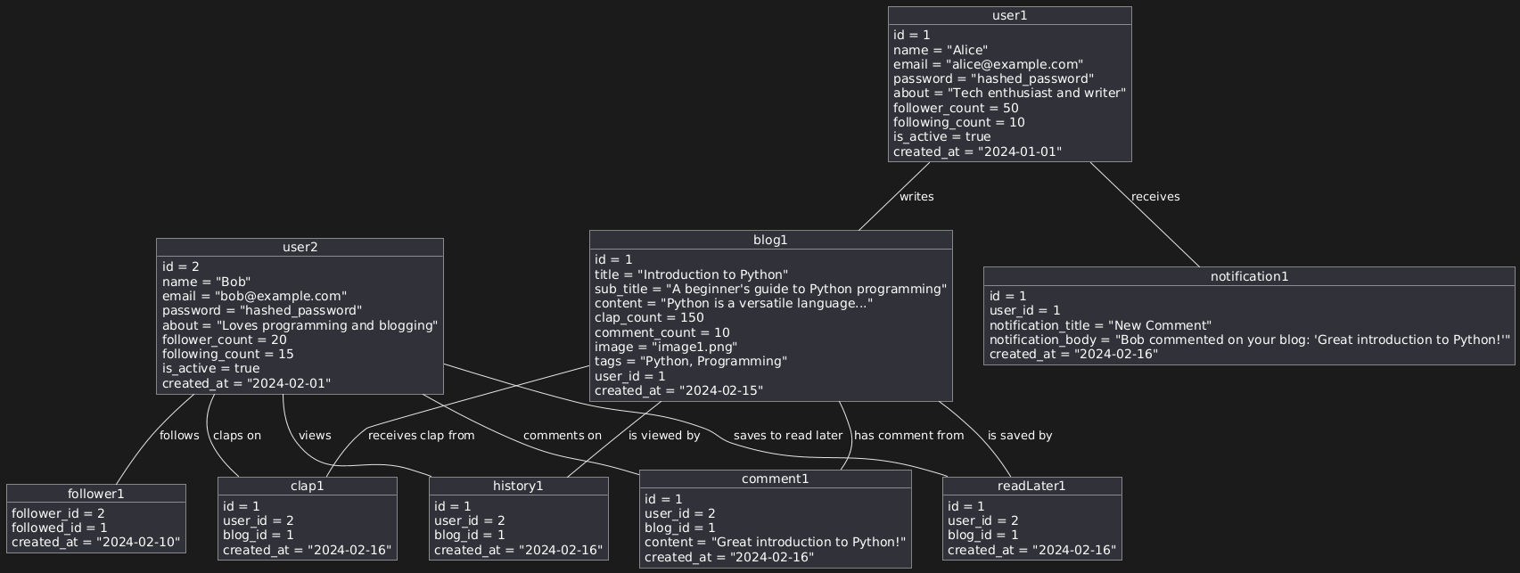
Object diagram

Slide 3
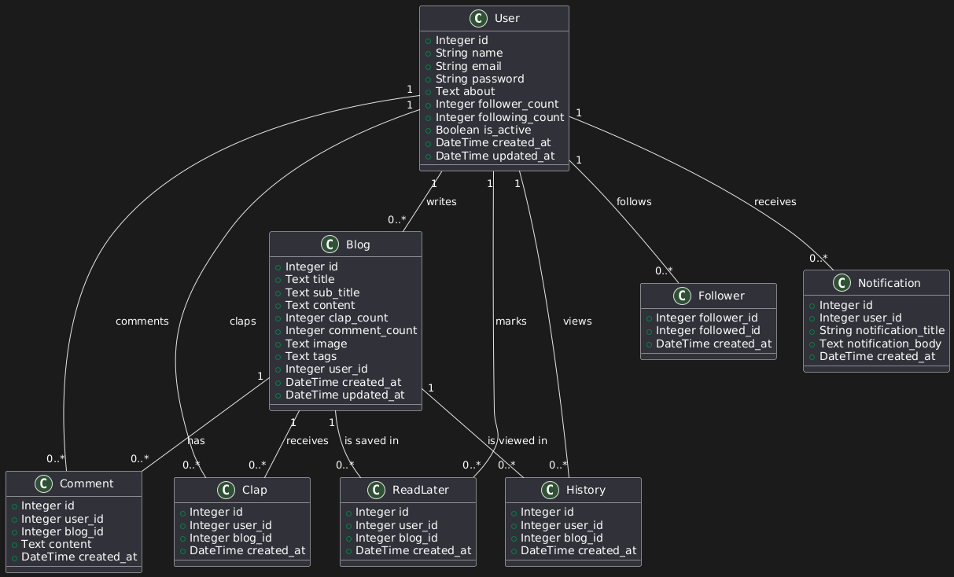
Class diagram

Slide 4
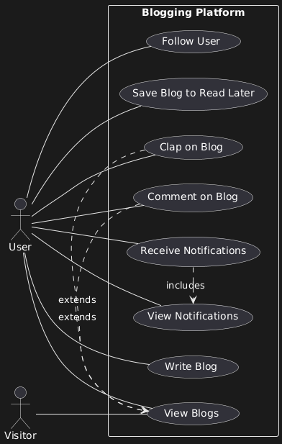
Use-case diagram

Slide 5
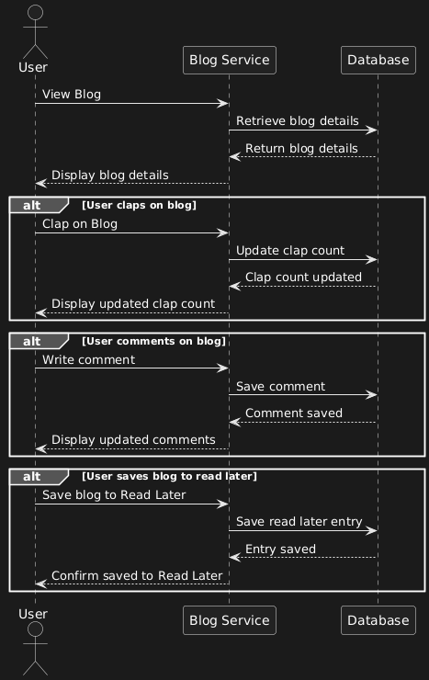
Sequence diagram

Slide 6
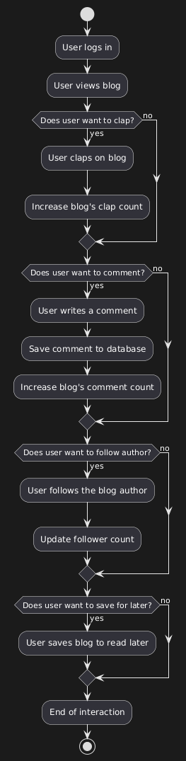
Activity diagram

Slide 7
Module overview
User Management
Blog Content Management
Blog Recommendation System
Notification System
Search & Discoverability
Report Management (Admin Module)
Analytics & History

Slide 8
Module specification
User Management Module
Features
User authentication (login, signup)
Profile management (update, follow/unfollow)
Secure login and password encryption

Slide 9
Module specification
Blog Management Module
Features
Blog writing, editing, and multimedia support
Like(clap) and comment interaction
Read later feature for saving blogs
Audio playback for blog listening

Slide 10
Module specification
ML-based blog recommendation module
Personlization: Provides personalized blog suggestion based on:
User history
Interaction and preference
ML model
Collaborative filtering/content-based recommendation model

Slide 11
Module specification
Notification module
Real-Time Notifications:
Interaction notifications (comments, likes)
Optimized for high-frequency interactions (e.g., bulk clap notifications)
Push Notifications: for user engagement

Slide 12
Module specification
Search module
Search Engine: Keyword-based search for blogs
Trending Content: Highlights popular and recommended blogs
Categories: For easy discovery based on user preferences

Slide 13
Module specification
Admin module
User Reports: Tracks user activity, engagement, and growth
Blog Reports: Analyzes blog popularity and interactions
Interaction Reports: Monitors claps, comments, and engagement statistics
User Activity Tracking: Logs views, claps, comments for recommendations
Analytics Dashboard: Provides insights on platform usage, trends, and peak times

Slide 14
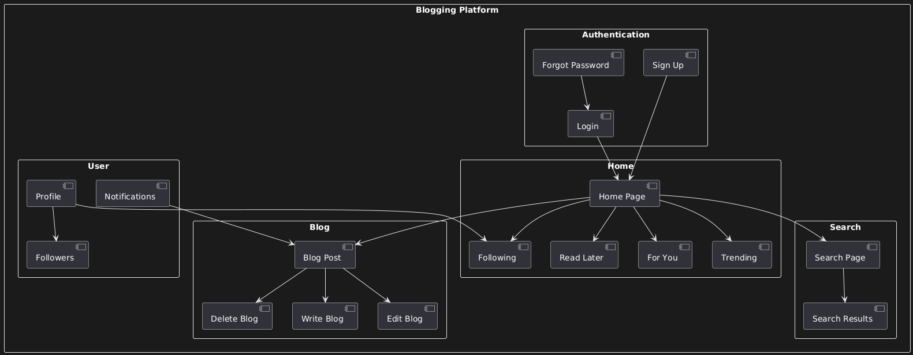
Website map specification

Slide 15
Backend specification

Slide 16
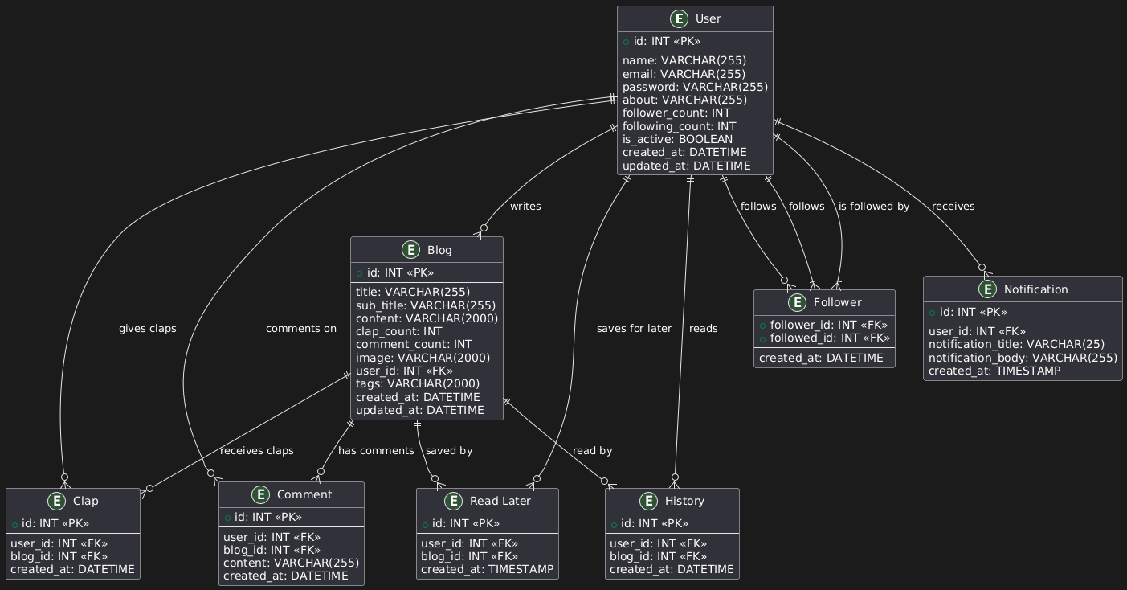
ERD

Slide 17
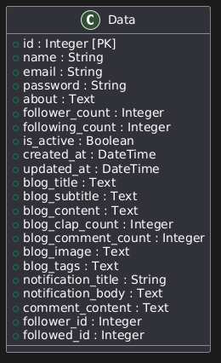
0th normalization

Slide 18
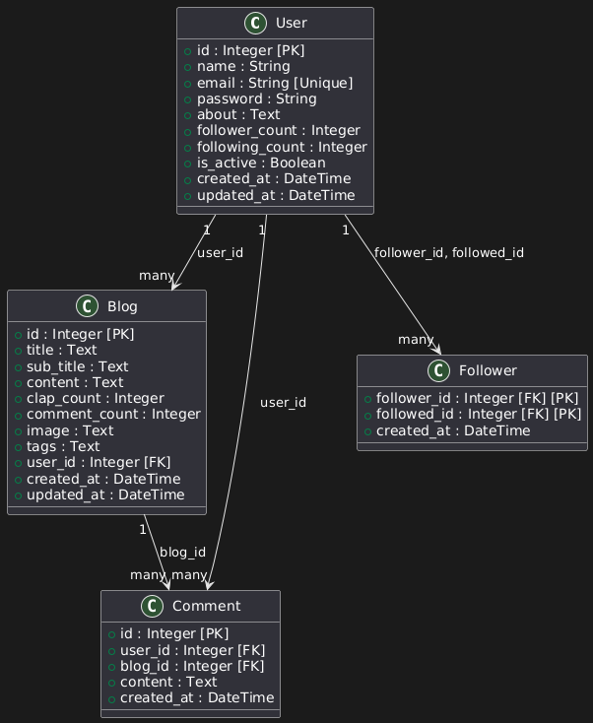
1st normalization

Slide 19
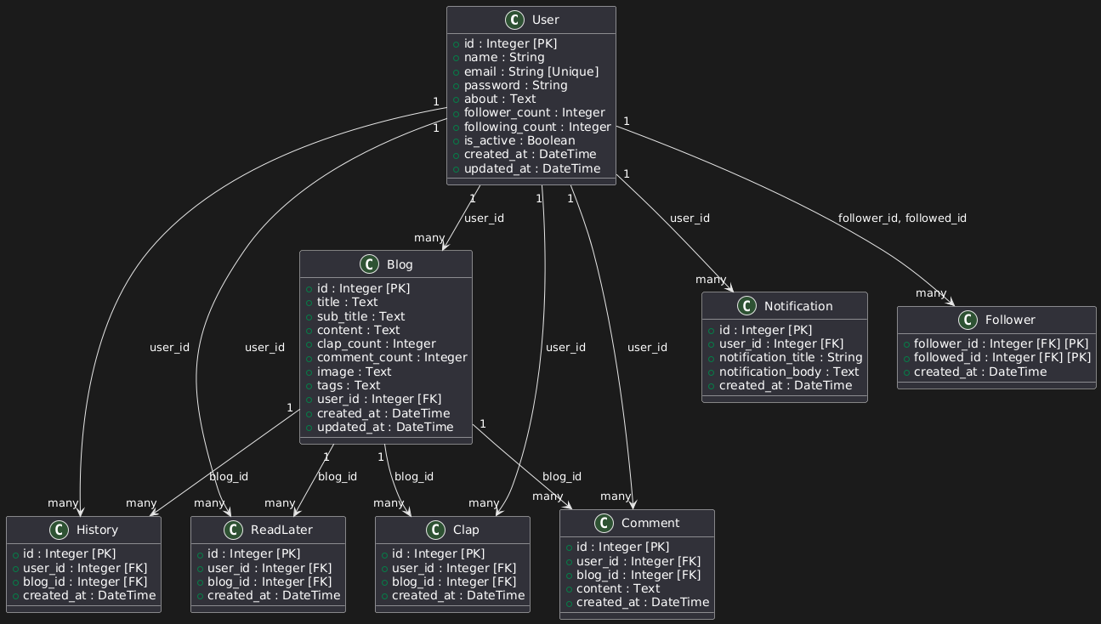
2nd normalization

Slide 20
3rd normalization

Slide 21
Frontend specification

Slide 22
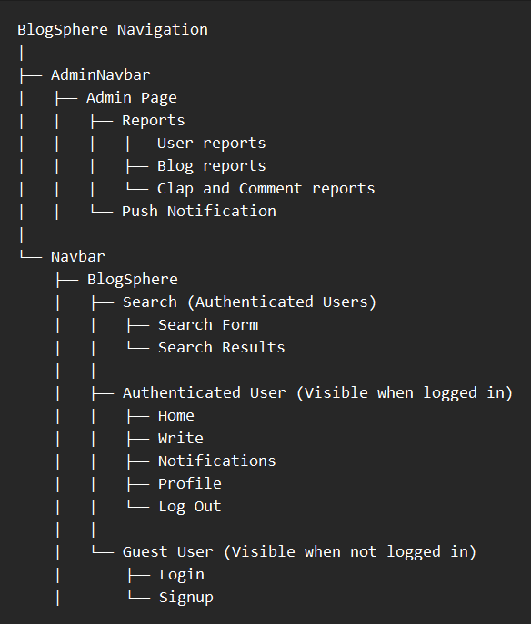
Menu tree

Slide 23
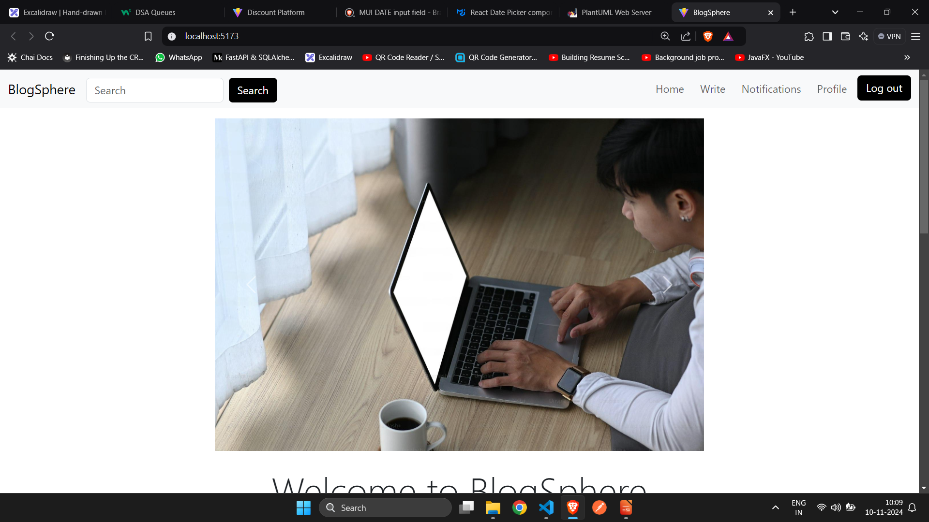
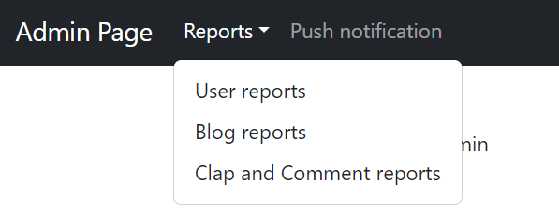
Menu screen

Slide 24
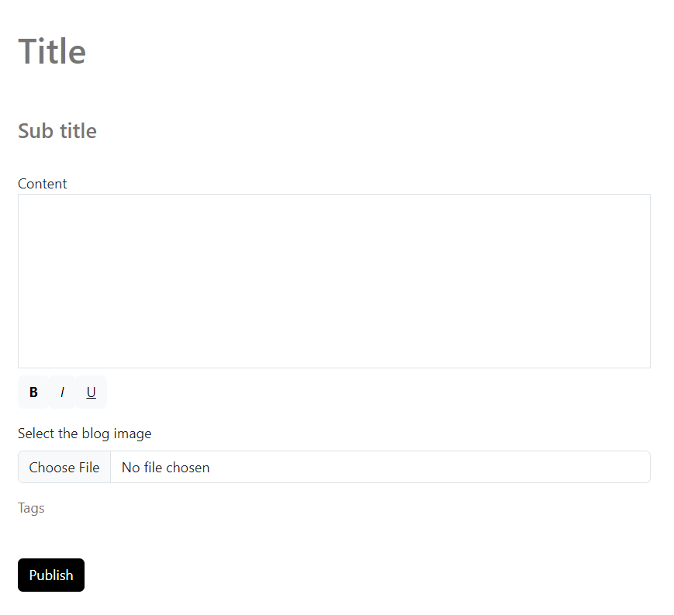
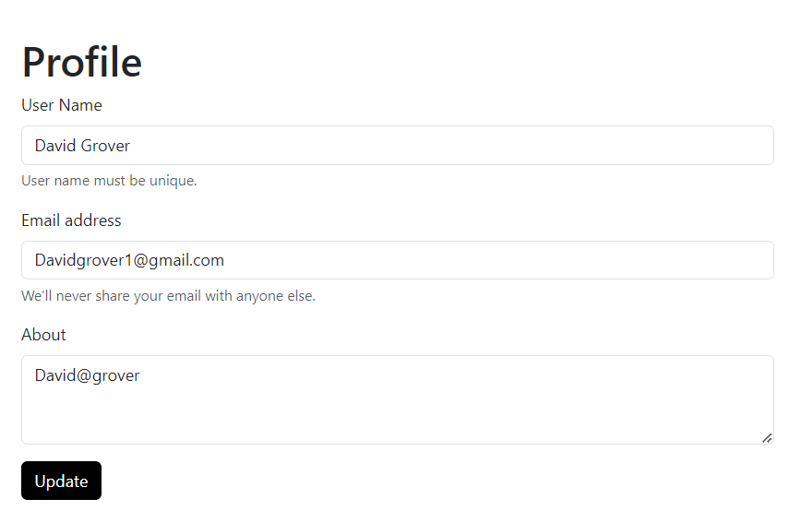
Input screen

Slide 25
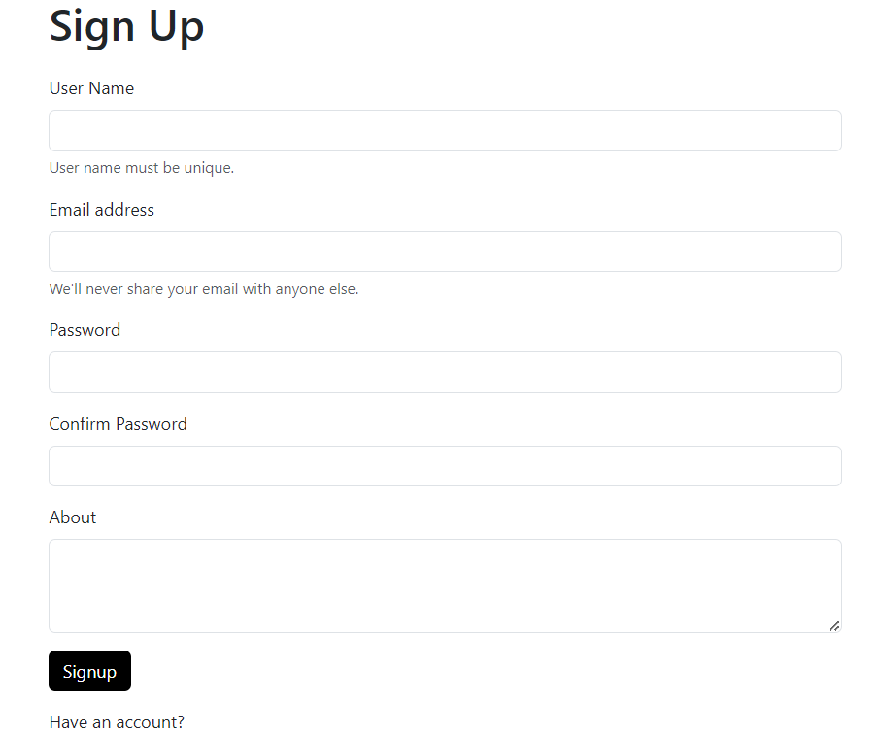
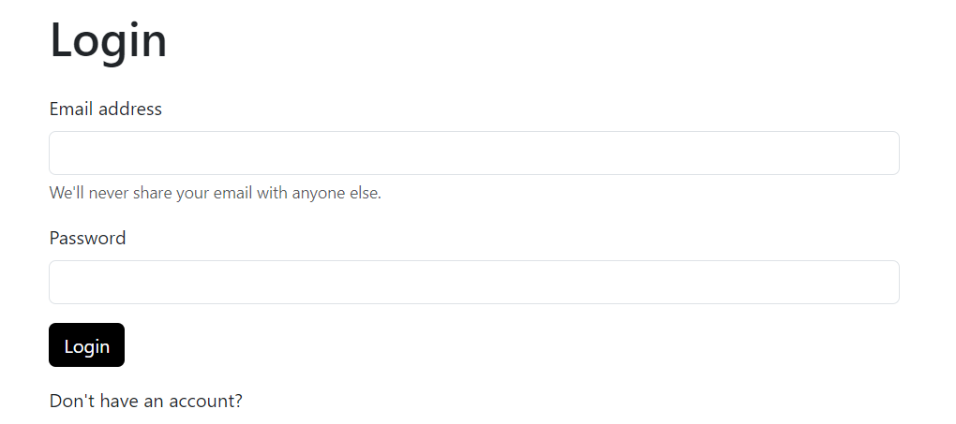
Input screen

Slide 26
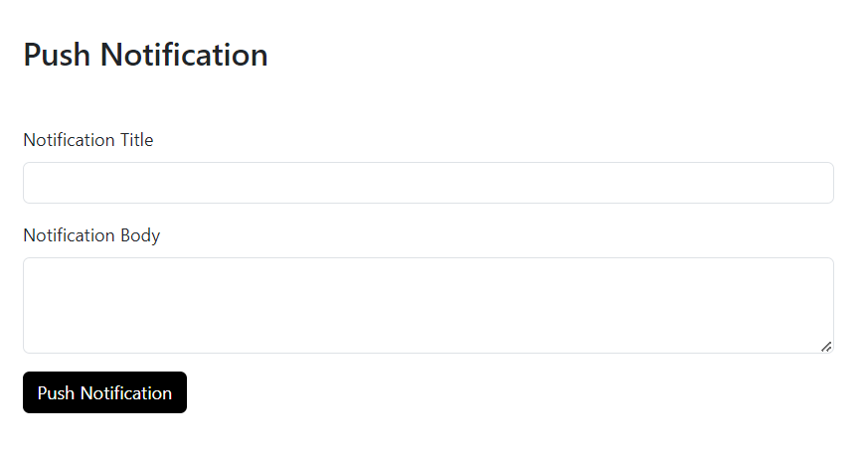
Input screen

Slide 27
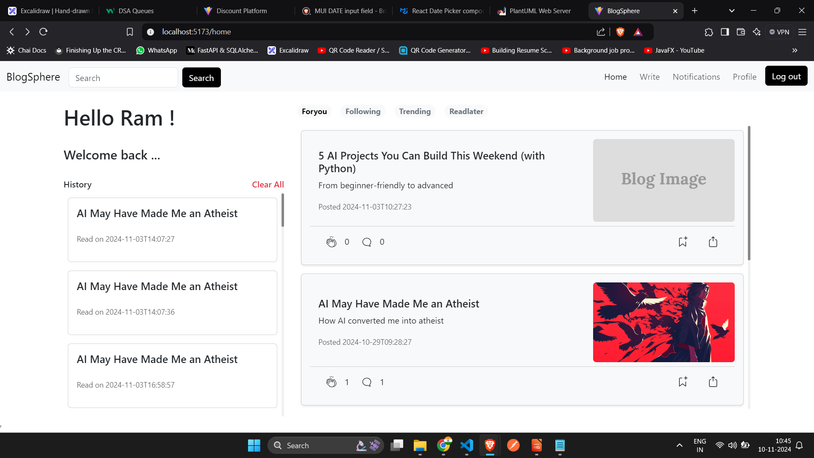
Output screen

Slide 28
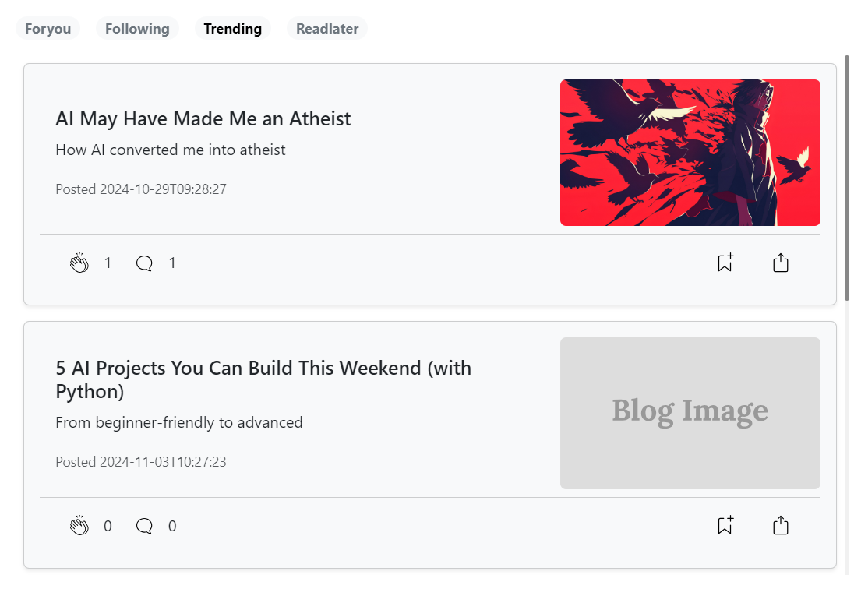
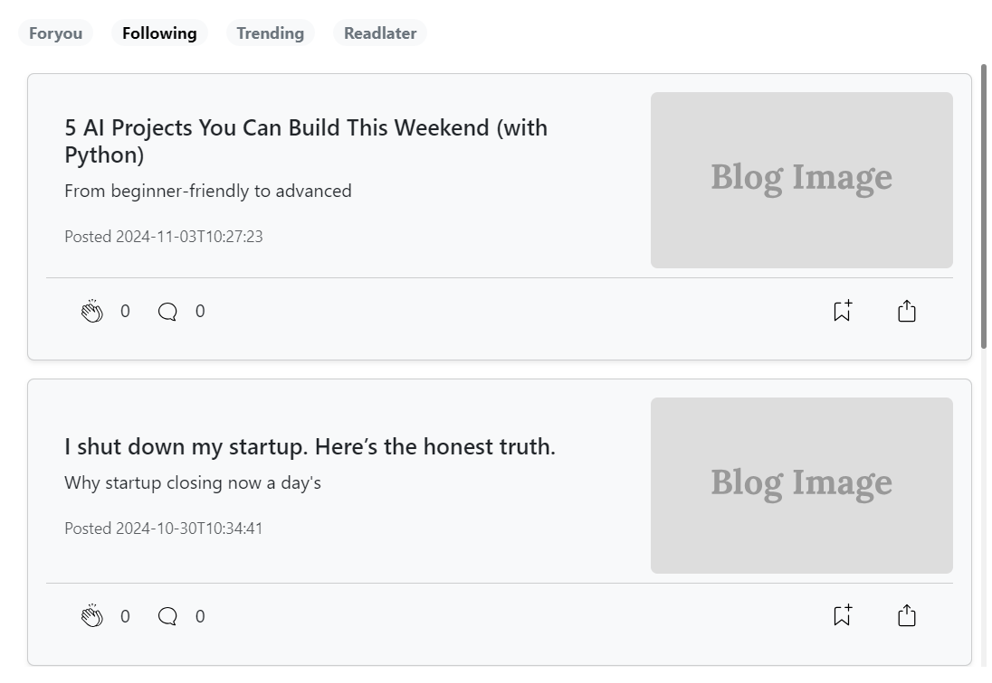
Output screen

Slide 29
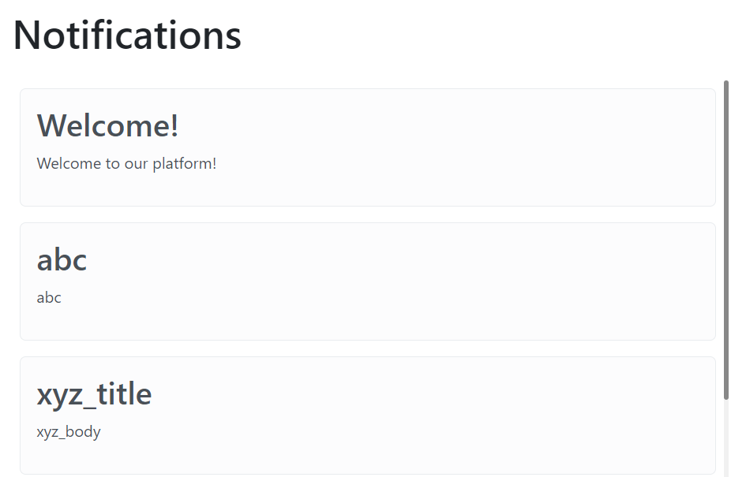
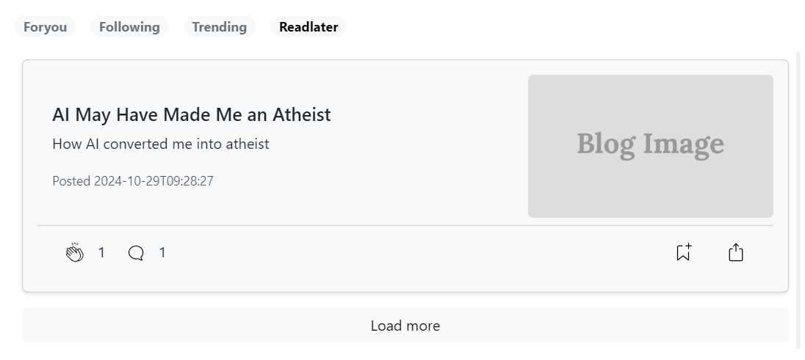
Output screen

Slide 30
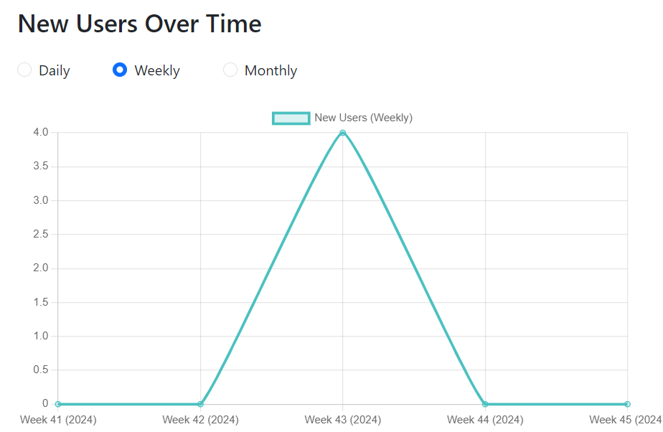

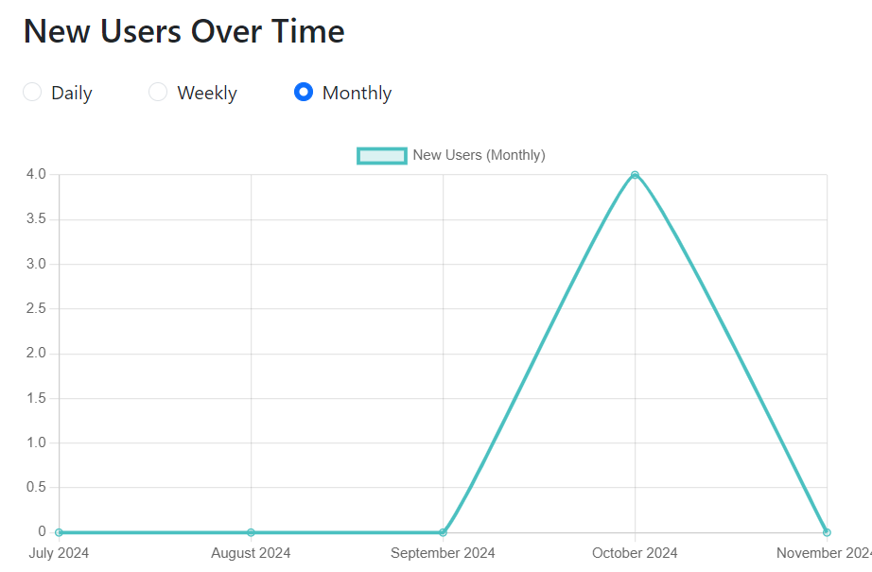
Output screen

Slide 31
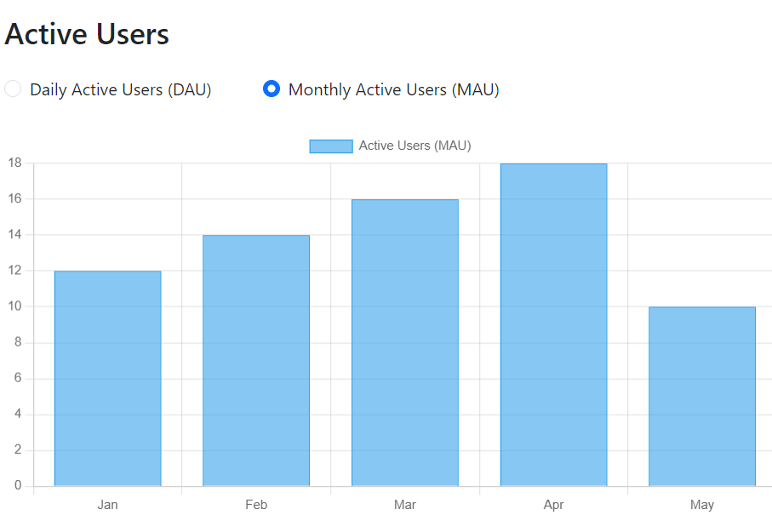
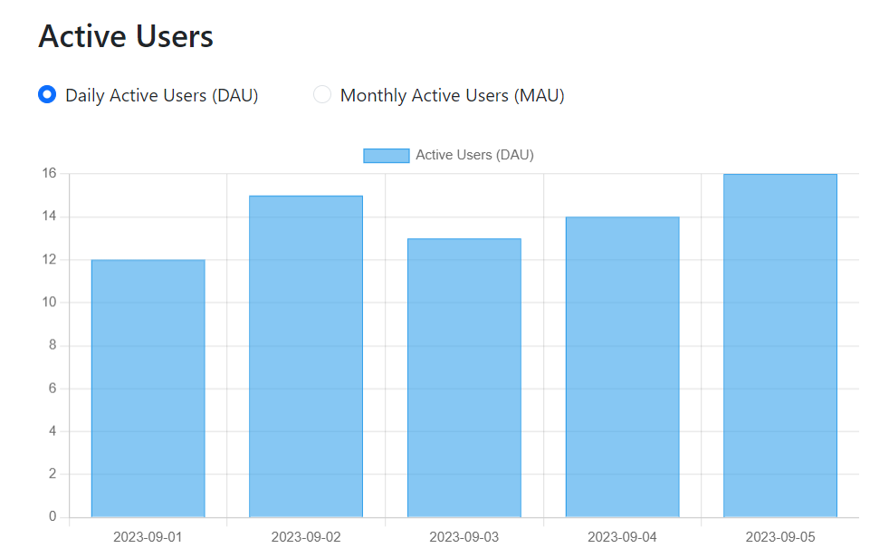
Output screen

Slide 32
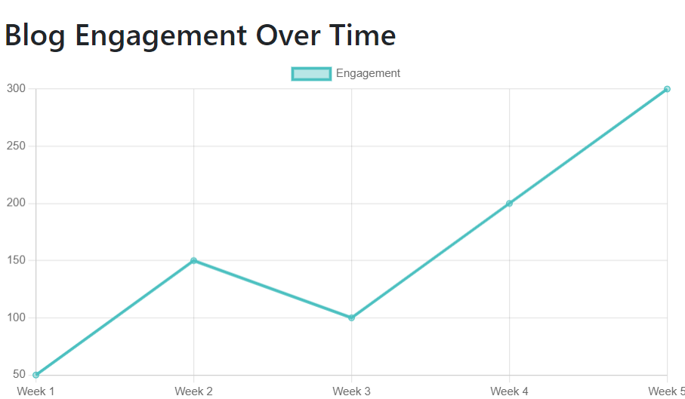
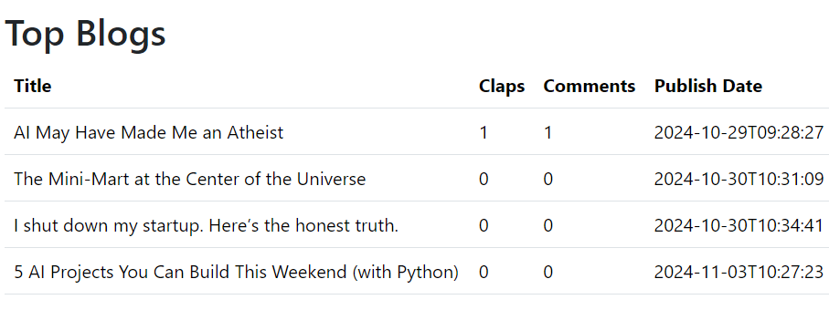
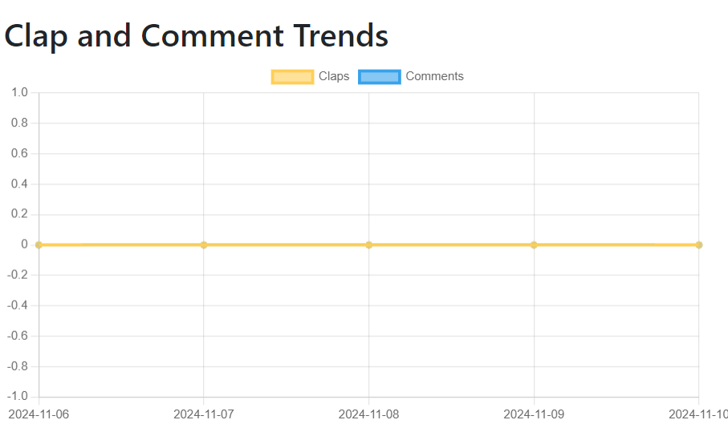
Output screen

Slide 33
Validation control
Validation in the React Ecosystem:
Form Libraries:
Formik: A popular library that simplifies form management, including validation.
Yup: A powerful schema validation library used with Formik.
React's Built-in Validation:
Discuss using HTML5 validation attributes like required, pattern, min, max, etc.
Explain how to leverage React's state management and conditional rendering for custom validation.

Slide 34
Validation control
Validation with Formik and Yup
Creating a Validation Schema with Yup:
Demonstrate how to define validation rules using Yup's schema builder.
Provide examples of common validation scenarios (e.g., required fields, email format, number ranges).
Integrating Yup with Formik:
Show how to pass the Yup schema to Formik's validationSchema prop.
Explain how Formik automatically validates user input against the schema.

Slide 35
Thank you

