Slide 1
Blog-Sphere
By: 76. Prajwal Prakash Kulkarni

Slide 2
Blog-Sphere
Welcome to the Blogging Website Project, an exciting venture that aims to create a visually stunning and highly engaging online platform for aspiring writers, subject matter experts, and content creators to share their thoughts, insights, and experiences with the world.
This project will leverage the power of modern web technologies and user-centric design principles to deliver a seamless and immersive blogging experience for both authors and readers.

Slide 3
Introduction
Embracing the Written Word
  The Blogging Website Project is a testament to the enduring power of the written word in the digital age. It provides a vibrant and inclusive space for individuals to express their ideas, share their stories, and connect with like-minded readers across the globe.

Slide 4
Introduction
Fostering Creativity and Knowledge Sharing
  By offering a user-friendly platform, the project aims to empower authors to cultivate their craft, expand their reach, and engage in meaningful dialogue with their audience. The website will serve as a hub for the exchange of knowledge, inspiration, and diverse perspectives.

Slide 5
Introduction
Driving Audience Engagement
  At the core of the Blogging Website Project is a deep commitment to fostering a thriving community of readers and writers. Through innovative features and interactive elements, the platform will encourage active participation, discussion, and the establishment of lasting connections.

Slide 6
Key Features
Intuitive Content Management
  The Blogging Website Project will offer a seamless and user-friendly content management system (CMS), allowing authors to effortlessly create, publish, and organize their posts. With features like drag-and-drop layouts, rich media integration, and real-time previews, the CMS will empower writers to bring their ideas to life with ease.

Slide 7
Key Features
Social Engagement and Sharing
  To amplify the reach and impact of the blog content, the platform will integrate robust social sharing capabilities. Readers will be able to easily share articles across various social media platforms, fostering the viral spread of engaging and thought-provoking content.

Slide 8
Key Features
User Profiles and Interactions
  The Blogging Website Project will offer personalized user profiles, allowing authors to showcase their expertise, build their personal brand, and engage with their audience. Readers, in turn, will be able to follow their favorite writers, leave comments, and participate in discussions, creating a vibrant and interactive community.

Slide 9
Existing Systems
WordPress
  WordPress is one of the most widely adopted and versatile content management systems, powering millions of websites and blogs worldwide. It offers a diverse range of themes, plugins, and customization options, making it a popular choice for bloggers and website owners.

Slide 10
Existing Systems
Medium
  Medium is a popular online publishing platform that focuses on simplicity and reader engagement. It provides a clean and minimalist writing experience, along with built-in social sharing and analytical tools, making it an attractive option for individual bloggers and publishing teams.

Slide 11
Existing Systems
Squarespace
  Squarespace is a comprehensive website builder and content management system that offers a wide range of design templates and features tailored for blogs and online portfolios. Its user-friendly interface and visual editing tools make it a popular choice for small businesses and personal websites.

Slide 12
Existing Systems
Blogger
  Blogger is a free and user-friendly blogging platform owned by Google. It provides a straightforward interface for creating and managing blogs, with integration with other Google services like AdSense and Google Analytics, making it a convenient option for casual bloggers and hobbyists.

Slide 13
Proposed System
Robust CMS
  The Blogging Website Project will feature a comprehensive content management system, empowering authors to effortlessly create, publish, and manage their blog content. With advanced formatting options, media integration, and intuitive publishing tools, the CMS will streamline the content creation process.

Slide 14
Proposed System
Social Integrations
  To amplify the reach and engagement of the blog content, the platform will seamlessly integrate with leading social media platforms. Readers will be able to easily share articles across their social networks, fostering the viral spread of compelling and thought-provoking content.

Slide 15
Proposed System
User Engagement
  The Blogging Website Project will prioritize fostering a vibrant and interactive community of readers and writers. Through features like user profiles, commenting systems, and interactive discussions, the platform will encourage active engagement, knowledge sharing, and the formation of lasting connections.

Slide 16
Technologies Used
Front-end Development
  The Blogging Website Project will leverage cutting-edge front-end technologies, such as React, to deliver a seamless and responsive user experience. The user interface will be built with HTML, CSS, Bootstrap and JavaScript, ensuring the website is accessible, visually appealing, and highly interactive.

Slide 17
Technologies Used
Back-end Infrastructure
  The back-end of the Blogging Website Project will be powered by Python’s Fastapi framework, a robust and scalable Python runtime environment. This will enable the development of a secure and efficient API layer, handling tasks like content management, user authentication, and data storage.

Slide 18
Technologies Used
Database Integration
  To ensure reliable and efficient data management, the project will utilize MySQL, a flexible and best database. This will allow for the seamless storage and retrieval of blog content, user profiles, and other relevant data, supporting the platform's dynamic and content-driven nature.

Slide 19
Modules

Slide 20
Module overview
User Management
Blog Content Management
Blog Recommendation System
Notification System
Search & Discoverability
Report Management (Admin Module)
Analytics & History

Slide 21
Module specification
User Management Module
  Features
    User authentication (login, signup)
    Profile management (update, follow/unfollow)
    Secure login and password encryption

Slide 22
Module specification
Blog Management Module
  Features
    Blog writing, editing, and multimedia support
    Like(clap) and comment interaction
    Read later feature for saving blogs
    Audio playback for blog listening

Slide 23
Module specification
ML-based blog recommendation module
  Personlization: Provides personalized blog suggestion based on:
    User history
    Interaction and preference
  ML model
    Collaborative filtering/content-based recommendation model

Slide 24
Module specification
Notification module
  Real-Time Notifications:
    Interaction notifications (comments, likes)
    Optimized for high-frequency interactions (e.g., bulk clap notifications)
  Push Notifications: for user engagement

Slide 25
Module specification
Search module
  Search Engine: Keyword-based search for blogs
  Trending Content: Highlights popular and recommended blogs
  Categories: For easy discovery based on user preferences

Slide 26
Module specification
Admin module
  User Reports: Tracks user activity, engagement, and growth
  Blog Reports: Analyzes blog popularity and interactions
  Interaction Reports: Monitors claps, comments, and engagement statistics
  User Activity Tracking: Logs views, claps, comments for recommendations
  Analytics Dashboard: Provides insights on platform usage, trends, and peak times

Slide 27
Diagrams

Slide 28
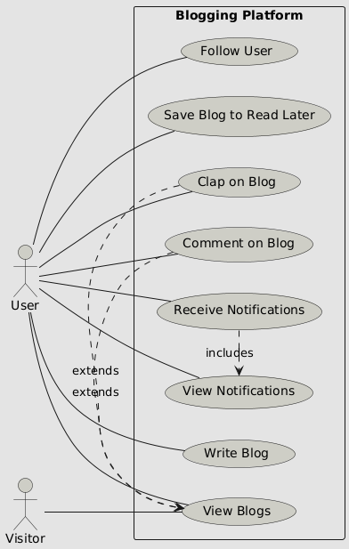
Use-case diagram

Slide 29
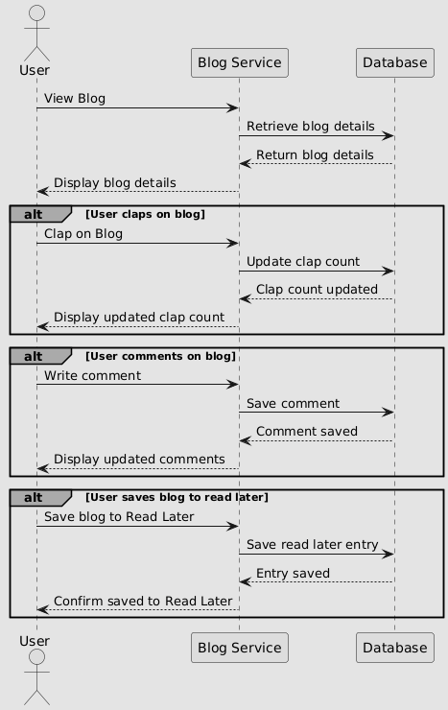
Sequence diagram

Slide 30
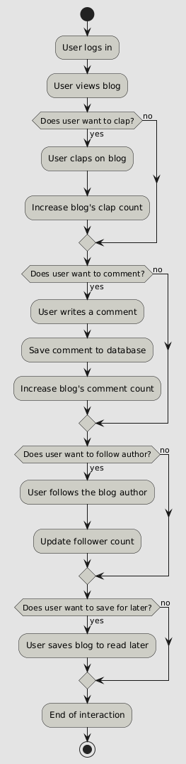
Activity diagram

Slide 31
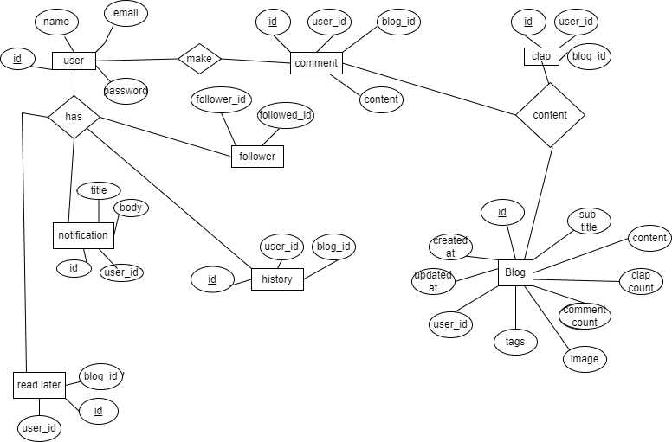
ERD

Slide 32
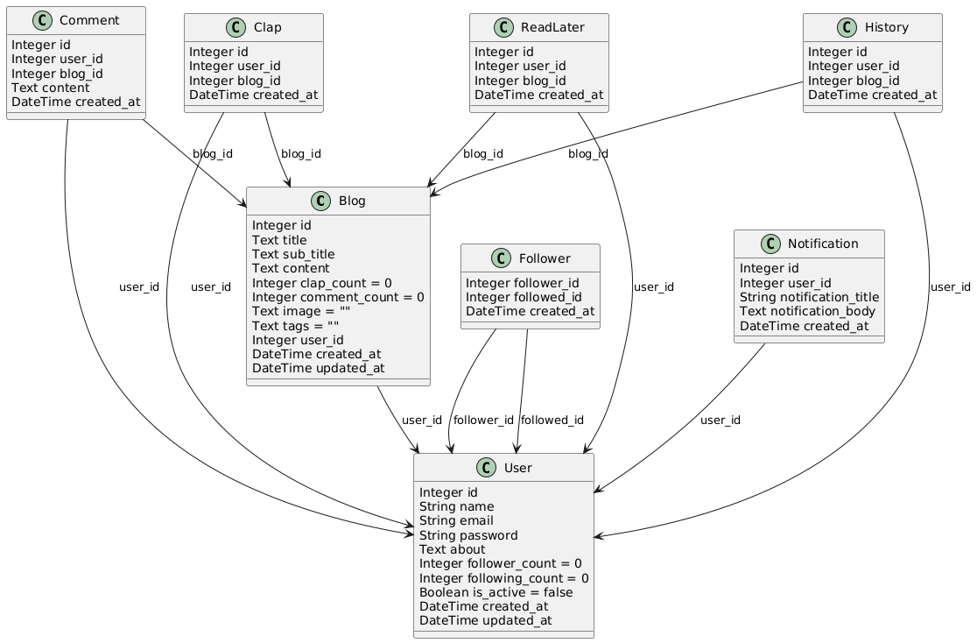
Class diagram

Slide 33
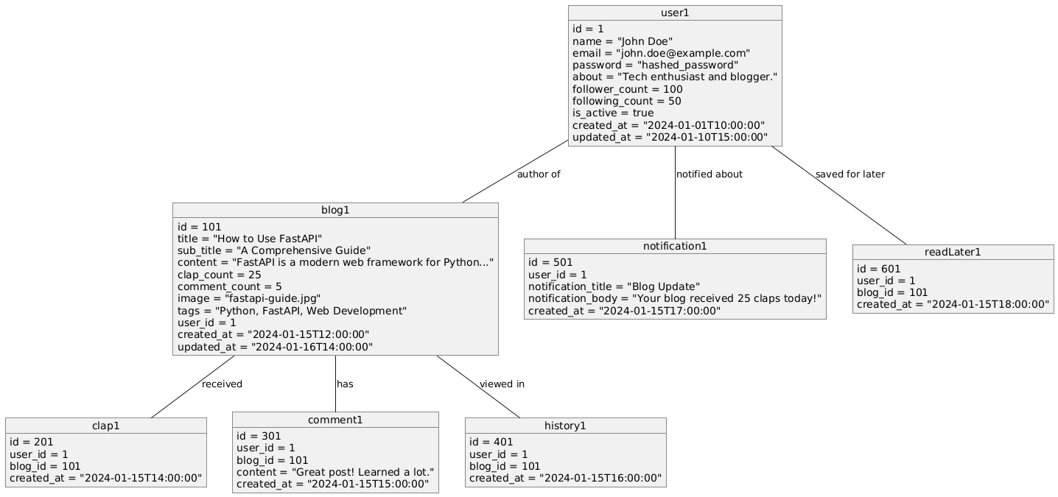
Object diagram

Slide 34
Screenshots

Slide 35
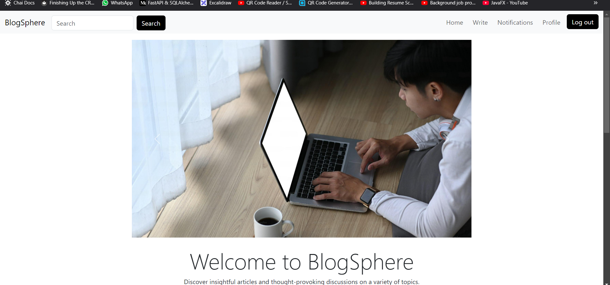

Slide 36
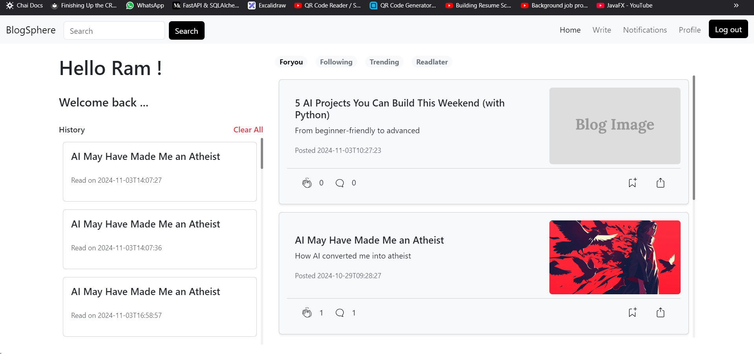

Slide 37
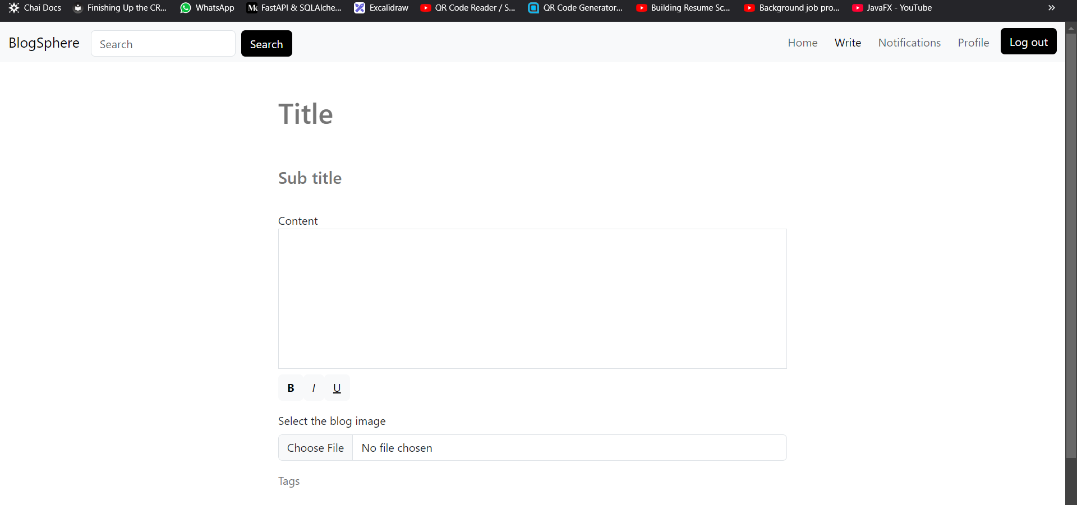

Slide 38
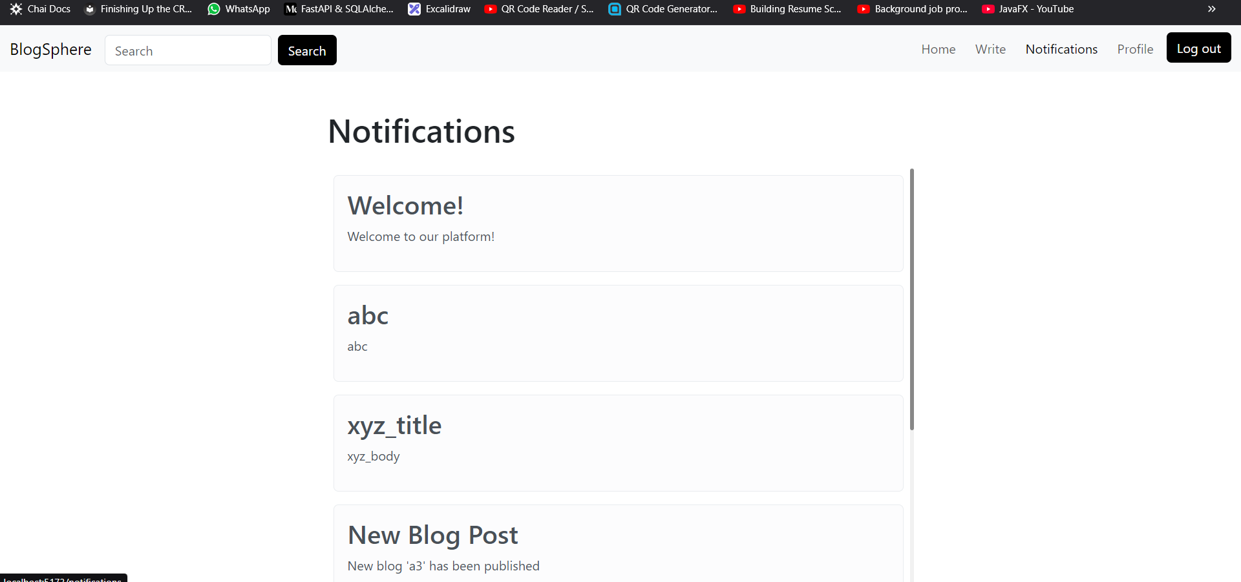

Slide 39
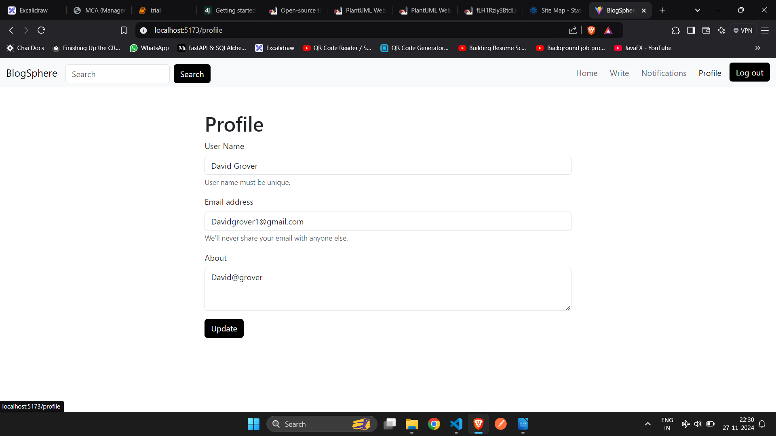

Slide 40
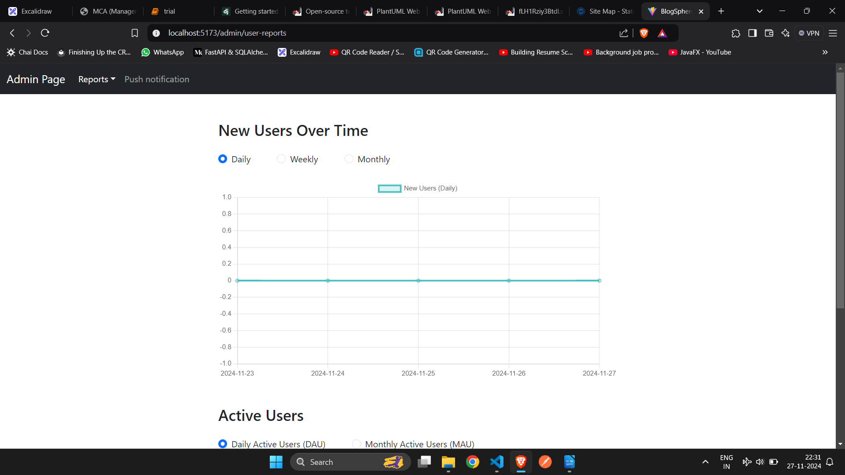

Slide 41
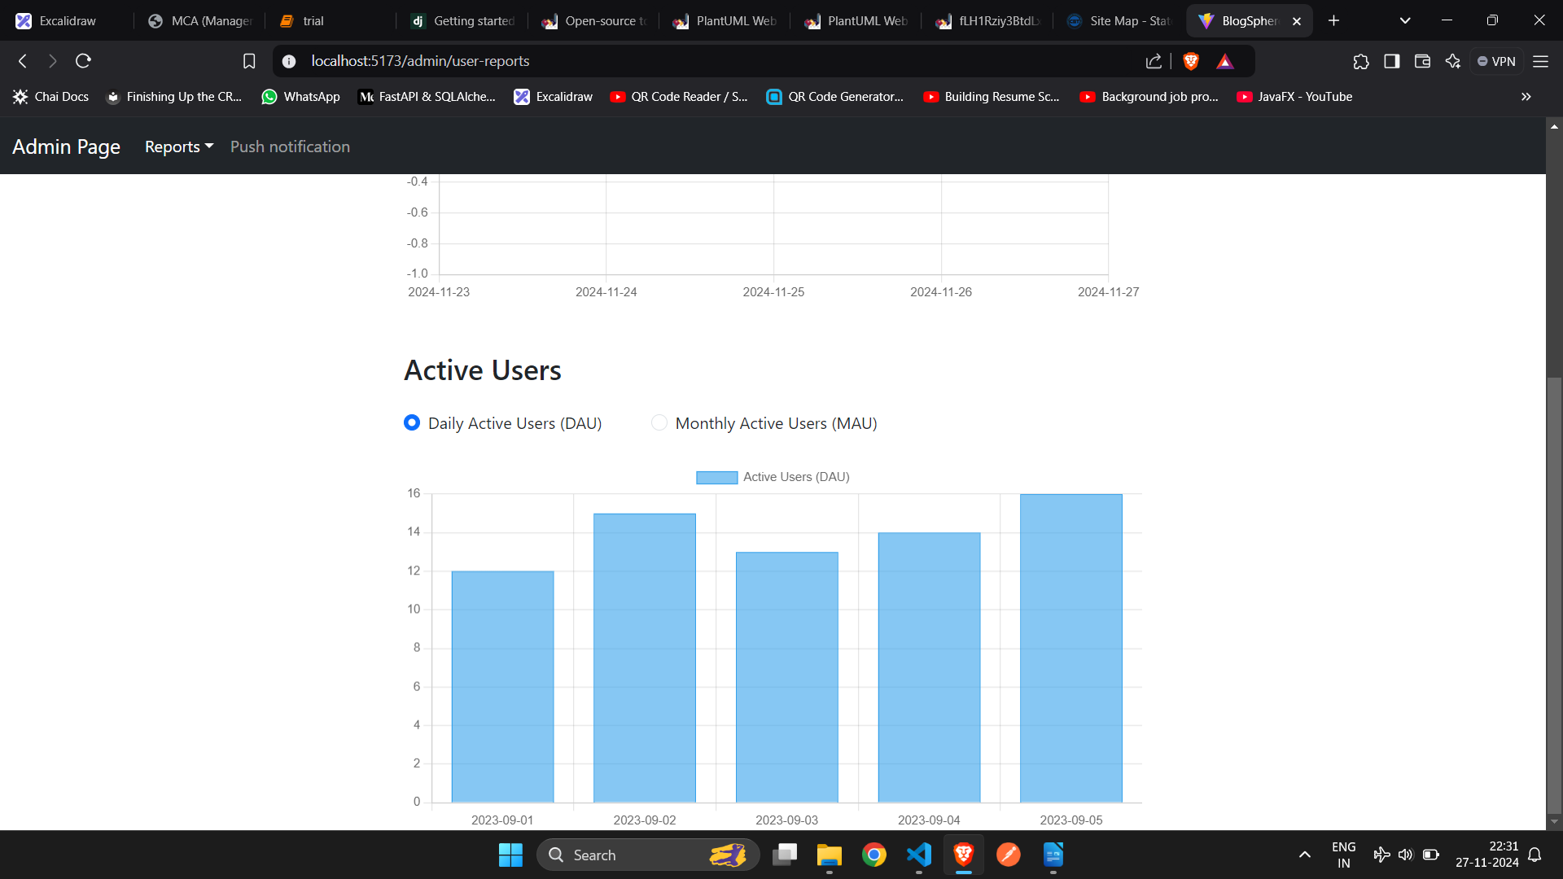

Slide 42
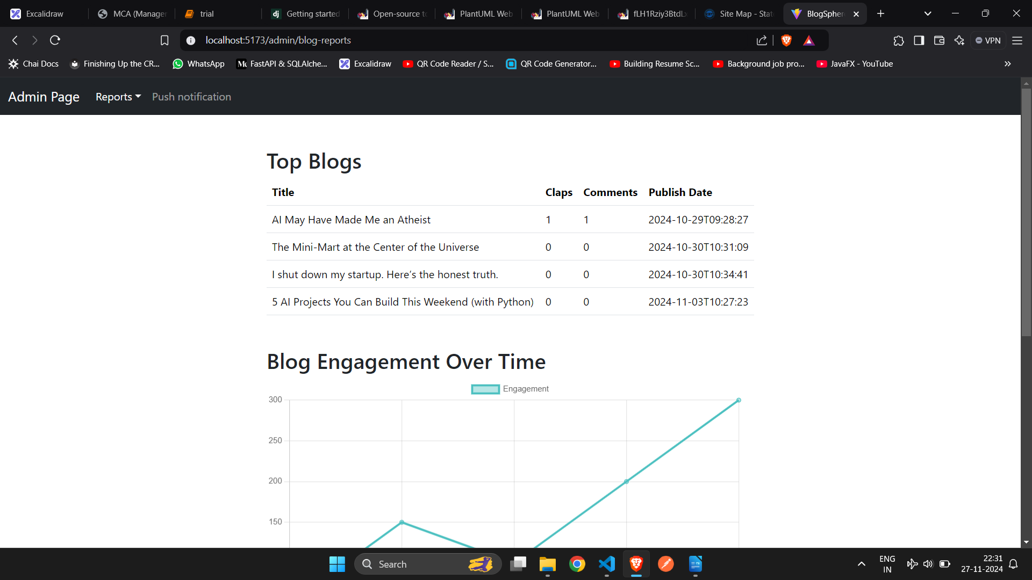

Slide 43
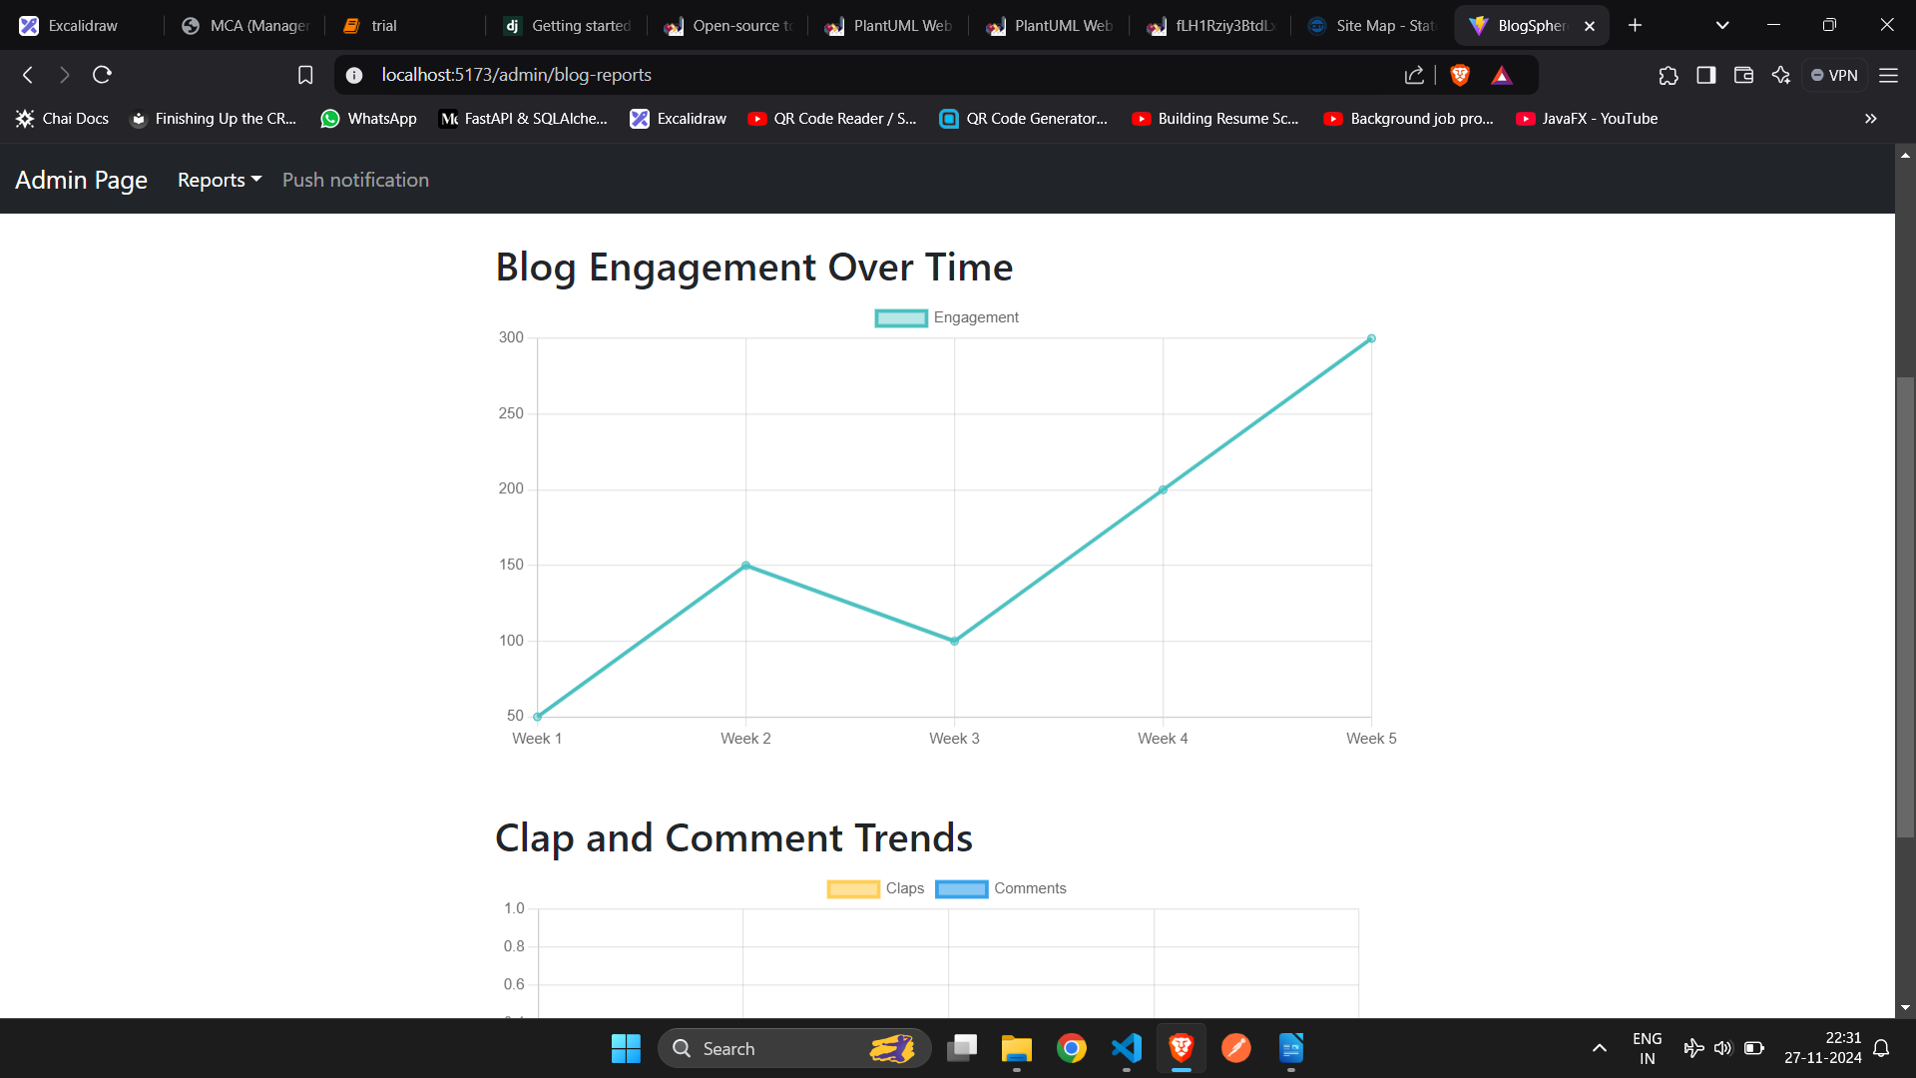

Slide 44
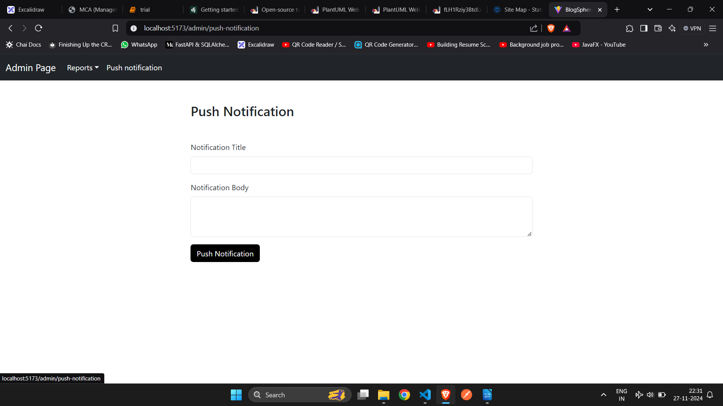

Slide 45
References
Medium : https://medium.com/
Blogger : https://www.blogger.com/
Tumblr: https://www.tumblr.com/
Ghost : https://ghost.org/
Postach: https://postach.io/
Weebly: https://www.weebly.com

Slide 46
Thank you

