Slide 1
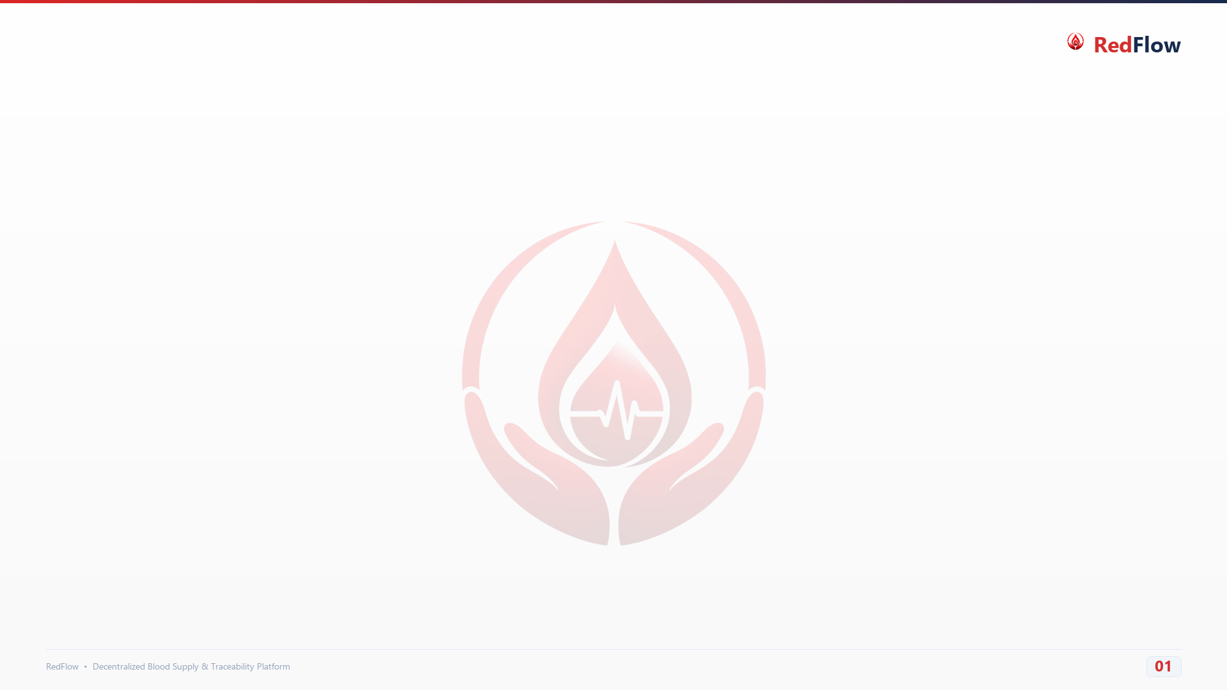
BLOCKCHAIN INFRASTRUCTURE
Ganache Local Testnet Implementation
High-Speed, Zero-Cost Ethereum Simulation for RedFlow Smart Contract Testing
Local Private EVM Network
Runs an isolated Ethereum Virtual Machine on Chain ID 1337 (RPC: http://127.0.0.1:8545). Eliminates reliance on external internet connections and public testnet downtime.
Network Configuration Parameters
• Network Architecture: Private Local Ethereum EVM (Ganache)
• RPC Endpoint: http://127.0.0.1:8545 (or 7545)
• Chain / Network ID: 1337 (EVM Compatible)
• Smart Contract Address: 0xA990b5Fe5948cC41648eE4D8D26Ac5f5FE9557BE
• Deployer / Admin Address: 0xA00D124986D984cA438f646903f3A3f485167154
Zero-Cost & Instant Mining
Contracts and state updates execute in milliseconds without spending real or faucet ETH. Allows rapid testing of donor verification and blood bag creation workflows.
Key Benefits in RedFlow Development
✓ Pre-Funded Accounts: 10 test accounts with 100 simulated ETH for admin operations.
✓ Zero Gas Costs: No expenditure required during repetitive donor verification tests.
✓ Instant Feedback: Block confirmation under 100ms enables live web app interactions.
✓ Deterministic Keypairs: Persistent test accounts simplify backend automated testing.
100% EVM Compatibility
Executes identical Solidity 0.8.20 bytecode and Keccak-256 state hashing as Ethereum Mainnet. Enables seamless future migration to Sepolia or Polygon Layer 2.

