Slide 1

Prayas Dataset
Energy Usage Index
Prepared by group 11
Margaux Massol - 25V0014
Prajwal Nayak - 22B4246
Sarvadnya Purkar - 22B4232
Somisetty Ruchita - 21D170041
1

Slide 2
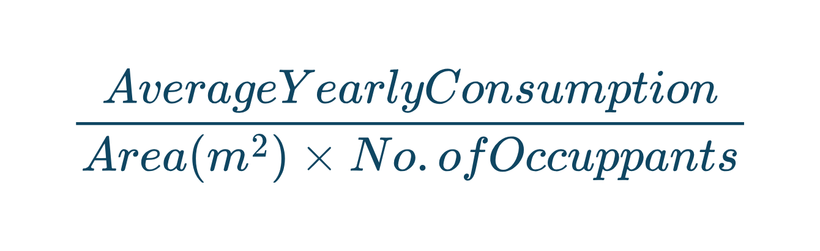
Objectives
Develop Energy Usage Index
Define an index to evaluate the energy consumption efficiency relative to household profiles (size (number of people) and floor area)
Suggestions for certain kind of houses
based on the clusters we obtain, we can provide
Compare Household Behavior
Detect behavioral or structural consumption patterns by using clustering
2

Slide 3
Methodology
Core Outcome
Metric
Per-Capita Energy Usage Index (EUI) → Annual consumption normalized by household size & area
Behavioral
Drivers
Seasonal Ratio → Summer vs. Winter consumption
Consumption Volatility → Standard deviation of daily consumption (steady vs. fluctuating use)
Features &
Derived Features
Area per Occupant (space-efficiency measure)
Weekend–Weekday Ratio (behavioral rhythm)
Appliance-based indicators (e.g., AC ownership)
Contextual
Features
Features standardized using StandardScaler
Optimal cluster number determined with Elbow Method & Silhouette Score.
K-Means
Clustering
Techniques
Used for comparative validation and to check consistency of household groupings
Gaussian Mixture
Models (GMM)
Dynamic Time Warping (DTW) + Hierarchical Clustering → to capture similarity in shapes of time-series patterns
Trajectory Clustering → Identifying households by long-term energy use evolution
Advanced
Analysis
Evaluation
& Validation
Internal
Metrics
Silhouette Score, Within-Cluster Sum of Squares (WCSS)
Visualization
Cluster distribution plots, time-series pattern overlays, EUI comparison charts
3

Slide 4
EUI-Centric Clustering
4

Slide 5
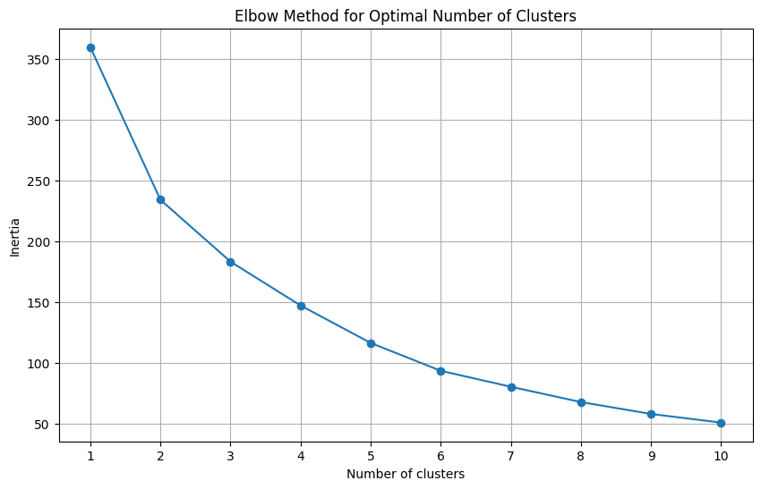
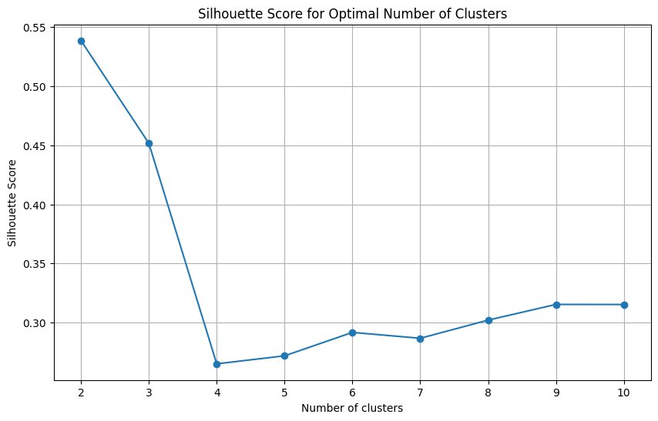
Optimal # of Clusters K-means - Elbow Method & Silhouette Score
5

Slide 6
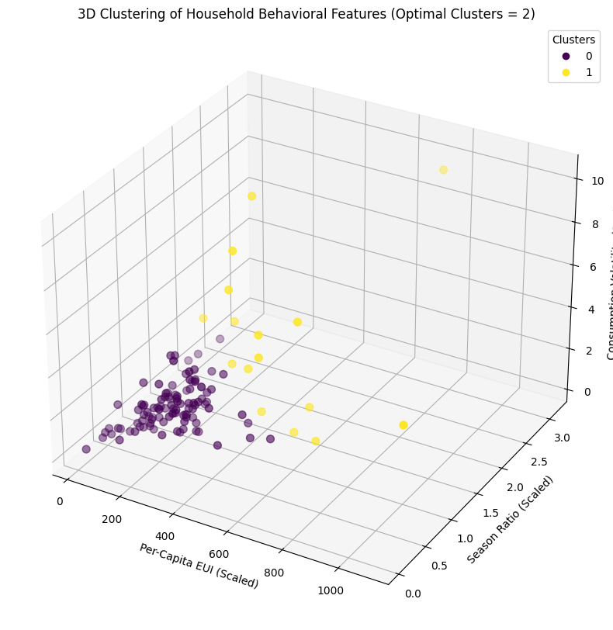
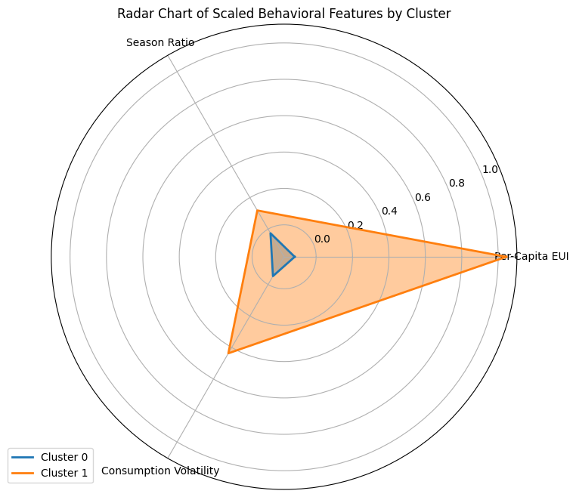
K-means: 3D Clustering of Household Behavioral Features
6

Slide 7
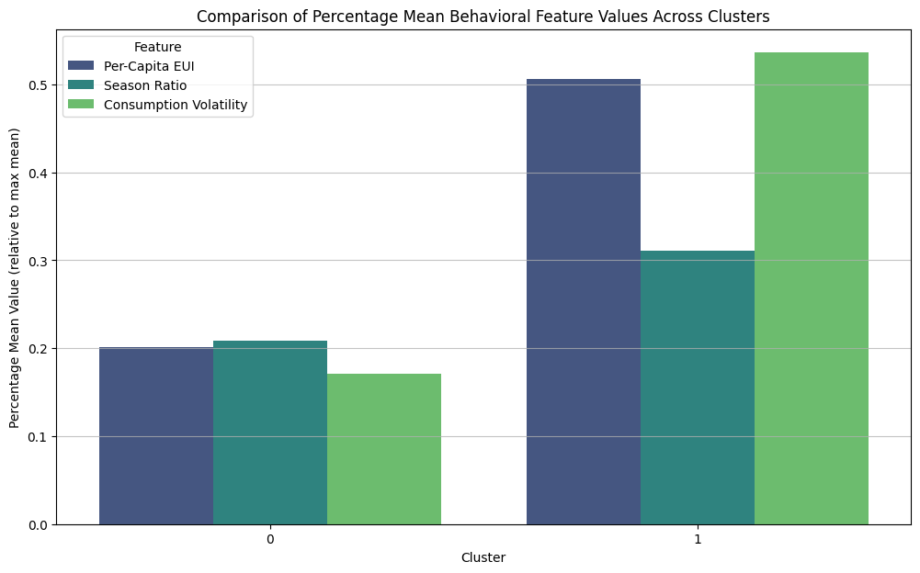
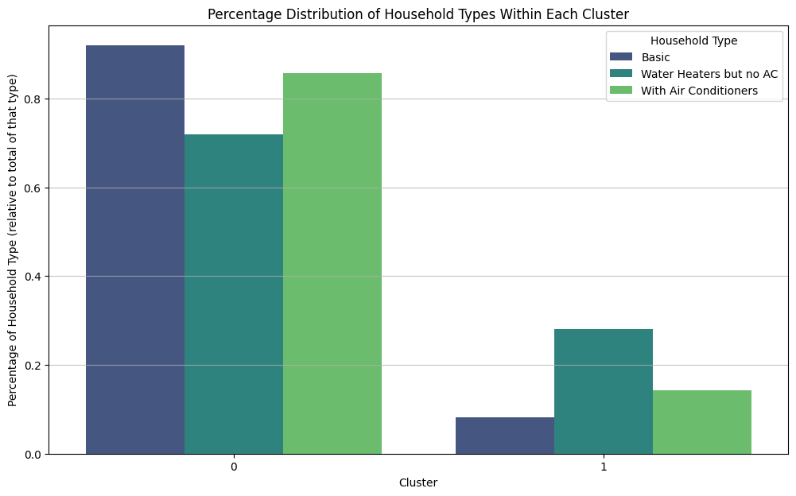
Comparison of Mean Behavioral Feature Values
7

Slide 8
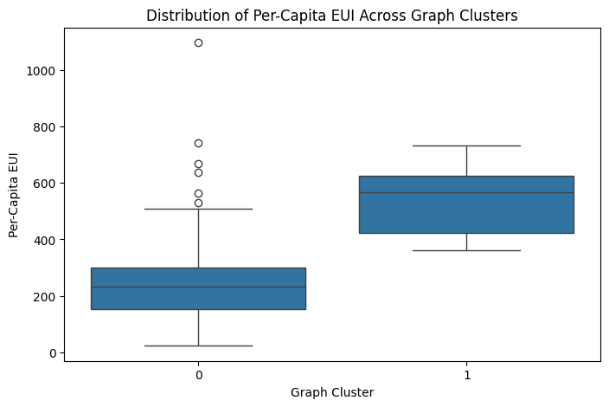
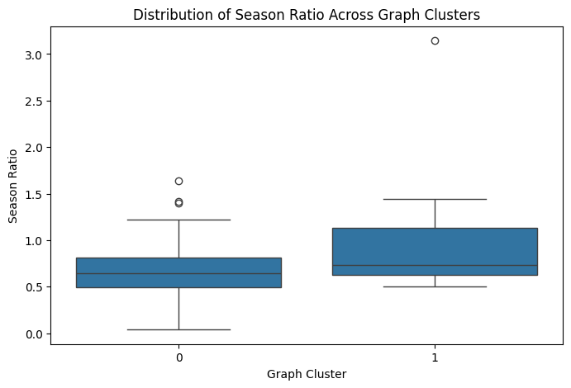
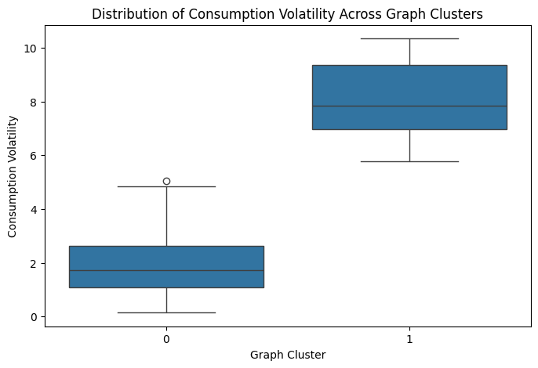
Distribution across Graph Clusters
(Spectral Clustering)
By Per-Capita EUI
By Season Ratio
By Consumption
Volatility
8

Slide 9
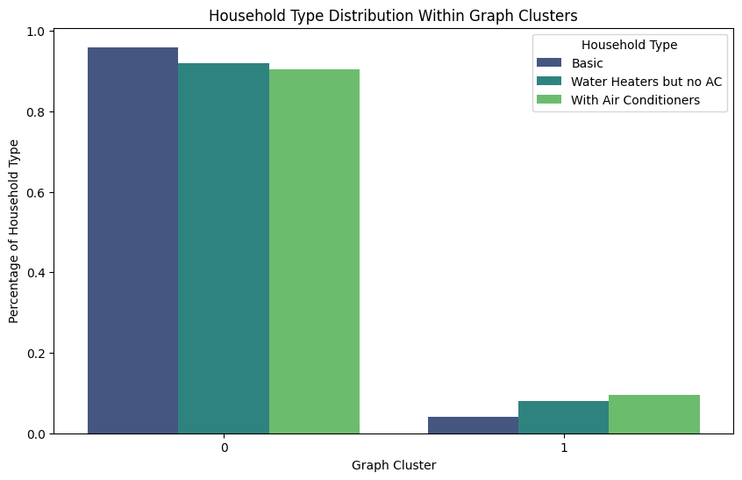
Household Types Distribution - Graph Clusters
9

Slide 10
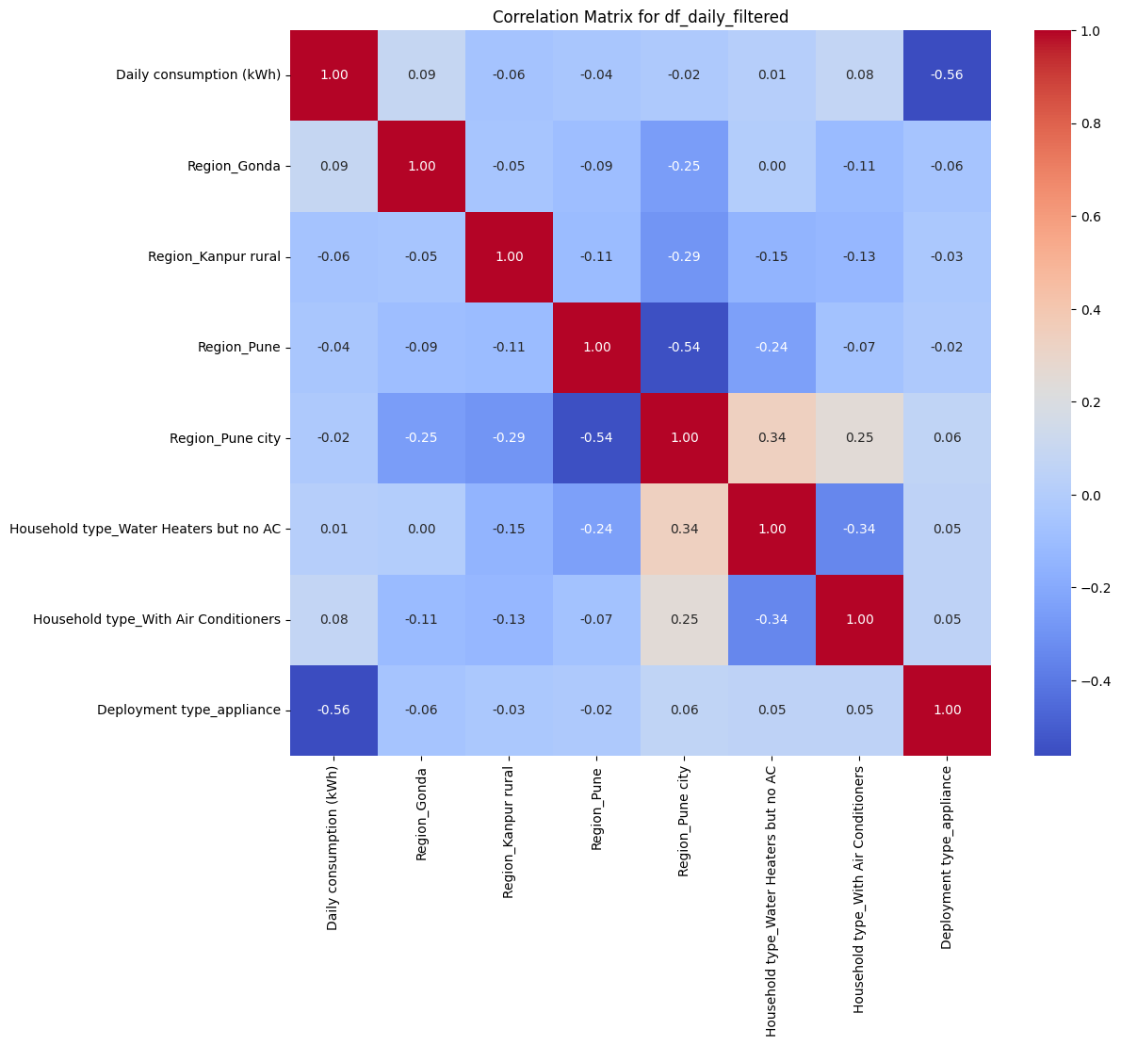
Bivariate Analysis
10

Slide 11
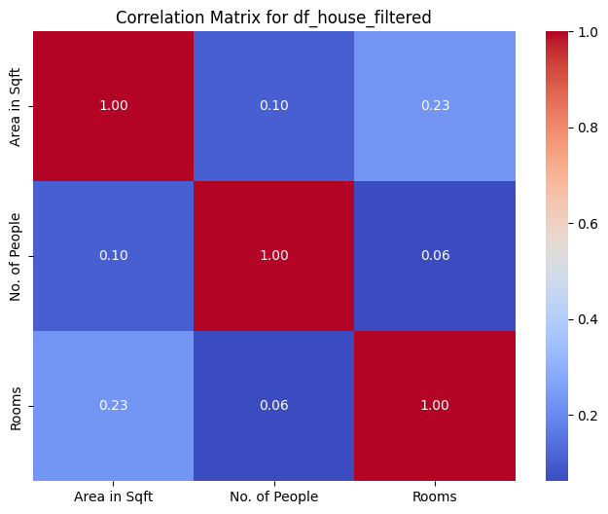
Bivariate Analysis
Correlation between Area, Number of people
and Number of Rooms
11

Slide 12
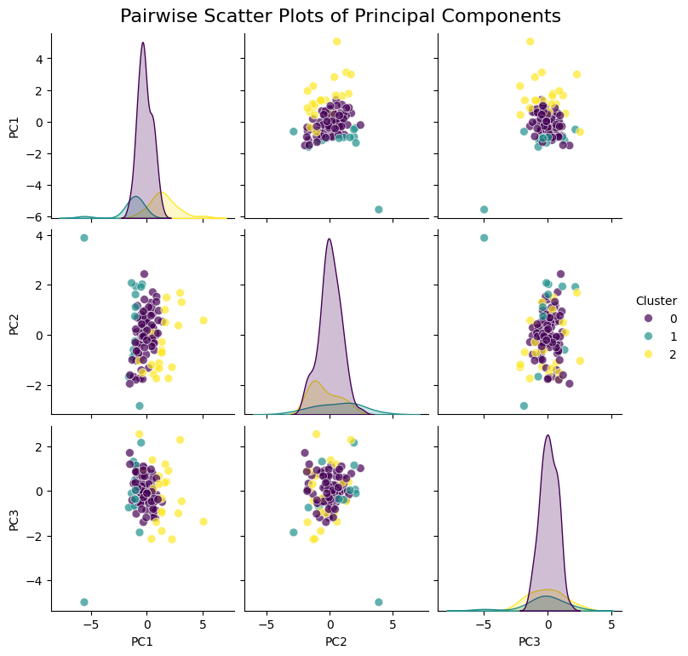
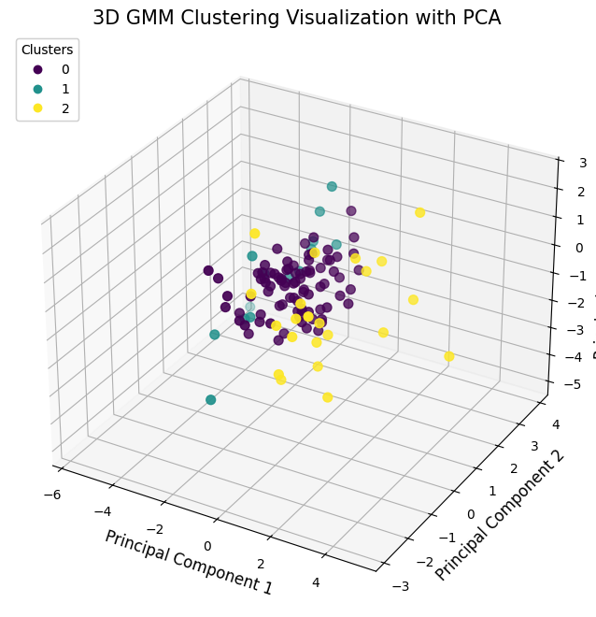
Clustering using GMM
12

Slide 13
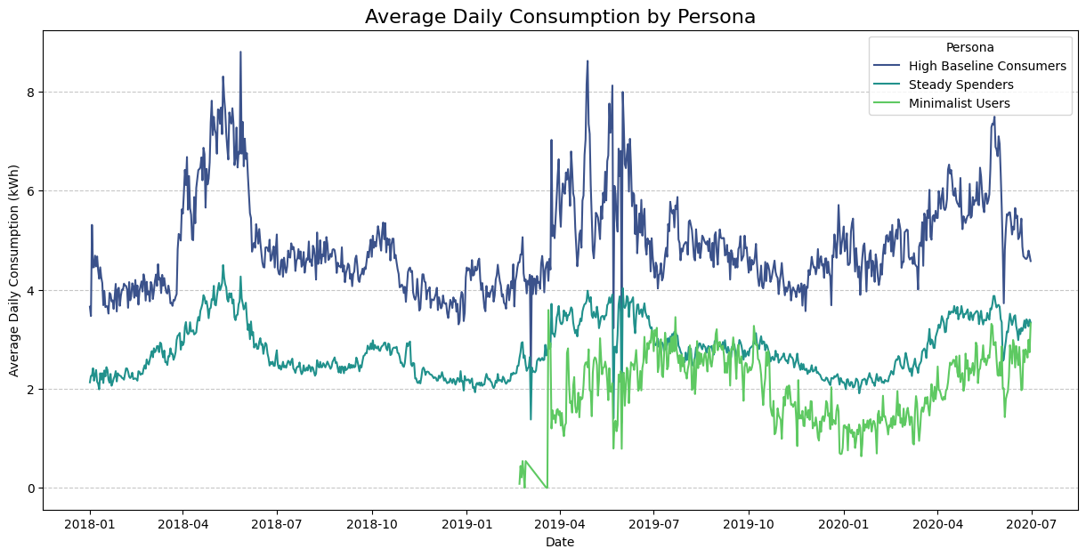
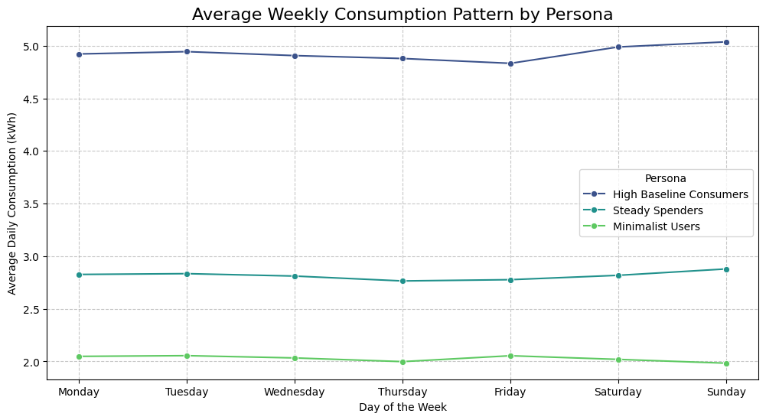
Persona Behavior - Average Consumption Patterns
13

Slide 14
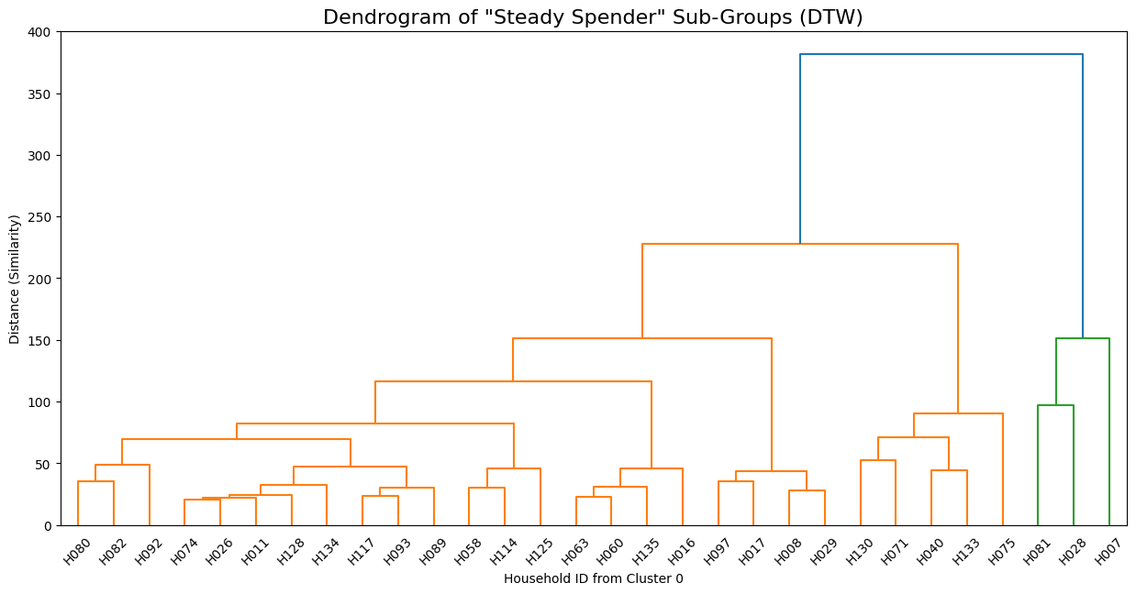
Dendogram using Dynamic Time Warping (DTW)
14

Slide 15
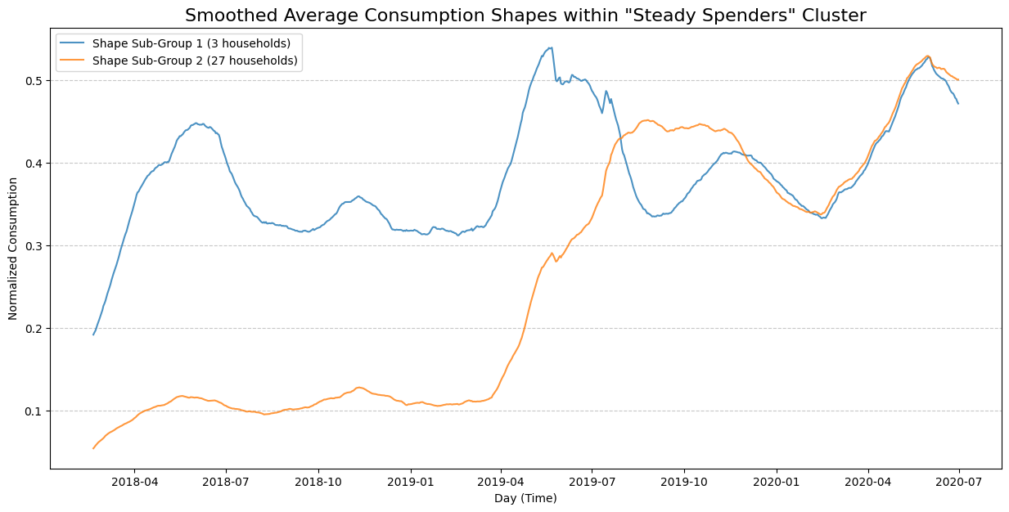
Average Consumption Shapes within ‘Steady Spender’ Cluster
15

Slide 16
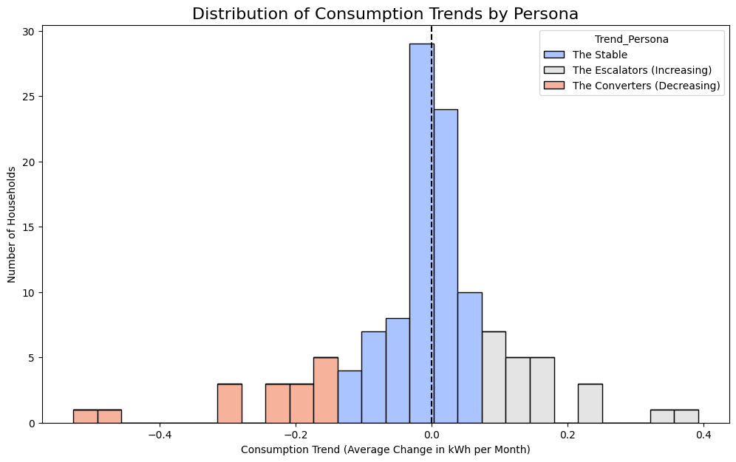
Predictive Analysis : Future Consumption Trajectories
16

Slide 17
Results & Key Findings
Spectral Clustering identified two distinct segments:
Cluster 0: Lower & stable usage → majority of households
Cluster 1: High, seasonal, volatile usage → small minority
Clustering
Outcomes
High Baseline Consumers – Consistently high usage; driven by inefficient appliances/baseload
Steady Spenders – Majority group, with two sub-profiles:
Consistent Responders → Lockdown-driven high & flat usage (work-from-home effect)
Seasonal Outliers → Traditional summer peak from AC loads
Minimalist Users – Low, efficient, stable consumption patterns
Household
Personas
Escalators – Rising consumption trend (future risk)
Converters – Actively reducing consumption (success stories)
Stable – Flat trends; majority group
Future-focused
Personas
17
Area per Occupant (space-efficiency measure)
Weekend–Weekday Ratio (behavioral rhythm)
Appliance-based indicators (e.g., AC ownership)

Slide 18
Inferences & Strategic Recommendations
Majority of households operate at a stable baseline with moderate efficiency
A smaller but critical group drives disproportionate seasonal and volatile demand
COVID-19 shifts permanently reshaped household energy behavior
Insights
High Baseline Consumers → Appliance audits, promote efficient replacements
Consistent Responders → WFH energy tips, phantom load management, smart strips
Seasonal Outliers → Cooling efficiency advice (thermostats, insulation, fans)
Minimalists → Positive reinforcement, "Energy Champion" recognition
Escalators → Early alerts, proactive audits
Converters → Congratulate & study them as best-practice models
Actionable
Recommendations
Personas allow personalized interventions instead of generic campaigns
Peer-based benchmarking motivates change
Trajectory-based personas serve as KPIs to measure long-term policy impact
Policy
Relevance
18
Area per Occupant (space-efficiency measure)
Weekend–Weekday Ratio (behavioral rhythm)
Appliance-based indicators (e.g., AC ownership)

Slide 19
Thank You!
19

