Slide 1

Data Mining Algorithm Course Project
(18ECSC301)
Building Insurance Claim Prediction
Project Id : 5DMACP08
Earlier known as
B. V. B. College of Engineering & Technology

Slide 2
Team Details
Earlier known as
B. V. B. College of Engineering & Technology
Team C7
Team Leader : Nisha Rao -146
TEAM MEMBERS:
Prajwal A Nazre - 154
Pratiksha Danti - 161
Rachana Udagatti - 167

Slide 3
Contents
Earlier known as
B. V. B. College of Engineering & Technology
About the Challenge 4-5
Understanding of Data 6-9
Exploring Data Analysis(EDA) 10-22
Data Preprocessing 23-24
References 25

Slide 4
About the Challenge
Earlier known as
B. V. B. College of Engineering & Technology
Challenge Goal :
The goal of the challenge is to predict if a building will have an insurance claim during a certain period. You will have to predict a probability of having at least one claim over the insured period of a building.
.

Slide 5
Challenge Duration
Earlier known as
B. V. B. College of Engineering & Technology
Start Date : 1st January, 2019
End Date : 1st January, 2020

Slide 6
Understanding of data
Earlier known as
B. V. B. College of Engineering & Technology
The total size of the dataset :
Total size of train data : 20458
Total size of test data : 3412
Number of rows : 23870 row
Number of columns : 26 columns

Slide 7
List of Attributes
Earlier known as
B. V. B. College of Engineering & Technology
Identifiant EXPO; Insee; target;
superficief; ft_2_categ; ft_4_categ; ft_5_categ;
ft_6_categ; ft_7_categ; ft_8_categ; ft_9_categ;
ft_10_categ; ft_11_categ; ft_12_categ; ft_13_categ;
ft_14_categ; ft_15_categ; ft_16_categ; ft_17_categ;
ft_18_categ; ft_19_categ; ft_21_categ; ft_22_categ;
ft_23_categ; ft_24_categ;
Note : Important Attributes are Highlighted

Slide 8
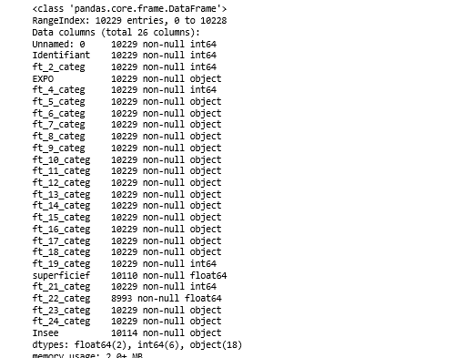
Data Description
Earlier known as
B. V. B. College of Engineering & Technology

Slide 9
Attribute Details
Earlier known as
B. V. B. College of Engineering & Technology
• login: variable to identify client in our database.
• ft_2_categ: year of observation for the insured policy.
• EXPO: time insured in Generali on the year. Numerical variable
(Ex: Full year insurance EXPO = 1; 6 months EXPO = 0.5 ).
• superficief: size in m² of the insured building. Numerical variable.
• Insee: French geographical code to locate the insured building.
Geographical/categorical variable.
• target: target variable. (0: no claim, 1: at least one claim over insured period).

Slide 10
Missing Data in Our Dataset(in percentage)
Earlier known as
B. V. B. College of Engineering & Technology
superficief - 1.230950
ft_22_categ - 11.781946
Insee - 1.143025

Slide 11
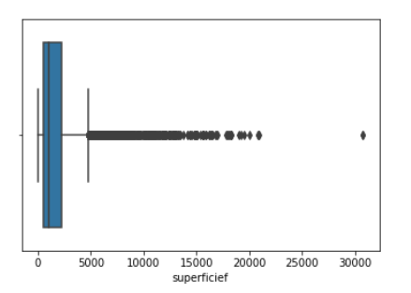
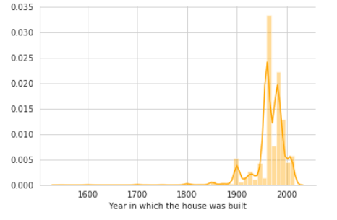
Understanding Important Attributes By Plots
Earlier known as
B. V. B. College of Engineering & Technology
ft_22_categ : The year in which the house was built
Inference :
from the graph we can infer that maximum house are built between the year of 1850 to 2012.

Slide 12
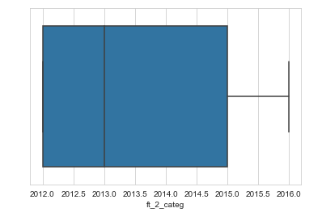
ft_2_categ
Earlier known as
B. V. B. College of Engineering & Technology
Inference :
•The year of insurance claimed.
•There is no missing values.
•Data is uniform.

Slide 13
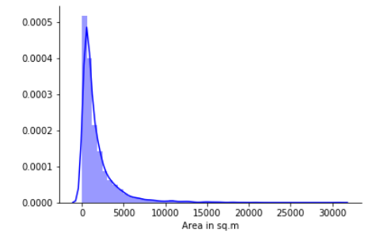
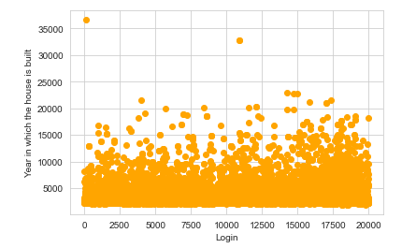
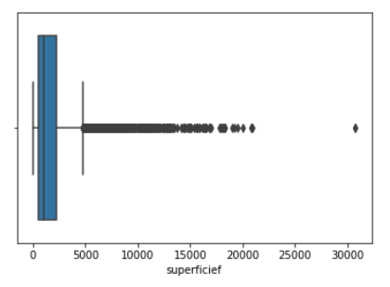
Superficief
Earlier known as
B. V. B. College of Engineering & Technology
Inference :
Size in m² of the insured building
There are certain outliers and maximum data is concentrated between 1000 m² to 8000m²

Slide 14
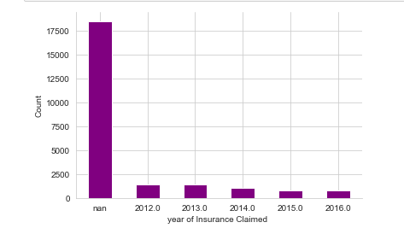
Data Visualisation
Earlier known as
B. V. B. College of Engineering & Technology
Inference :
From the graph we can conclude that there is no variation in the number of buildings insurance claimed every year in the given dataset.

Slide 15
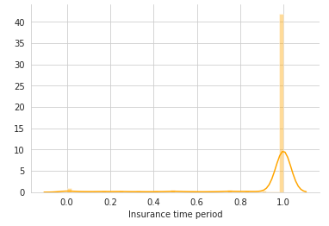
EXPO
Earlier known as
B. V. B. College of Engineering & Technology
Inference :
Time insured in Generali in the year.
This is a distributed plot for attribute EXPO which provides the data of the insurance time period. From this plot,we can clearly infer that most of the insurances being claimed are for 1 year.

Slide 16
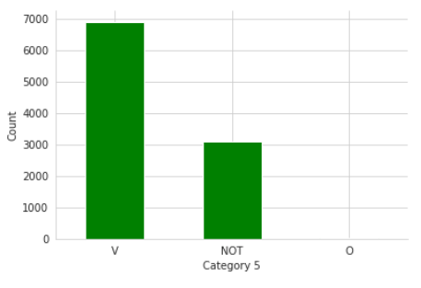
ft_5_categ
Earlier known as
B. V. B. College of Engineering & Technology
V | Canton city
Not | New Towns
Inference :
This is bar plot for the categorical data attribute Feature Category 5.
This plot shows that the maximum frequency of data in this plot are V.

Slide 17
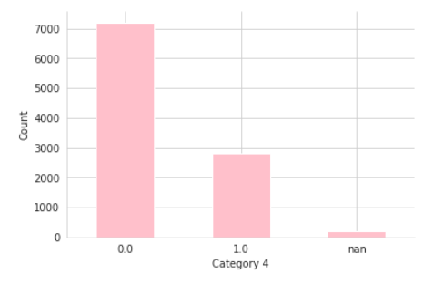
ft_4_categ
Earlier known as
B. V. B. College of Engineering & Technology
Inference :
This is bar plot for numeric data attribute Feature Category 4.
From this , we infer that most of the data in this attribute comprises of 0

Slide 18
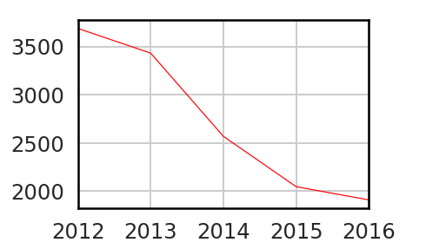
Earlier known as
B. V. B. College of Engineering & Technology
Inference :
This is line plot for attribute Feature Category 2(ft_2_categ) which provides the data about the year in which the house is insured. This plot shows a drastic decrease in the number of houses insured in 2012 to 2016.

Slide 19
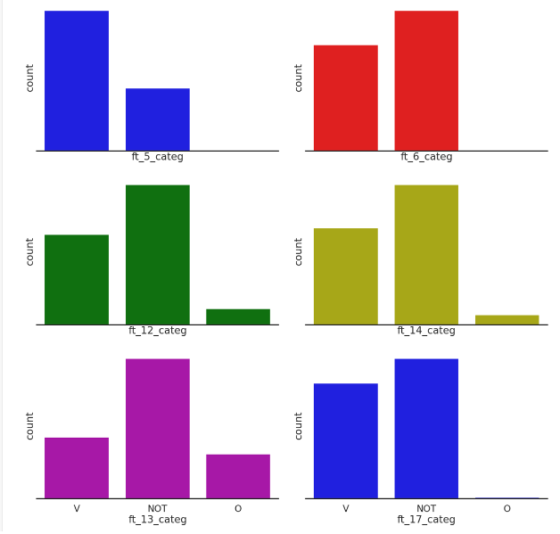
Bar plot
Earlier known as
B. V. B. College of Engineering & Technology

Slide 20
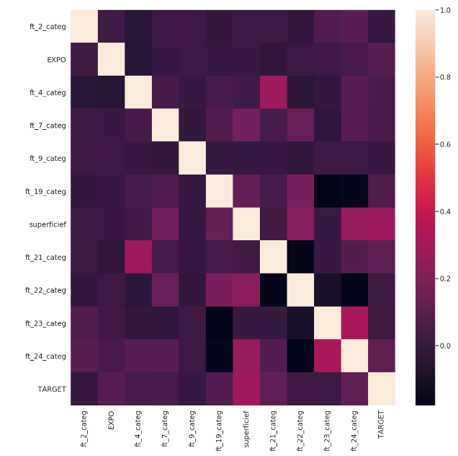
Heat-Map
Earlier known as
B. V. B. College of Engineering & Technology
Inference :
From the heat maps and correlation matrix it is visible that
ft_19_categ is negatively correlated with ft_23_categ and ft_24_categ.
ft_24_categ is negatively correlated with ft_22_categ and ft_19_categ.
ft_22_categ is negatively correlated with ft_21_categ

Slide 21
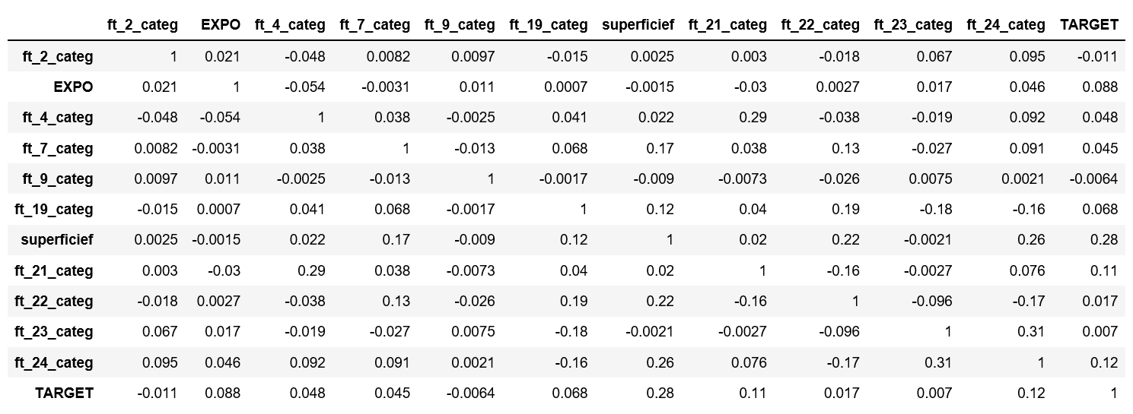
Correlated Matrix
Earlier known as
B. V. B. College of Engineering & Technology

Slide 22
Correlated Matrix
Earlier known as
B. V. B. College of Engineering & Technology
From Heat map and correlation matrix we can infer that ft_19_categ,ft_21_categ and
ft_24_categ are correlated with some attributes so we drop these attributes.

Slide 23
Data Preprocessing:
Earlier known as
B. V. B. College of Engineering & Technology
Data preprocessing is a data mining technique which is used to transform the raw data in a useful and efficient format.
Steps involved in data preprocessing are:
1. Data Cleaning:
The data can have many irrelevant and missing parts. To handle this part, data
cleaning is done.
It involves handling of missing data, noisy data etc.
Fill the Missing values:
We have filled missing values of attributes like superficief , ft_22_categ attributes.

Slide 24
Earlier known as
B. V. B. College of Engineering & Technology
2. Data transformation:
This step is taken in order to transform the data in appropriate forms suitable
for mining process.
2.1.Normalization: It is done to scale down the values to some specific range(here, we normalized in the
range 0 and 1).
We have applied this technique on all the numerical attributes of our dataset.
2.2.Attribute selection:
In this strategy, new attributes are constructed from the given set of attributes to help the mining process.
We have applied one hot encoding on categorical attributes of our dataset.

Slide 25
References
Earlier known as
B. V. B. College of Engineering & Technology
https://www.quora.com/What-kind-of-test-should-I-use-to-test-the-correlation-between-categorical-and-numeric-variables
https://www.datacamp.com/community/tutorials/xgboost-in-python
https://www.analyticsvidhya.com/blog/2016/03/complete-guide-parameter-tuning-xgboost-with-codes-python/
https://heartbeat.fritz.ai/boosting-your-machine-learning-models-using-xgboost-d2cabb3e948f
https://hackernoon.com/data-cleaning-3c3e37f358dc
https://www.stackabuse.com/applying-wrapper-methods-in-python-for-feature-selection/
https://hackernoon.com/what-steps-should-one-take-while-doing-data-preprocessing-502c993e1caa
https://hub.packtpub.com/4-ways-implement-feature-selection-python-machine-learning/
https://www.datacamp.com/community/tutorials/feature-selection-python

Slide 26
Earlier known as
B. V. B. College of Engineering & Technology
THANK YOU

