Slide 1
Mini project
TEMPERATURE CONVERTER
Members:
Name Roll No.
Sakshi Rasal 50
Prajwal Ruke 52
Neha Dhodi 17
Gitanjali Rathod 51

Slide 2
INTRODUCTION
We use real numbers to represent the temperature readings in various temperature units. This project is simple, easy to understand, and most importantly it correctly solves the original problem. The user can enter any value for the temperature in Celsius, Fahrenheit or kelvin as the argument to convert the method as per the user’s choice and press enter, and our program will immediately compute the corresponding temperature in Celsius, Fahrenheit or Kelvin.

Slide 3
OBJECTIVE
The Temperature Converter is one of the updated program which is created with the all possible features and actions to perform according to user needs. The world is a global village today and people are moving from one part of the world to another part of the world for business, travel, education and migration. One country’s weather forecast is different from another country. In this situation, we have to spot on while converting the temperature.

Slide 4
Formulae
Celsius to Fahrenheit:- (°C × 9/5) + 32 = °F
Celsius to Kelvin:- °C + 273.15 = K
Fahrenheit to Celsius:- (°F − 32) × 5/9 = °C
Fahrenheit to kelvin:- (°F − 32) × 5/9 + 273.15 = K
Kelvin to Celsius:- K − 273.15 = °C
Kaelvin to Fahrenheit:- (K − 273.15) × 9/5 + 32 = °F

Slide 5
METHODOLOGY
1. HARDWARE AND SOFTWARE REQUIREMENTS
1.1. HARDWARE REQUIREMENTS
RAM : 512 MB RAM
Hard Drive : 40 GB Hard Drive
Processor : Intel Core 2 Processor
4. Camera module (Webcam)
5. Projector
6. Colour Markers

Slide 6
1.2 SOFTWARE REQUIREMENTS
NetBeans or any other software that supports Java .

Slide 7
2. DESIGN DETAILS :
Source code:
Converter
public class iIterface extends javax.swing.JFrame {
/**
* Creates new form iIterface
*/
public iIterface() {
initComponents();
}
/**
* This method is called from within the constructor to initialize the form.
* WARNING: Do NOT modify this code. The content of this method is always
* regenerated by the Form Editor.
*/
@SuppressWarnings("unchecked")
// <editor-fold

Slide 8
defaultstate="collapsed" desc="Generated Code">//GEN-BEGIN:initComponents
private void initComponents() {
jPanel1 = new javax.swing.JPanel();
jLabel1 = new javax.swing.JLabel();
jComboBox1 = new javax.swing.JComboBox<>();
jComboBox2 = new javax.swing.JComboBox<>();
jTextField1 = new javax.swing.JTextField();
jTextField2 = new javax.swing.JTextField();
jButton4 = new javax.swing.JButton();
jButton5 = new javax.swing.JButton();
jButton6 = new javax.swing.JButton();

Slide 9
setDefaultCloseOperation(javax.swing.WindowConstants.EXIT_ON_CLOSE);
setTitle("Tempratureconverter");
setResizable(false);
jPanel1.setBackground(new java.awt.Color(0, 204, 204));
jLabel1.setFont(new java.awt.Font("Tahoma", 1, 18)); // NOI18N
jLabel1.setForeground(new java.awt.Color(51, 0, 51));
jLabel1.setText("Temprature Converter");
javax.swing.GroupLayout jPanel1Layout = new javax.swing.GroupLayout(jPanel1);
jPanel1.setLayout(jPanel1Layout);
jPanel1Layout.setHorizontalGroup(

Slide 10
jPanel1Layout.createParallelGroup(javax.swing.GroupLayout.Alignment.LEADING)
.addGroup(jPanel1Layout.createSequentialGroup()
.addGap(86, 86, 86)
.addComponent(jLabel1, javax.swing.GroupLayout.PREFERRED_SIZE, 213, javax.swing.GroupLayout.PREFERRED_SIZE)
.addContainerGap(javax.swing.GroupLayout.DEFAULT_SIZE, Short.MAX_VALUE))
);
jPanel1Layout.setVerticalGroup(
jPanel1Layout.createParallelGroup(javax.swing.GroupLayout.Alignment.LEADING)
.addGroup(jPanel1Layout.createSequentialGroup()
.addGap(23, 23, 23)
.addComponent(jLabel1,

Slide 11
javax.swing.GroupLayout.DEFAULT_SIZE, javax.swing.GroupLayout.DEFAULT_SIZE, Short.MAX_VALUE)
.addGap(23, 23, 23))
);
jComboBox1.setFont(new java.awt.Font("Tahoma", 1, 12)); // NOI18N
jComboBox1.setModel(new javax.swing.DefaultComboBoxModel<>(new String[] { "Celsius", "Ferhenheit", "Kelvin" }));
jComboBox2.setFont(new java.awt.Font("Tahoma", 1, 12)); // NOI18N
jComboBox2.setModel(new javax.swing.DefaultComboBoxModel<>(new String[] { "Celsius", "Ferhenheit", "Kelvin" }));
jTextField1.addActionListener(new java.awt.event.ActionListener() {
public void

Slide 12
actionPerformed(java.awt.event.ActionEvent evt) {
jTextField1ActionPerformed(evt);
}
});
jTextField2.setEditable(false);
jTextField2.addActionListener(new java.awt.event.ActionListener() {
public void actionPerformed(java.awt.event.ActionEvent evt) {
jTextField2ActionPerformed(evt);
}
});
jButton4.setFont(new java.awt.Font("Tahoma", 2, 12)); // NOI18N
jButton4.setText("Convert");
jButton4.addActionListener(new java.awt.event.ActionListener() {

Slide 13
public void actionPerformed(java.awt.event.ActionEvent evt) {
jButton4ActionPerformed(evt);
}
});
jButton5.setFont(new java.awt.Font("Tahoma", 2, 12)); // NOI18N
jButton5.setText("Clear");
jButton5.addActionListener(new java.awt.event.ActionListener() {
public void actionPerformed(java.awt.event.ActionEvent evt) {
jButton5ActionPerformed(evt);
}
});
jButton6.setFont(new java.awt.Font("Tahoma", 1, 12)); // NOI18N

Slide 14
jButton6.setText("Exit");
jButton6.addActionListener(new java.awt.event.ActionListener() {
public void actionPerformed(java.awt.event.ActionEvent evt) {
jButton6ActionPerformed(evt);
}
});
javax.swing.GroupLayout layout = new javax.swing.GroupLayout(getContentPane());
getContentPane().setLayout(layout);
layout.setHorizontalGroup(
layout.createParallelGroup(javax.swing.GroupLayout.Alignment.LEADING)
.addComponent(jPanel1, javax.swing.GroupLayout.DEFAULT_SIZE, javax.swing.GroupLayout.DEFAULT_SIZE, Short.MAX_VALUE)
.addGroup(layout.createSequentialGroup()
.addGap(29, 29, 29)

Slide 15
.addGroup(layout.createParallelGroup(javax.swing.GroupLayout.Alignment.LEADING, false)
.addComponent(jComboBox1, javax.swing.GroupLayout.PREFERRED_SIZE, 80, javax.swing.GroupLayout.PREFERRED_SIZE)
.addComponent(jComboBox2, 0, 1, Short.MAX_VALUE))
.addGroup(layout.createParallelGroup(javax.swing.GroupLayout.Alignment.LEADING)
.addGroup(layout.createSequentialGroup()
.addGap(71, 71, 71)
.addGroup(layout.createParallelGroup(javax.swing.GroupLayout.Alignment.LEADING)
.addGroup(layout.createSequentialGroup()
.addComponent(jButton4)
.addGap(26, 26, 26)

Slide 16
.addComponent(jButton4)
.addGap(26, 26, 26)
.addComponent(jButton5))
.addGroup(layout.createSequentialGroup()
.addGap(155, 155, 155)
.addComponent(jButton6))))
.addGroup(layout.createSequentialGroup()
.addGap(57, 57, 57)
.addGroup(layout.createParallelGroup(javax.swing.GroupLayout.Alignment.LEADING)
.addComponent(jTextField2, javax.swing.GroupLayout.PREFERRED_SIZE, 224, javax.swing.GroupLayout.PREFERRED_SIZE)
.addComponent(jTextField1, javax.swing.GroupLayout.PREFERRED_SIZE, 219,

Slide 17
javax.swing.GroupLayout.PREFERRED_SIZE))))
.addContainerGap(21, Short.MAX_VALUE))
);
layout.setVerticalGroup(
layout.createParallelGroup(javax.swing.GroupLayout.Alignment.LEADING)
.addGroup(layout.createSequentialGroup()
.addComponent(jPanel1, javax.swing.GroupLayout.PREFERRED_SIZE, javax.swing.GroupLayout.DEFAULT_SIZE, javax.swing.GroupLayout.PREFERRED_SIZE)
.addGap(34, 34, 34)
.addGroup(layout.createParallelGroup(javax.swing.GroupLayout.Alignment.BASELINE)
.addComponent(jComboBox1, javax.swing.GroupLayout.PREFERRED_SIZE, 30, javax.swing.GroupLayout.PREFERRED_SIZE)
.addComponent(jTextField1, javax.swing.GroupLayout.PREFERRED_SIZE, 29, javax.swing.GroupLayout.PREFERRED_SIZE))

Slide 18
.addPreferredGap(javax.swing.LayoutStyle.ComponentPlacement.RELATED, 35, Short.MAX_VALUE)
.addGroup(layout.createParallelGroup(javax.swing.GroupLayout.Alignment.BASELINE)
.addComponent(jButton4)
.addComponent(jButton5))
.addGap(31, 31, 31)
.addGroup(layout.createParallelGroup(javax.swing.GroupLayout.Alignment.BASELINE)
.addComponent(jComboBox2, javax.swing.GroupLayout.PREFERRED_SIZE, 30, javax.swing.GroupLayout.PREFERRED_SIZE)
.addComponent(jTextField2, javax.swing.GroupLayout.PREFERRED_SIZE, 28, javax.swing.GroupLayout.PREFERRED_SIZE))
.addGap(35, 35, 35)
.addComponent(jButton6)
.addContainerGap())
);

Slide 19
pack();
}// </editor-fold>//GEN-END:initComponents
private void jTextField2ActionPerformed(java.awt.event.ActionEvent evt) {//GEN-FIRST:event_jTextField2ActionPerformed
// TODO add your handling code here:
}//GEN-LAST:event_jTextField2ActionPerformed
private void jTextField1ActionPerformed(java.awt.event.ActionEvent evt) {//GEN-FIRST:event_jTextField1ActionPerformed
// TODO add your handling code here:
}//GEN-LAST:event_jTextField1ActionPerformed
private void
jButton5ActionPerformed(java.awt.event.ActionEvent evt) {//GEN-FIRST:event_jButton5ActionPerformed

Slide 20
jTextField1.setText("");
jTextField2.setText("");
}//GEN-LAST:event_jButton5ActionPerformed
private void jButton6ActionPerformed(java.awt.event.ActionEvent evt) {//GEN-FIRST:event_jButton6ActionPerformed
System.exit(0);
}//GEN-LAST:event_jButton6ActionPerformed
private void jButton4ActionPerformed(java.awt.event.ActionEvent evt) {//GEN-FIRST:event_jButton4ActionPerformed
String box1 = (String)jComboBox1.getSelectedItem();
String box2 = (String)jComboBox2.getSelectedItem();
if(box1.equals("Celsius") && box2.equals("Ferhenheit"))

Slide 21
{
double c = Double.parseDouble(jTextField1.getText());
double f = (double)(c * 1.8 + 32);
jTextField2.setText(String.valueOf(f));
}
if(box1.equals("Celsius") && box2.equals("Kelvin"))
{
double c = Double.parseDouble(jTextField1.getText());
double k = (double)(c + 173.15);
jTextField2.setText(String.valueOf(k));
}
if(box1.equals("Celsius") && box2.equals("Celsius"))
{
double c = Double.parseDouble(jTextField1.getText());

Slide 22
jTextField2.setText(String.valueOf(c));
}
if(box1.equals("Ferhenheit") && box2.equals("Celsius"))
{
double f = Double.parseDouble(jTextField1.getText());
double c = (double)((f-32)*5/9);
jTextField2.setText(String.valueOf(c));
}
else if(box1.equals("Ferhenheit") && box2.equals("Kelvin"))
{
double f = Double.parseDouble(jTextField1.getText());
double k = (double)((f - 32)*5/9 + 273.15);
jTextField2.setText(String.valueOf(k));

Slide 23
else if(box1.equals("Ferhenheit") && box2.equals("Ferhenheit"))
{
double f = Double.parseDouble(jTextField1.getText());
jTextField2.setText(String.valueOf(f));
}
//--------------------------------------------------------
if(box1.equals("Kelvin") && box2.equals("Celsius"))
{
double k = Double.parseDouble(jTextField1.getText());
double c = (double)(k - 273.15);
jTextField2.setText(String.valueOf(c));
}
else if(box1.equals("Kelvin") && box2.equals("Ferhenheit"))
{

Slide 24
jTextField2.setText(String.valueOf(c));
}
else if(box1.equals("Kelvin") && box2.equals("Ferhenheit"))
{
double k = Double.parseDouble(jTextField1.getText());
double f = (double)(0 - 273.15) * 9/5 +32;
jTextField2.setText(String.valueOf(f));
}
else if(box1.equals("Kelvin") && box2.equals("Kelvin"))
{
double k = Double.parseDouble(jTextField1.getText());
jTextField2.setText(String.valueOf(k));
}

Slide 25
}//GEN-LAST:event_jButton4ActionPerformed
/**
* @param args the command line arguments
*/
public static void main(String args[]) {
/* Set the Nimbus look and feel */
//<editor-fold defaultstate="collapsed" desc=" Look and feel setting code (optional) ">
/* If Nimbus (introduced in Java SE 6) is not available, stay with the default look and feel.
* For details see http://download.oracle.com/javase/tutorial/uiswing/lookandfeel/plaf.html
*/
try {
for (javax.swing.UIManager.LookAndFeelInfo info : javax.swing.UIManager.getInstalledLookAndFeels()) {

Slide 26
if ("Nimbus".equals(info.getName())) {
javax.swing.UIManager.setLookAndFeel(info.getClassName());
break;
}
}
} catch (ClassNotFoundException ex) {
java.util.logging.Logger.getLogger(iIterface.class.getName()).log(java.util.logging.Level.SEVERE, null, ex);
} catch (InstantiationException ex) {
java.util.logging.Logger.getLogger(iIterface.class.getName()).log(java.util.logging.Level.SEVERE, null, ex);
} catch (IllegalAccessException ex) {
java.util.logging.Logger.getLogger(iIterface.class.getName()).log(java.util.logging.Level.SEVERE, null, ex);
} catch

Slide 27
(javax.swing.UnsupportedLookAndFeelException ex)
{
java.util.logging.Logger.getLogger(iIterface.class.getName()).log(java.util.logging.Level.SEVERE, null, ex);
}
//</editor-fold>
/* Create and display the form */
java.awt.EventQueue.invokeLater(new Runnable() {
public void run() {
new iIterface().setVisible(true);
}
});
}

Slide 28
// Variables declaration - do not modify//GEN-BEGIN:variables
private javax.swing.JButton jButton4;
private javax.swing.JButton jButton5;
private javax.swing.JButton jButton6;
private javax.swing.JComboBox<String> jComboBox1;
private javax.swing.JComboBox<String> jComboBox2;
private javax.swing.JLabel jLabel1;
private javax.swing.JPanel jPanel1;
private javax.swing.JTextField jTextField1;
private javax.swing.JTextField jTextField2;
// End of variables declaration//GEN-END:variables
}

Slide 29
Interface
<?xml version="1.0" encoding="UTF-8" ?>
<Form version="1.3" maxVersion="1.9" type="org.netbeans.modules.form.forminfo.JFrameFormInfo">
<Properties>
<Property name="defaultCloseOperation" type="int" value="3"/>
<Property name="title" type="java.lang.String" value="Tempratureconverter"/>
<Property name="resizable" type="boolean" value="false"/>

Slide 30
</Properties>
<SyntheticProperties>
<SyntheticProperty name="formSizePolicy" type="int" value="1"/>
<SyntheticProperty name="generateCenter" type="boolean" value="false"/>
</SyntheticProperties>
<AuxValues>
<AuxValue name="FormSettings_autoResourcing" type="java.lang.Integer" value="0"/>
<AuxValue name="FormSettings_autoSetComponentName" type="java.lang.Boolean" value="false"/>

Slide 31
<AuxValue name="FormSettings_generateFQN" type="java.lang.Boolean" value="true"/>
<AuxValue name="FormSettings_generateMnemonicsCode" type="java.lang.Boolean" value="false"/>
<AuxValue name="FormSettings_i18nAutoMode" type="java.lang.Boolean" value="false"/>
<AuxValue name="FormSettings_layoutCodeTarget" type="java.lang.Integer" value="1"/>
<AuxValue name="FormSettings_listenerGenerationStyle" type="java.lang.Integer" value="0"/>
<AuxValue name="FormSettings_variablesLocal" type="java.lang.Boolean" value="false"/>

Slide 32
<AuxValue name="FormSettings_variablesModifier" type="java.lang.Integer" value="2"/>
</AuxValues>
<Layout>
<DimensionLayout dim="0">
<Group type="103" groupAlignment="0" attributes="0">
<Component id="jPanel1" alignment="0" max="32767" attributes="0"/>
<Group type="102" alignment="0" attributes="0">
<EmptySpace min="-2" pref="29" max="-2" attributes="0"/>

Slide 33
<Group type="103" groupAlignment="0" max="-2" attributes="0">
<Component id="jComboBox1" min="-2" pref="80" max="-2" attributes="0"/>
<Component id="jComboBox2" pref="0" max="32767" attributes="0"/>
</Group>
<Group type="103" groupAlignment="0" attributes="0">
<Group type="102" alignment="0" attributes="0">
<EmptySpace min="-2" pref="71" max="-2" attributes="0"/>

Slide 34
<Group type="103" groupAlignment="0" attributes="0">
<Group type="102" attributes="0">
<Component id="jButton4" min="-2" max="-2" attributes="0"/>
<EmptySpace min="-2" pref="26" max="-2" attributes="0"/>
<Component id="jButton5" min="-2" max="-2" attributes="0"/>
</Group>
<Group type="102" alignment="0" attributes="0">
<EmptySpace min="-2" pref="155" max="-2" attributes="0"/>
<Component id="jButton6" min="-2" max="-2" attributes="0"/>

Slide 35
</Group>
</Group>
</Group>
<Group type="102" alignment="0" attributes="0">
<EmptySpace min="-2" pref="57" max="-2" attributes="0"/>
<Group type="103" groupAlignment="0" attributes="0">
<Component id="jTextField2" alignment="0" min="-2" pref="224" max="-2" attributes="0"/>
<Component id="jTextField1" alignment="0" min="-2" pref="219" max="-2" attributes="0"/>

Slide 36
</Group>
</Group>
</Group>
<EmptySpace pref="21" max="32767" attributes="0"/>
</Group>
</Group>
</DimensionLayout>
<DimensionLayout dim="1">
<Group type="103" groupAlignment="0" attributes="0">
<Group type="102" alignment="0" attributes="0">
<Component id="jPanel1" min="-2" max="-2" attributes="0"/>

Slide 37
<EmptySpace min="-2" pref="34" max="-2" attributes="0"/>
<Group type="103" groupAlignment="3" attributes="0">
<Component id="jComboBox1" alignment="3" min="-2" pref="30" max="-2" attributes="0"/>
<Component id="jTextField1" alignment="3" min="-2" pref="29" max="-2" attributes="0"/>
</Group>
<EmptySpace pref="35" max="32767" attributes="0"/>
<Group type="103" groupAlignment="3" attributes="0">
<Component id="jButton4" alignment="3" min="-2" max="-2" attributes="0"/>

Slide 38
<Component id="jButton5" alignment="3" min="-2" max="-2" attributes="0"/>
</Group>
<EmptySpace min="-2" pref="31" max="-2" attributes="0"/>
<Group type="103" groupAlignment="3" attributes="0">
<Component id="jComboBox2" alignment="3" min="-2" pref="30" max="-2" attributes="0"/>
<Component id="jTextField2" alignment="3" min="-2" pref="28" max="-2" attributes="0"/>
</Group>

Slide 39
<EmptySpace min="-2" pref="35" max="-2" attributes="0"/>
<Component id="jButton6" min="-2" max="-2" attributes="0"/>
<EmptySpace max="-2" attributes="0"/>
</Group>
</Group>
</DimensionLayout>
</Layout>
<SubComponents>
<Container class="javax.swing.JPanel" name="jPanel1">
<Properties>

Slide 40
<Property name="background" type="java.awt.Color" editor="org.netbeans.beaninfo.editors.ColorEditor">
<Color blue="cc" green="cc" red="0" type="rgb"/>
</Property>
</Properties>
<Layout>
<DimensionLayout dim="0">
<Group type="103" groupAlignment="0" attributes="0">
<Group type="102" alignment="0" attributes="0">
<EmptySpace min="-2" pref="86" max="-2" attributes="0"/>

Slide 41
<Component id="jLabel1" min="-2" pref="213" max="-2" attributes="0"/>
<EmptySpace max="32767" attributes="0"/>
</Group>
</Group>
</DimensionLayout>
<DimensionLayout dim="1">
<Group type="103" groupAlignment="0" attributes="0">
<Group type="102" attributes="0">
<EmptySpace min="-2" pref="23" max="-2" attributes="0"/>
<Component id="jLabel1" max="32767" attributes="0"/>

Slide 42
<EmptySpace min="-2" pref="23" max="-2" attributes="0"/>
</Group>
</Group>
</DimensionLayout>
</Layout>
<SubComponents>
<Component class="javax.swing.JLabel" name="jLabel1">
<Properties>
<Property name="font" type="java.awt.Font" editor="org.netbeans.beaninfo.editors.FontEditor">

Slide 43
<Font name="Tahoma" size="18" style="1"/>
</Property>
<Property name="foreground" type="java.awt.Color" editor="org.netbeans.beaninfo.editors.ColorEditor">
<Color blue="33" green="0" red="33" type="rgb"/>
</Property>
<Property name="text" type="java.lang.String" value="Temprature Converter"/>
</Properties>
</Component>
</SubComponents>

Slide 44
</Container>
<Component class="javax.swing.JComboBox" name="jComboBox1">
<Properties>
<Property name="font" type="java.awt.Font" editor="org.netbeans.beaninfo.editors.FontEditor">
<Font name="Tahoma" size="12" style="1"/>
</Property>
<Property name="model" type="javax.swing.ComboBoxModel" editor="org.netbeans.modules.form.editors2.ComboBoxModelEditor">

Slide 45
<StringArray count="3">
<StringItem index="0" value="Celsius"/>
<StringItem index="1" value="Ferhenheit"/>
<StringItem index="2" value="Kelvin"/>
</StringArray>
</Property>
</Properties>
<AuxValues>
<AuxValue name="JavaCodeGenerator_TypeParameters" type="java.lang.String" value="&lt;String&gt;"/>
</AuxValues>
</Component>

Slide 46
<Component class="javax.swing.JComboBox" name="jComboBox2">
<Properties>
<Property name="font" type="java.awt.Font" editor="org.netbeans.beaninfo.editors.FontEditor">
<Font name="Tahoma" size="12" style="1"/>
</Property>
<Property name="model" type="javax.swing.ComboBoxModel" editor="org.netbeans.modules.form.editors2.ComboBoxModelEditor">
<StringArray count="3">
<StringItem index="0" value="Celsius"/>

Slide 47
<StringItem index="1" value="Ferhenheit"/>
<StringItem index="2" value="Kelvin"/>
</StringArray>
</Property>
</Properties>
<AuxValues>
<AuxValue name="JavaCodeGenerator_TypeParameters" type="java.lang.String" value="&lt;String&gt;"/>
</AuxValues>
</Component>
<Component class="javax.swing.JTextField" name="jTextField1">

Slide 48
<Events>
<EventHandler event="actionPerformed" listener="java.awt.event.ActionListener" parameters="java.awt.event.ActionEvent" handler="jTextField1ActionPerformed"/></Events>
</Component>
<Component class="javax.swing.JTextField" name="jTextField2">
<Properties>
<Property name="editable" type="boolean" value="false"/>
</Properties>
<Events>

Slide 49
</Component>
<Component class="javax.swing.JButton" name="jButton4">
<Properties>
<Property name="font" type="java.awt.Font" editor="org.netbeans.beaninfo.editors.FontEditor">
<Font name="Tahoma" size="12" style="2"/>
</Property>
<Property name="text" type="java.lang.String" value="Convert"/>
</Properties>

Slide 50
<Events>
<EventHandler event="actionPerformed" listener="java.awt.event.ActionListener" parameters="java.awt.event.ActionEvent" handler="jButton4ActionPerformed"/>
</Events>
</Component>
<Component class="javax.swing.JButton" name="jButton5">
<Properties>
<Property name="font" type="java.awt.Font" editor="org.netbeans.beaninfo.editors.FontEditor">
<Font name="Tahoma" size="12" style="2"/>
</Property>

Slide 51
<Property name="text" type="java.lang.String" value="Clear"/>
</Properties>
<Events>
<EventHandler event="actionPerformed" listener="java.awt.event.ActionListener" parameters="java.awt.event.ActionEvent" handler="jButton5ActionPerformed"/>
</Events>
</Component>
<Component class="javax.swing.JButton" name="jButton6">
<Properties>

Slide 52
<Property name="font" type="java.awt.Font" editor="org.netbeans.beaninfo.editors.FontEditor">
<Font name="Tahoma" size="12" style="1"/>
</Property>
<Property name="text" type="java.lang.String" value="Exit"/>
</Properties>
<Events>
<EventHandler event="actionPerformed" listener="java.awt.event.ActionListener" parameters="java.awt.event.ActionEvent" handler="jButton6ActionPerformed"/>
</Events>

Slide 53
</Component>
</SubComponents>
</Form>

Slide 54
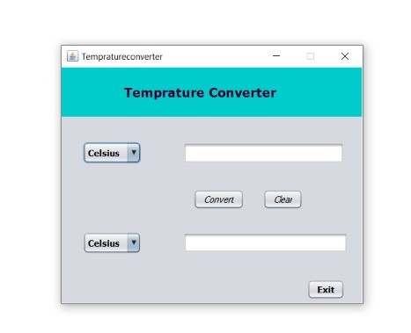
OUTPUT

Slide 55
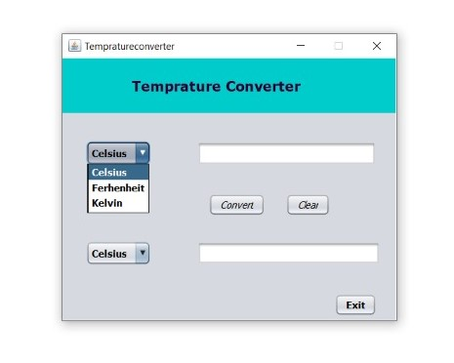

Slide 56
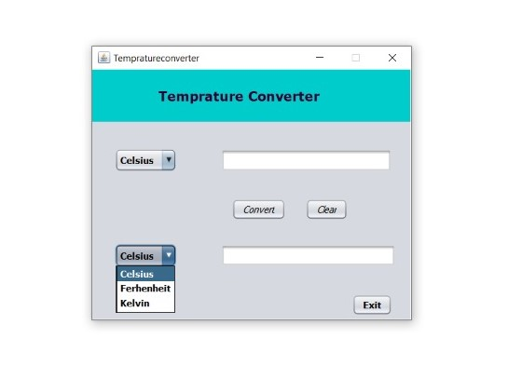

Slide 57
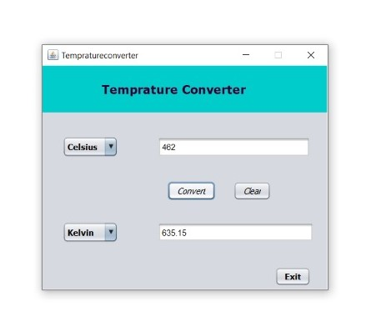

Slide 58
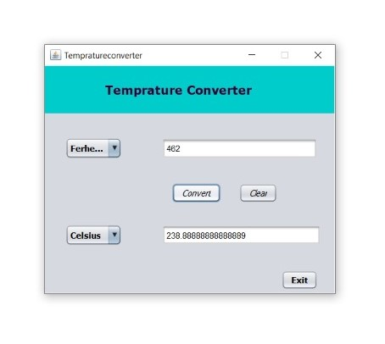

Slide 59
Advantages
1. Can include local indication and control.
2. Much greater noise resistance especially over long distances.
3.Isolate Amplify Filter noise linearize and convert the input signal from the sensor.
4.Output signal works with many standarddevices.
5.Does not require expensive extension wire.

Slide 60
CONCLUSION
Here we successfully done this project. Temperature converter in this we take imputs from user and they can openly select their choice to convert temperature unit. It was great experience with our group members our guide and they really support us and solve each and every queries with us. We are able to make this project and run successfully. Thankyou.

