Slide 1
Everyday Dilemma
Team : Power Rangers
Group Presentation
Shalu Thamang
Amrit Sharma
Group Leader & Coordinator
GitHub Lead & Prototype Developer
Prajwal Shahi
Manish Thapa
Research Lead & Game Designer
Project Coordinator
Sujal Pathak
Timekeeper & Deadline Manager

Slide 2
THE PROBLEM
Phishing Attacks Are Targeting Students — Right Now
Cyber phishing is one of the fastest-growing threats facing university students. Attackers craft convincing fake emails, messages, and websites designed to steal login credentials, financial information, and personal data. Students are particularly vulnerable: they manage multiple online accounts, communicate heavily via email, and often lack formal cybersecurity training.
Why Students Are at Risk
The Real-World Impact
Frequent use of academic portals, banking apps, and social media
High-pressure communications around deadlines, visas, and grades
Limited experience recognising social engineering tactics
International students face additional language and cultural barriers
Account compromise and identity theft
Financial loss from credential and banking fraud
Academic disruption caused by unauthorised access
Emotional distress and loss of trust in digital systems

Slide 3

TARGET AUDIENCE
Designed for University Students Aged 18–25
Our game is purpose-built for the student demographic — a group that is digitally active yet statistically underprepared for sophisticated phishing attempts. International students face compounded risks due to unfamiliarity with local systems and heightened anxiety around immigration and academic performance.
Digital Natives
International Students
No Prior Training
Students live online but often mistake familiarity with security awareness. High engagement with email, portals, and apps creates multiple attack surfaces.
Visa-related threats and unfamiliar institutional processes make international students especially susceptible to urgency-based phishing tactics.
Most students have never received formal cybersecurity education. A game-based approach lowers the barrier to learning and makes it memorable and engaging.
Research shows that interactive, scenario-based learning increases knowledge retention by up to 75% compared to passive reading — making games the ideal format for cybersecurity education.

Slide 4
GAME CONCEPT
Everyday Dilemma — How It Works
The player takes on the role of an international university student navigating a semester full of real-world digital challenges. Every decision they make — whether to click a suspicious link, report a dubious email, or verify a source — has consequences that shape their academic fate.
📧 Example Scenario
🏆 Scoring & Winning
"Your assignment submission has failed due to a technical issue. Click the link below to resubmit. If you do not submit by tonight, your visa will be cancelled."
Safe decisions award points
Risky decisions deduct points
80+ points = Successful Semester 🎓
Low score = Account compromise or academic setback
⚠️ Option A
✅ Option B
🎯 Learning Objectives
Click the link and enter credentials — Risky! Lose points.
Ignore, check official website, and report — Safe! Earn points.
Identify phishing emails and fake links
Recognise social engineering and urgency tactics
Practise safe, verified online behaviour
Understand real consequences of sharing personal data

Slide 5
UX & DESIGN
Design Philosophy — Cyber Aesthetic Meets Accessible UX
Our design language draws from three key inspirations to create a visual identity that feels authentic, engaging, and inclusive. We combine high-contrast cyber aesthetics with accessible, student-friendly interaction patterns.
🛡️ CyberMission
🎮 Prodigy Education
Inspired by the cyber military theme — strong iconography, mission-briefing layouts, and a sense of urgency that mirrors real phishing scenarios.
Clear visual symbols and intuitive decision-making prompts that guide students through choices without overwhelming them with text.
🌐 CyberEdu
♿ Accessibility
High-contrast colour palette — electric blues, greens, and deep darks — that emphasises digital security themes and ensures readability.
Smooth animations, readable font sizes, clear button labels, and keyboard-friendly navigation ensure the game is inclusive for all users.

Slide 6
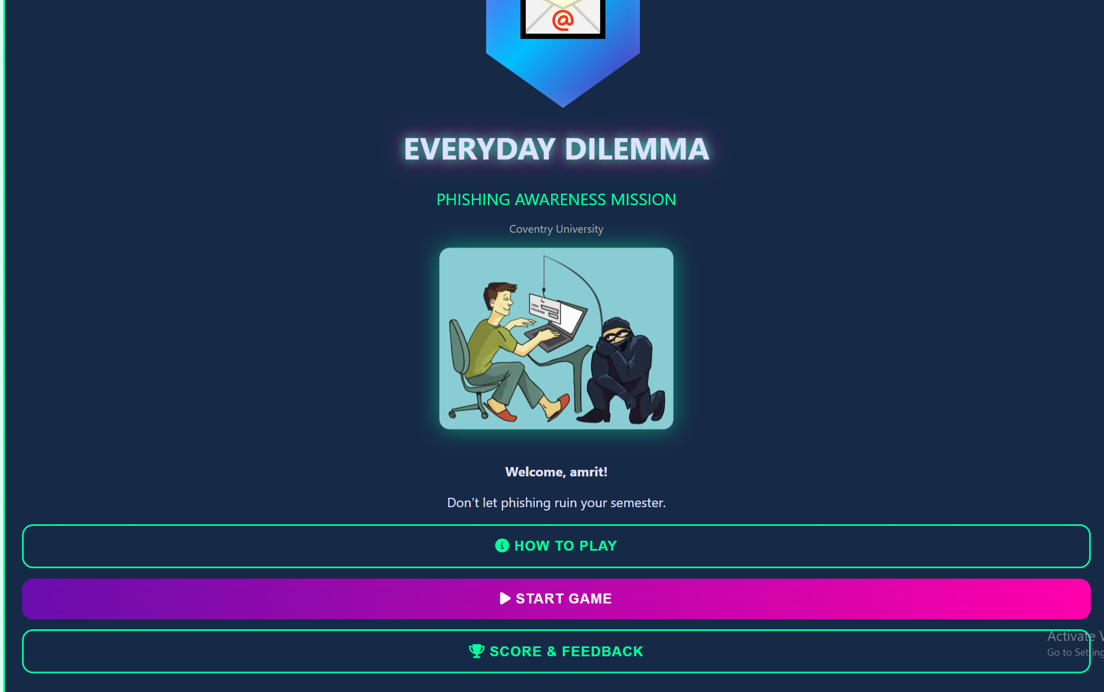
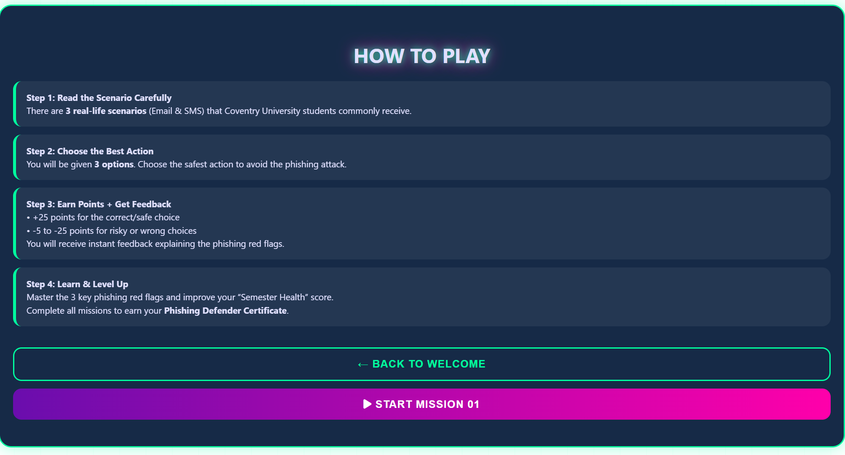
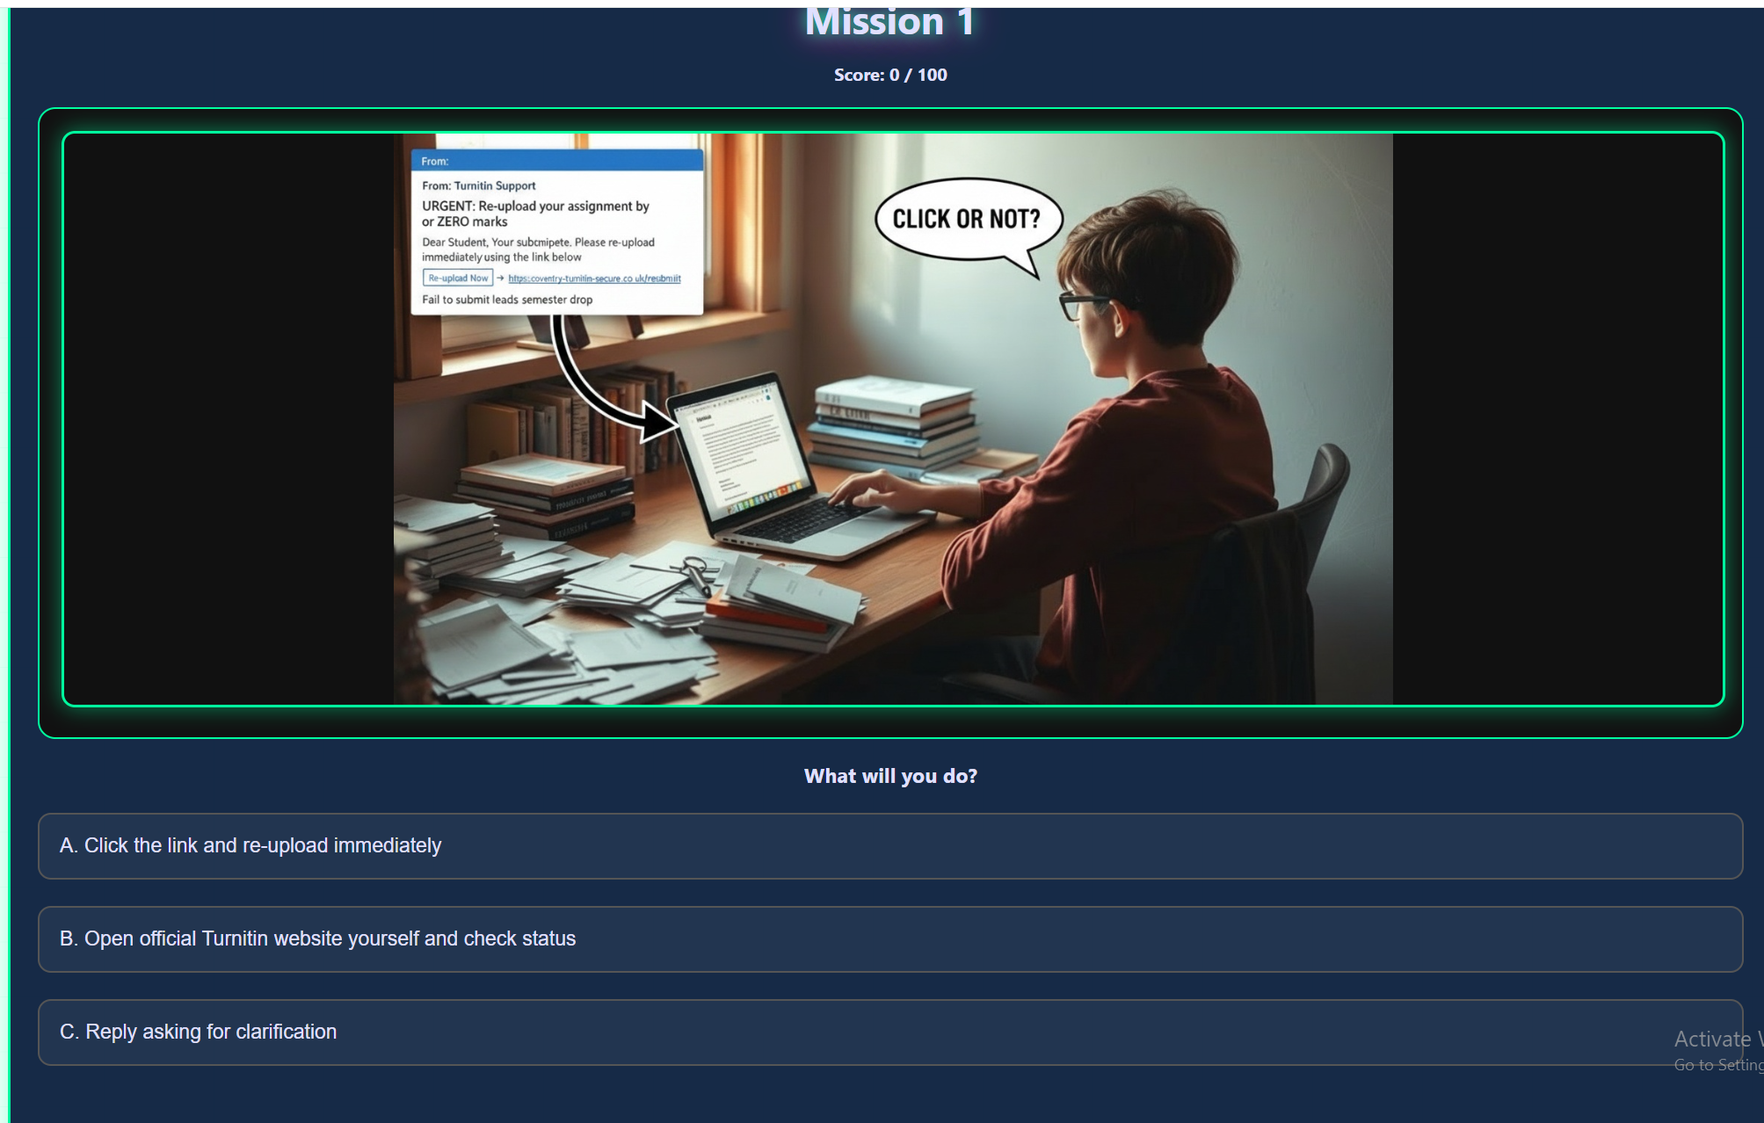
PROTOTYPE DEMO
What We've Built So Far
In just two development sessions, our team has moved from concept to a functional prototype. The welcome screen and instructions section are fully built, with core gameplay screens actively in progress.
🖥️ Welcome Screen
📖 Instructions Section
🎯 Gameplay Screens
Displays the Everyday Dilemma title and logo. Three clear buttons: How to Play, Start Game, and Score & Feedback. Clean, high-contrast layout sets the tone immediately.
A fully animated game instructions screen walks new players through the rules, scoring system. Designed for first-time users with zero prior knowledge.
Scenario-based decision cards present realistic phishing emails with multiple-choice responses. Each choice triggers feedback, a score update, and an educational explanation of the outcome.

Slide 7

TESTING & FEEDBACK
Testing Strategy & Early Insights
Our team is applying a structured testing approach to validate usability, learning effectiveness, and player engagement before final submission.
Planned Testing Methods
Early Observations & Improvements
Peer testing within the student team — checking for bugs clarity, functionality and availability.
Classmate playtesting — gathering qualitative feedback from target-age users
Think-aloud protocol — observing how users reason through phishing scenarios
Score analysis — reviewing whether point deductions align with intended difficulty
Storyboard review identified the need for clearer urgency cues in phishing scenarios
UX research informed a simplified navigation flow — fewer clicks to reach gameplay
Team review of game visuals prompted refinements to icon clarity and button sizing
README and GitHub review helped ensure version consistency across all builds
Key insight: Players engage more when phishing scenarios feel personally relevant — visa threats and grade deadlines resonate strongly with our target audience.

Slide 8
TEAM COLLABORATION
How We Work Together
Our team operates with clearly defined roles, regular structured meetings, and a shared GitHub repository that keeps all development transparent and version-controlled. Every member contributes both technically and creatively.
Day 1
Week 2
Finalised title, topic, scenarios, storyboard, and learning objectives as a full team.
Built welcome screen, animated instructions section, and core game buttons.
1
2
3
4
Session 2
Ongoing
UX research on existing games. Updated project canvas and storyboard based on findings.
GitHub updates, README maintenance, weekly role check-ins, and iterative design reviews.
🗂️ Task Management
💻 GitHub Workflow
Roles assigned from day one to avoid overlap and ensure accountability
Meeting agendas prepared in advance by the Group Leader
All the GitHub repository are managed and pull request reviews
README kept up to date with progress, instructions, and contributor notes
Version control ensures no work is lost and all changes are traceable

Slide 9
INDIVIDUAL CONTRIBUTIONS
What Each Team Member Brought Today
Beyond defined roles, today's session saw every team member make a focused, tangible contribution that moved the project forward — from design and code to coordination and communication.
Shalu Thamang
Amrit Sharma
Assigned team roles, finalised meeting agendas, and confirmed all key decisions as Group Leader.
Updated the GitHub repository and README, and conducted a detailed review of current game visuals.
Prajwal Shahi
Manish Thapa
Transformed the storyboard into a full visual game representation — bringing the concept to life visually.
Created the presentation outline and managed timekeeping during today's meeting session.
Sujal Pathak
Organised team meetings and ensured clear, consistent communication across all members.

Slide 10

CONCLUSION
Where We Are — and Where We're Going
In a short time, our team has moved from idea to functional prototype, demonstrating both technical capability and strong collaborative practice. Everyday Dilemma is on track to become a polished, impactful learning tool for the students who need it most.
✅ What We've Achieved
🚀 Next Steps
Fully scoped game concept with clear educational objectives
Functional welcome screen and animated instructions section
Collaborative workflows via GitHub and structured meetings
Defined roles with consistent, accountable delivery
Complete all scenario gameplay screens and decision logic
Conduct peer and classmate playtesting sessions
Refine scoring, feedback animations, and UI polish
Prepare final demo and project submission documentation
Key Professional Skills Gained: Agile teamwork, UX research, game-based learning design, version control with GitHub, and applying cybersecurity concepts in a creative, student-centred context.

