Slide 1
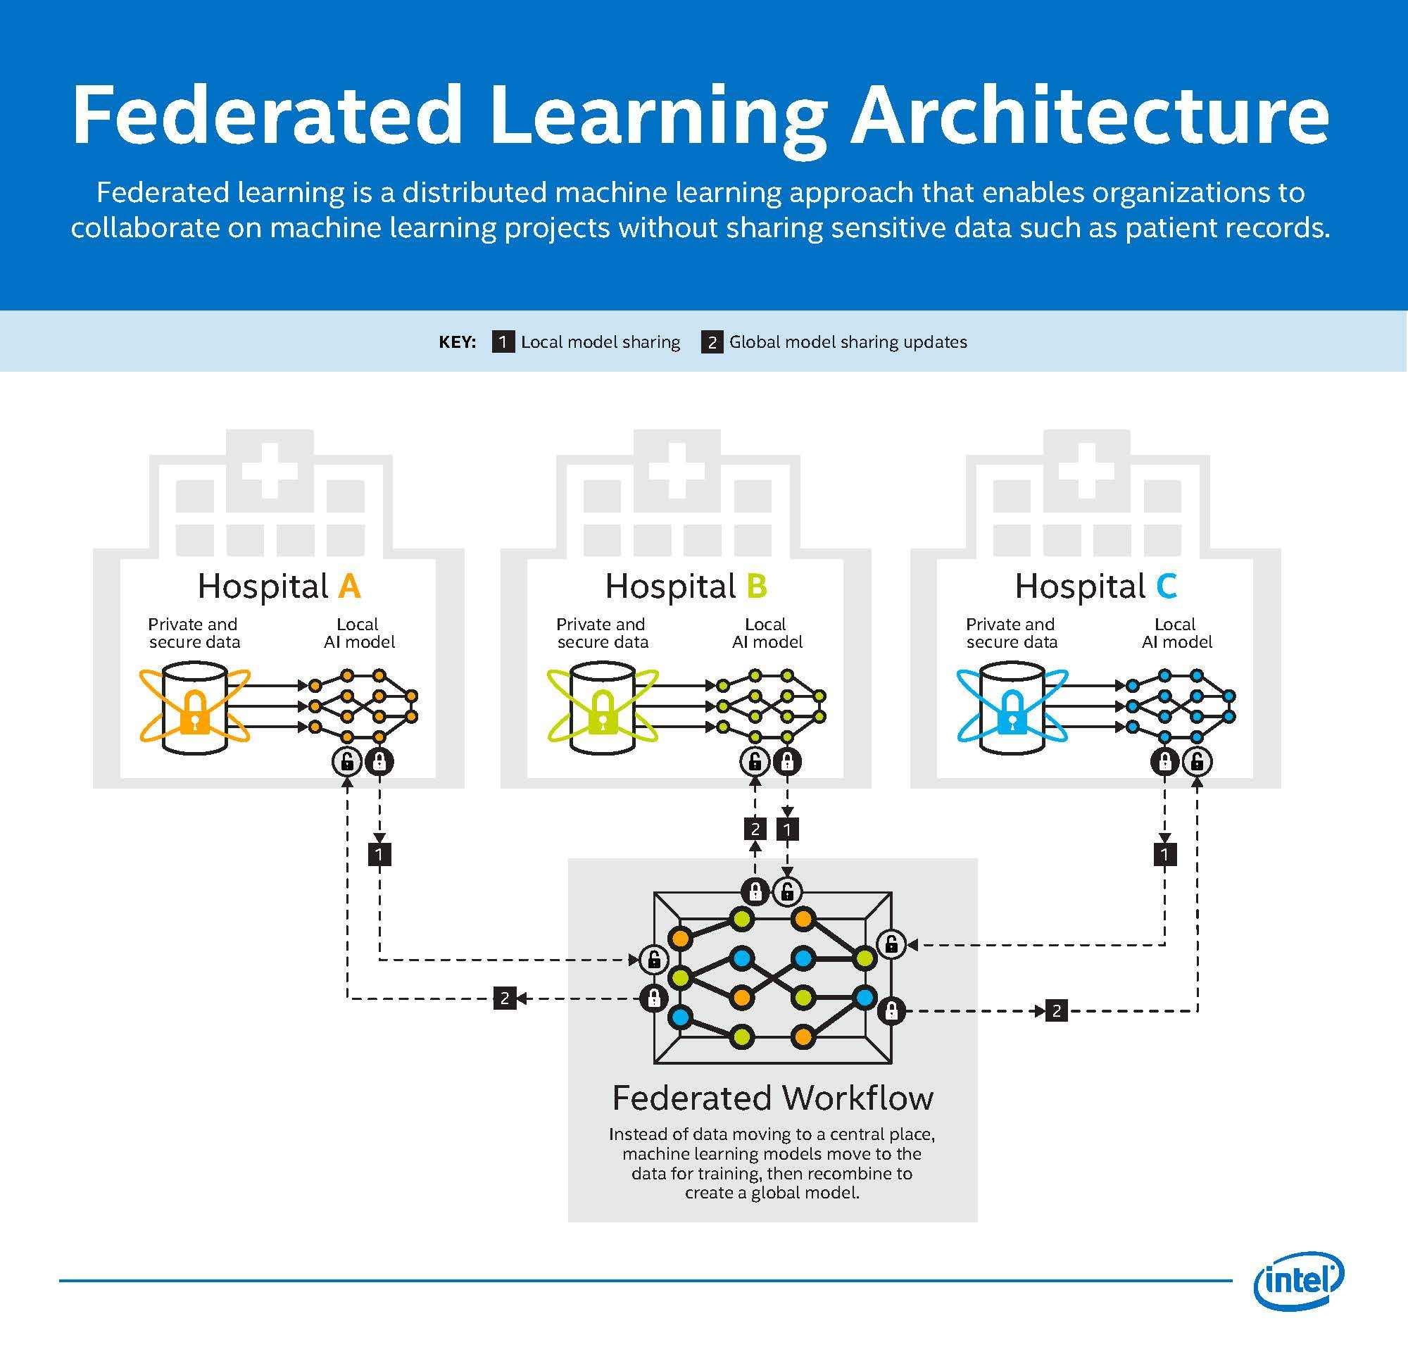
Federated Learning

Slide 2
What Is Federated Learning?
Federated learning is a method for training a single, shared machine learning model across multiple devices or organizations without transferring raw data from those devices.
Each client trains the current global model locally on its own private data and sends only model updates, such as parameters or gradients.
A coordinator or a decentralized protocol aggregates these updates to enhance the global model while maintaining the privacy of sensitive data.

Slide 3
Why Federated Learning Emerged
Federated learning emerged to address strict privacy, security, and regulatory requirements that make centralizing sensitive data impractical or illegal.
It enables collaboration across many parties that cannot share raw data, while still building models that benefit from diverse and distributed datasets.
Privacy is the primary driver of the paradigm, with efficiency and scalability treated as important but secondary concerns.

Slide 4
Key Benefits at a Glance
By keeping data local, federated learning reduces the risk of data breaches and supports compliance with frameworks such as GDPR and HIPAA.
Learning from diverse, real‑world data sources can improve robustness and generalization of the final model.
Sending updates instead of datasets reduces bandwidth needs and can lower latency for edge and mobile deployments.

Slide 5
How FL Differs from Traditional Distributed ML
Traditional distributed machine learning typically assumes data can be centralized or freely moved to worker nodes for parallel computation.
Federated learning inverts that flow by keeping raw data decentralized and sending the model to the data for local training on each client.

Slide 6
Bridging Data Fragmentation
Federated learning provides a structured way to learn from fragmented data that exists across millions of devices or multiple organizations.
It acts as a bridge between the ideal of large, diverse training data and the legal and technical reality that data must often remain where it is generated.
This bridging effect allows stakeholders to benefit from collective intelligence without central data pooling.

Slide 7
Standard Centralized Workflow — Overview
A central server initializes a global model and distributes it to a subset of available clients.
Selected clients perform local training on their own data for the configured number of epochs and produce updated model parameters.
Clients send their updates to the server, which aggregates them into a new global model and repeats the process over many rounds.

Slide 8
Standard Centralized Workflow
Typical rounds include initialization, client selection, local training, reporting of updates, global aggregation, and iteration until convergence.
Initialization: The server defines the model architecture, initializes weights (randomly or from a pre‑trained checkpoint), sets hyperparameters, and configures any privacy or cryptography settings for the round.
Client selection: A subset of eligible clients is sampled using strategies such as uniform random sampling, availability‑aware sampling, or fairness‑aware quotas so that the same clients are not always chosen.
Local training: Each selected client receives the current global model, trains it on local data for a fixed number of epochs with its optimizer and batch size, and may apply regularizers such as FedProx or control‑variates as in SCAFFOLD.

Slide 9
Standard Centralized Workflow
Reporting: Clients package their update (weights or gradients), include statistics such as the number of local samples and loss metrics, optionally compress or quantize the update, and upload it with retries if connectivity is unstable
Secure aggregation: If enabled, updates are masked, secret‑shared, or encrypted so the server can only recover the aggregate sum and cannot inspect any individual client contribution.
Server aggregation: The server combines updates, typically via sample‑weighted averaging, or with robust aggregators such as median, trimmed mean, or inverse‑distance weighting to down‑weight outliers or poisoned updates.

Slide 10
Standard Centralized Workflow
Broadcast and next round: The updated global model and round metadata are sent back to clients, control‑variates or momentum states are updated if used, and training continues until a stopping criterion such as validation plateau or round limit is met.
Aggregation often uses weighted averaging so that clients with more data can have proportionally greater influence on the global model.
The server also manages failures and dropouts by handling missing or delayed client updates between rounds.

Slide 11
Decentralized and Peer‑to‑Peer Architectures
In decentralized federated learning there is no single coordinating server, and clients share model updates directly with peers.
This removes a single point of failure and can enhance resilience and privacy, but it introduces coordination complexity tied to the network topology.
Model quality and convergence depend on how peers are connected and how updates are propagated through the graph.

Slide 12
Federated Learning Categories — Overview
Federated learning can be organized by client type and by how datasets align across participants.
Cross‑device settings involve many small, intermittently connected devices, while cross‑silo settings involve a few well‑resourced organizations.
Horizontal, vertical, and transfer‑learning variants describe how features and samples are shared or differ between parties.

Slide 13
Cross‑Device Federated Learning
Cross‑device federated learning targets vast numbers of devices such as smartphones and IoT nodes with small, local datasets and unstable connectivity.
Clients join opportunistically when available, so algorithms must tolerate dropouts and variable participation.
This setting powers on‑device personalization such as next‑word prediction and voice recognition without uploading raw content.

Slide 14
Cross‑Silo Federated Learning
Cross‑silo federated learning connects a smaller number of organizations, such as hospitals or banks, that maintain robust compute and stable networks.
Data governance is strict, and raw data must not leave organizational boundaries, so only model updates are exchanged.
Coordination emphasizes trust, compliance, and standardized protocols between institutions.

Slide 15
Horizontal vs Vertical vs Federated Transfer Learning
In horizontal federated learning, participants share the same feature space but hold different samples, which is common across many users.
In vertical federated learning, participants share the same set of entities but hold different features, such as a bank and a retailer sharing customer IDs.
Federated transfer learning combines FL with transfer learning to handle limited overlap in features and samples by sharing learned representations.

Slide 16
Foundational Algorithm: Federated SGD (FedSGD)
FedSGD broadcasts the global model to selected clients, who compute gradients on local data and send gradients back to the server.
The server averages client gradients, often weighted by local sample counts, and performs a global update step.
Although straightforward, FedSGD can be communication‑intensive because gradients are sent frequently.

Slide 17
Foundational Algorithm: Federated Averaging (FedAvg)
FedAvg allows clients to perform several local SGD steps before transmitting updated model parameters to the server.
By reducing how often updates are sent, FedAvg can decrease communication rounds by an order of magnitude compared to FedSGD.
This design makes large‑scale FL practical on edge devices that connect intermittently.

Slide 18
Personalized Federated Learning (PFL)
Personalized federated learning trains models that are adapted to each client’s local data while still benefiting from collaboration.
Approaches include fine‑tuning, adding personalized layers, or combining global and local objectives during training.
Personalization acknowledges that one global model may not serve all clients equally well when data is highly heterogeneous.

Slide 19
Clustered Federated Learning (CFL)
Clustered federated learning groups clients with similar data distributions so that a shared model within each cluster fits better.
Clustering reduces interference from dissimilar clients and can improve accuracy where populations differ significantly.
Determining the number of clusters is nontrivial because the underlying client distributions are typically unknown.

Slide 20
Handling Heterogeneity: FedProx
FedProx stabilizes training under non‑IID data by adding a proximal term to the local objective to discourage excessive drift from the global model.
The proximal regularizer helps align local updates with global goals while allowing useful local progress.
This technique often improves convergence in settings with uneven data and compute resources.

Slide 21
Handling Heterogeneity: FedDyn
FedDyn dynamically regularizes each client’s loss so that fully optimizing the local objective remains compatible with global convergence.
By aligning local and global objectives during training, FedDyn mitigates client drift without restricting local computation unduly.
This method is robust across varying levels of data heterogeneity.

Slide 22
Variance Reduction: SCAFFOLD
SCAFFOLD maintains control variates for clients and the server to correct biased local updates that arise from data heterogeneity.
During local training, gradients are adjusted by subtracting the client’s control variate and adding the server’s estimate of global drift.
This correction reduces variance across client updates and leads to more stable and faster convergence.

Slide 23
Dynamic Aggregation: Inverse Distance Aggregation (IDA)
Inverse distance aggregation assigns lower weights to client updates that deviate far from the current global model in parameter space.
Distances can be measured with norms such as Euclidean distance, and weights are set inversely proportional to those distances.
This strategy reduces the influence of outliers and can improve robustness on skewed, non‑IID data.

Slide 24
Advanced Optimizers and Sub‑FedAvg
Adaptive optimizers such as Adam and AdaGrad can be used within the federated setting to speed and stabilize convergence.
Sub‑FedAvg prunes client networks and averages intersecting subnetworks to save bandwidth while supporting personalization.
These techniques address resource constraints and heterogeneous client needs more effectively than plain averaging.

Slide 25
Communication Is the Main Bottleneck
The dominant cost in federated training is often communication rather than local computation, especially for deep models.
Large updates and frequent rounds can overwhelm limited bandwidth and delay convergence on edge networks.
Managing dropouts and stragglers further complicates coordination across many clients.

Slide 26
Reducing Communication: Fewer, Smarter Updates
Letting clients train locally for multiple steps before sending updates reduces the number of rounds required.
Event‑triggered policies send an update only when a client’s local change exceeds a meaningful threshold.
These strategies reduce unnecessary traffic while preserving most of the learning signal.

Slide 27
Reducing Communication: Quantization
Quantization represents model parameters or updates with fewer bits to shrink message sizes.
Lower precision can be sufficient for learning and yields large bandwidth savings in practice.
Careful design aims to balance compression with acceptable accuracy loss.

Slide 28
Reducing Communication: Sparse Updates
Sparse update schemes transmit only the most significant parameter changes instead of full dense vectors.
Top‑k or thresholding approaches can drastically reduce payloads for large neural networks.
Servers reconstruct global updates from the sparse contributions collected from clients.

Slide 29
Reducing Communication: Knowledge Distillation
Distillation allows clients to share model predictions or logits rather than full parameters, which can be more compact.
A public or proxy dataset can be used to align models by matching outputs instead of exchanging all weights.
This approach is helpful when local models differ in architecture or size.

Slide 30
Asynchrony and Hierarchical Aggregation
Asynchronous schemes allow clients to report updates when ready, which better matches intermittent device availability.
Hierarchical aggregation combines updates at intermediate nodes before forwarding to a central server, reducing core‑network load.
Both ideas improve throughput and make training more resilient to network variability.

Slide 31
Communication Protocols and Frameworks
Centralized systems follow a hub‑and‑spoke protocol where the server manages distribution, collection, and aggregation of updates.
Decentralized systems adopt peer‑to‑peer communication in which each node exchanges and aggregates updates directly.
Open‑source frameworks such as TensorFlow Federated and PySyft help define computations and secure communication patterns.

Slide 32
Security Threats in FL
Model inversion and membership inference can extract or identify sensitive information from shared models or updates.
Poisoning attacks inject malicious updates to degrade accuracy or implant backdoors in the global model.
Sybil, replay, and man‑in‑the‑middle attacks target the communication channel or the trust model of the federation.

Slide 33
Differential Privacy (DP)
Differential privacy adds calibrated noise to data or updates so that the presence or absence of an individual’s record cannot be reliably detected.
A smaller privacy budget (epsilon) provides stronger privacy but usually reduces accuracy, so practitioners must tune it carefully.
DP can be applied at the client side or at the server during aggregation, with formal accounting across rounds.

Slide 34
Secure Multi‑Party Computation (SMPC)
Secure multi‑party computation enables secure aggregation so that only the sum of client updates is revealed and no party sees another’s cleartext.
This reduces the amount of trust placed in any central server and protects data in use during the aggregation step.
The cryptographic protocols increase communication and computation overhead, especially on resource‑constrained devices.

Slide 35
Homomorphic Encryption (HE) and Hybrids
Homomorphic encryption allows computations directly on encrypted data so the server never observes plaintext updates.
Fully homomorphic schemes are powerful but computationally heavy, while partially homomorphic schemes support limited operations more efficiently.
Hybrid designs combine DP, SMPC, and HE to layer defenses and balance privacy with practical performance.

Slide 36
Federated Reinforcement Learning (FRL) — Core Idea
Federated reinforcement learning lets multiple agents improve a shared policy while keeping raw experience data on local devices.
Clients act as agents that take actions by training locally, and the global model plays the role of a shared policy.
Improvements in the global objective or task performance serve as the reward signal for the federation.

Slide 37
Mapping FL Concepts to RL
Clients correspond to RL agents, local data and context correspond to states, and local training updates correspond to actions.
The aggregated global model corresponds to the policy that guides future actions across agents.
Federated aggregation becomes the experience‑sharing mechanism that improves the shared policy over time.

Slide 38
Horizontal vs Vertical FRL
In horizontal FRL, agents interact with independent environments that share aligned state and action spaces, enabling parallel learning with knowledge sharing.
In vertical FRL, agents share one global environment but have partial observations or rewards, and aggregation helps complete the picture.
Both forms preserve privacy by exchanging learned parameters or policies rather than raw trajectories.

Slide 39
Applications — Mobile and Edge
On mobile devices, federated learning powers features such as next‑word prediction and speech recognition without uploading sensitive inputs.
Edge deployments leverage local computation to reduce latency and bandwidth while personalizing models to user behavior.
These use cases demonstrate privacy‑preserving personalization at scale.

Slide 40
Applications — Healthcare
Hospitals collaborate on diagnostic models by training locally on patient records and sharing only model updates for aggregation.
This approach respects regulations and allows models to learn from broader and more diverse patient populations.
Federated learning accelerates medical AI while maintaining confidentiality of sensitive data.

Slide 41
Applications — Finance and Smart Cities/IoT
Financial institutions jointly detect fraud and assess risk by sharing model updates that capture transaction patterns without exposing raw records.
Smart‑city and IoT systems use federated learning for traffic management, energy optimization, and predictive maintenance across distributed sensors.
These applications benefit from reduced communication costs and faster local decision making.

Slide 42
Research Trends and Future Directions
Continual federated learning aims to update models over time without catastrophic forgetting while handling decentralized, shifting data.
Personalization and fairness remain priorities so that models serve diverse clients reliably and equitably.
New defenses and communication schemes push the accuracy‑communication Pareto frontier and improve robustness at very large scales.

Slide 43
References
McMahan, H.B., et al. (2016/2017). Communication‑Efficient Learning of Deep Networks from Decentralized Data. AISTATS/arXiv. [link]
Bonawitz, K., et al. (2017). Practical Secure Aggregation for Privacy‑Preserving ML. CCS. [link]
Roy, A.G., et al. (2019). BrainTorrent: A Peer‑to‑Peer Environment for Decentralized FL. arXiv. [link]
Kairouz, P., et al. (2021). Advances and Open Problems in Federated Learning. FnT ML. [link]
Yu, B., et al. (2022). A Survey on FL in Data Mining. WIREs Data Mining. [link]
Lydia, A.A.; Francis, F.S. 2019. Adagrad—An Optimizer for Stochastic Gradient Descent. Int. J. Inf. Comput. Sci.6:566–568. [link]
Papadopoulos, C., Kollias, K.-F., & Fragulis, G.F. 2024. Recent Advancements in Federated Learning: State of the Art, Fundamentals, Principles, IoT Applications and Future Trends. Future Internet 16(11):415. [link]

Slide 44
References
Acar, D.A.E., et al. (2021). Federated Learning Based on Dynamic Regularization (FedDyn). ICLR. [link]
Jin, H., et al. (2022). Federated RL with Environment Heterogeneity. PMLR. [link]
Li, X., et al. (2021). FedBN: FL on Non‑IID Features via Local Batch Norm. arXiv. [link]
Garcia, M.H., et al. (2022). FLUTE: Framework for High‑Performance FL Simulations. arXiv. [link]
Chen, Y., et al. (2022). Federated Learning Attacks and Defenses: A Survey. arXiv. [link]
Chen, Y., et al. (2020). Asynchronous Online FL for Edge Devices with Non‑IID Data. IEEE Big Data. [link]
Teo, Z.L., et al. (2024). Federated ML in Healthcare: Systematic Review. npj Digit. Med./PMC. [link]
Nilsson, A.; Smith, S.; Ulm, G.; Gustavsson, E.; Jirstrand, M. 2018. A Performance Evaluation of Federated Learning Algorithms. Proceedings of the Second Workshop on Distributed Infrastructures for Deep Learning (DIDL@Middleware 2018), Rennes, France, 10–11 Dec; pp. 1–8. [link]

Slide 45
References
European Data Protection Supervisor (2025, June 10). Techdispatch 1/2025: Federated learning. [link]
Fang et al. (2021). Federated reinforcement learning: techniques, applications, and open challenges. ResearchGate. [link]
Kairouz et al. (2025). Federated Learning: From Theory to Practice. arXiv. [link]
ResearchGate Q&A: Ways to deal with FL heterogeneity. [link]
Afsar, M. A., et al. (2024). Privacy‑Preserving FL for Healthcare using DP and HE. ResearchGate. [link]
Federated Learning Communication Protocol (2024). Applied Sciences (MDPI). [link]
Iyer, V.N. (2024). Review on Techniques to Combat Non‑IID and Heterogeneous Data in FL. arXiv. [link]
Zhang, X.; Yin, W.; Hong, M.; Chen, T. Hybrid Federated Learning: Algorithms and Implementation. arXiv (2021), arXiv:2012.12420. [link]

