Slide 1
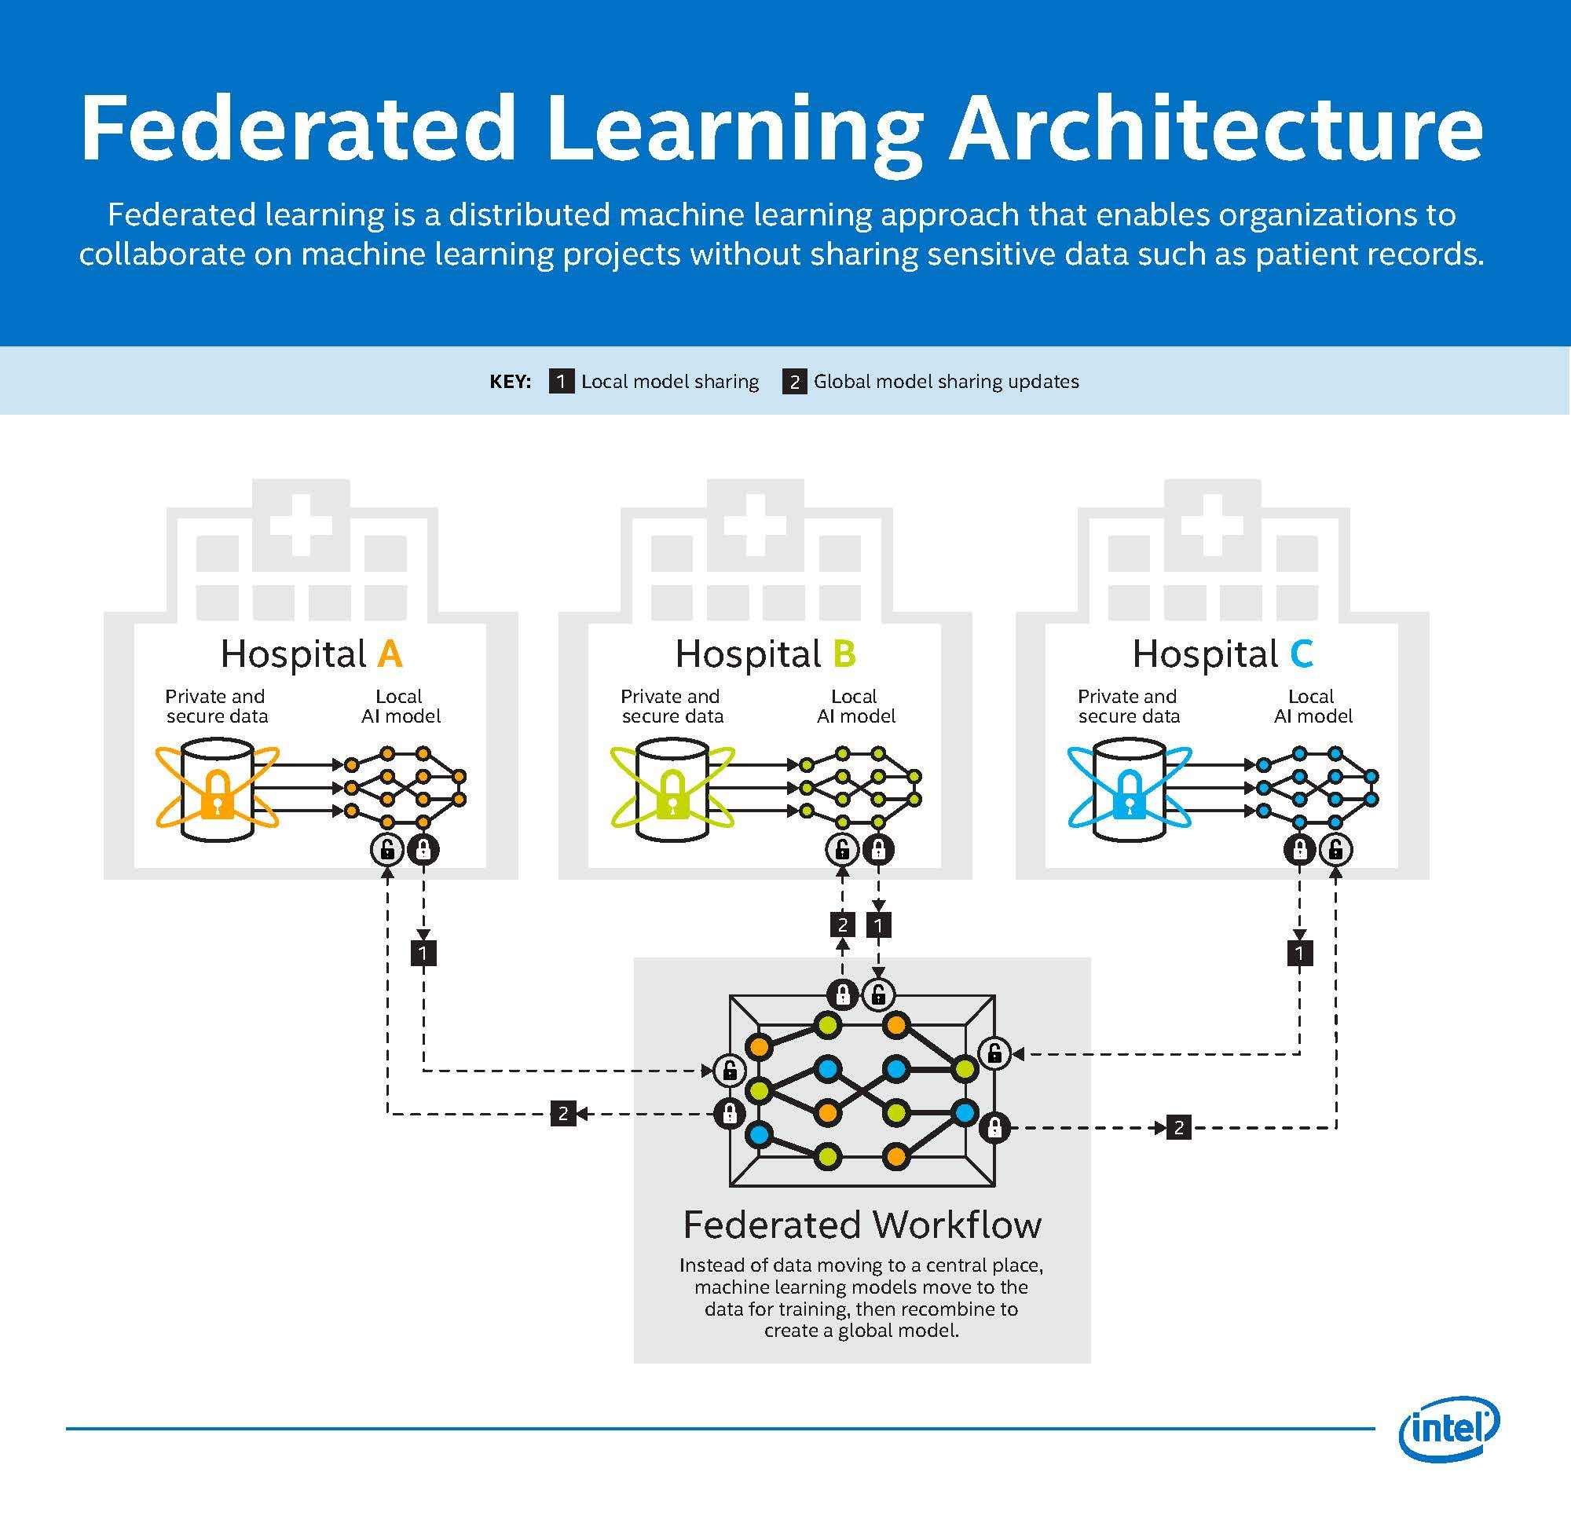
Federated BERT for Clinical Notes

Slide 2
What Is Federated Learning?
Federated learning is a method for training a single, shared machine learning model across multiple devices or organizations without transferring raw data from those devices.
Each client trains the current global model locally on its own private data and sends only model updates, such as parameters or gradients.
A coordinator or a decentralized protocol aggregates these updates to enhance the global model while maintaining the privacy of sensitive data.

Slide 3
Research goal and Core Idea
Enable collaborative model training across hospitals without sharing raw clinical data.
Combine ClinicalBERT and Federated Learning (FL) to achieve privacy-preserving NLP in healthcare
Use selective updates and quantization to reduce communication costs.

Slide 4
Motivation
Clinical data is fragmented across hospitals, with strict privacy regulations (HIPAA, GDPR).
Centralized model training requires data sharing, which is often infeasible.
Hospitals differ in:
  Patient demographics
  Documentation styles
  Label distributions
Need: Collaborative learning without centralizing data, enabling better generalization across institutions.

Slide 5
Dataset
Source: AGBonnet / Augmented
Clinical Notes (HuggingFace)Size: 30,000 clinical note triplets

Slide 6
Architecture
Peer to Peer Federated Learning architecture (Decentralized).
Local Training: Each client fine tunes BERT on private clinical notes.
Aggregation : Peers combine neighbor updates with weighted averaging – global convergence without raw data sharing.

Slide 7
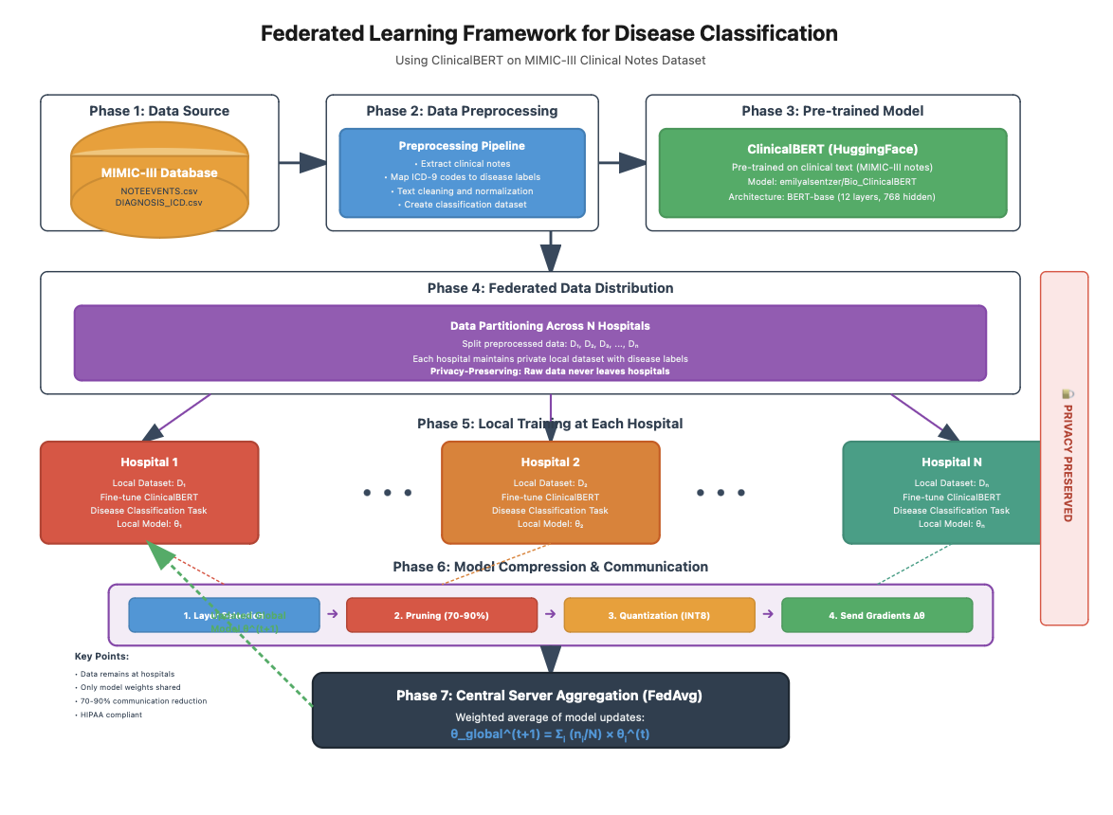

Slide 8
Workflow
Local Training - Hospitals fine-tune BERT on private notes (no raw data leaves site).
Selective Updates – Share only critical layers(last encoder block and classifier head). Cuts down communication.
Pruning – Removes low impact weights. Keeps essential signal and reduces payload.
Quantization – Idea is to convert FP32 -> INT8/INT4.
Aggregate + Model Update – Weighted average of peer update and integrate new weights to local BERT

Slide 9
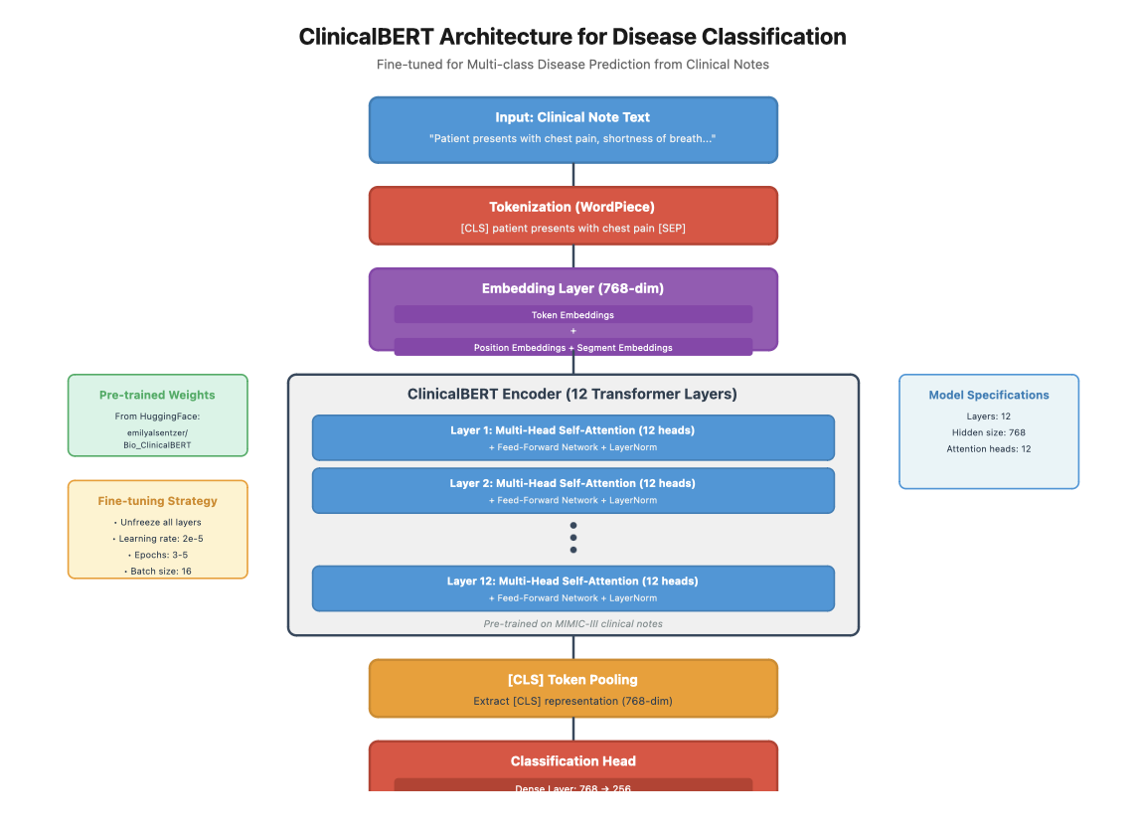

Slide 10
ClinicalBERT Model Architecture
Base model: emilyalsentzer/Bio_ClinicalBERT pretrained on MIMIC-III notes.
Architecture summary:
12 Transformer encoder layers, hidden size 768.
WordPiece tokenizer with [CLS] and [SEP] tokens.
[CLS] embedding → Dense layer → Softmax over 13 disease classes.
Fine-tuning strategy:
Freeze lower encoder layers.
Train classifier head and top encoder layers.
Loss Function: Cross-Entropy (class-weighted for imbalance).

Slide 11
Data and Pre-processing Pipeline
Dataset: De-identified clinical notes with fields idx (patient ID), full_note (text), label (disease type).
Steps:
  Robust file reading, text normalization, deduplication.
  Map disease labels to integer classes (13 total, including “no disease”).
  Use GroupShuffleSplit to ensure same idx not in train/test.
Split: 80% training, 20% testing.
Class Imbalance: Class Weightsa
Metrics: Accuracy, Macro-F1, and loss across federated rounds.

Slide 12
Experiment 1: Even Distribution
Setup:
  5 hospitals with equal data size and balanced label distribution.
  Federated rounds = 10, local epochs = 10, batch size = 16.
Compression:
  Start pruning from round 8 (keep 80% → 60% weights).
  Quantize to INT8 for communication efficiency.
Goal: Establish clean i.i.d baseline to isolate federated optimization behavior.

Slide 13
Experiment 2: Uneven Distribution
Setup:
  5 hospitals with Dirichlet α = 0.3 label distribution → strongly non-IID.
  Each client has different class imbalance and data volume.
  Federated rounds = 10, local epochs = 10.
Model training:
  Fine-tune classifier + first 4 BERT layers; rest frozen.
  Enable pruning after round 8 (≈30% sparsity).
Purpose: Simulate realistic hospital heterogeneity.
Metrics tracked: Loss, accuracy, macro-F1, sparsity, communication cost.

Slide 14
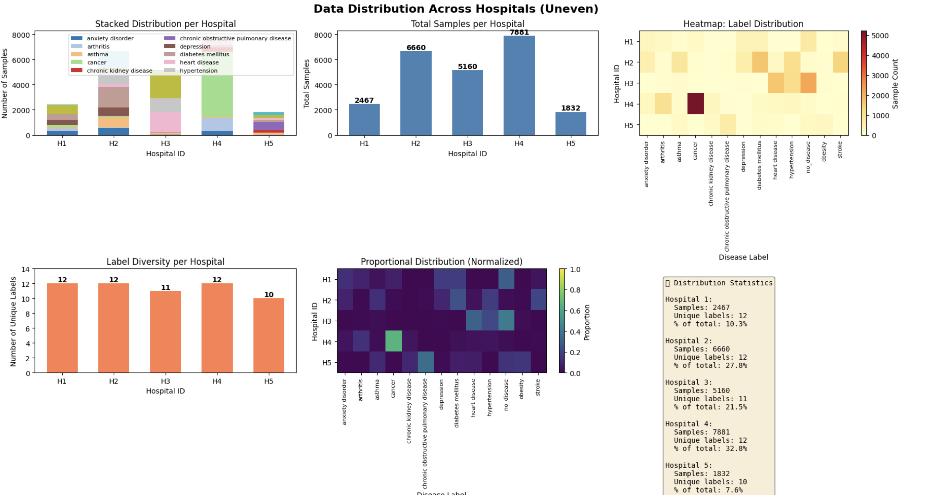
Data Distribution for Uneven Splits

Slide 15
Results and comparison ( so far)
EVEN | UNEVEN
Accuracy: 76.50 | Accuracy: 73.75
F1 Score: 0.7285 | F1 Score: 0.6915
Loss: 0.0575 | Loss: 1.3560

