Slide 1
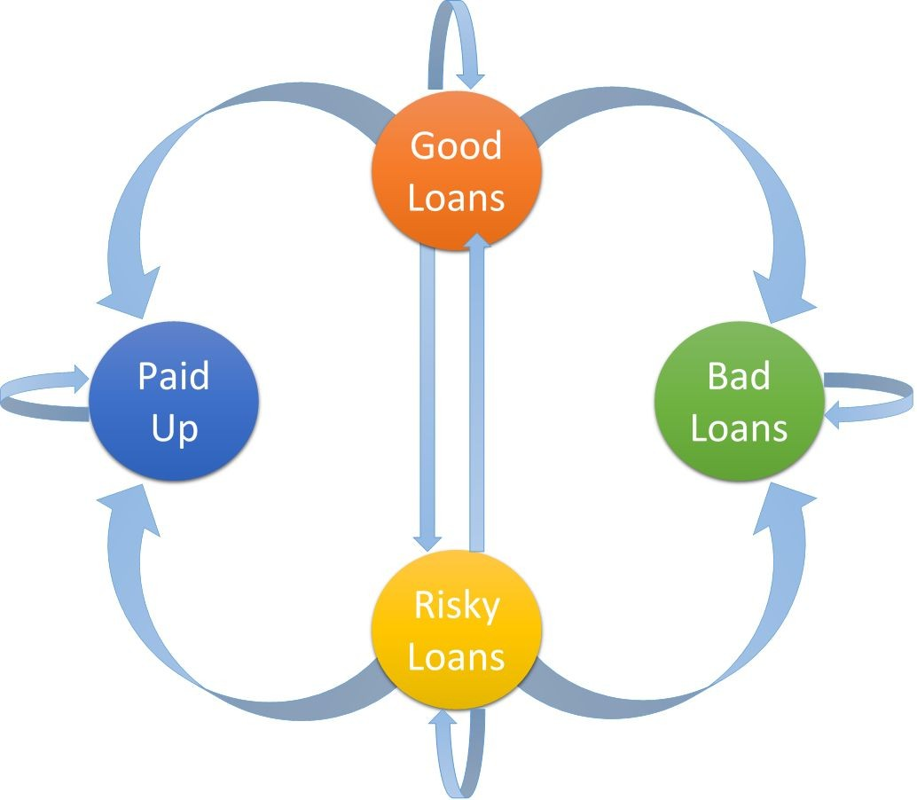
An introduction to Markov chains and its application to predict market trend using R
MVE220 Financial Risk: Reading Project
SAKSHI PARIT ROLL NO. 2020TS098
DHANASHRI MANE ROLL NO.2020TS095
VAISHALLI MOHITE ROLL NO. 2020TS096
YOGESH PATIL ROLL NO. 2020TS100
PRAJYOT KORE ROLL NO. 2020TS092
BSc III , DEPT. OF STATISTICS
RAJARAM COLLEGE, KOLHAPUR

Slide 2
CONTENTS………..
ACKOWNAGEMENT
INTRODUCTION
BACKGROUND
INTRODUCTION TO MARKOVS CHAIN
MARKOVS CHAIN TO PREDICT MARKET TRENDS
CONCLUSIONS AND FINDINGS
REFERENCES
LIMITATIONS

Slide 3
ACKNOWLEDGEMENT
We have great pleasure while submitting this project report "Markov's chain and application of markov's chain for predicting market trend“.
We thank Miss A Patil, Miss. K. MALI, Miss A Makandar, Mr G U Kulavmode, Miss S Patil for giving the permission this project. We take opportunity to thank those who directly or indirectly related with this project work, without there active co-operation and guidance It would have became extremely difficult to complete this task time.
we keep on giving deep gratitude towards our project guide who gives us guidance right from this initial stage of this project and offered us several valuable suggestions for developing this project in systematic manner. We should like to express our higher regards to our DEPARTMENT OF STATISTICS.

Slide 4
Introduction
Markov chains are an important mathematical tool in stochastic processes. The underlying idea is the Markov Property, in order words, that some predictions about stochastic processes can be simplified by viewing the future as independent of the past, given the present state of the process. This is used to simplify predictions about the future state of a stochastic process.

Slide 5
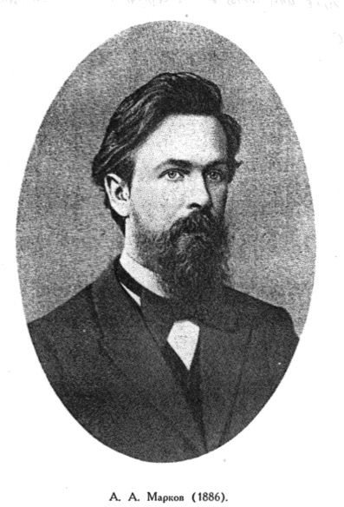
Background
Andrei Markov was a Russian mathematician who lived between
1856 and 1922. He was a poorly performing student and the only
subject he didn’t have difficulties in was mathematics. He later
studied mathematics at the university of Petersburg .

Slide 6
Introduction to Markov chains
Markov chains are a fundamental part of stochastic processes. They are used widely in many different disciplines. A Markov chain is a stochastic process that satisfies the Markov property, which means that the past and future are independent when the present is known. This simplicity allows for great reduction of the number of parameters when studying such a process. [2]
In mathematical terms, the definition can be expressed as follows:
A stochastic process X = {X_{n} , n ε N } in a countable space S is a discrete-time Markov chain if:
For all n ≥ 0, X_{n} ε S
For all n ≥ 1 and for all i₀ , ... i_{n−1} , i_{n} ε S, we have :
P { X_{n} = i_{n} | X_{n−1} = i_{n−1} , ... , X ₀ = i₀ } = P { X_{n} = i_{n}| X_{n−1} = i_{n−1} } [2]

Slide 7
Markov chains are used to compute the probabilities of events occurring by viewing them as states transitioning into other states, or transitioning into the same state as before. We can take weather as an example: If we arbitrarily pick probabilities, a prediction regarding the weather can be the following: If it is a sunny day, there is a 30% probability that the next day will be a rainy day, and a 20% probability that if it is a rainy day, the day after will be a sunny day. If it is a sunny day, there is therefore a 70% chance that the next day will be another sunny day, and if today is a rainy day, there is a 80% chance that the next day will be a rainy day as well. This can be summarized in a transition diagram, where all of the possible transitions of states are described:

Slide 8
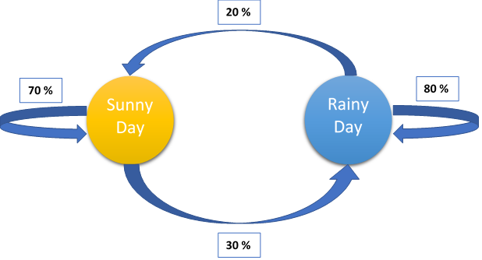
In our weather example, we define S = [Sunny Rainy] . Where S is called our state space, in which all the elements are all the possible states that the process can attain. If, for example, today is a sunny day, then the S₀ vector will be S₀ = [1 0] , because there is 100% chance of a sunny day and zero chance of it being a rainy day. To get to the next state, the transition probability
matrix is required, which is just the state transition probabilities summarized in a matrix. in this case it will be as follows:

Slide 9
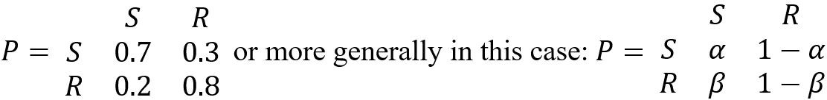
To get to the next state, S₁ , you simply calculate the matrix product S₁ = S₀ P . Since calculations for successive states of S is only of the type S_{n} = S_{n−1} P , the general formula for computing the probability of a process ending up in a certain state is S_{n} = S₀P^{n} .

Slide 10
Markov chains to predict market trends
Markov chains and their respective diagrams can be used to model the probabilities of
certain financial market climates
and thus predicting the likelihood of future market conditions [7]. These conditions,
also known as trends, are:
Bull markets: periods of time where prices generally are rising, due to the actors
having optimistic hopes of the future.
Bear markets: periods of time where prices generally are declining, due to the actors
having a pessimistic view of the future.
Stagnant markets: periods of time where the market is characterized by neither a
decline nor rise in general prices.

Slide 11
Abstract
Price volatilities make stock investments risky, leaving investors in critical position when uncertain decision is made. To improve investor evaluation confidence on exchange markets, while not using time series methodology. We further developed an R algorithm for running the methodology introduced. The established methodology is applied to selected equities from Ghana Stock Exchange weekly trading data.

Slide 12
Background
Stock market performance and operation has gained recognition as a significantly viable investment field within financial markets.
In stochastic analysis, the Markov chain specifies a system of transitions of an entity from one state to another. Identifying the transition as a random process, the Markov dependency theory emphasizes "memoryless property" i.e. the future state (next step or position) of any process strictly depends on its current state but not its past sequence of experiences noticed over time
Equity with the highest state transition probability and least mean return time will remain the best choice for an investor.

Slide 13


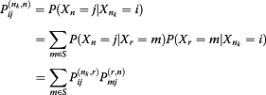
We explore model performance using weekly historical data from the Ghana Stock Exchange (GSE); we set up the respective transition probability matrix for selected stocks to test the model efficiency and use.
The stochastic process {X (t), tϵT} is said to exhibit Markov dependence if for a finite set of points
(t₀, t₁, … , t_{n}, t), t₀ < t₁ < t₂ < … < t_{n} < t where t, t_{r}ϵT (r = 0, 1, 2, …, n).
When the stochastic process has discrete state and parameter space, (2) takes the following form: for n > n₁ > n₂ > … > n_{k} and n, n_{r}ϵT (r = 1, 2, …, k)
From the Markov property, for n_{k} < r < n we get

Slide 14


Model specification
Limiting distribution of a Markov chain
If P is the transition probability matrix of Markov chain, then
5
Where α = [α₁, α₂, …, α_{m}] with 0 < α_{j} < 1 .

Slide 15


For a two-state Markov process
We maintain the above defined terms and set
further set i, j = 0, 1, (for k = 1) and apply (9), (10), (11), (12a), and (12b) sequentially, we obtain
without loss of generality, suppose X_{t} has state space s = {0, 1} and transition probability matrix

Slide 16


Then, f₀₀ = 1 - θ and for n ≥ 2, we have;
By the Markov property and the definition of conditional probability, we have

Slide 17



solving
to obtain the respective mean recurrence time. Thus,
15
Similarly, we have..
....
16
With the corresponding R algorithm shown in Additional file 2 (two-state Markov Chain funct.ion column

Slide 18
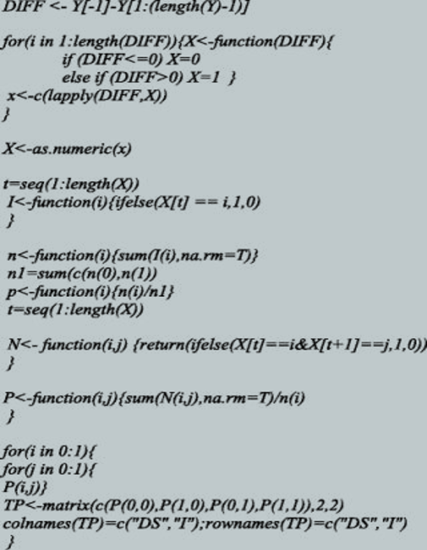
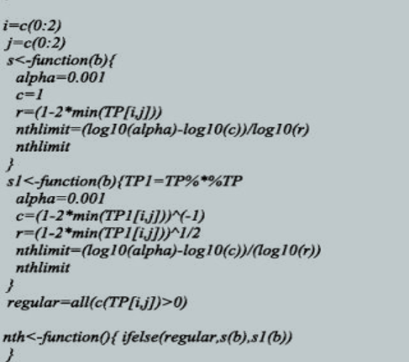

Slide 19
Findings and discussions
Data structure and summary statistics
Data used for this paper are weekly trading price changes for five randomly selected equities on the Ghana Stock Exchange (GSE), each covering period starting from January 2012-December 2013. We obtain the weekly price changes using the relation d_{t} = Y_{t} - Y_{t-1} where Y_{t} represents the equity closing price on week t and Y_{t-1} is the opening price for the immediate past week. The equities selected include Aluworks (ALW), Cal Bank (CAL), Ecobank Ghana (EBG), Ecobank Transnational Incorporated (ETI), and Fan Milk Ghana Limited (FML).
In all, 104 (52 weeks) observational data points where obtained. Summary statistics on all respective equities on the GSE are shown in Table 1. We present summaries on the respective number of weekly price decreases, no change in price and price increase. Descriptive statistics for each equity weekly price change is also shown.Overall, the frequency of "no price change" was more experienced over the study period. The lowest and highest price changes for the trading period are respectively -4.19 and 9.54. The estimated values of the kurtosis and skewness are also shown. Figure 1 presents a plot of the average weekly equity price changes of respective equities listed on the GSE over the study period in comparison to the standard deviation of weekly price changes.

Slide 20
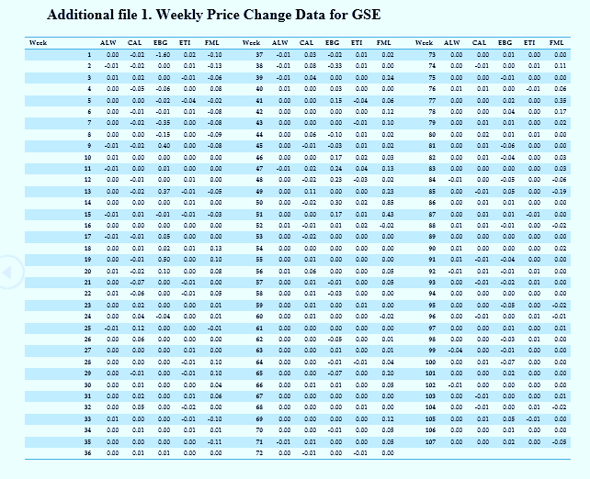

Slide 21
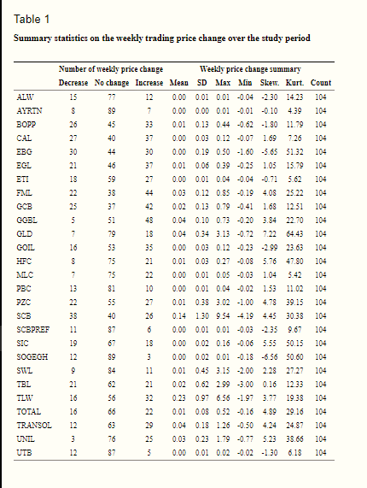

Slide 22
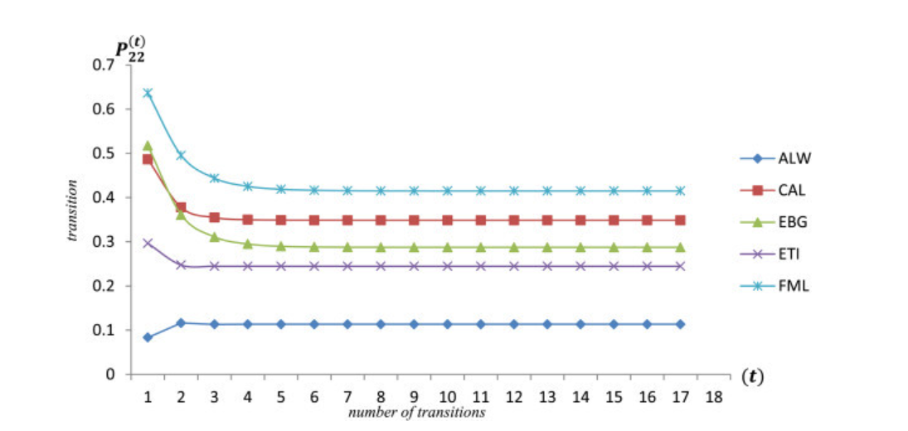

Slide 23
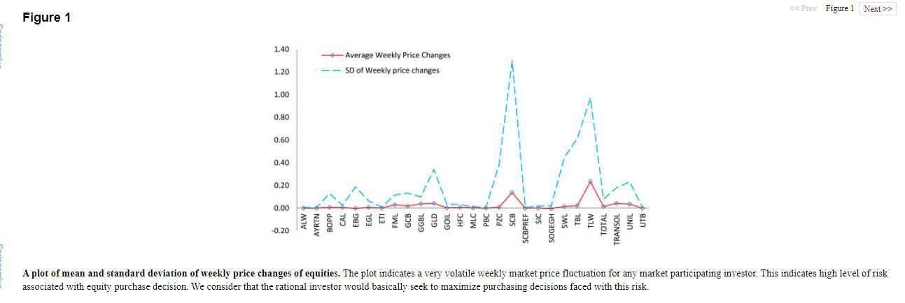
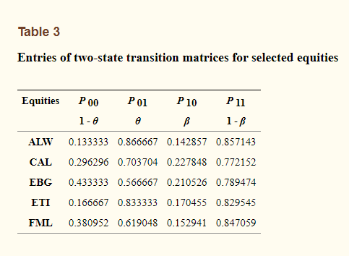
Empirical model application (the two-state Markov process)
Defining a two-state space Markov process following from equation (13), we derive the state transition probabilities. The two-state transition probability matrix entries are indicated in Table 3 below;
we obtain the respective mean return time of the selected equities. These are shown in Table 4 below;

Slide 24
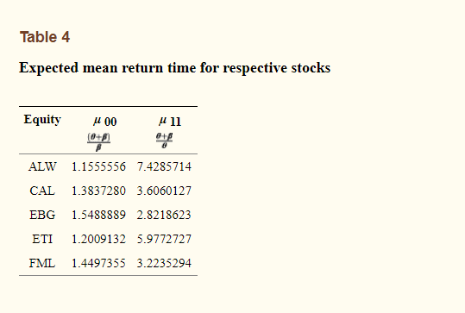
Conclusion
The Markov Process provides a credible approach for successfully analyzing and predicting time series data which reflect Markov dependency. It is distinctive from Figures 1 and and22 (expected return time and t-step state transition probabilities of equity price increases i.e. P_{ij} transition from state 2 to state 2) that the investor gains good knowledge about the characteristics of the respective equities hence improving decision making in the light return maximization. With regards to the selected stocks, FML equity recorded the highest state transition probabilities, highest limiting distribution but the second lowest mean return time to price increases (i.e. 3.224 weeks).
Our suggested use of Markov chains as a tool for improving stock trading decisions indeed aids in improving investor knowledge and chances of higher returns given risk minimization through best choice decision. We showed that the proposed method of using Markov chains as a stochastic analysis method in equity price studies truly improves equity portfolio decisions with strong statistical foundation.

Slide 25
References
Aguilera MA, Ocaña AF, Valderrama JM. Stochastic modeling for evolution of stock prices by means of functional principal component analysis. New York: John Wiley & Sons, Ltd; 1999. Applied stochastic models in business and industry. [Google Scholar]
Ammann M, Verhofen M. The effect of market regimes on style allocation. 2006. Working paper series in Finance. No. 20. [Google Scholar]
Bhat UN. Elements of applied stochastic processes. 2 1984. Wiley series in Probability & Mathematical Statistics. [Google Scholar]
Bulla J, Mergner S, Bulla I, Sesboüé A, Chesneau C. Markov-switching asset allocation: do profitable strategies exist? 2010. Munich Personal RePEc Archive. [Google Scholar]
Duffie D, Singleton JK. Simulated moments estimation of Markov models of asset
prices. Econometrica. 1993;61(4):929–952. doi: 10.2307/2951768. [CrossRef] [Google Scholar]
Hassan RM, Nath B. Stock market forecasting using hidden Markov model: a new
approach. Washington, DC, USA: IEEE Computer Society; 2005. Proceedings of the 2005 5th international conference on intelligent systems design and applications (ISDA’05) [Google Scholar]
Xi X, Mamon R, Davison M. A higher-order hidden Markov chain-modulated model for asset
allocation. J Math Model Algorithm Oper Res. 2012;13(1):59–85. doi: 10.1007/s10852-012-9214-
4. [CrossRef] [Google Scholar]
Zhang D, Zhang X. Study on forecasting the stock market trend based on stochastic analysis method. Int J Bus Manage. 2009;4(6):163–170. [Google Scholar]

Slide 26
LIMITATIONS:-
Unfortunately, Markov analysis is not very useful for explaining events, and it cannot be the true model of the underlying situation in most cases. Yes, it is relatively easy to estimate conditional probabilities based on the current state. However, that often tells one little about why something happened.
Markov analysis is a valuable tool for making predictions, but it does not provide explanations.

Slide 27
RAJARAM COLLEGE,KOLHAPUR
DEPARTMENT OF STATISTICS
certificate
This is certify that Miss. Dhanashri Mane, Miss. Vaishali Mohite, Miss. Sakshi Parit, Mr. Prajyot Kore, Mr. Yogesh Patil have done the project intitled “An introduction to Markov chains and its application to predict market trend using R” under the guidance of Miss A S Patil ,Miss. K. Mali ,Mrs . G. Kulavmode , Miss A Makandar, Miss S Patil for partial fulfillment of degree of BSc. III(STATISTICS).
Date:-
Place:-Kolhapur
Project Guide Examiner H.O.D.
[Miss. K. Mali] [Miss. A.S.Patil

