Slide 1


SEMANTIC PROOF ENGINE FOR TEXT-TO-SQL
Semmai: Deterministic Verification for AI Databases
Guaranteeing semantic intent preservation between Natural Language requests and generated SQL through Action-Graph alignment and Tamil NLP synthesis.
CORE MECHANISM
SUPPORTED TARGET
USIG Graph Verification
Multilingual & Tamil NLP

Slide 2


THE CRITICAL AI FLAW
The Text-to-SQL Hallucination Problem
Silent Data Distortion
Boundary & Negation Flips
LLMs generate syntactically correct SQL that silently alters the query intent—flipping operators, dropping constraints, or drifting values without throwing errors.
A simple request for silently transformed into or mapped to leads to catastrophic financial or operational misreports.
The Solution: Semmai proves mathematically whether generated SQL preserves the original user intent prior to database execution.

Slide 3
END-TO-END PIPELINE
Architecture & Verification Workflow
1
2
3
4
Natural Language Input
USIG Extraction
Proof Engine
Finding Generation
English or Tamil query parsed into structured intent tokens.
Generates Intent Graph (I) and SQL Action Graph (A).
Evaluates 8 proof obligations (Entities, Constraints, Aggregations).
Returns Critical blocks or Warnings with exact details.
Hybrid Reasoning: Combines deterministic graph-matching algorithms with optional SBERT/TF-IDF neural embeddings for soft value alignment.

Slide 4

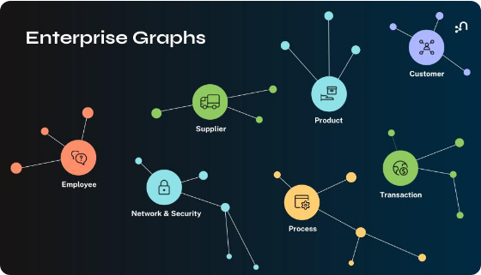
CORE ABSTRACTION
Universal Semantic Intent Graph (USIG)
The USIG represents user requests as canonical semantic structures independent of target SQL dialects, syntax, or phrasing variations.
Entities & Primary Target Isolation
Constraint & Canonicalized Value Triples
Projections, Groupings & Aggregations

Slide 5
PROOF OBLIGATIONS
The 8 Semantic Proof Checks
1. Entity Check
2. Constraint Check
3. Aggregation
4. Order & Limit
Validates that intended primary tables are queried without extraneous joins.
Detects value drift, boundary shifts, and negation flips in WHERE clauses.
Verifies correct mapping of SUM, AVG, COUNT, MIN, and MAX functions.
Ensures ranking column, direction (ASC/DESC), and size limits match.
Additional Checks: Logic Conjunction Preservation (AND vs OR), Column Projection, Grouping Equivalence, and Action Match (SELECT vs DELETE).

Slide 6
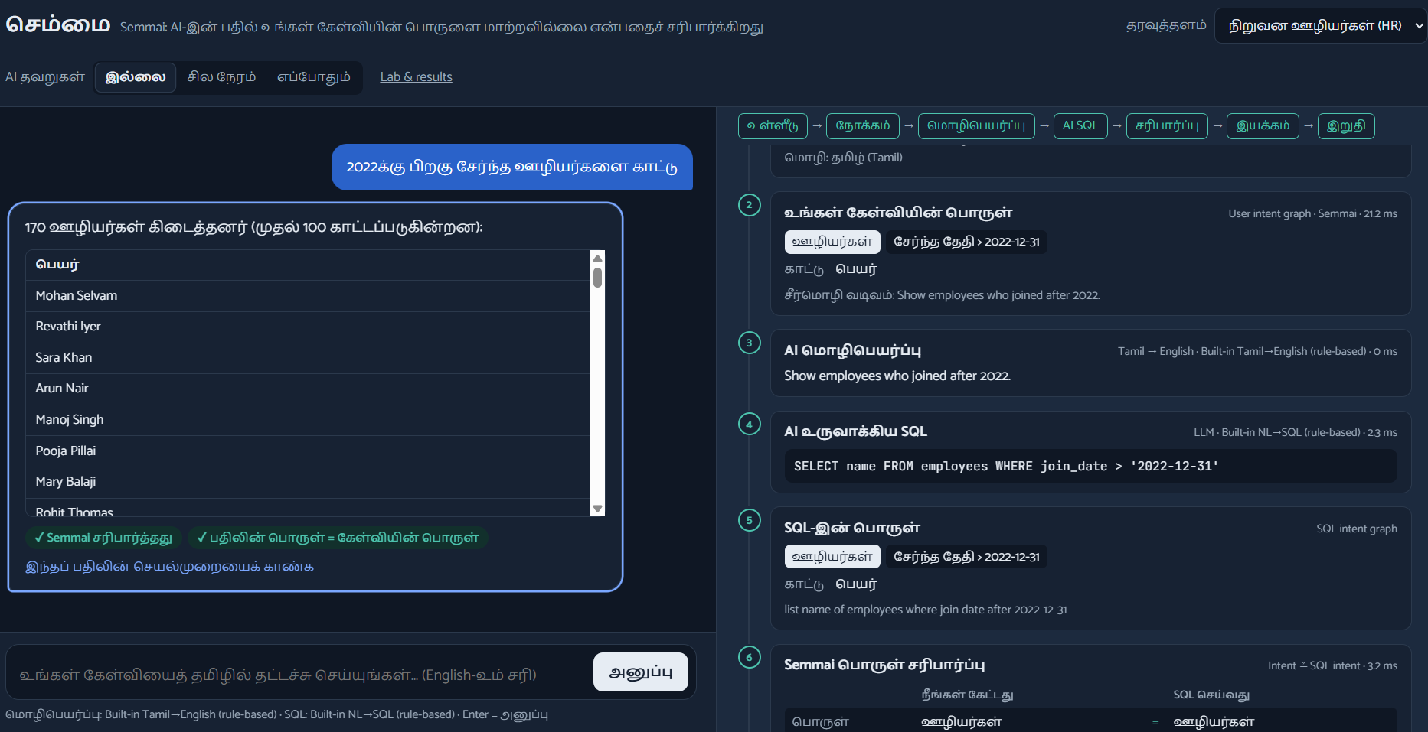
CROSS-LINGUAL CAPABILITIES
Native Tamil Semantic Parsing
Tamil is agglutinative and verb-final, placing comparison words after numerical values. Semmai handles morphology and case suffixes natively.
"2022க்குப் பிறகு சேர்ந்த ஊழியர்கள்"
Deconstructs: [2022 + DAT] + [after] + [joined] + [employees]
Sandhi Removal: Drops euphonic consonants (ஊழியர்களைக் → ஊழியர்களை)
Suffix-Aware Stemming: Extracts core attributes automatically

Slide 7
PRACTICAL DEMONSTRATION
Real-World Enterprise Applications
Healthcare Diagnostics
Enterprise Payroll & HR
Prevents incorrect medical query execution when searching patient records in intensive care units.
Guarantees strict audit compliance by enforcing exact boundary matches on compensation queries.
Target Domain:
Target Domain:
Patients, ICU Ward, Cardiology
Salary Thresholds, Experience Metrics
ZERO TOLERANCE FOR FLIPS
FINANCIAL AUDIT SAFE

Slide 8
LIVE CASE STUDY
Catching a Critical Operator Mismatch
USER REQUEST (English / Tamil):
Critical Finding Triggered
"Show employees with salary greater than 50000"
GENERATED SQL (Erroneous):
Kind: OPERATOR_MISMATCH
SELECT * FROM employees WHERE salary >= 50000;
Severity: critical
"boundary/operator changed: expected 'salary > 50000', got 'salary >= 50000'"
The engine prevents execution before corrupted data is returned to the client dashboard.
Status: Execution Blocked

Slide 9
EVALUATION HIGHLIGHTS
Verification Impact
100%
<5ms
Deterministic Protection
Proof Engine Overhead
Catches critical operator and logic flips
Ultra-fast graph matching latency
Tested against enterprise schemas and benchmark databases with zero execution overhead.

Slide 10

Thank You!
Semmai delivers deterministic intent preservation, proving that AI-generated queries can be both intelligent and trusted.
Questions & Discussion

