Slide 1

IDS (Identity System)
Secure login with Api GateWay Intigration in the applicaion using (IDS) Identity System server
#TU202113

Slide 2




Our Introduction
Prakash Chinnappa
Shrinidhi Joshi
Shashidhar Jadhav
Senior Software Engineer
Senior Test Engineer JL11
Senior Software Engineer
I&H
I&H
I&H

Slide 3
Problem Statement
For Multiple Application login Credential details saved in different database server with different access rights
Solution
For above problem statement IDS Api GateWay provides the solution by giving collabrated and identical credential rights with single secured Api Gateway

Slide 4
Technology Stack
DotNet Core 5.0.1 Version (open source and cross platform)
WEB API project implemented
Swagger Integration
Dapper ORM for connecting the Database
SQL Server 2016
Bearer Token Integration
NodeJS 14.15.1
Angular 10
Bootstrap 4.5
Visual studio Code IDE

Slide 5
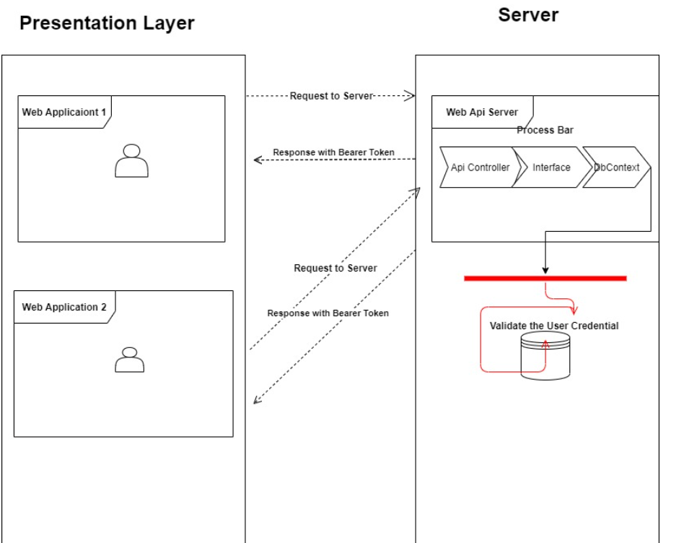
Project architecture

Slide 6
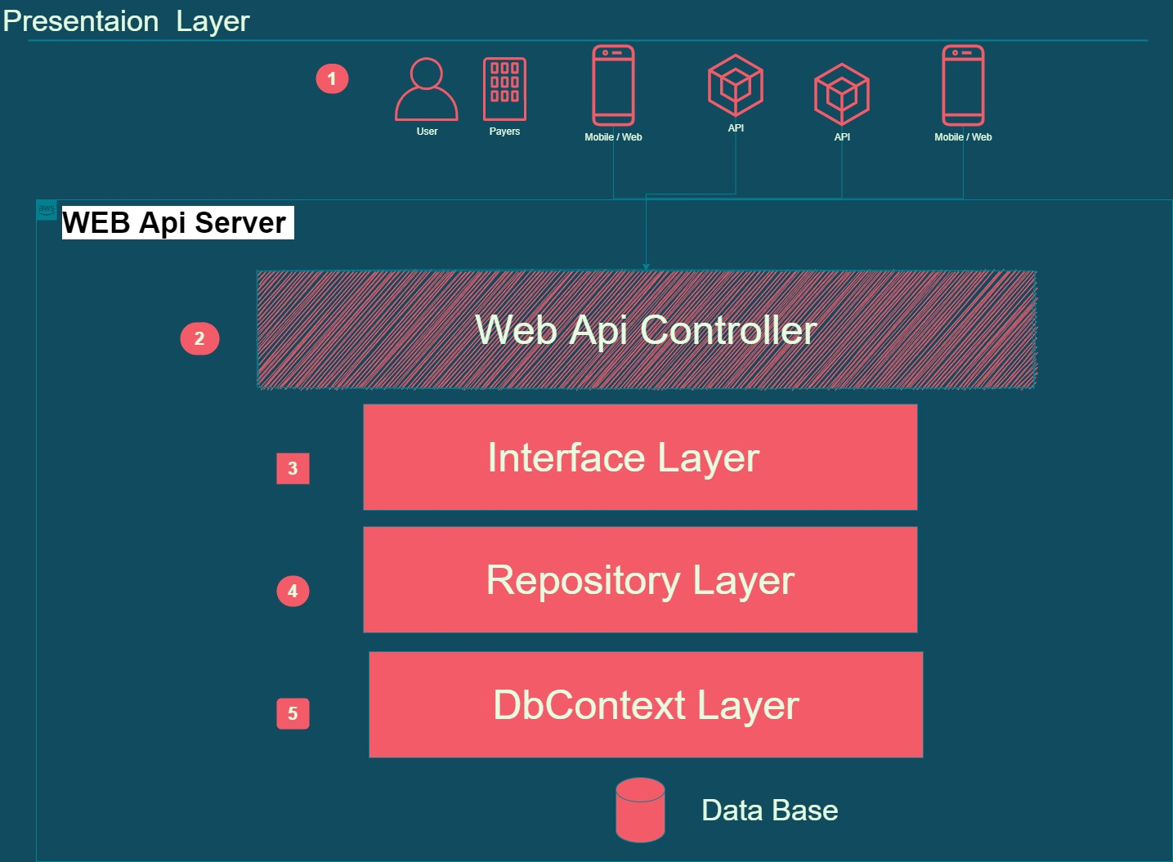

Slide 7
Solution Demo

Slide 8
Thank you

