Slide 1
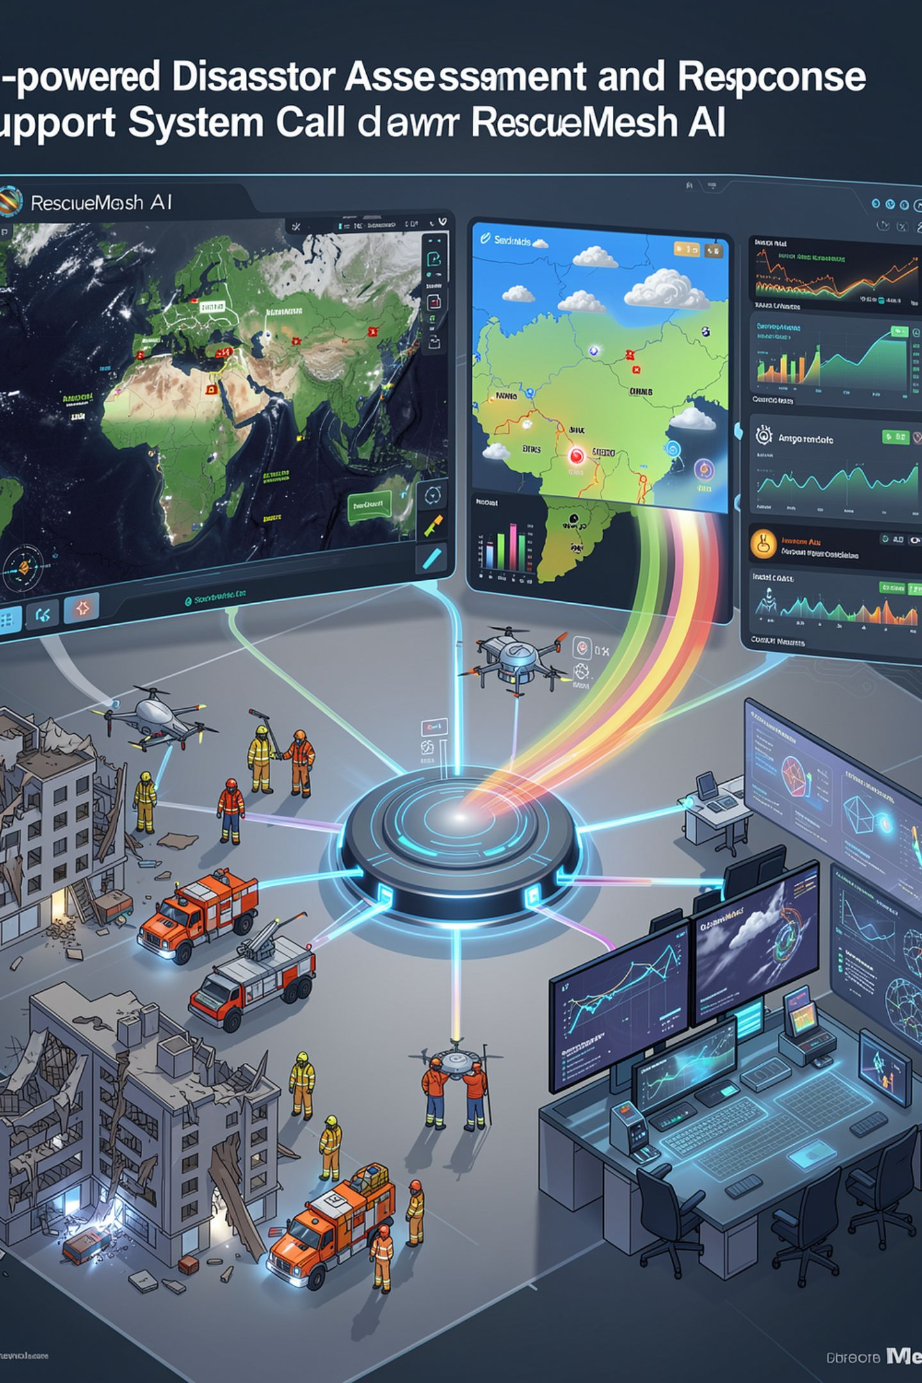
RescueMesh AI
AI-Powered Disaster Assessment & Response Support System
Turning disaster data into faster, evidence-based response decisions
Presented by: E. Prakalya (25cs188), V. Nidrashri (25cs163)

Slide 2


Problem Statement
During natural disasters such as floods, cyclones, earthquakes and landslides, authorities receive information from multiple sources such as images, reports, weather data and maps.
However:
Data Overload
Critical Area Identification
Access Delays
Large amounts of data are difficult to analyze quickly.
Blocked roads and inaccessible locations can delay emergency response.
Identifying the most critical areas requires significant time.
Scattered Information
Decision-Making
Existing information is often scattered across different sources.
Decision-makers need clear, evidence-based priorities.

Slide 3
Proposed Solution
RescueMesh AI is an intelligent decision-support system that combines Machine Learning, Computer Vision, Geospatial Analysis and Generative AI.
It will:
Analyze disaster images
Predict risk levels
Identify critical locations
Detect damage and affected areas.
Using environmental and location-based data.
Using geospatial information.
Analyze nearby roads, hospitals and shelters
Generate evidence-based response recommendations
Present all results through an interactive dashboard

Slide 4
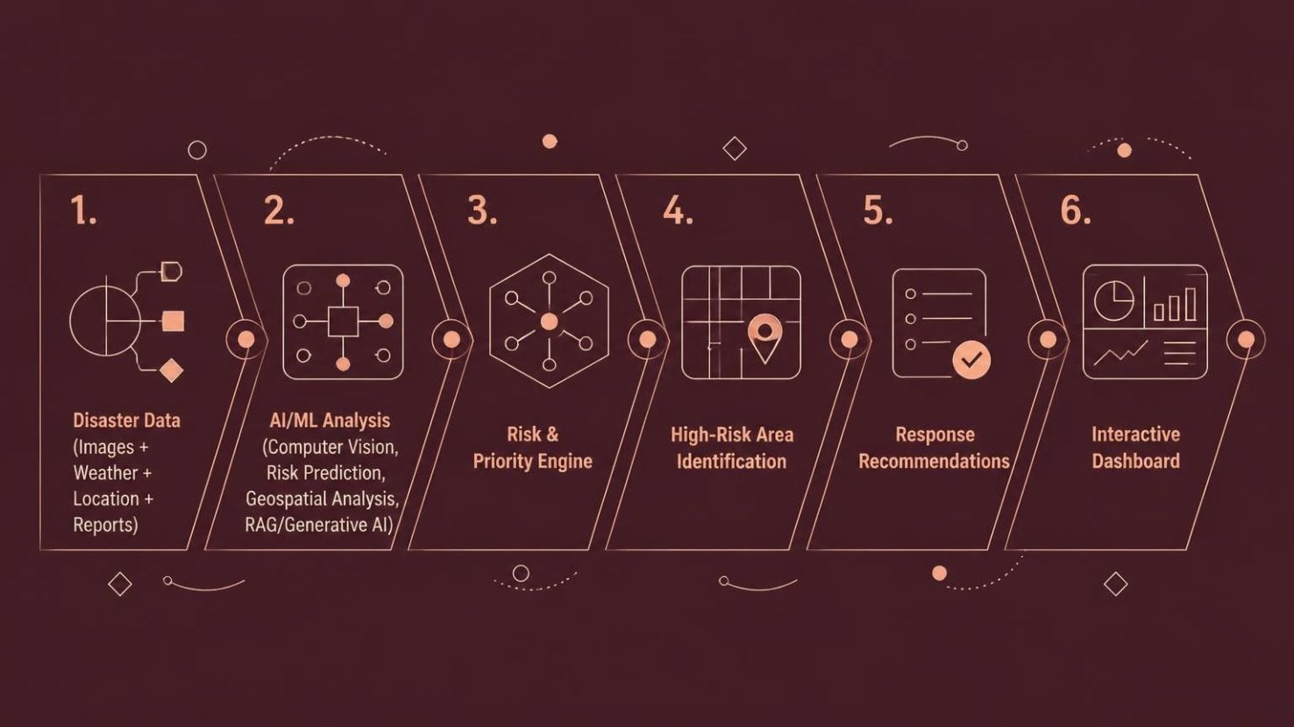
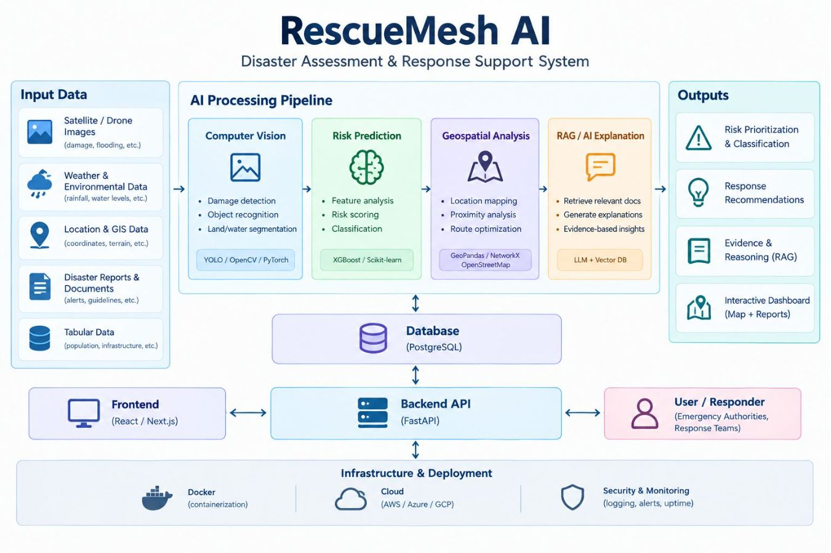

System Workflow and Architecture
Output
Risk Level
Affected Area
Priority
Supporting Evidence
Recommended Action

Slide 5
Key Modules
1
2
3
Damage Detection
Risk Prediction
Geospatial Intelligence
Computer Vision identifies flooding, damaged structures and blocked areas from images.
ML models analyze factors such as rainfall, population, damage and accessibility to calculate a risk score.
Analyzes roads, hospitals, shelters and distances to identify accessibility and priority locations.
4
5
Evidence-Based AI
Decision Dashboard
RAG retrieves relevant disaster-response information and generates explainable recommendations.
Displays risk zones, affected areas, priority locations and recommendations visually.

Slide 6
Components of the System
1
Ingestion Layer
2
ML / AI Core
3
Decision Layer
Image and document upload (satellite, drone, field photos)
Field reports and structured forms
Geospatial data connectors (OpenStreetMap)
Live or simulated sensor feeds
Vision model for damage and flood detection
XGBoost risk-scoring model
Geospatial engine (NetworkX, GeoPandas)
RAG pipeline and agent orchestration
Priority map and zone ranking
Evidence trail for every zone
Resource-allocation suggestions
Conflict and verification flagging
4
Access & Control Layer
5
Interface Layer
6
Infrastructure
Authentication (login)
Role-based access control
Human-approval gate before plans are final
Audit log of who approved what, when
Dashboard: map, zone drill-down, charts
FastAPI connecting frontend to ML core
Alerts for critical zones (optional)
Database: incidents, user roles, audit logs
Vector DB for RAG
Docker deployment and CI/CD

Slide 7
Access Control & Human-in-the-Loop
Built for authorized personnel only: disaster-response coordinators, emergency-management staff, NGO field leads and verified field workers. Not a consumer app.
Coordinator / Admin
Field Worker / Reporter
Viewer / Analyst
Auditor (optional)
Full access
Limited access
Read-only
Review access
View the priority map, approve plans and allocate resources.
Submit reports and images. Cannot approve actions.
See the map and evidence. Cannot approve or allocate.
Reviews decisions after the fact for accountability.
1
Human-Approval Gate
2
Audit Log
No plan is finalized until an authorized coordinator reviews the evidence and approves it.
Every decision is recorded: who approved what, and when, so responses stay accountable.

Slide 8
Technology Stack and Core Technologies
Programming
Machine Learning
Computer Vision
Geospatial Analysis
Generative AI
Python
LLM + RAG
Scikit-learn, XGBoost
PyTorch, YOLO, OpenCV
GeoPandas, NetworkX, OpenStreetMap
Backend
Database
Frontend
Deployment
FastAPI
PostgreSQL + Vector DB
React / Next.js
Docker, CI/CD, Cloud
Machine Learning
Computer Vision
Generative AI
Geospatial Intelligence

Slide 9

Expected Output & Benefits
Expected Benefits
Expected Output
The system will provide:
Faster Analysis
Better Prioritization
Risk score and severity level for affected regions
Detection of damaged or inaccessible areas
Reduce manual data analysis
Identify critical areas first
Identification of high-priority locations
Suggested routes considering road accessibility
Improved Awareness
Explainable Decisions
Nearby hospitals and shelters
Evidence supporting AI recommendations
Combine multiple data sources
Provide evidence behind recommendations
Interactive disaster-risk visualization

Slide 10
What Makes RescueMesh Stand Out
1
Multiple real ML paradigms
Computer vision, tabular ML (XGBoost), geospatial algorithms and RAG integrated in one pipeline.
2
Evidence-grounded reasoning
Shows why a zone is critical (source images, reports, confidence score) instead of confident-sounding text.
3
Human-in-the-loop by design
The approval gate and audit trail are core to the architecture, not an afterthought.
4
Role-based access control
Coordinator, field worker and viewer permissions: built for real deployment, not just a demo.
5
Measured performance
Real precision, recall, IoU, model comparisons and ablations instead of vague claims.
Honest note: vision models, RAG and RBAC each exist elsewhere. The difference is the combination, with real evaluation, in a high-stakes domain with responsible-AI framing.

Slide 11
Innovation & Future Scope
(What makes RescueMesh different?)
Instead of analyzing only one type of disaster data, RescueMesh combines: Visual Data,Environmental Data,Geospatial Data ,AI Knowledge
Future Scope
Real-time satellite/drone data integration
IoT-based water-level and environmental monitoring
Mobile application for field responders
Real-time emergency alerts
Multi-disaster support
Integration with government emergency-response systems

